Slide 1
#11.Puzzle in a beaker
Maryia Valoshyna, Spectrum, Belarus

Slide 2
Problem situation
A researcher decided to measure the diffusion rate of ammonia in gelatin. He added some magnesium sulfate to the hot gelatin solution which set to a gel on cooling. He then poured some aqueous solution of ammonia onto the gel and left the beaker for two days. The researcher was surprised to discover white layers of precipitate in the beaker. Explain this phenomenon and determine what does the number of bands depend upon.
white layers
number of bands

Slide 3
What is going on?
MgSO₄ + 2NH₄OH = Mg(OH)₂↓ + (NH₄)₂SO₄
Mg²⁺ + 2OH⁻ = Mg(OH)₂↓
(white)
Gelatin forms a gel medium

Slide 4
Experimental part

Slide 5
Safety measures. Experiment methodic
!All the experiments must be done in the draft hood!
20 ml 0,05M MgSO₄
20 ml gelatin
Aqueous ammonia
38 ml H₂O → 0,6 g MgSO₄ → 2,7 g gelatin → 1,54 ml 25% NH₄OH

Slide 6
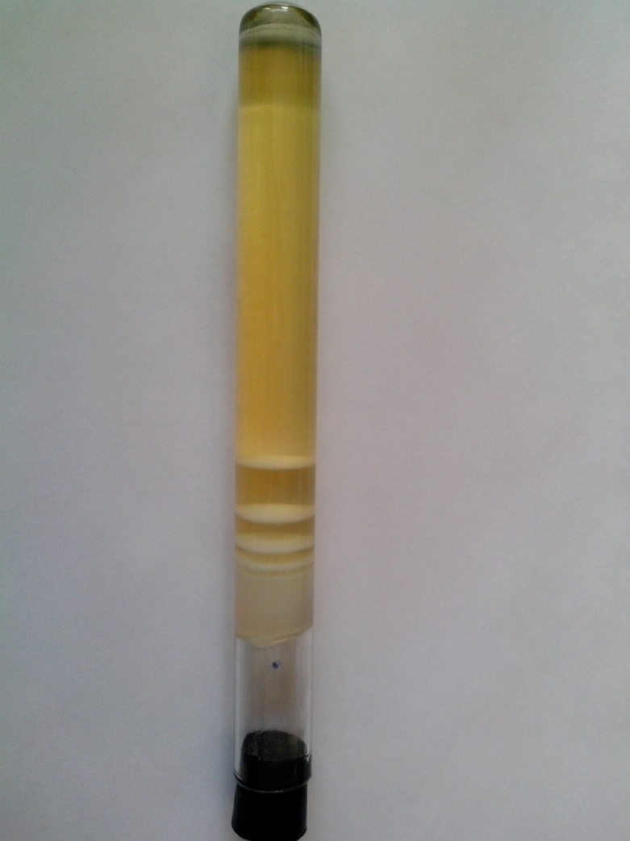
Standard

Slide 7
Varying gelatin concentration
___ - gelatin border,
-10% ,
- 6%

Slide 8
Changing MgSO₄ concentration
Two times more
Two times less

Slide 9
Changing NH₄OH amount
Two times more
Two times less

Slide 10
Changing both NH₄OH and MgSO₄
Two times more

Slide 11
Number and thickness of the layers

Slide 12
Distances between the layers

Slide 13
Existing models
Prenucleation (Ostwald)
Postnucleation

Slide 14
Liesegang rings
Raphael Eduard Liesegang

Slide 15
Various methods
K₂Cr₂O₇ + 2AgNO₃ = Ag₂Cr₂O₇↓ + 2KNO₃
(with gelatin)
K₂Cr₂O₇ + CuSO₄ = CuCr₂O₇↓ + K₂SO₄
(with H₂SiO₃)
Co(OH) ₂

Slide 16
Petri dish

Slide 17
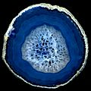
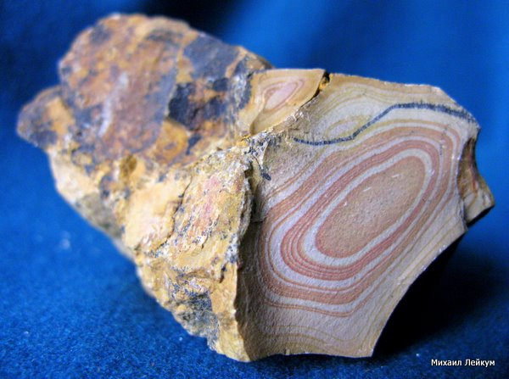
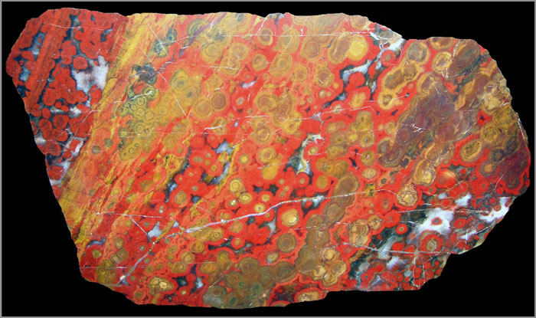
Natural examples
agate
Jasper
Blue agate

Slide 18
Results
Plenty of experiments have been done, including varying concentrations of all the included reagents.
More NH₄OH/MgSO₄ → more rings
The distance between the rings appeared to depend on the concentration of gelatin, MgSO₄ and NH₄OH;
More gelatin/MgSO₄ / NH₄OH → distance less

Slide 19
Thank you for your kind attention!

Slide 20
Supplement

Slide 21
Safety measures
Wear smock (+gloves, mask etc.)
Make experiments in the draft hood
Don’t place cold glasses onto the heated plate

Slide 22
Literature
Воюцкий С.С. Курс коллоидной химии.
Большая энциклопедия природы. Т. 12: Камни и минералы.
http://biosurvey.ou.edu/oas/06/paper/weaver.pdf
http://www.insilico.hu/index.html

Slide 23
The rope
The precipitate is shifted to the rope
One of the layers is right on the knot

Slide 24
Calculations
40 ml of 6% solution of gelatin: 2,7 g of gelatin, 38 ml of water
10%: 4,58 g of gelatin, 35 ml of water
C(MgSO₄)=0,05 M; m(MgSO₄)=Mn=0,6 g
V(NH₄OH)=m:ρ=1,54 ml

