Slide 1
Shining orbs
Spectrum
Reporter
Gleb Penyazkov

Slide 2
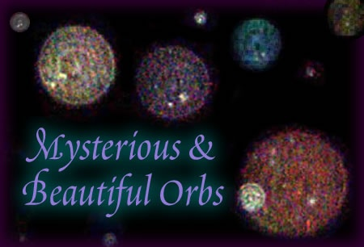
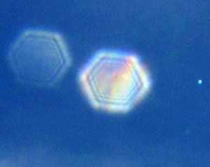
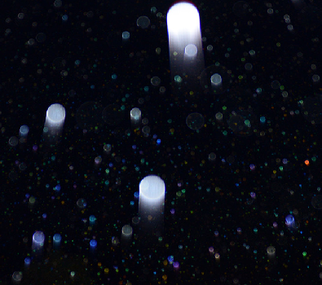
The problem
Bright and rather unexpected white disks may appear in a photo taken with a flash in a dark room. Explain why such shining orbs appear in the photos.

Slide 3
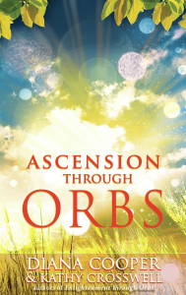
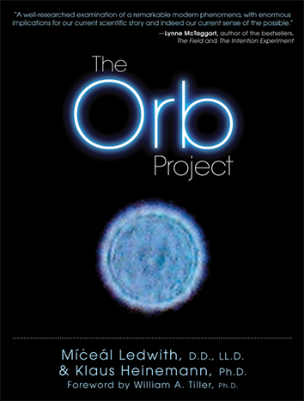
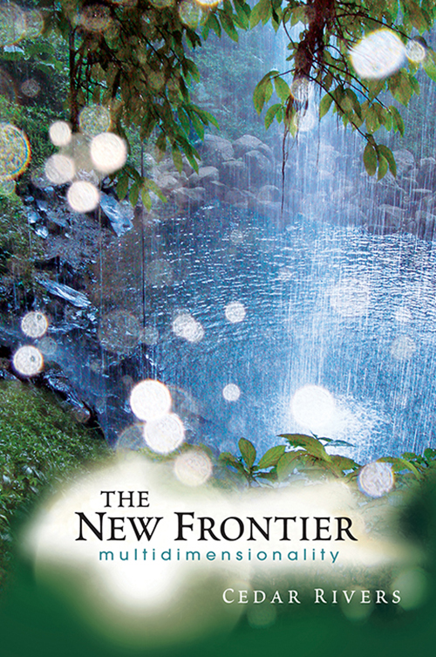
This problem is an object of interest of many people. So there are even several books on this theme
But not everyone understand the scientific explanation of that phenomena

Slide 4
Explanation
The orb phenomenon is caused by small particles suspended in the air.
Conditions needed for shining orbs:
Small particles in the air
Flash in the camera ( the short distance between the lens and the built-in flash) or low-light instances or where a bright light source is near the camera
Particles out of focus

Slide 5
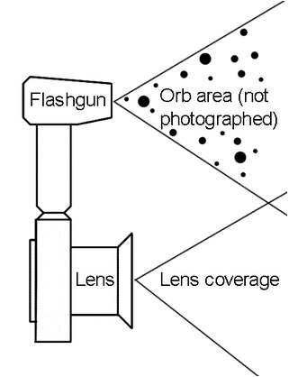
Flash near and far from the lens

Slide 6
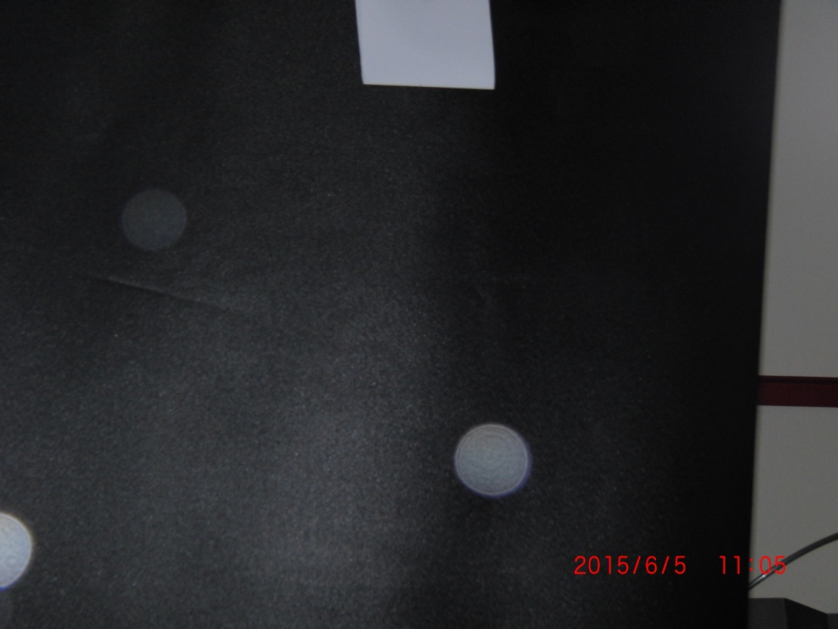
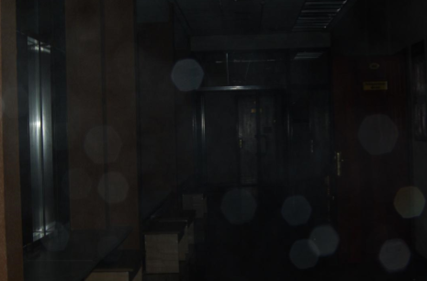
Orbs are not always circle in shape
When the diaphragm is small and the particle in the air is close to the camera only part of the orb appears on the matrix. This part have the shape of the diaphragm.

Slide 7
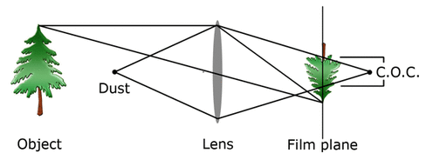
Visual explanation

Slide 8
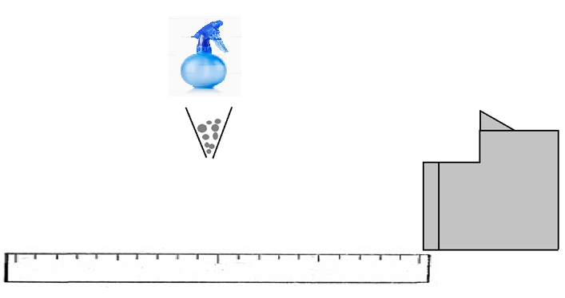
EXPERIMENTAL PART
Experimental setup

Slide 9
The orb artifact can be the result from: √ solid particles (e.g., dust, pollen), √ liquid particles (water droplets, especially rain), √ other foreign material within the camera lens.
Chalk
Water
Distance to the focused object – 260 cm
Camera – Casio Exilim EX-F1

Slide 10
Outdoors Spring pollen

Slide 11
The size depends on three parameters:
Distance between particles and lens - inverse proportionality
Radius of the diaphragm - linear dependence
Distance between lens and focused object - small contribution, neglect this dependence

Slide 12
Calculating the size of the orb
r – orb radius
R – diaphragm radius
F – lens focus
l – distance to the focused object
x – distance to the particle

Slide 13
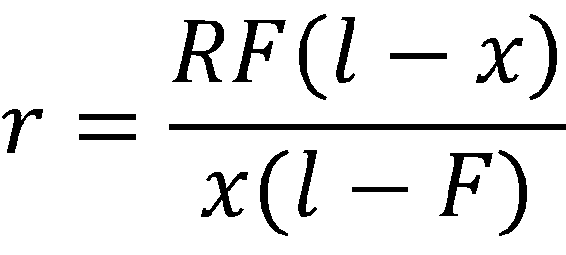
Calculating the size of the orb
r – orb radius
R – diaphragm radius
F – lens focus
l – distance to the focused object
x – distance to the particle

Slide 14
Influence of the radius of the diaphragm

Slide 15
The graph of the distance to the particle affection on the radius of orb
F

Slide 16
Summing up
The phenomenon of shining orbs was investigated and explained. The reason of this phenomenon - unfocused small particles in the air.
Three conditions for this phenomenon were analyzed.
The main parameters that influence on the size of orbs were experimentally checked. It appeared that the principle factor is the distance between the lens and the particle.
The formula for calculating of the orb was derived. Theoretical aspect of this problem is comparable with the experiment

Slide 17
Thank you for your attention!

Slide 18
Detailed calculations

Slide 19
Detailed calculations
$$x1=rF+F$$
$\frac{1}{l}+\frac{1}{x1}=\frac{1}{F}$ $→$ $x1=\frac{Fl}{l−F}$
$\frac{y}{R}=\frac{y−\frac{Fl}{l−F}}{r}$ $→$ $r=\frac{\left(y−\frac{Fl}{l−F}\right)R}{y} → r=\frac{RF\left(l−x\right)}{\left(l−F\right)x}$

