Slide 1
Smoke cannon
Kolb Anton
Spectrum, Belarus

Slide 2
Problem
Construct such a vortex ring cannon that would shoot with smoke rings on a distance sufficient to hit the chairperson of your Science Fight.

Slide 3
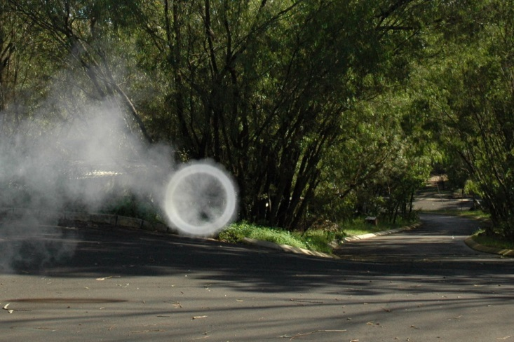
Why it’s interesting?
Here we can see a lot of physical processes
It looks amazing

Slide 4
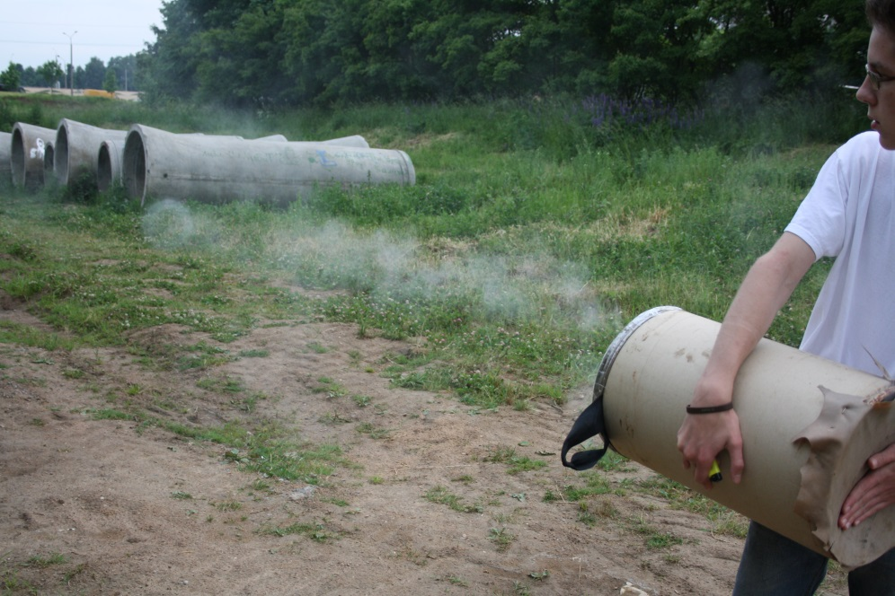
Shooting

Slide 5
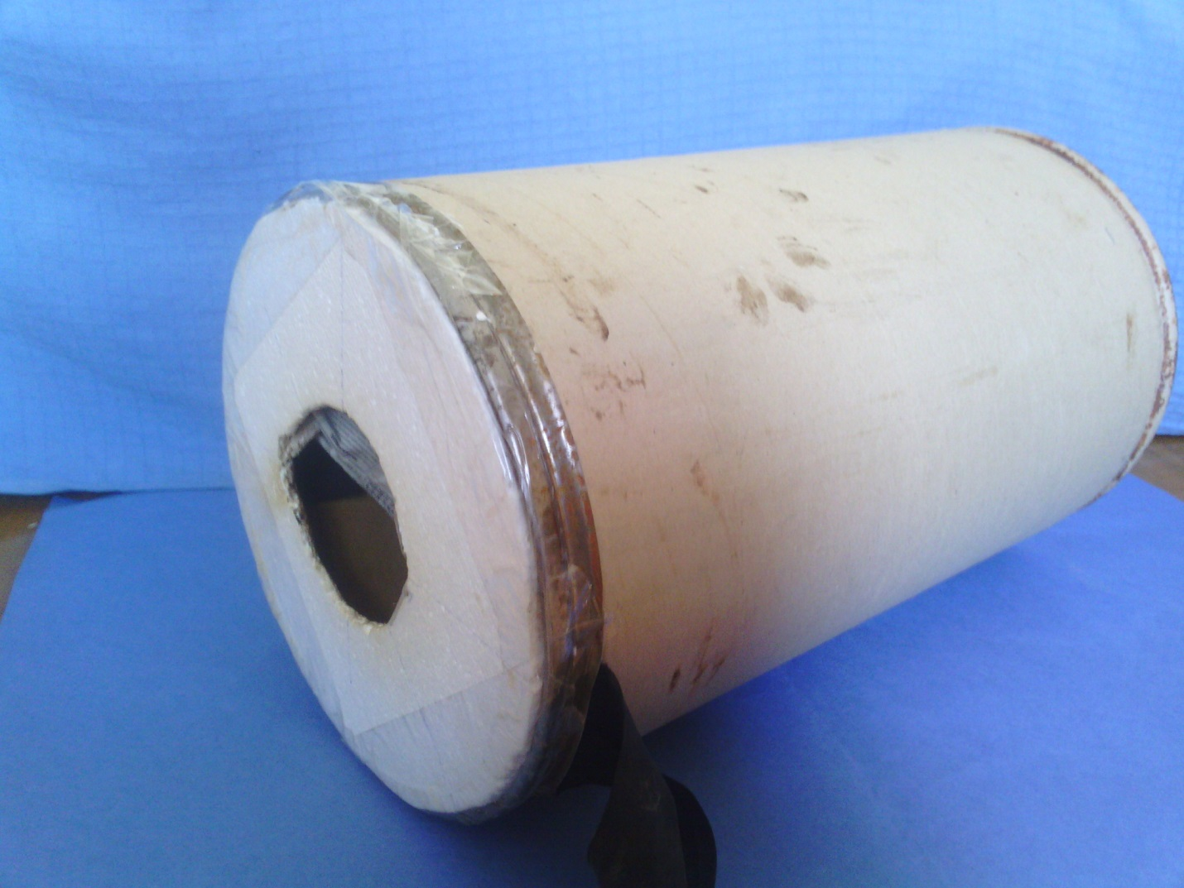
Construction
Smoke source
Tank
Membrane
Nozzle

Slide 6
Formation of the ring

Slide 7
Formation of the ring

Slide 8
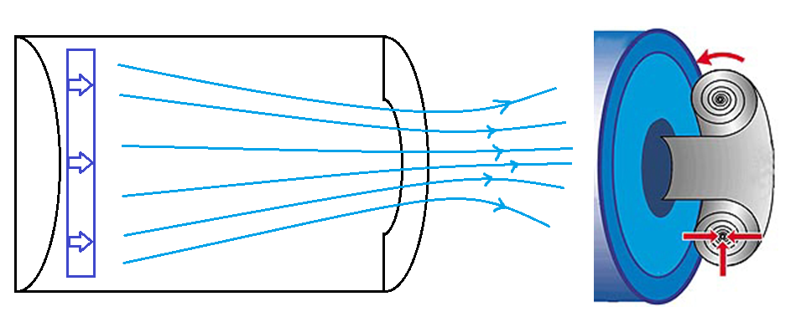
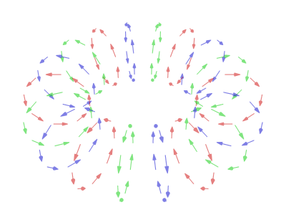
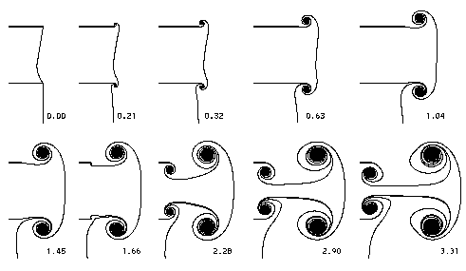
Formation of the ring
Flow around an idealized vortex ring
Vortex ring formation at the edge of a circular tube

Slide 9
Why the ring lives and moves so long?
The vortexes roll along the immovable gas tube and the friction accelerates the ring after its emerging.
While the moment of force for rolling vortex is small so the ring can exist for a long time
The ring has a “solid” kernel

Slide 10
Sketch of the velocity distribution in a vortex
v_{t}
r

Slide 11
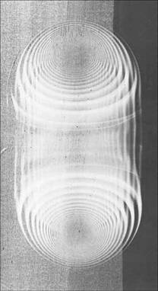
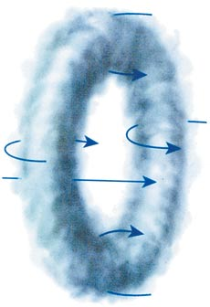
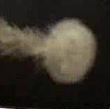
Structure of the smoke ring
Our own pictures

Slide 12
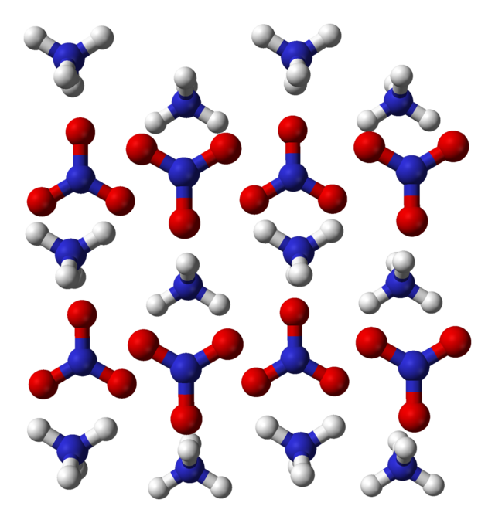
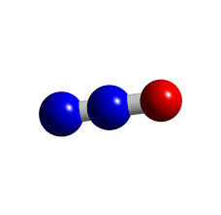
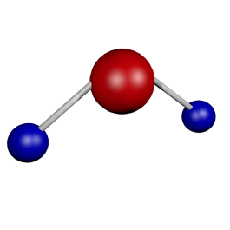
What does the smoke consist of?
Self-made smoke grenade (NH4NO3)
t < 270 C
NH4NO3
N2O + 2H2O

Slide 13
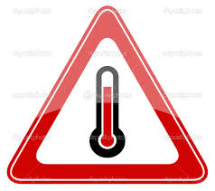
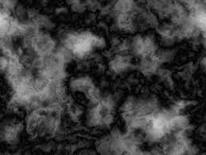
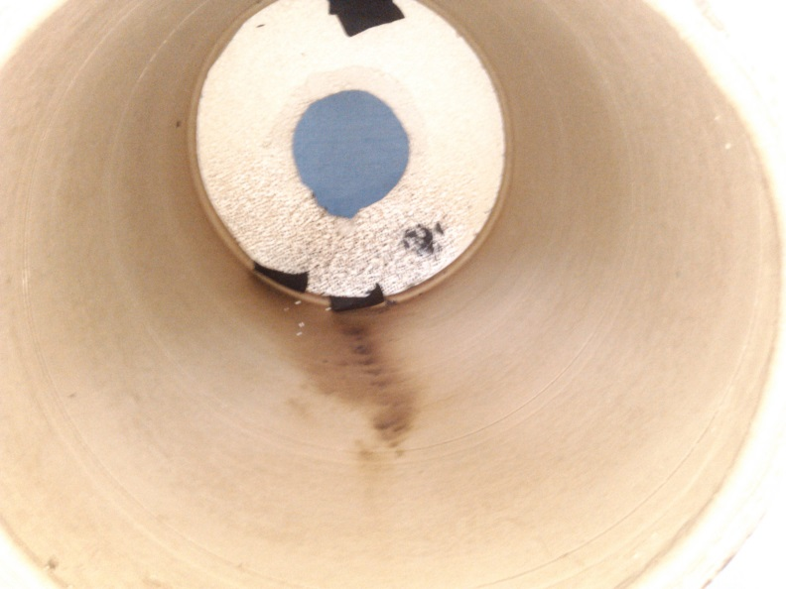
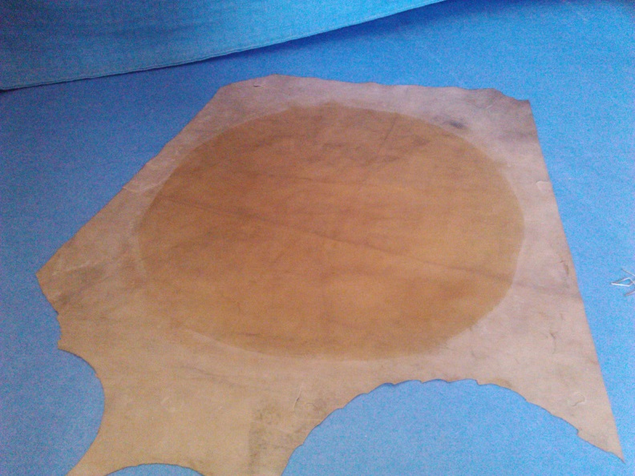
Troubles
After first test some troubles in the construction were found. They are:
Too hot grenade
Too much smoke

Slide 14
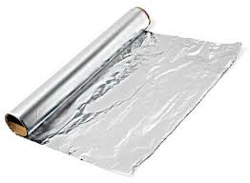
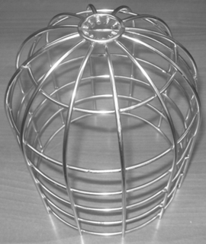
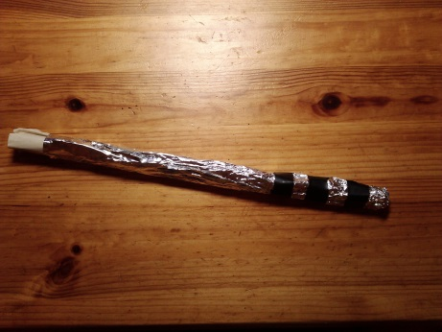
Increase reliability
Foil
Basket of thick wire
Smaller grenade

Slide 15
Main parameters
Changes in the membrane
Change nozzle size
Change nozzle configuration
Distance

Slide 16
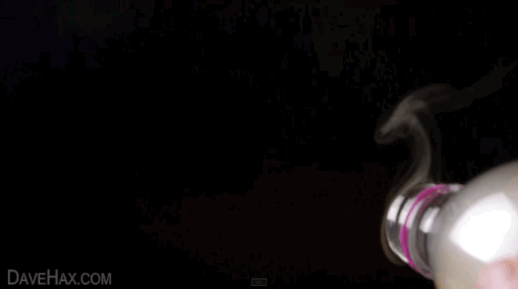
The role of hydrodynamic regime
turbulent flow
Laminar flow

Slide 17
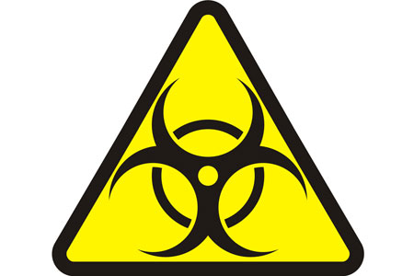
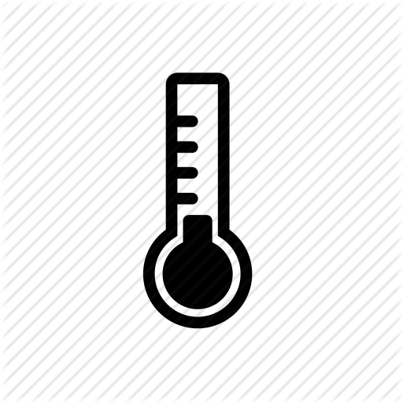
Restrictions
Smoke toxicity
Size of the tank
Temperature

Slide 18
Conclusion
We designed and made the smoke cannon which produces smoke rings propagating at about 10 meters
There are two main physical laws explaining the long-time existence and stability of smoke rings. These laws are the moment of momentum conservation and Bernoulli’s law.
The main parameters affecting formation of smoke gun are:
the momentum providing to the air in the tank by initial hit;
the shape of nozzle;
hydrodynamic regime of air flow (laminar or turbulent)

Slide 19
Thank You for Your attention!

