Slide 1
12. Structure of a hair
The hair of various animals may significantly differ in their structure. What are these differences and how can you explain them?

Slide 2
Relevance
1
forensic medical practice, criminalistics
The question we have to answer:
Can animal’s hair be recognizable like human fingerprint?

Slide 3
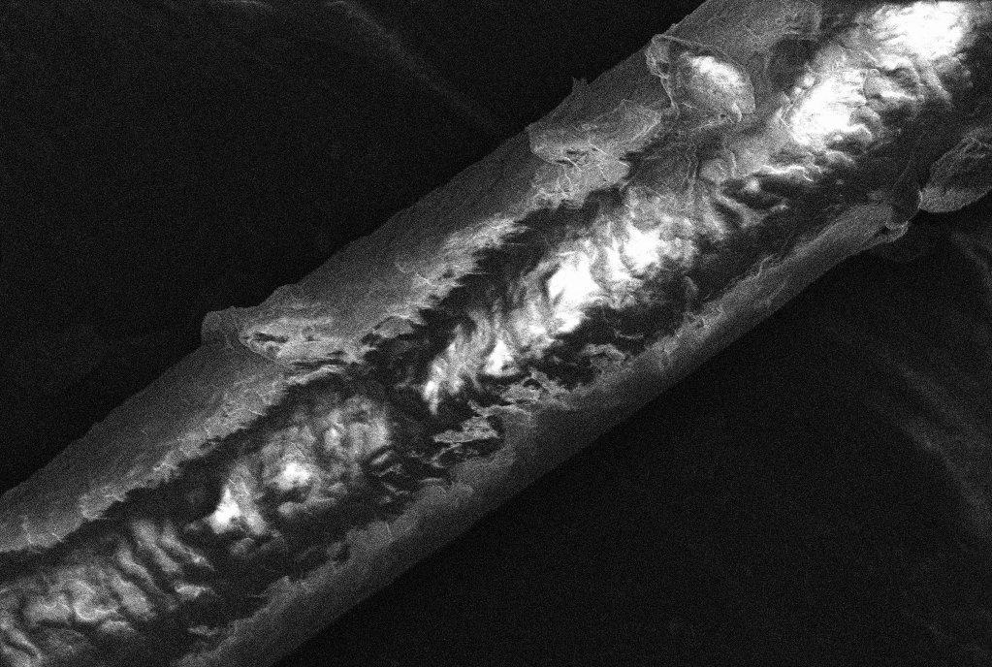
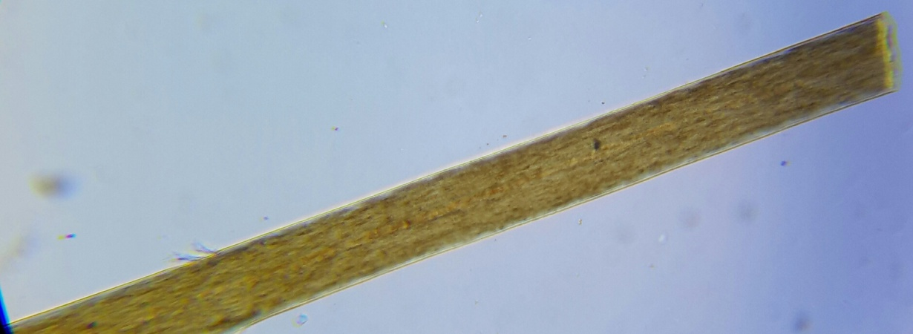
What is a hair?
2
Hair is a protein filament that grows from follicles found in the dermis, or skin.

Slide 4
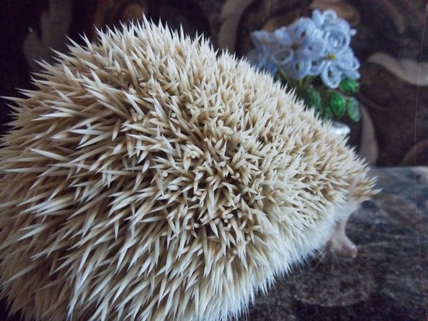
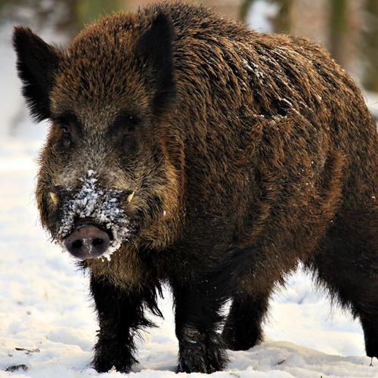
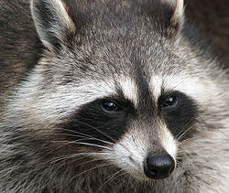
Modifications. What the hair can be like?
3
Hedgehog ‘sneedles
Boar’s bristles
Raccoon’s whiskers

Slide 5
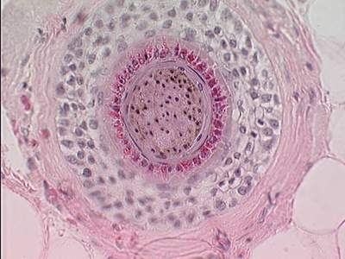
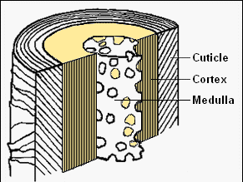
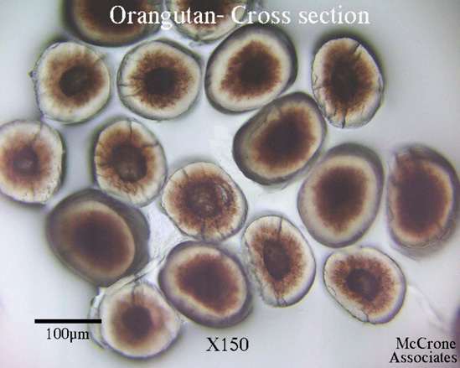
Structure of a hair
4

Slide 6
Human | Animal
The shape
Narrowing in both directions | Narrowing in one direction
Thickness
0.2 mm | >0.2 mm – for cattle
The most thick layer is the cortex one | The thicker layer is medulla
Cuticle layer
Serrulated: scales adjoin tightly | Coarsely: the scales are free arranged
Cortex layer
Medulla layer
5

Slide 7
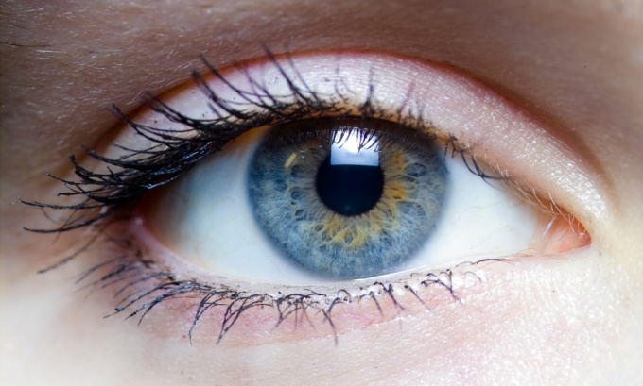
The most important parameters for hair comparison
Morphology
The appearance, shape, color (pigments), the thickness
Edge of hair - flakes location (with microscope)
The cuticle layer in cross-section (cells lie loosely or tightly)
Physical parameters: tensile strength, resistance at the passage of electric current etc.
Chemical analysis
6

Slide 8
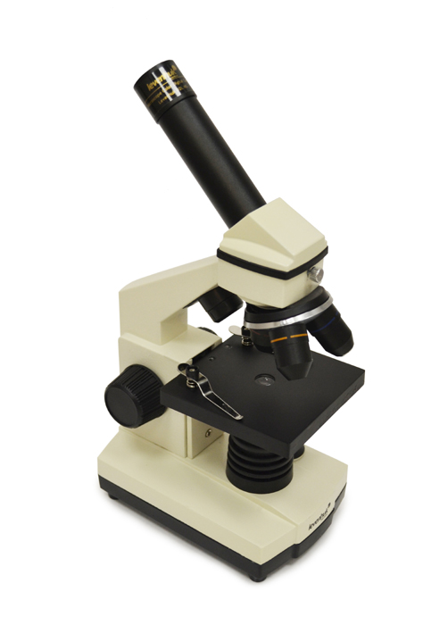
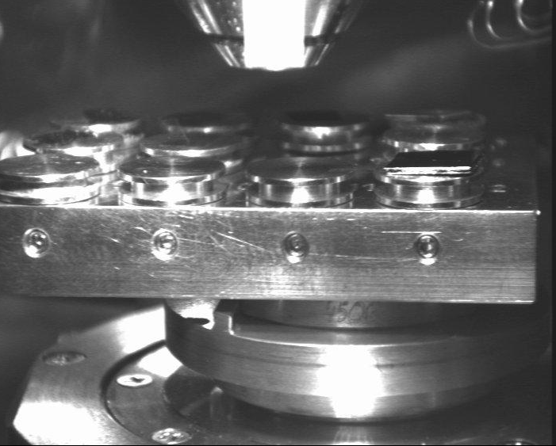
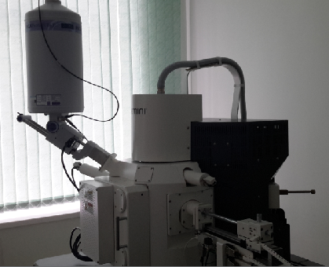
Animals that we decided to research (guard hairs). Methods that we have used
Levenhuk microscope
Human
Cat
Dog
Badger
Fox
Mink
Sheep
7
Scanning electron microscope SUPRA 55WDS

Slide 9
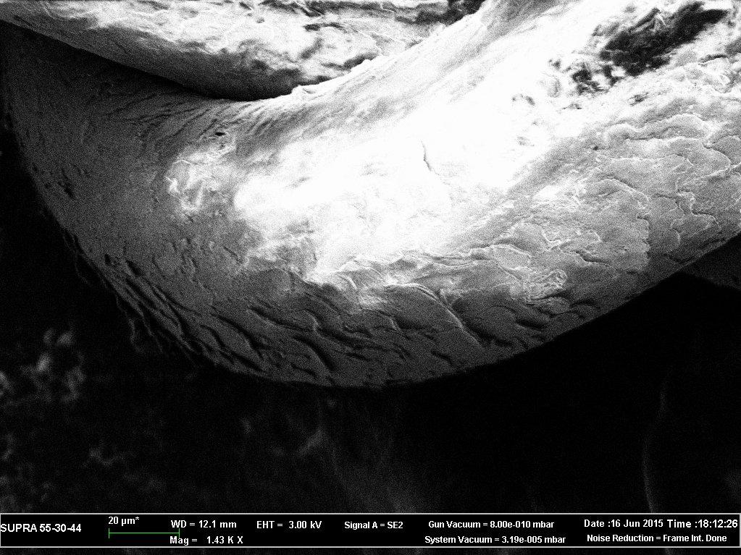
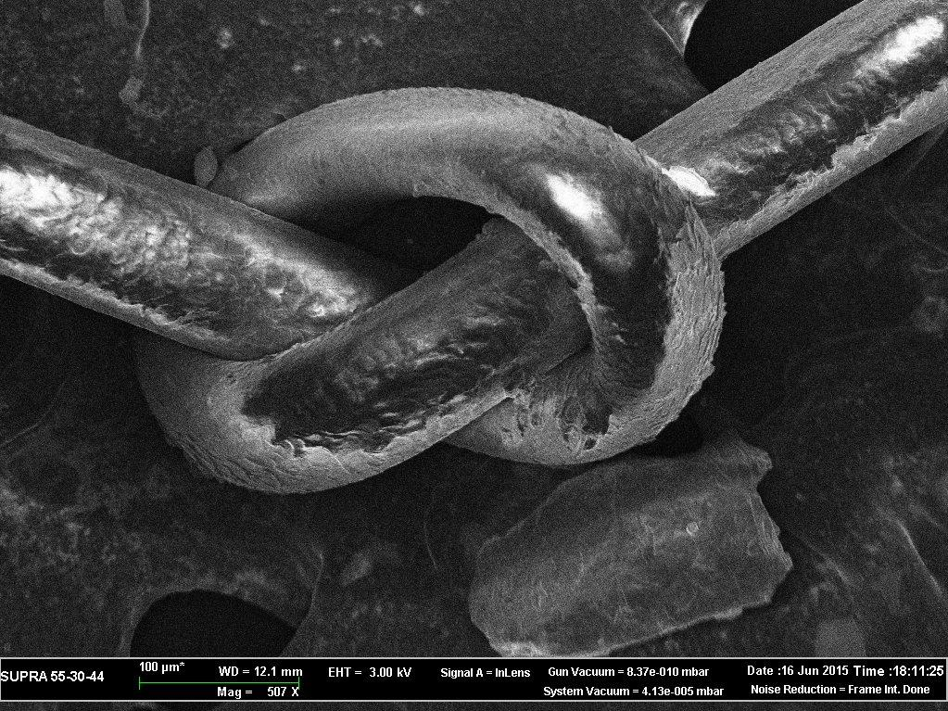
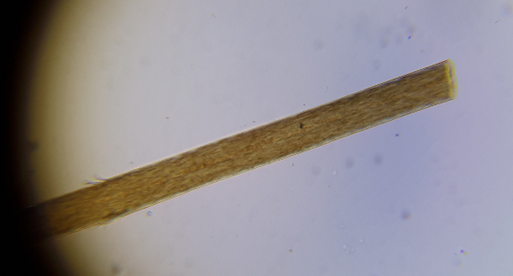
Human
Hair thickness 0.09 mm
Flakes length 0.006 mm
8

Slide 10
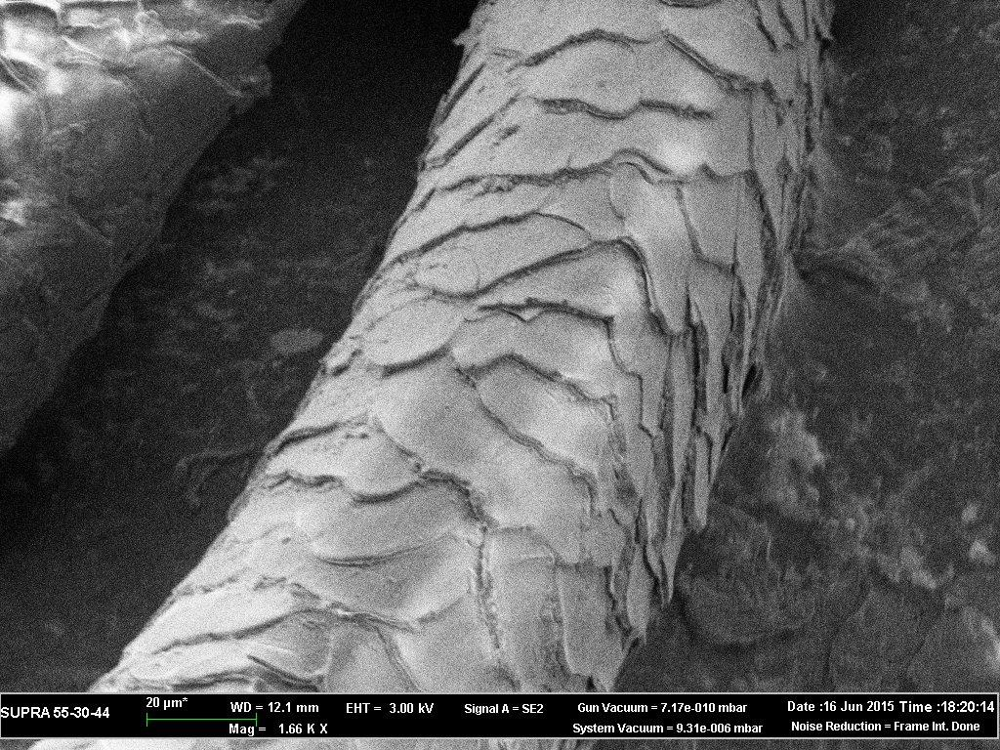
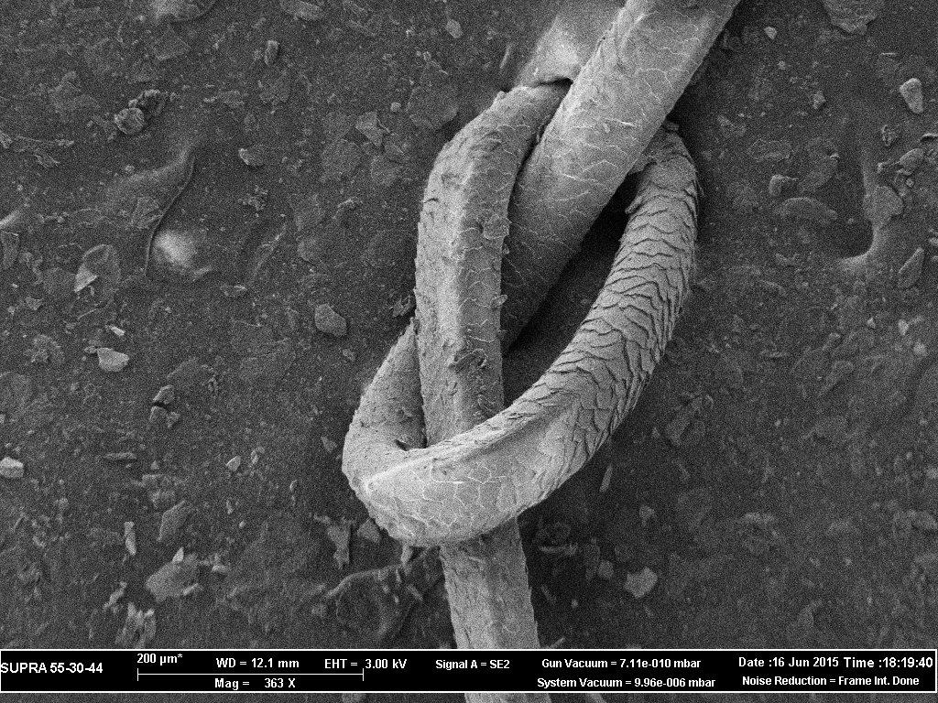
Badger
Hair thickness 0.07 mm
Flakes length 0.012 mm
Thickness of the flakes 0.002 mm
9

Slide 11
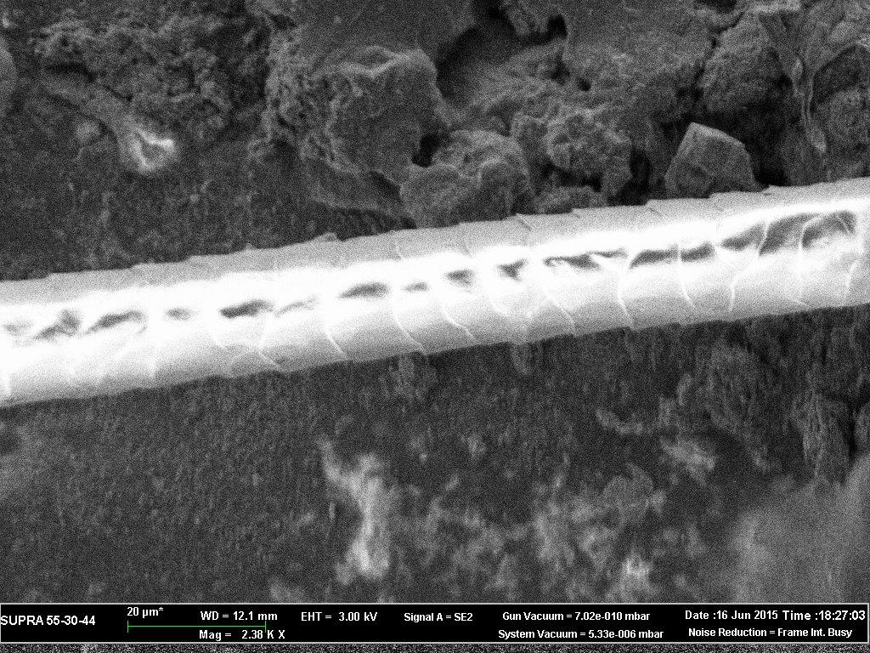
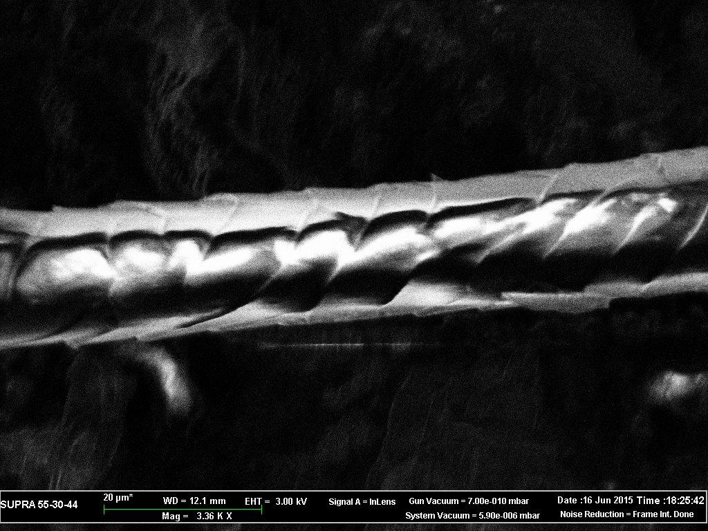
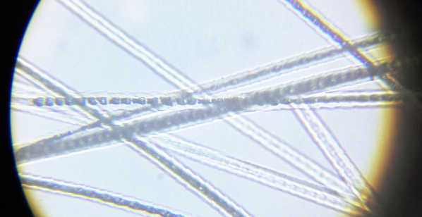
Cat
Hair thickness 0.018 mm
Flakes length 0.007 mm
Thickness of the flakes <0.001 mm
10

Slide 12
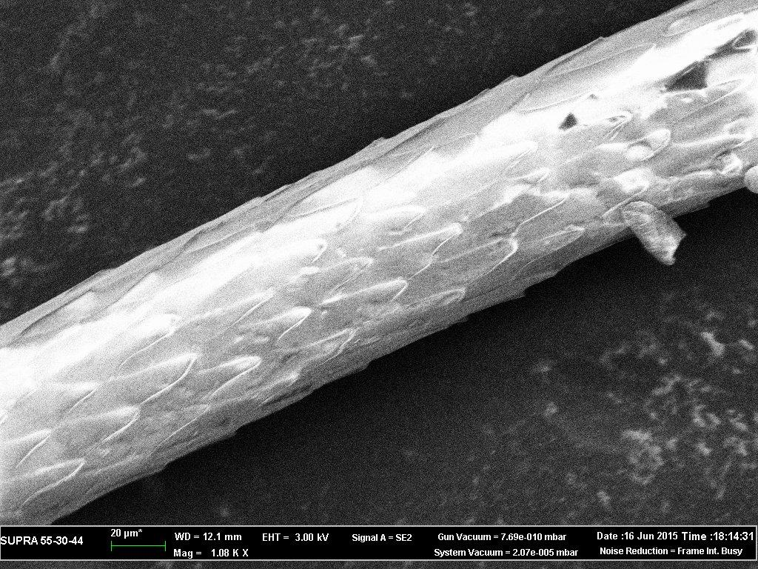
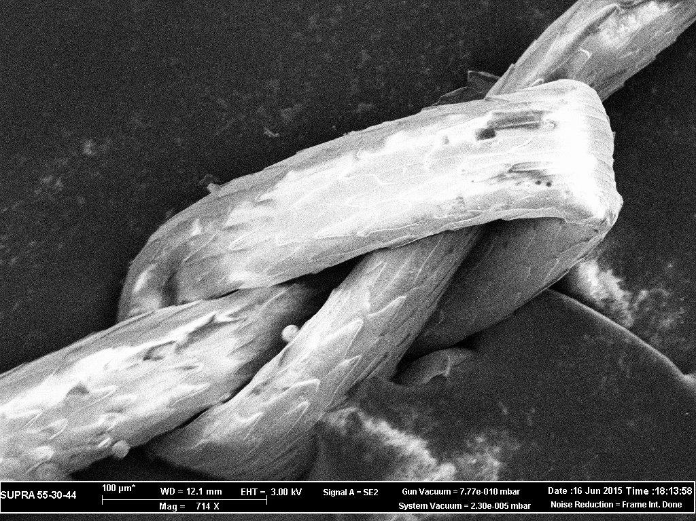
Fox
Hair thickness 0.072 mm
Flakes length 0.031 mm
Thickness of the flakes <0.001 mm
11

Slide 13
Table of comparison
12
Animal | Hair thickness , mm | Flakes length , mm
Human | 0.092 | 0.006
Cat | 0.018 | 0.007
Dog | 0.025 | 0.004
Badger | 0.071 | 0.012
Fox | 0.072 | 0.031
Mink | 0.111 | 0.002
Sheep | 0.032 | 0.013
 | ∆ =0.093 | ∆ =0.029
Thus we can determine what genus includes the animal

Slide 14
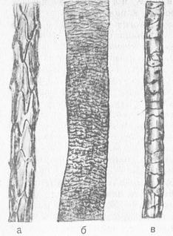
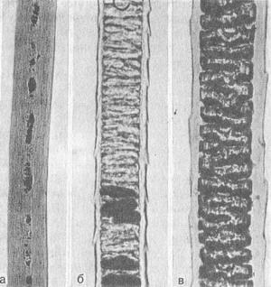
Cuticle pattern and structure of the core of the hair
Cuticle layer:
a-fox, b-sheep, c-deer
Cortex layer:
a-human, b- goat, c-rat
13

Slide 15
The reason of differences: adaptation to the habitat of spices due to evolution.

Slide 16
Conclusions
Class
mammals
By the presence of hair
Squad
Appearance, shape, pigments, thickness
Family and
genus
Morphology
Species of an animal
Emission spectral analysis, physical parameters
14

Slide 17
Thank you for your attention!
15

Slide 18
Sources:
Sherrow. Encyclopedia of hair: A cultural History.
www.mccrone.com/mm/a-microscopical-study-of-exotic-animal-hair-1/
http://www.medical-enc.ru/sudmed/study of the hair.shtmal
http//www.medical911.ru/ forensic medical study/

