Slide 1
SUNSET
Reporter
Gleb Penyazkov

Slide 2
The problem
The visible Sun disk touches the horizon and after a particular time interval disappears behind the horizon. What is the duration of this time interval? Explain the optical phenomena observed during a sunset.
We have to:
Calculate time interval of the sunset
Explain optical phenomena during the sunset

Slide 3
Formulas for calculation the duration of sunset
The fastest sunset:
128/cos(latitude)
The slowest sunset:
142/cos(1.14 x latitude)
$$T=\frac{32}{K\cos{δ\cos{φ\sqrt{1−{\left(\tan{δ\tan{φ}}\right)}^{2}}}}}$$
δ - declination of an object
φ - latitude of observer
K - $\frac{dH}{dt}$
H - hour angle of an object
http://www.idialstars.com/fss.htm
https://answers.yahoo.com/question/index?qid=20090123174556AAdrmS8

Slide 4
The duration of sunset in different cities of the world

Slide 5
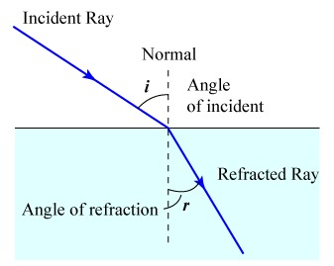
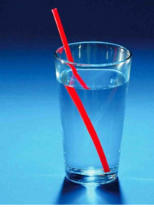
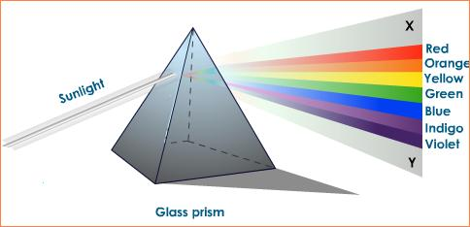
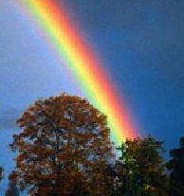
Optical phenomena that we used for explanation of this problem
Refraction
Dispersion

Slide 6
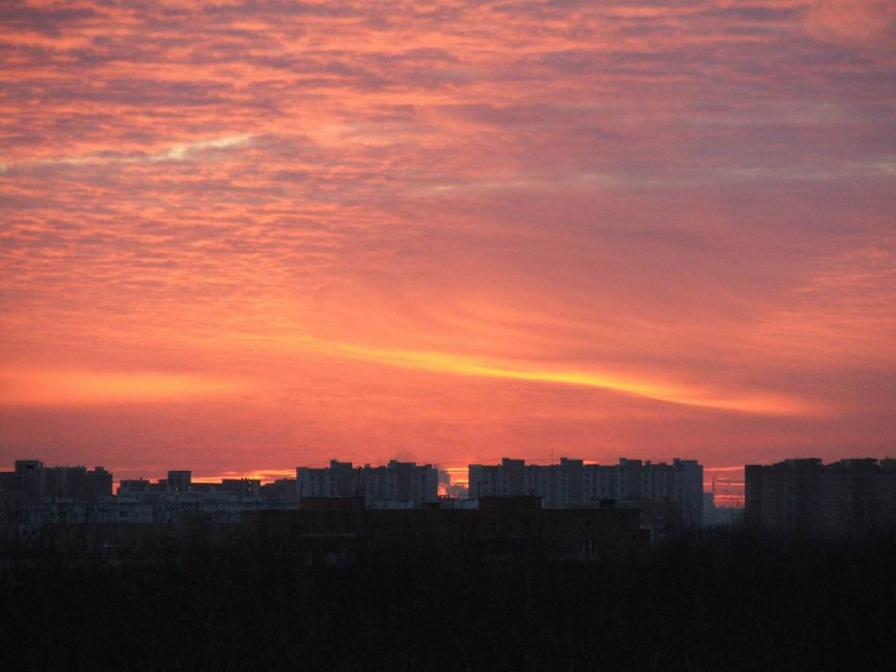
Why is the sky blue at day and rose-red at sunset?

Slide 7
Explanation

Slide 8
Red color of the Sun during a sunset

Slide 9
The narrowing of the Sun during a sunset

Slide 10
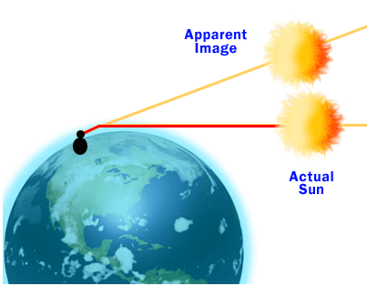
Explanation

Slide 11
Mirages of the Sun

Slide 12
Explanation

Slide 13
Blind lane

Slide 14
Explanation

Slide 15
Green ray

Slide 16
Explanation

Slide 17
Light pillar

Slide 18
Explanation

Slide 19
Parghelia
Types of Parhelia: 1. 22° Parghelia 2. Secondary Parghelia 3. 120° Parghelia 4. The Parghelia Of Liliequist 5. Anthelia

Slide 20
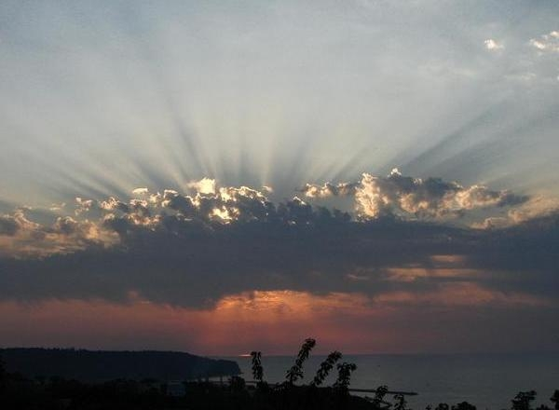
Crepuscular rays

Slide 21
Conclusions
We have calculated the time of the sunset in different cities and found out, that the difference may reach 420 seconds!
Great amount of optical phenomena were described and explained. Several of them we can see every evening, but another part is very rare.

Slide 22
Thank you for your attention!

Slide 23
Refraction and dispersion
Refraction is the change in direction of propagation of a wave due to a change in its transmission medium.
Dispersion is the phenomenon in which the phase velocity of a wave depends on its frequency.

