Slide 1
Additional Problem No.24
Team China
Taking the stage: ZENG Xiangjian

Slide 2
Problem
A list of four compounds includes CuSO4, K2Cr2O7, MgCl2, NaCl. Three of those are in three marked test tubes. Determine the contents of each test tube.

Slide 3
Out-line
Some research on these four compounds.
Our plan to determine.
Experiment
Conclusion

Slide 4
COLORS of solution:
K2Cr2O7:Orange
CuSO4: Blue
MgCl2 and NaCl: No color

Slide 5
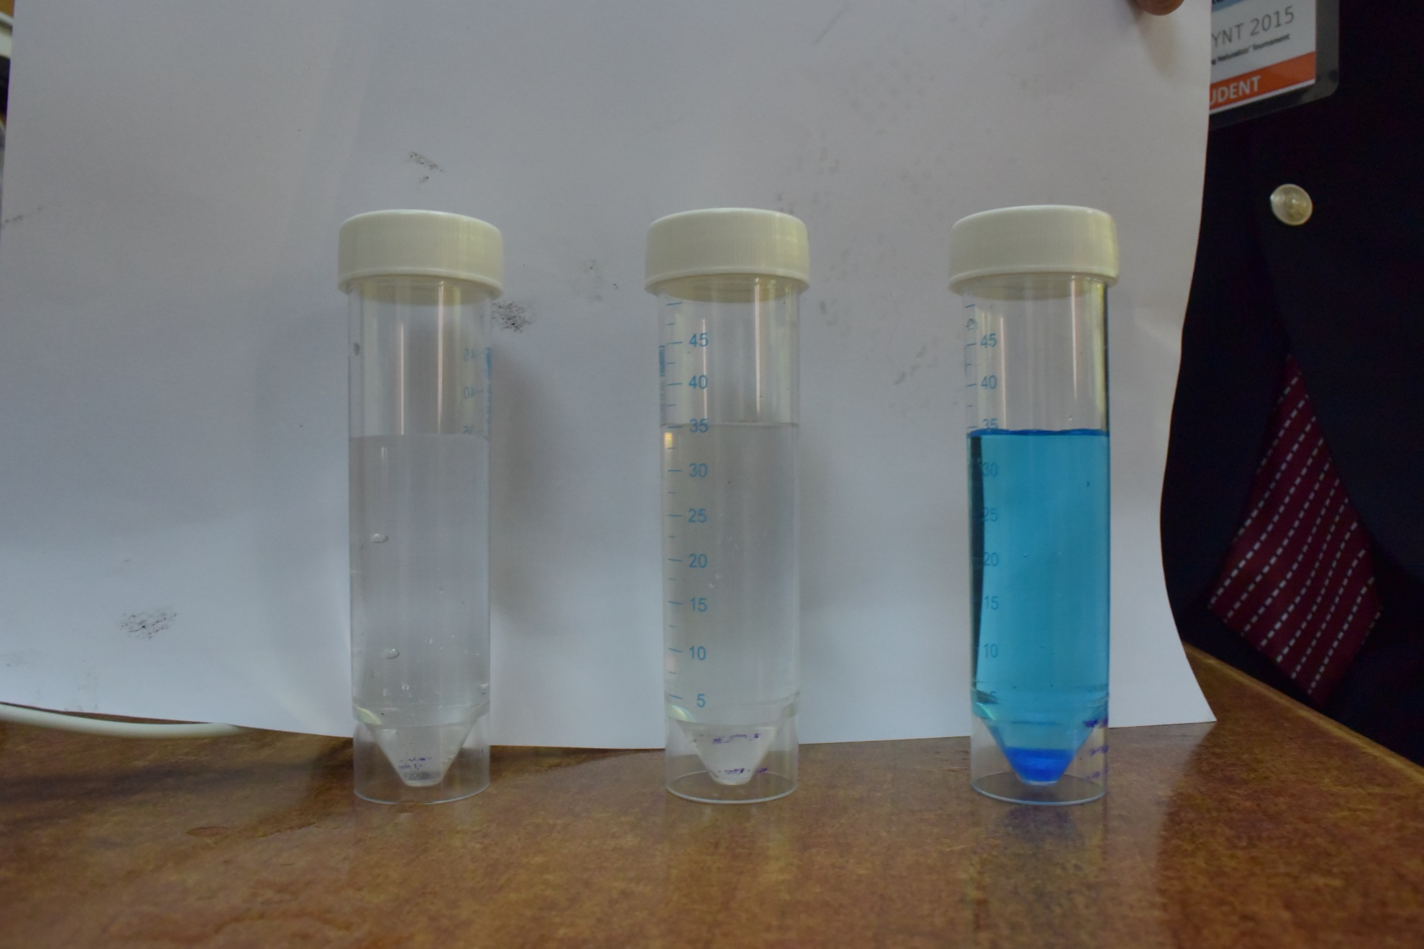
1
2
3

Slide 6
COLORS:
1 and 2: no color
3: Blue
Thus, the solution in 3 is CuSO4
In 1 and 2, it can be either NaCl or MgCl2

Slide 7
Our plan
First we could determine CuSO4 in tube 3 by color and we proved that in 1 and 2 there isn’t K2Cr2O7

Slide 8
Theory used to determine the chemicals in tube 1 & 2
H20→(boild)(H+)+(OH-)
(OH-)+(Mg2+)→Mg(OH)2(precipitation)
Thus, in the tube containing MgCl2, the solution may get muddy when boiled.

Slide 9
Experiment
We used an alcohol lamp to heat.

Slide 10
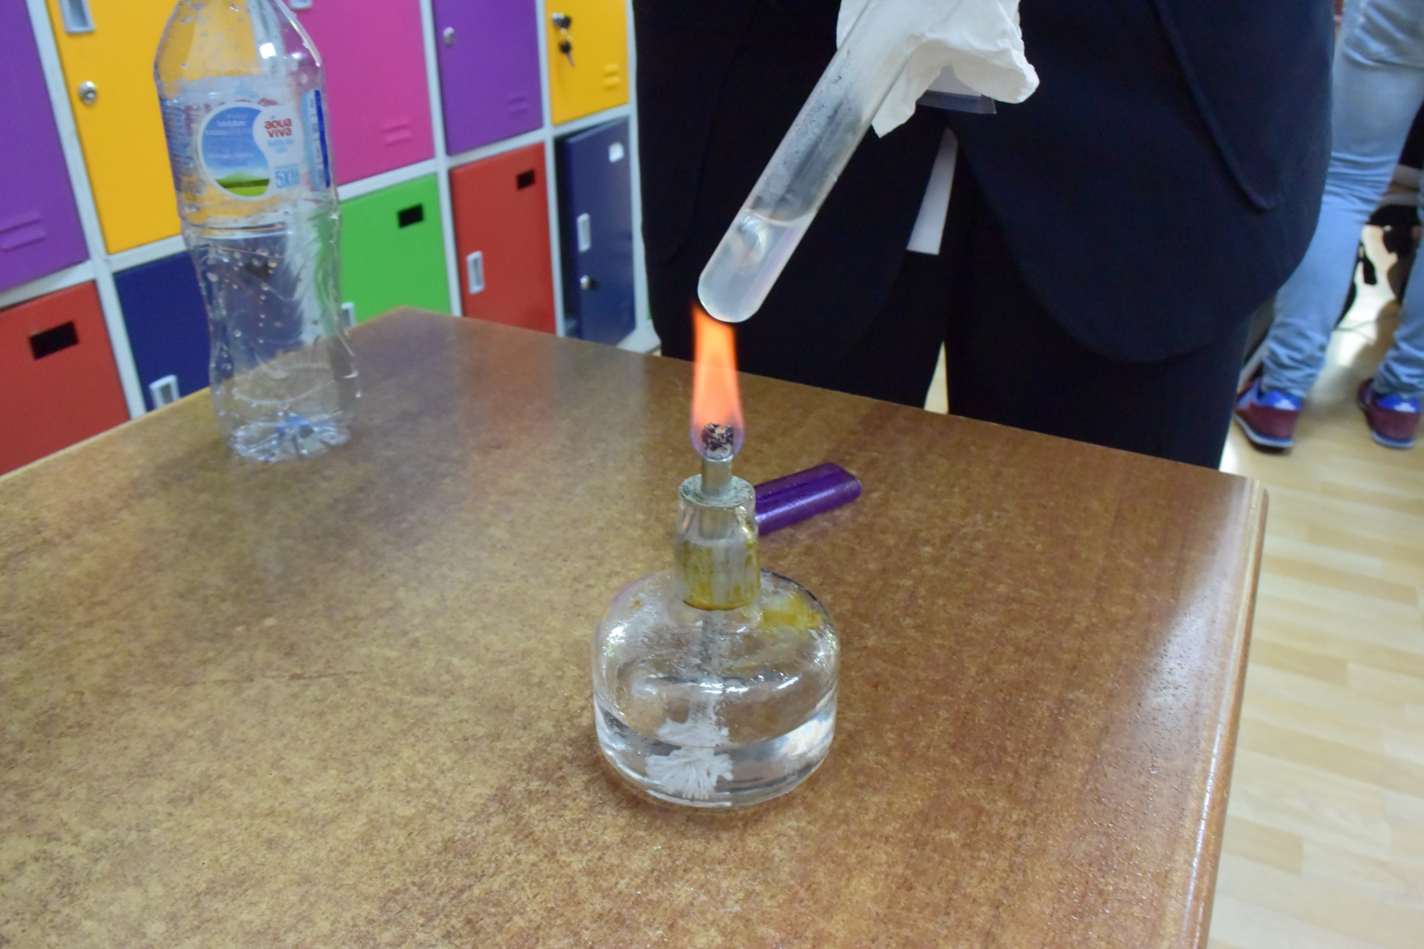
Experiment 1(tube 1)
1

Slide 11
1

Slide 12
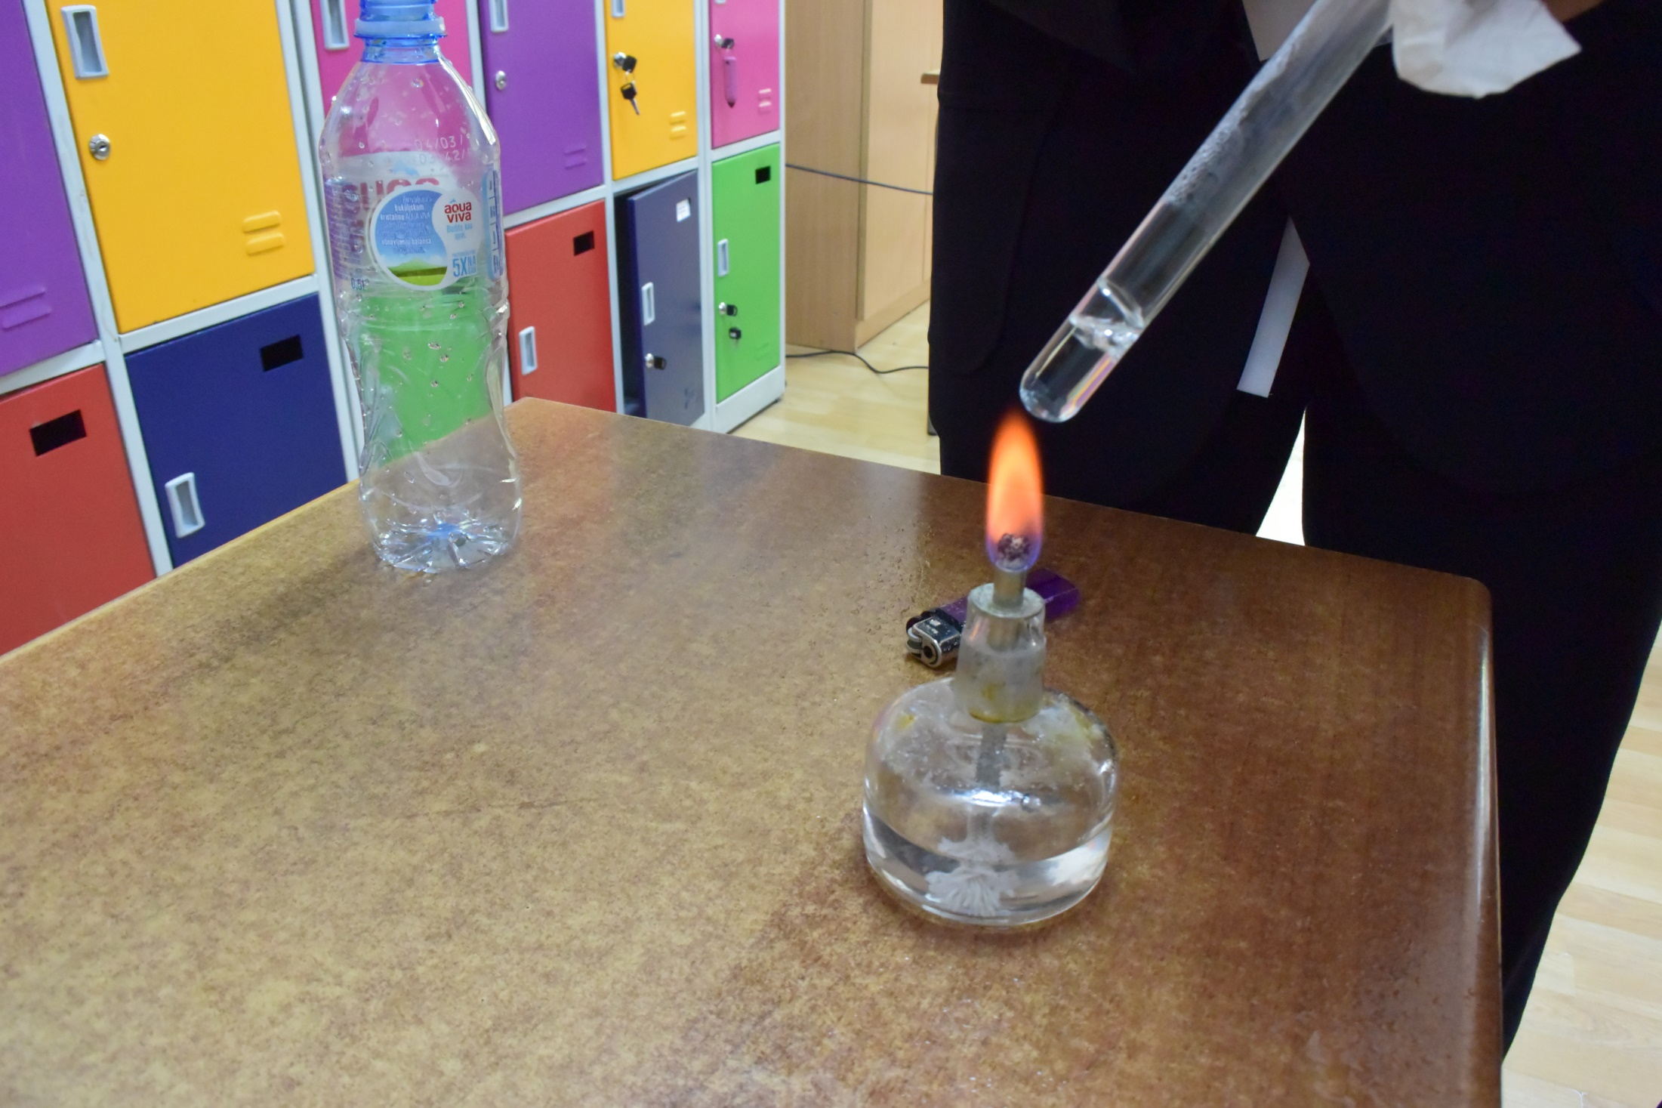
Experiment 2(tube 2)

Slide 13
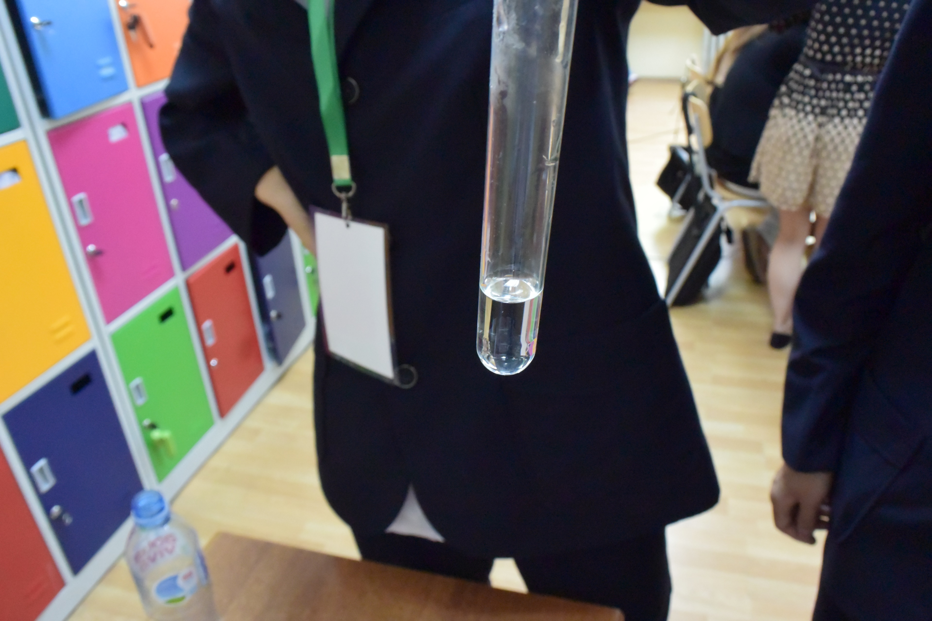

Slide 14
Tube 1: Muddy
Tube 2: Clear

Slide 15
Conclusion
MgCl2
NaCl
CuSO4
1
2
3

Slide 16
THANK YOU FOR YOUR ATTENTION！

