Slide 1
Problem No.5 “Falling ball”
WANG Yuhao, Team China

Slide 2
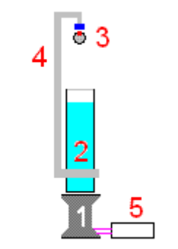
Problem Review
An electronic balance (1) is connected to a PC (5) in order to record the time dependence of the measured weight. A light frame (4) is mounted on a tall beaker (2) filled with water. The frame has a holder (3) allowing controlled release of a small ball such that it falls into the water. The beaker is placed on the balance as depicted in the Figure. Investigate how the readings of the balance reflect the different phases of the motion of the ball.

Slide 3
A few questions we ask ourselves:
What is the motion of the ball like?
How does the readings of the balance change?
What is the relationship of the readings and the motion?
How does parameters like the diameter of the ball or the density of the ball influence on the result of the experiments?

Slide 4
Outline
PART I Experiment
1.Equipment & Set up
2.The process of the experiments
3.Graphs
PART II Theoretical analysis
PART III Error analysis
PART IV References

Slide 5
I. Experiment

Slide 7
We observed the motion of the ball as well as the readings on the balance.
“Splash”: a dramatic increase of the reading
“Travelling in the water”: the reading tend to get smaller until the ball reaches the bottom.

Slide 8
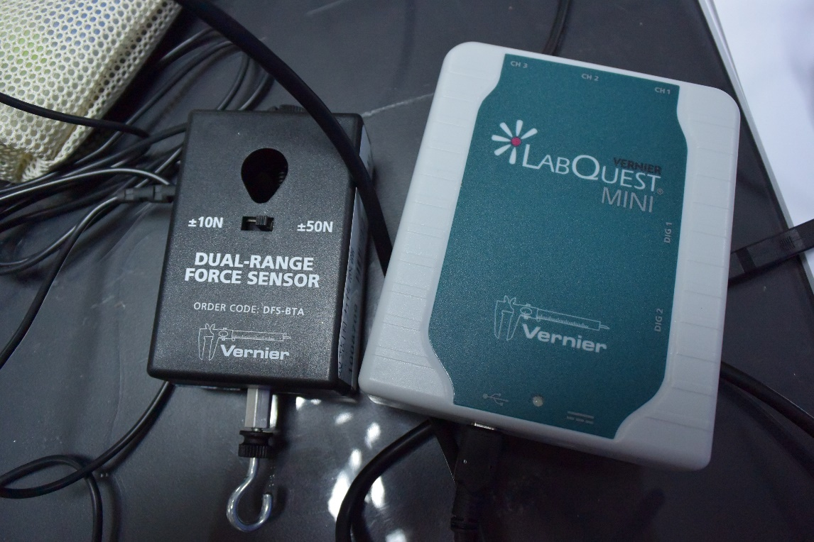
When the balance is connected to a computer, it couldn’t “record the time dependence of the measured weight”.
Replace the balance with force sensors:

Slide 9
1. Equipment & Set up
Electric balance: replaced by sensors for better accuracy
Camera: record the motion of the ball
Software(Tracker): analyze the motion of the ball

Slide 10
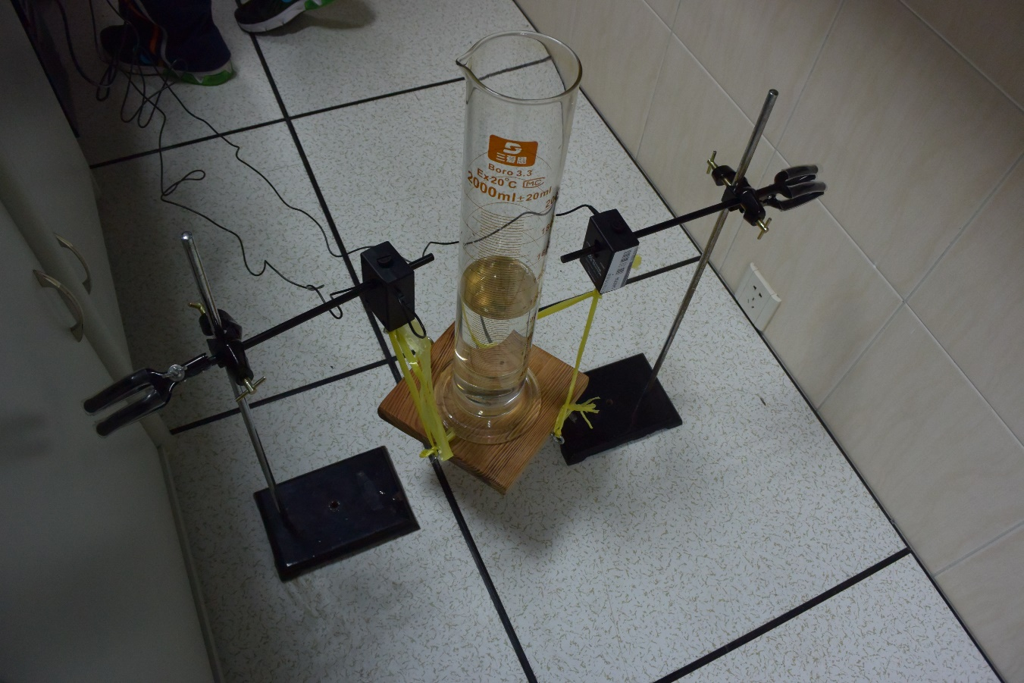
sensors

Slide 11
The ball we used for the analyzed experiment is an iron ball with a density of and radius of 1.25cm. Consider the density of water .

Slide 12
2.Process of the experiments
1.To simplify, we still choose to release by hand.
2.Use the camera to record the motion(400 fps).
3.Use the sensors can record the time dependence
of the force.
4.Export the data to Excel to draw the figure.

Slide 15
3.Graphs

Slide 16
3.Graphs

Slide 17
II. Theoretical analysis

Slide 18
From our experiments, we find three phases of motion:
Above the water;
Entering the water;
Travelling in the water, which consists of acceleration and uniform motion.

Slide 19
The phase of ‘entering the water’ is reflected by a dramatic increase with fluctuation in the reading. Because the time interval of this phase is short, it’s hard to do a quantitative analysis.
The next phase is the longest and most well-reflected. As observed, the reading of the balance is positive and tend to decrease during this phase. In the rest of the research, we focused on this phase of motion.

Slide 20
Theoretical Analysis
To begin a strict qualitative analysis of the last phase, we define some parameters:
The density of water
The density of the ball
The radius of the ball
The time interval after the set starting point
The displacement of the ball from the starting point
The velocity of the ball

Slide 21
Theoretical Analysis
Forces on the ball:

Slide 22
Theoretical Analysis
Some explanation for the drag equation:
In fluid dynamics, the drag equation is a formula used to calculate the force of drag experienced by an object due to movement through a fully enclosing fluid. The formula is accurate only under certain conditions: the objects must have a blunt form factor and the fluid must have a large enough Reynolds number* to produce turbulence behind the object.
is the drag coefficient – a dimensionless coefficient related to the object's geometry and taking into account both skin friction and form drag. In the case of a sphere traveling in the water,
(*In this case, the Reynolds number is between
and , which fits the condition of the equation)

Slide 23
Theoretical Analysis
Newton’s Second Law:
In differential form:

Slide 24
Theoretical Analysis
Substitution:

Slide 25
Solve the equation, we get:
*
$$v_{0} is the velocity when t=0$$

Slide 26
Now we have finished analyzing the motion of the ball, we are moving on to make a connection between the motion and the reading of the balance.
Considering the system of the beaker, the water in it and the ball.
According to the Impulse-momentum theorem,
However, the reading of the balance doesn’t directly show the force on it. Transfer the force to the reading in mass(g):

Slide 27
Solve the equations and let
we can get the theoretical graphs:

Slide 30
Error analysis
The inaccuracy of some parameters, e.g. the density of the ball and water, the value of current .
The inaccuracy of tracking the ball with software.
The instability of the experiment set up may cause some shaking, thus the readings have a fluctuating graph.

Slide 31
IV. Conclusion

Slide 32
Conclusion
The different phases of the ball are reflected by evident changes in the reading of the balance.
The motion of the ball in the last phase can be well predicted with force analysis.
The reading of the balance in the last phase can be well predicted with the Impact-momentum theorem.

Slide 33
References
· Wikipedia Drag (physics)
https://en.wikipedia.org/wiki/Drag_%28physics%29
· Wikipedia Drag equation
https://en.wikipedia.org/wiki/Drag_equation
· Wikipedia Drag coefficient
https://en.wikipedia.org/wiki/Drag_coefficient
· Wikipedia Reynold’s number
https://en.wikipedia.org/wiki/Reynolds_number
· Wikipedia Viscosity
https://en.wikipedia.org/wiki/Viscosity

Slide 34
Thank you for you attention!

