Slide 1
9. Distances in open space
Reporter : Giga Khizanishvili
Team: Georgians

Slide 2
How do astronomers measure distances between the planets of the Solar System, between the stars in our Galaxy, or between the galaxies? Determine the distance between the two space objects of your choice.
Task conditional

Slide 3
Plan
Radar
Distance to the Moon
Trigonometric Parallax
Standard Cables
Cepheid Variable
Supernovae
Conclusion

Slide 4
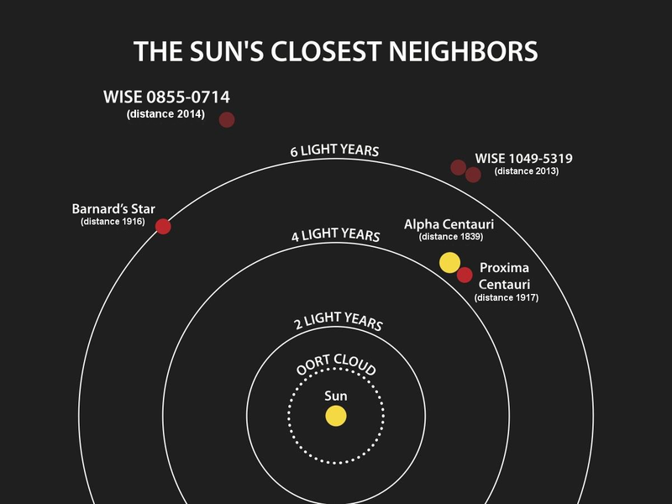
The Sun’s closest neighbors

Slide 5
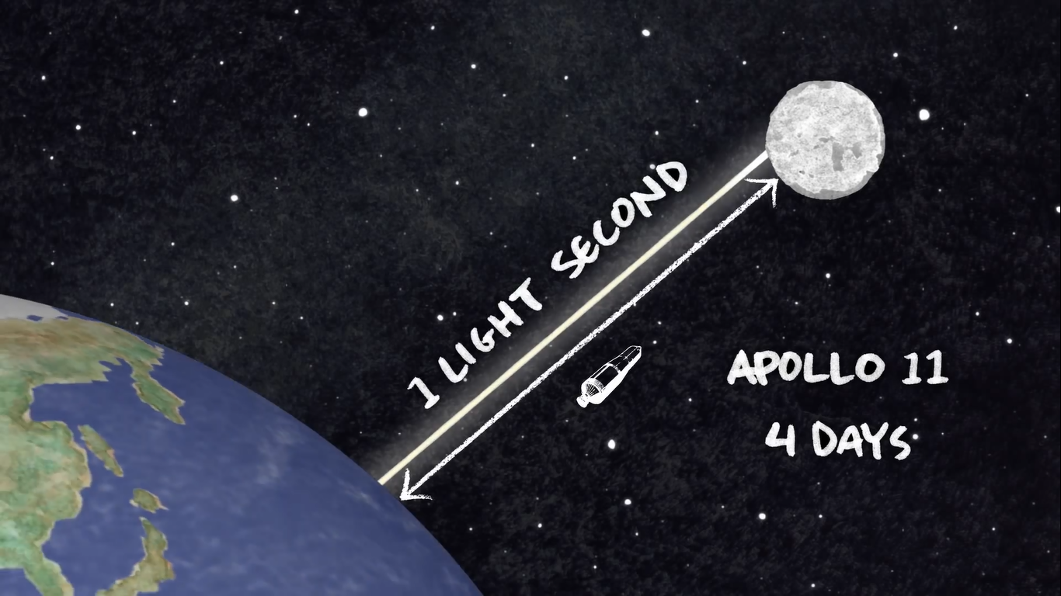
Distance between the Earth and the Moon

Slide 6
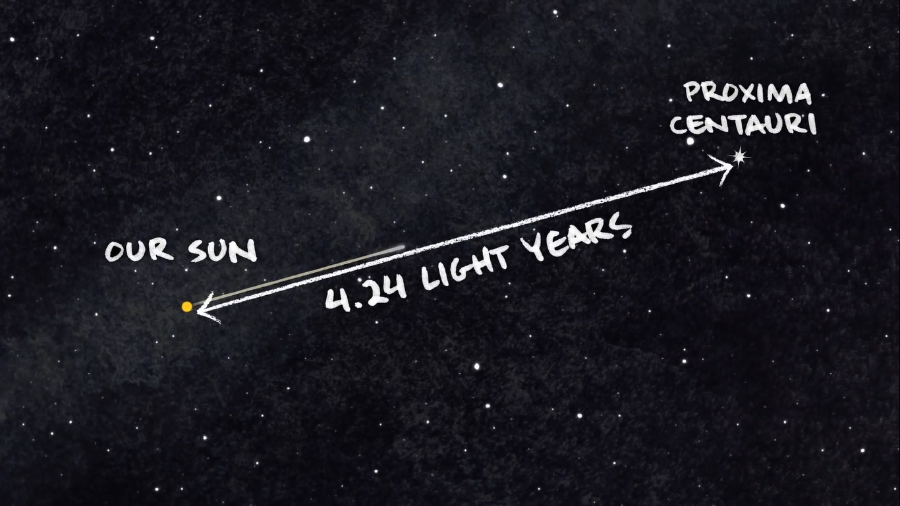
Distance between the Sun and Proxima Centauri

Slide 7
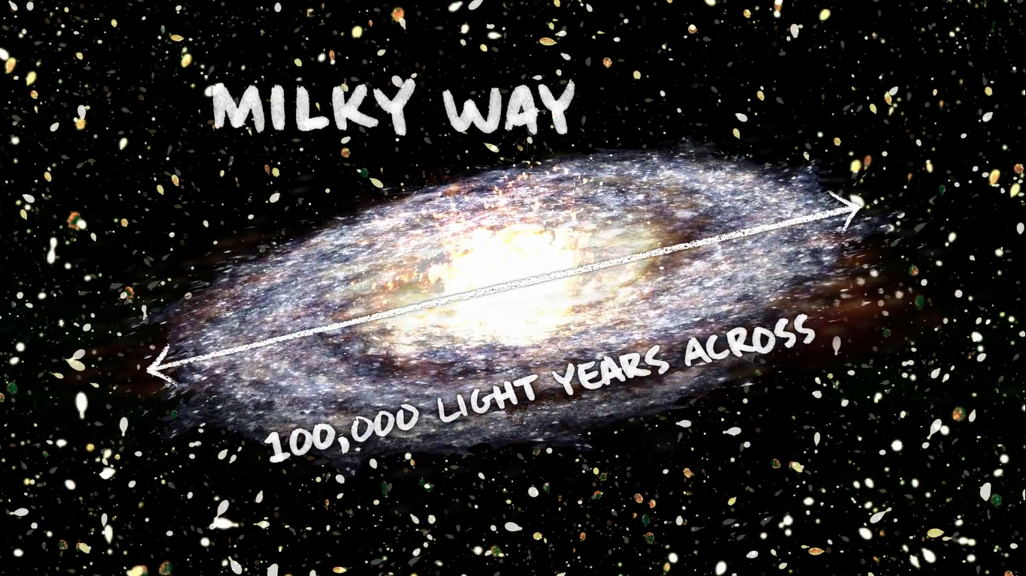
Distance across the Milky Way

Slide 8
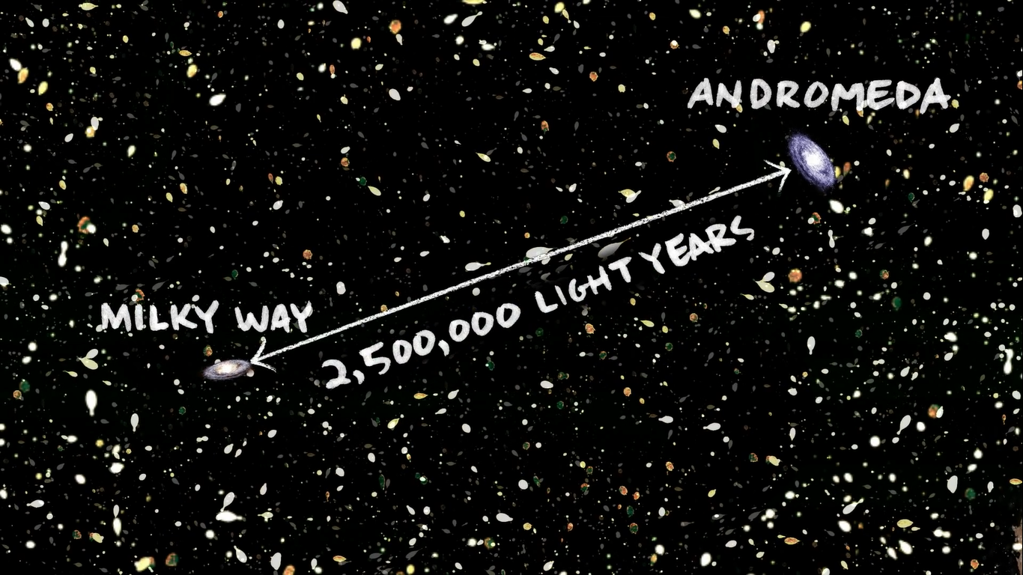
Distance between the Milky Way and the Andromeda

Slide 11
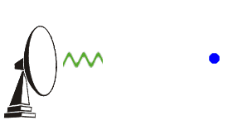
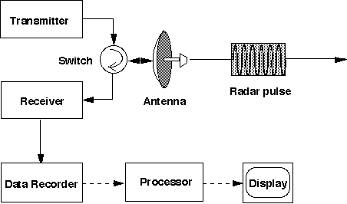
Radar – How It Works?

Slide 12
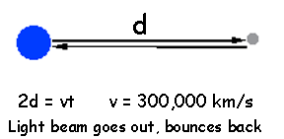
Radar - measuring distances in our solar system
d – Distance
V – Velocity
T – Time

Slide 13
How I measured distance between the Earth and the Moon
1:00.58 – 1:00.62 – S (First Time)
1:03.11 – 1:03.16 – S (Second Time)
Now calculate distance:
2d=v*t –› 2d=300000*t –› d=150000*t
t (max) = 1:03.14 – 1:00.60 = 2.54
t (min) = 1:03.11 – 1:00.62 = 2.49
Margin of Error of time 2,54 - 2,49 = 0.05 min
d (max) = 150000 * t(max) = 2,58 * 150000 = 387000km
d (min) = 150000 * t(min) = 2,49 * 150000 = 373500km
Margin of Error o distance to the moon = d(max) – d(min) = 387000 – 373500 = 13500km
The really distance between the Earth and the Moon is 384000km, our calculated distance (387000+373500) / 2 it is equal to about 380000

Slide 14
We use Trigonometric Parallax for object, which are very Close by.

Slide 15
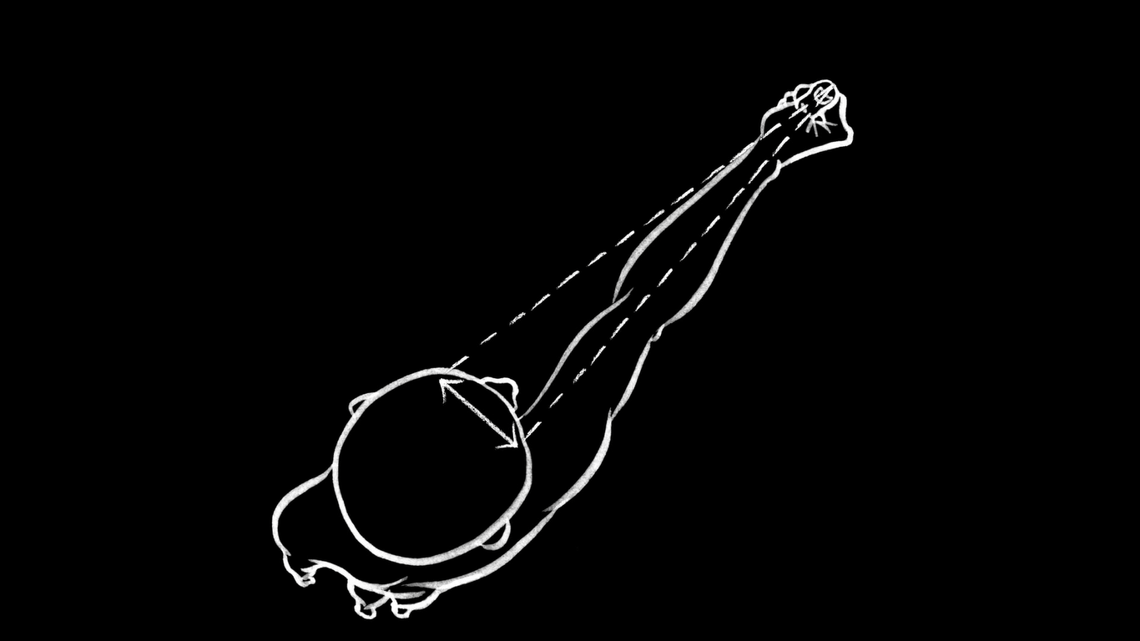
Parallax is the way an object’s position or direction seems to change depending on viewing angle.

Slide 16
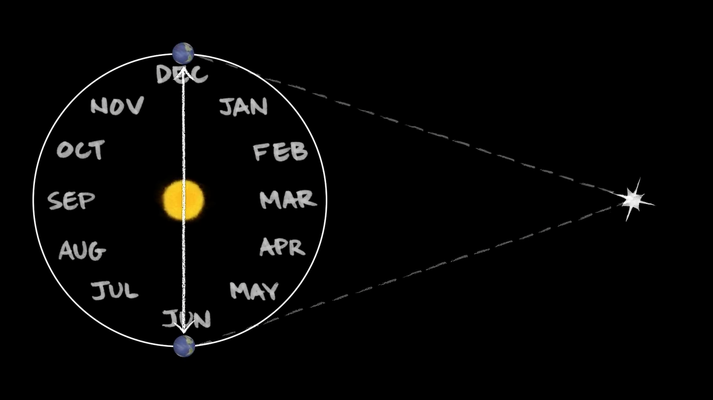
Parallax in space

Slide 17
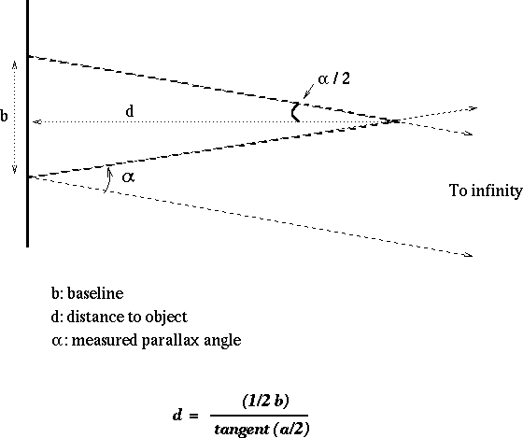
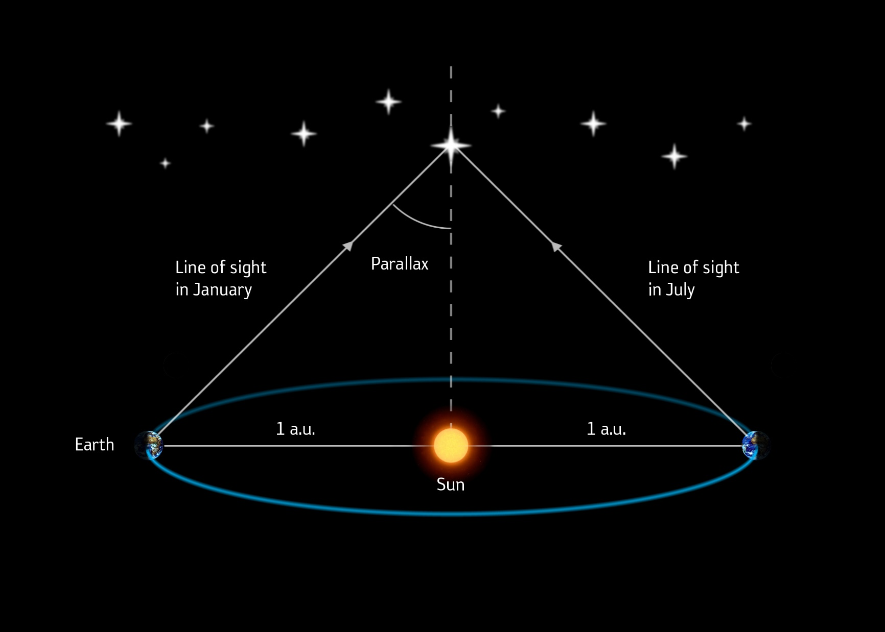
Parallax - measuring distances to nearby stars

Slide 18
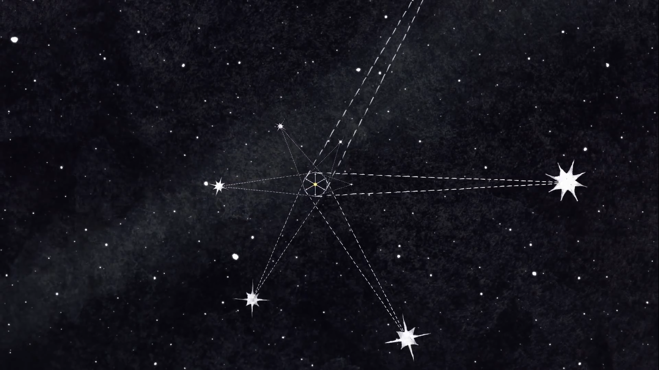
We Use Parallax Only
We use Trigonometric Parallax for object, which are very Close

Slide 19
use for objects which are 100 light year or more

Slide 20
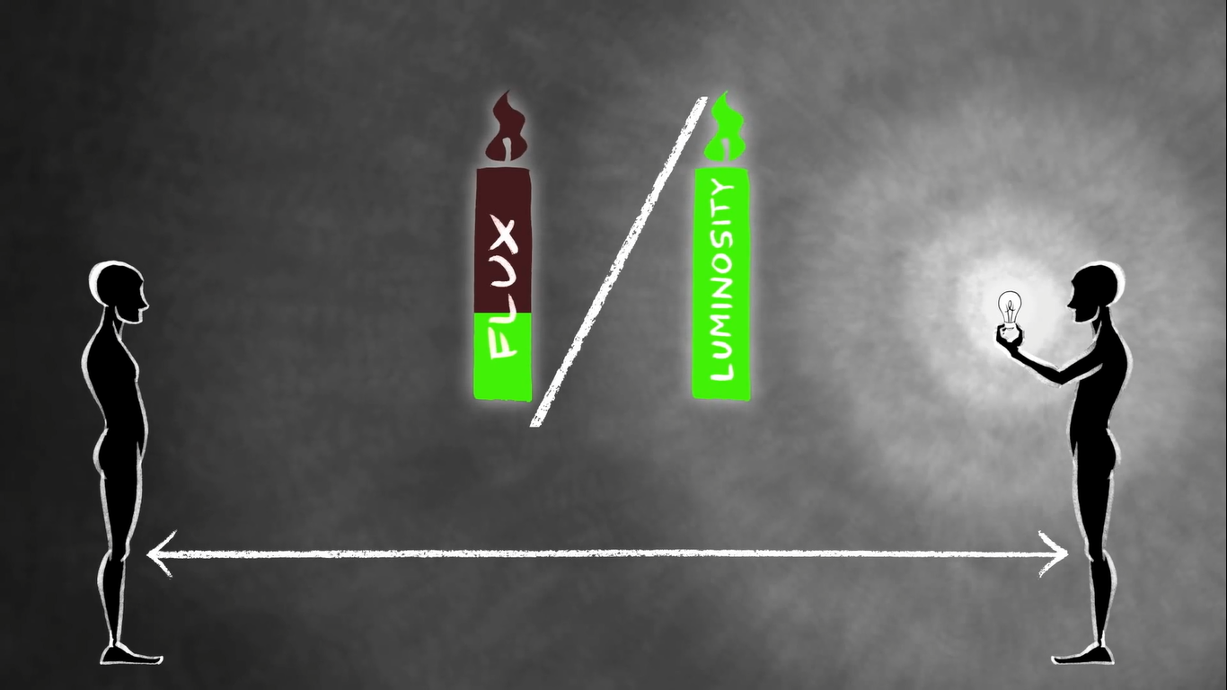
How To Measure Distance By Luminosity?

Slide 21
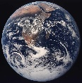
How to measure Distance by Luminosity?
b = ΔE / (Δt*4πR²)
ΔE
L = ——
Δt
Where
L – Radiated energy in the time’s unit
ΔE – Radiated Energy
Δt – Time’s Unit
b = L / (4πR²)
R² = L / (4πb)
Where
L – Radiated energy in the time’s unit
ΔE – Radiated Energy
Δt – Time’s Unit
b – Radiated energy in the time’s unit on unit of area
R
●

Slide 22
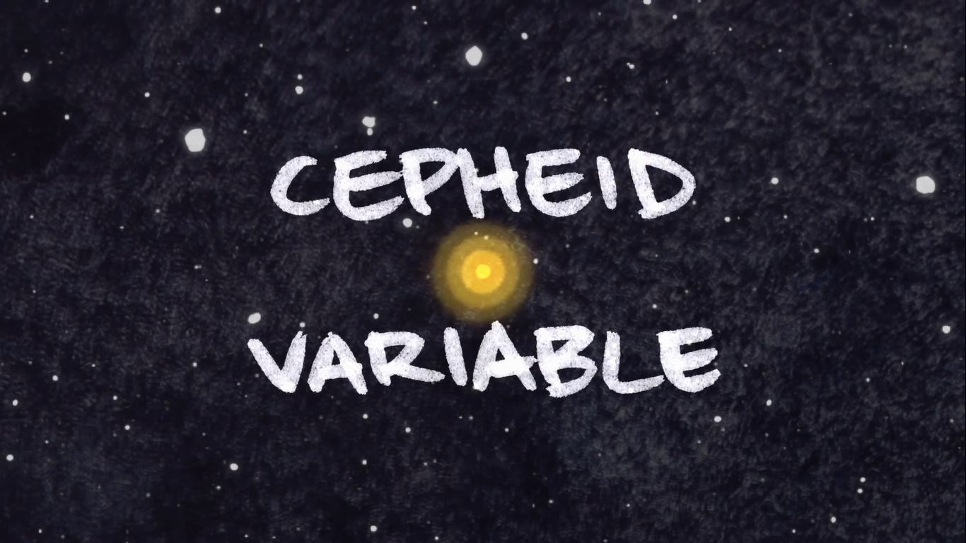
Special stars called – Cepheid variable

Slide 23
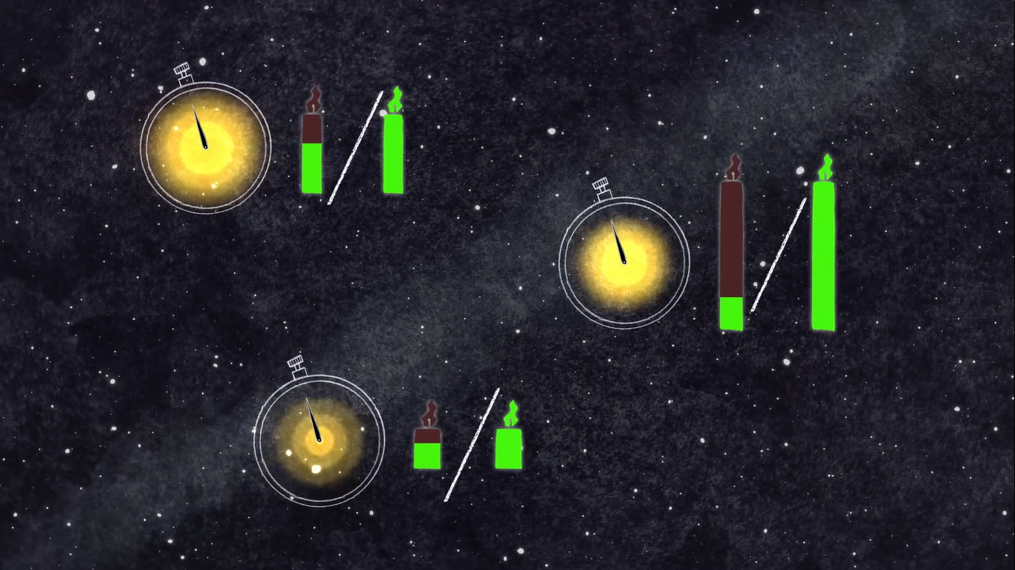
We use period for measure Luminosity

Slide 24
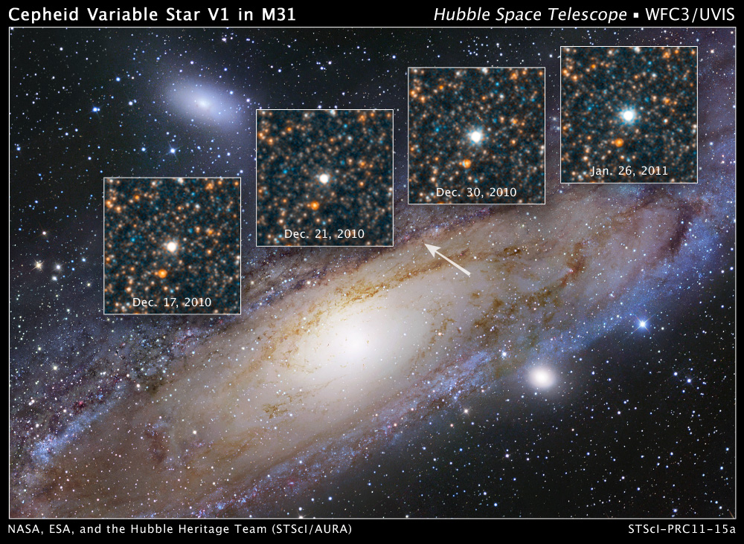
Cepheid Variable Star V1

Slide 25
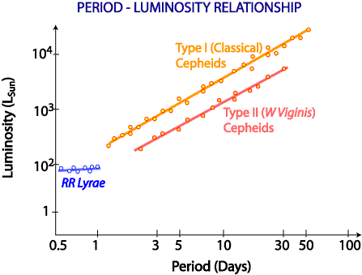
Period – Luminosity Relationship
There is Logarithmic relationship between Period and Luminosity
Log L = log P^{k} + log C
Log L = log C * P^{k}
L = C * P^{k}

Slide 26
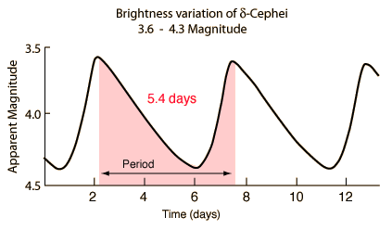
Brightness Variation of ð Cepheid

Slide 27
Experiment
10:00 pm
04:00 am

Slide 28
Experiment
10:00 pm
04:00 am

Slide 29
Experiment distance to the moon
57±1 px
32±1 px

Slide 30
Counting α and $\text{ß}$
$\text{ß}$ = 0,009*57 = 0,52
57±1 px
32± 3%
$$α=\text{0.52}\text{o}\frac{\text{57±1}}{\text{32±1}}=0.92\text{o} \text{±}\text{ 5\%}$$
L = R / ( α*57 ) = 6400 / (0,92*57) = 400000 $\text{±}$ 20000
ß
α

Slide 31
Conclusion
We investigated the different methods of distance measurement’s of the open space:
Radar – for planets
Parallax – for objects, which aren’t more than 100 light year away
Standard Candles – for stars, whose Luminosity is known well
Cepheid Variable – for special stars, whose have variable radius
We calculated distance between the Earth and the Moon (by two methods)

Slide 32
● Barbieri, Cesare (2007). Fundamentals of astronomy ● Webb, Stephen (1999), "3.2 Aristarchus, Hipparchus, and Ptolemy“ ● Freedman, W.L. (2000). "The Hubble constant and the expansion age of the Universe". Physics Reports ● Benedict, G. Fritz et al. (1999). "Interferometric Astrometry of Proxima Centauri and Barnard'
References

Slide 33
USED INTERNET SPACE
● https://en.wikipedia.org/wiki/Parallax
● http://ed.ted.com/lessons/how-do-we-measure-distances-in-space/
● http://starchild.gsfc.nasa.gov/docs/StarChild/questions/question39.html
● http://news.discovery.com/space/supernova-cosmos-distance.htm
● https://www.youtube.com/watch?v=Op3AYaJc0Xw
● http://www.universetoday.com/way-to-measure-cosmic-distances/
● http://coolcosmos.ipac.caltech.edu/cosmic_classroom/distance.html

Slide 34
Thanks You For Your Attention
©Giga Khizanishvili

Slide 35
Added Slides

Slide 36
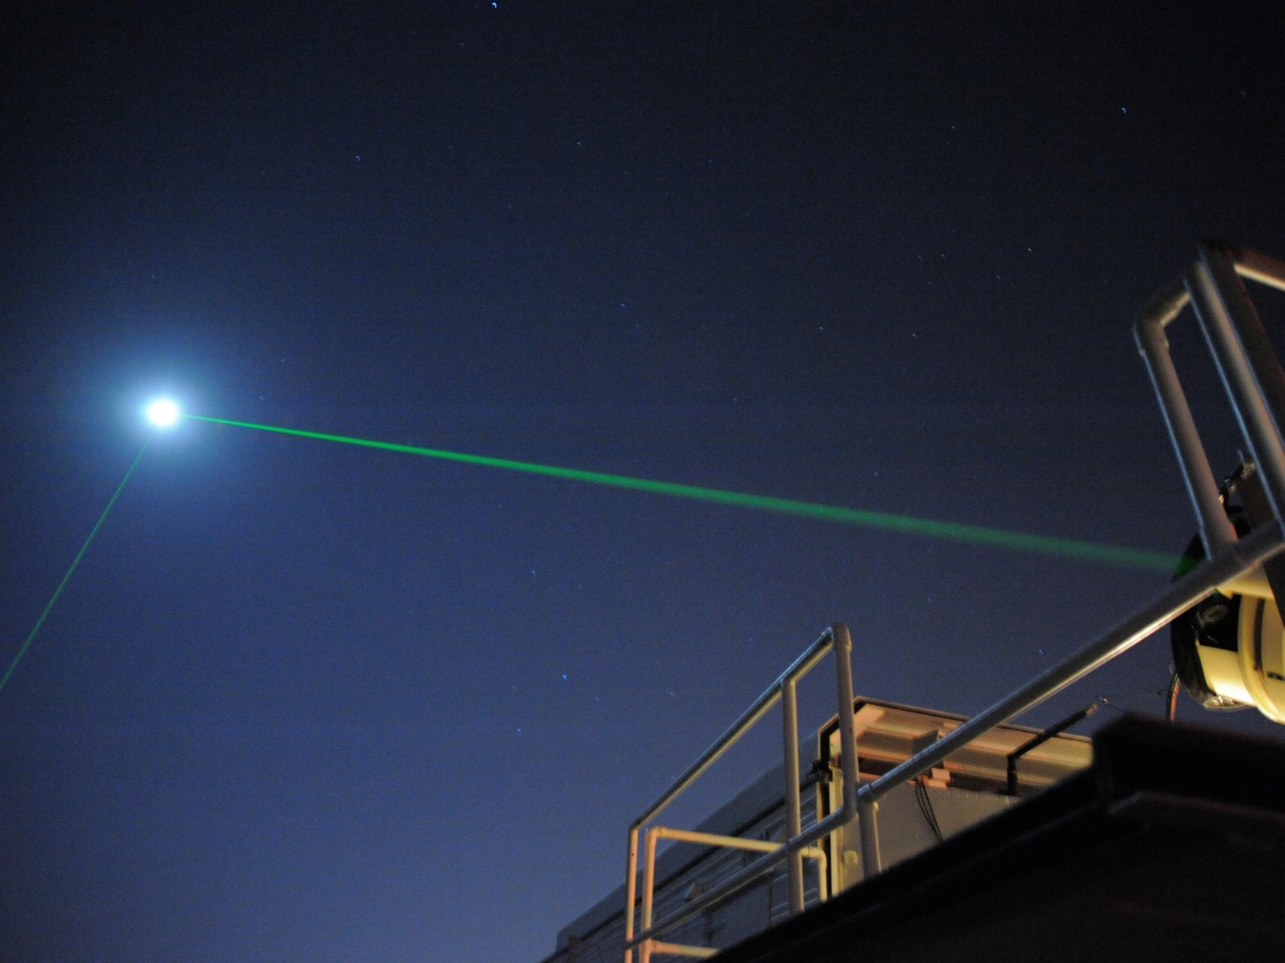
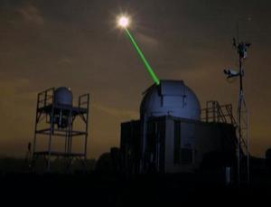
How Measure Distance to Moon

Slide 37
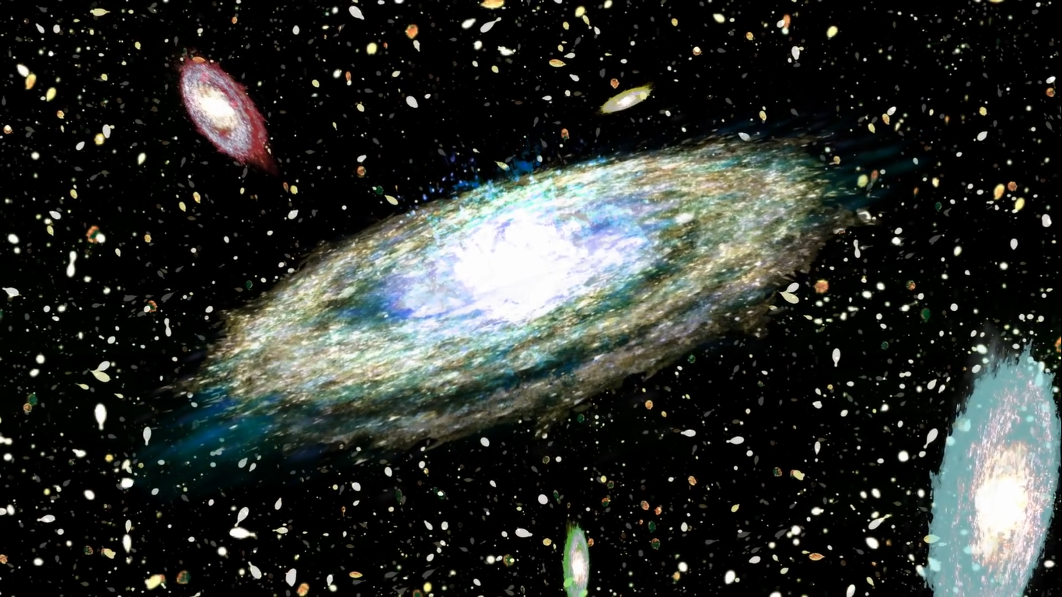
How to Measure Distance Between Galaxies?

Slide 38
We use Supernovae for measure distances between galaxies

Slide 39
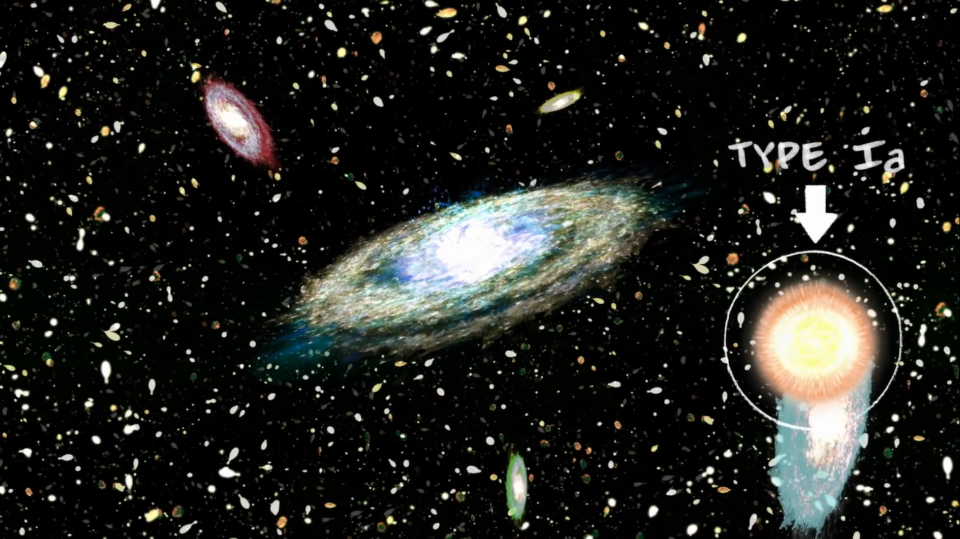
When stars die they bright too much explosion

Slide 40
Parallax
α
α

