Slide 1
Problem №14
Galton box
Reporter – Toma Rtveliashvili
Team - Georgians

Slide 2
Task condition
In the Galton box, a regular 2D lattice of obstacles disperses a thin flow of falling particles. When falling on the bottom of the box, the particles show a normal distribution. Use various types or particles and different arrangements of the obstacles to find the conditions when the distribution is no longer normal

Slide 3
Plan
About galton box
Normal distribution
Experiments
Abnormal distribution
Comparison of experiments
Conclusion

Slide 4
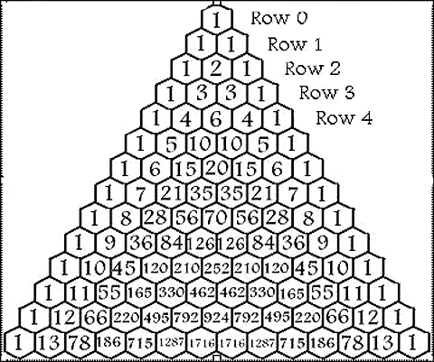
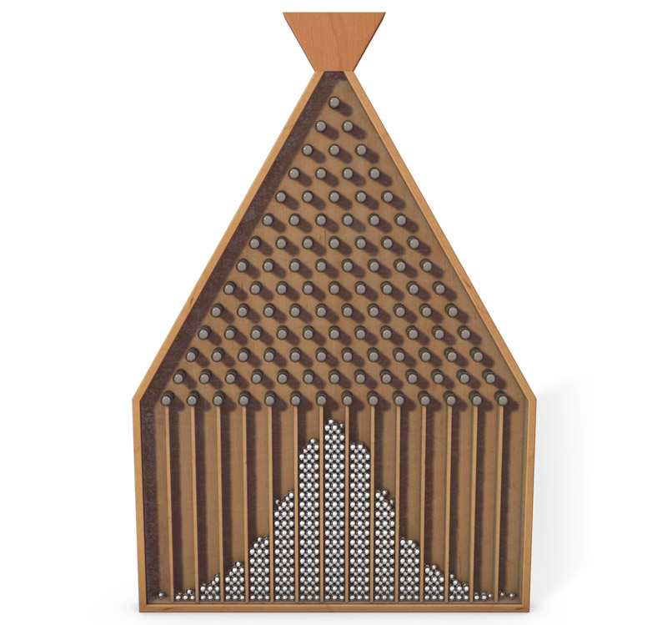
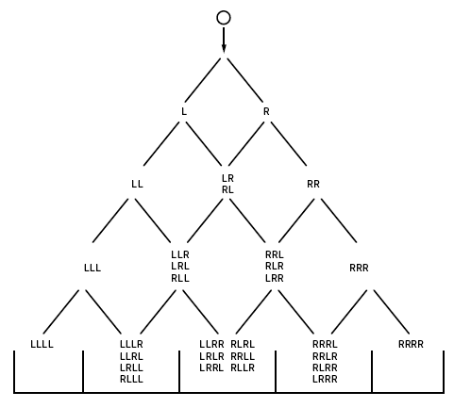
Galton box/board (quincunx)

Slide 5
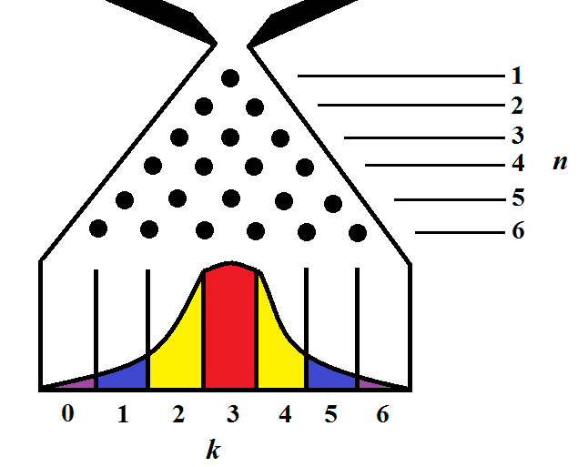
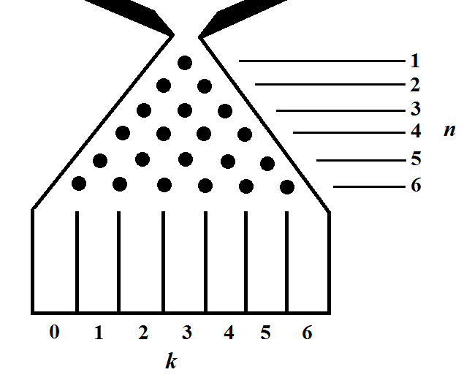
Normal distribution
$C_{n}^{k}$*$q^{k}∗{(1−q)}^{n−k}$- probability, that the
ball ends up in the kth bin
k – quantity of bouncings right side
n – quantity of all the rows
q – probability, that the ball bounces right side
$C_{n}^{k}$ - binomial coefficient, quantity of all the ways by which ball ends up in kth bin

Slide 8
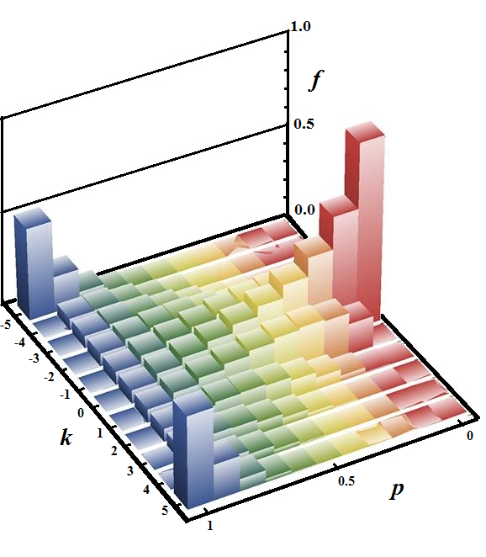
Abnormal distribution
n= k=
Induction basis - $f\left(0, a\right)=δ_{0a}$
Kronecker Delta: $δ_{ij}≡$ $\left\{\begin{aligned}1 if i=j \\ 0 if i≠j\end{aligned}\right\}$
In case of bouncing from the top
$$f\left(n,k\right)=p∗f\left(n−1, k−1\right)+\left(1−p\right)∗f\left(n−1, −k−1\right)$$
$$g\left(n,k\right)=\frac{1}{2}\left(f\left(n−1, k−1\right)+f\left(n−1, −k−1\right)\right)$$
$f\left(n,k\right)$ - probability of finding the ball in a position, which is separated by k units in the direction of last move (after n steps)
$$\text{g}\left(n,k\right)\text{ − }\text{probability} \text{of} \text{falling} \text{down} \text{in} \text{k}\text{−}\text{th} \text{bin} \text{after} \text{n} \text{steps}$$

Slide 9
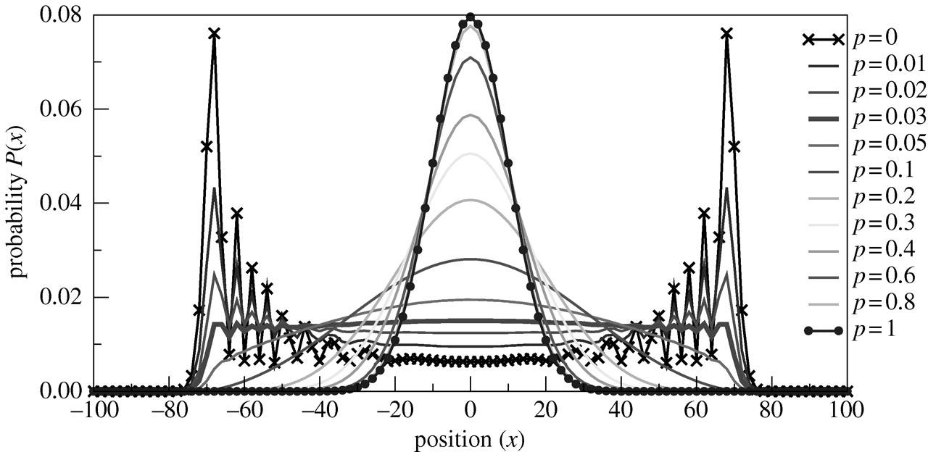

Slide 10
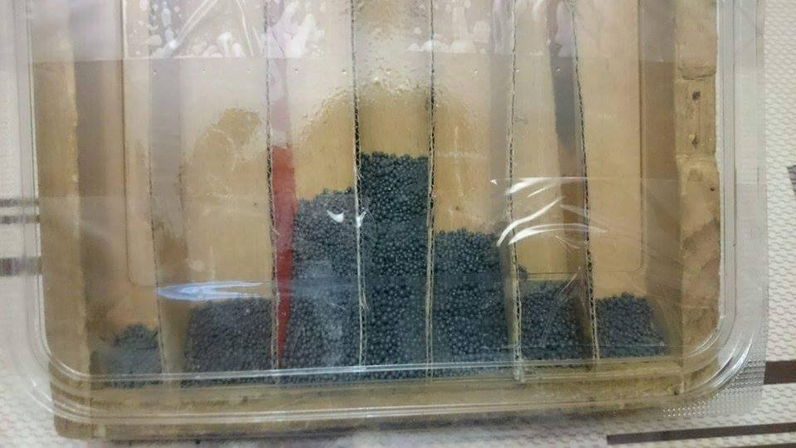
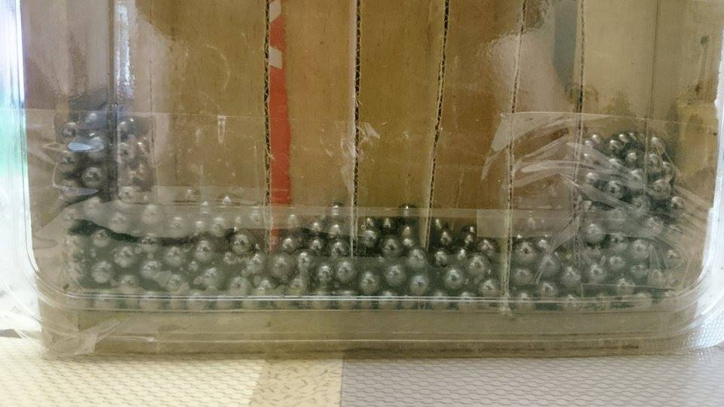
Experiments
$$\frac{V_{1}}{V_{2}}=\frac{1}{12}$$
$$V_{1}$$
$$\frac{p_{1}}{p_{2}}=\frac{0,2}{0,9}$$
$$V_{2}$$

Slide 11
References
Galton, Sir Francis (1894). Natural Inheritance. Macmillan. pp. 63f.
Chepelianskii, A. D. and Shepelyansky, D. L. Phys. Rev. Lett. 87, 034101-1, 2001.
Galton, F. Natural Inheritance. New York: Macmillan, 1894
Hoover, W. G. and Moran, B. Phys. Rev. A 40, 5319, 1989.
Lue, A. and Brenner, H. Phys. Rev. E 47, 3128, 1993.
Moran, B. and Hoover, W. G. J. Stat. Phys. 48, 709, 1987.

Slide 12
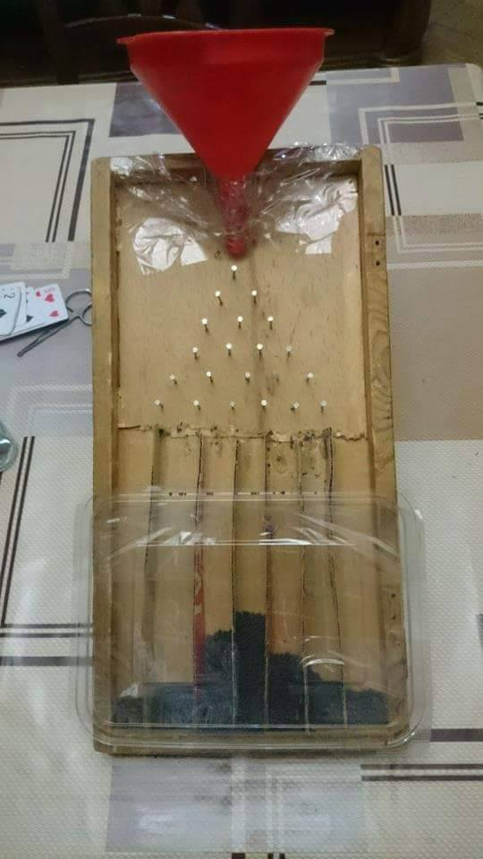
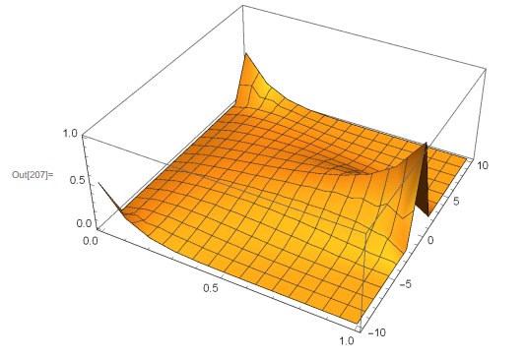
Conclusion

Slide 13
Thanks For Attention

