Slide 1
Reporter: Mate Sharvadze
13. Shining orbs
Team: Georgians

Slide 2
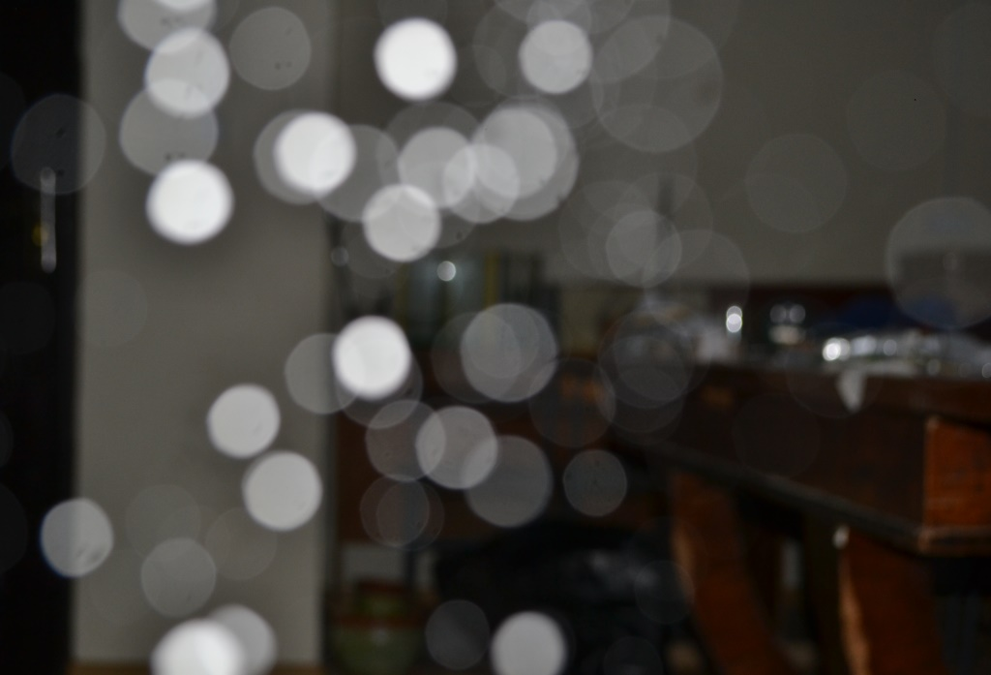
Formulation of the problem
13. Shining orbs bright and rather unexpected white disks may appear in a photo taken with a flash in a dark room. Explain why such shining orbs appear in the photos.

Slide 3
Plan:
1) Basic idea:
a. Explaining why orbs appear
b. Conditions for “Shining orbs”
c. Calculation of orbs' size
2) Parameters of a camera
a. Discuss camera
b. Diaphragm
3) Characteristics of specks
a. size
b. shape
c. color

Slide 4
Explanation
Flash
Shoot object
Light
F
F
Speck
Blind zone
Camera

Slide 5
Conditions for Shining orbs:
Specks in air
Using a flash light
Specks out of focus
Dark space

Slide 6
Specks in air
No dust
With chalk dust

Slide 7
Using a flash light
No Flash
With Flash

Slide 8
Specks out of focus
Out of focus
Closer to focus

Slide 9
Dark space
Only flash light
Light bulbs’ & flash light

Slide 10
Calculation of orb’s size
x
D
R
F
F
L

Slide 11
Calculation orb’s radius
R is orb’s radius
l is the distance from lens to shoot object
$$R=D\frac{F\left(l−x\right)}{x(l−F)}$$
x is the distance from lens to speck
F is lens focus
D is diaphragm radius

Slide 12
II. Parameters of camera
1) Discuss camera
2) Diaphragm

Slide 13
Camera
ISO
Shutter speed
Focal length
F-stop number

Slide 14
$$\text{d}\text{iaphragm}\text{(}\text{aperture}\text{)} \text{diameter}\text{ = }\frac{\text{focal} \text{length}}{F_{\text{stop} \text{number}}}$$
$$R=D\frac{F\left(l−x\right)}{x(l−F)}$$
For investigate we can change f/stop number and distance between camera and speck!

Slide 15
Experimental setup

Slide 16
Photos from experiments

Slide 17
Experimental calculation
D

Slide 18
The orb’s radius against the diaphragm radius
R, Pixels
$$R=D\frac{F\left(l−x\right)}{x(l−F)}$$
D, mm

Slide 19
Specks characteristics
Size
Distance from
lens to speck
color
Shape

Slide 20
Size
The size of the speck is influence on intensity
of the orb:
I ~ d
I is intensity of the orb
2
d is speck diameter

Slide 21
Size
Smaller chalk dust
Bigger chalk dust

Slide 22
Distance from lens to speck

Slide 23
Ghost radius against the distance from lens to speck
R, pixels
X, mm

Slide 24
Different Shape and color of orb

Slide 25
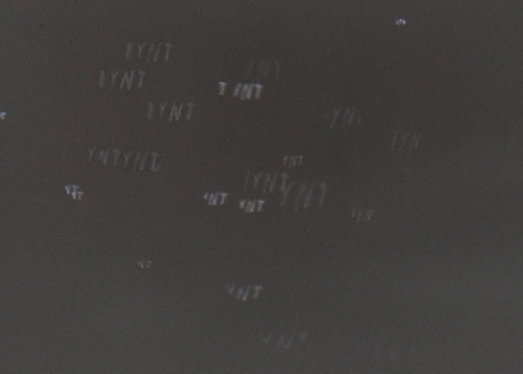
IYNT

Slide 26
Batman

Slide 27
Summary:
We have explained the phenomenon of
appearing Shining orbs and it’s conditions
We have found the radius of shining disk
We have found how do the parameters of a
camera influence on Shining orbs
We have changed the characteristics of the speck and we have investigated it’s influence on the orbs shining
We have changed shape and color of orbs

Slide 28
References
https://en.wikipedia.org/wiki/Lens_flare
https://en.wikipedia.org/wiki/Bokeh
http://archive.iypt.org/
https://en.wikipedia.org/wiki/Camera
https://en.wikipedia.org/?title=Diaphragm

Slide 29
Thank you for attention!

