Slide 1
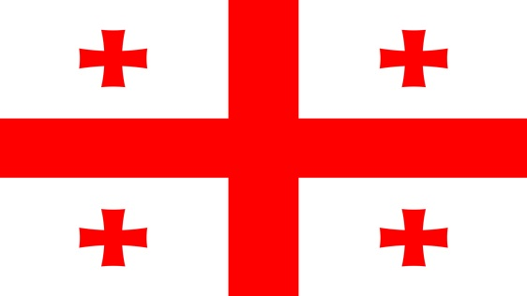
Problem № 12
Structure of a hair
Reporter - Toma Rtveliashvili
Team - Georgians

Slide 2
Task Condition
The hair of various animals may significantly differ in their structure. What are these differences and how can you explain them?

Slide 3
Plan
About hair functions
About hair structure
It’s components
Types of different components of the hair
Functions of each component
Difference between various animals’ (including human) hair
About hair colors and reasons of its variety
About hair textures and reasons of its variety
Experiment
Conclusion

Slide 4
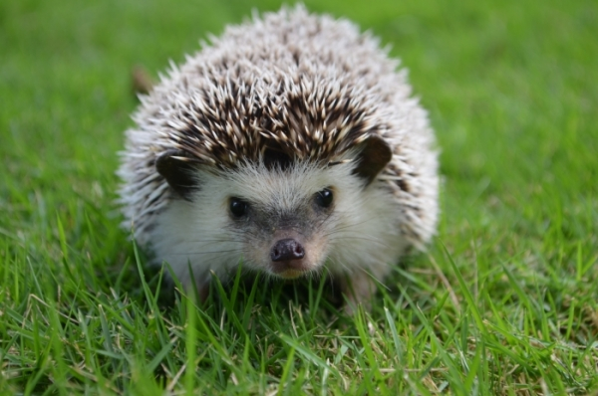
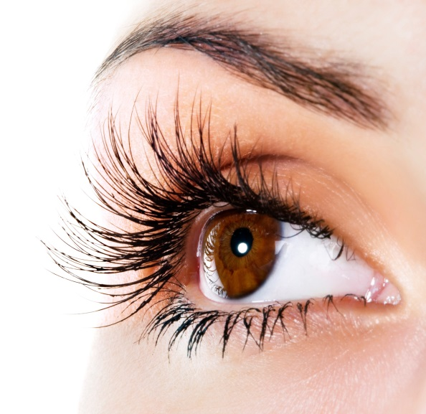
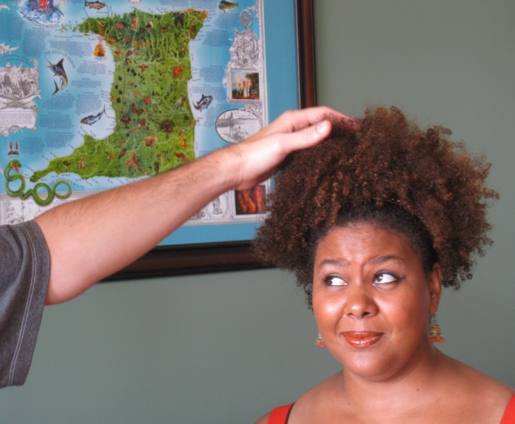
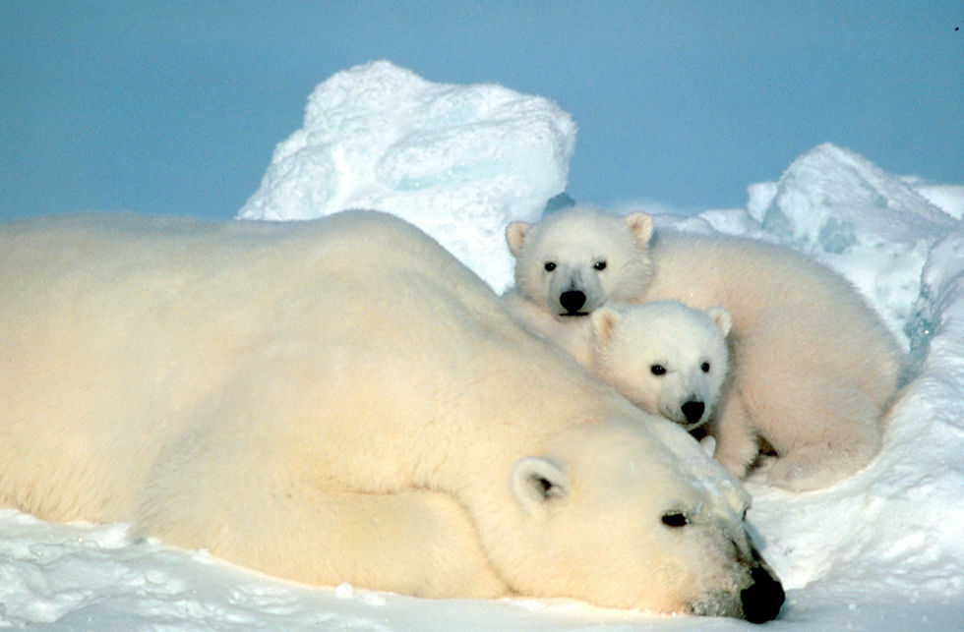
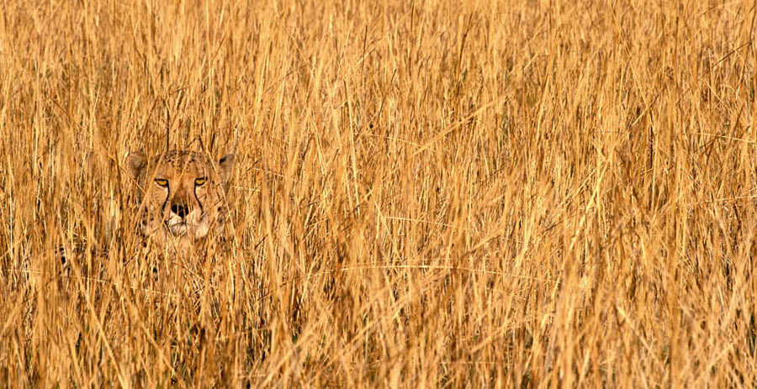
Hair functions
Thermal regulation
Protection
from predators
Protection from dirt, sweat and rain
Camouflage
Touch sense

Slide 5
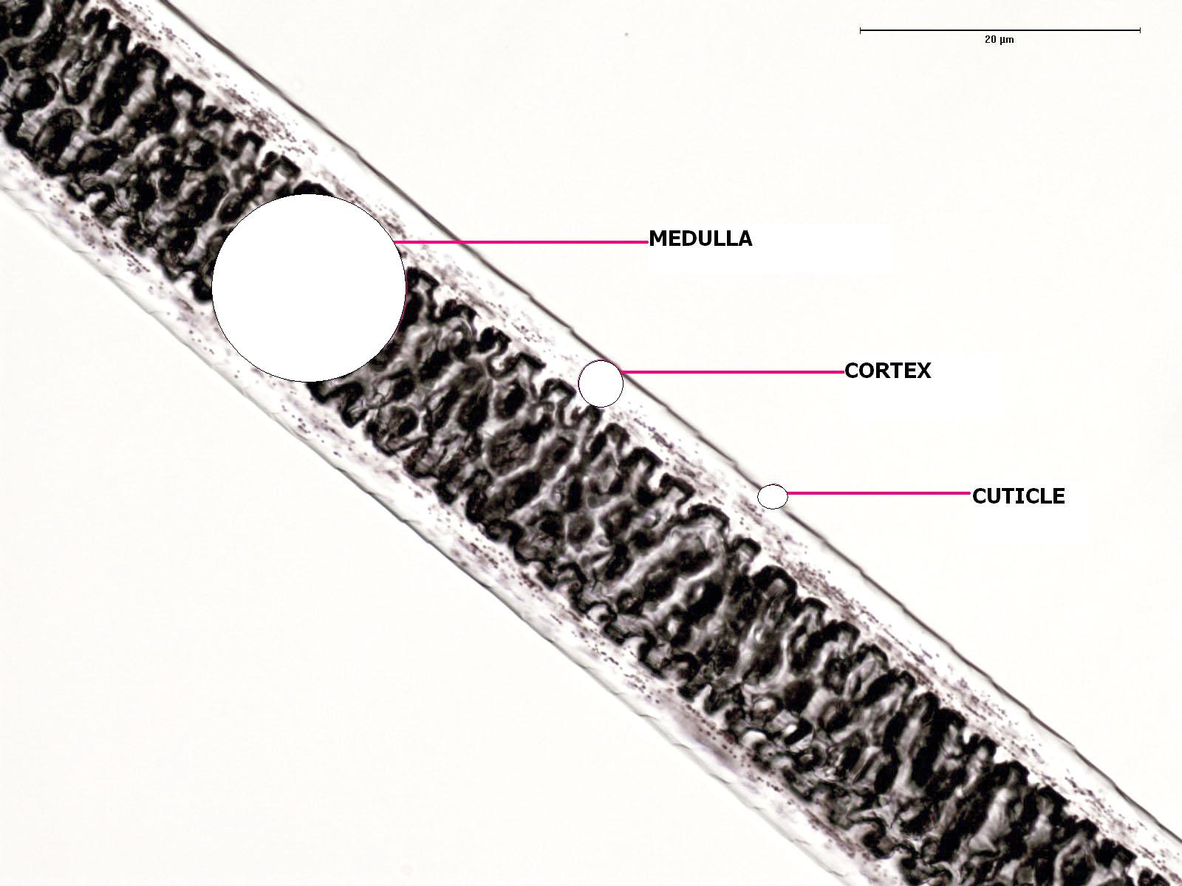
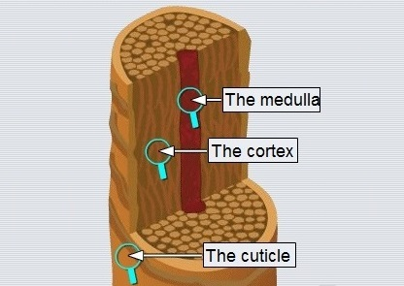
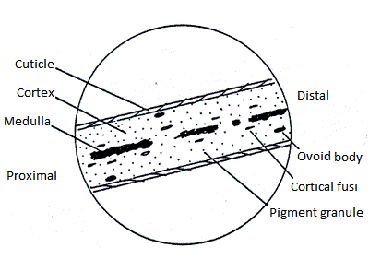
Hair structure

Slide 6
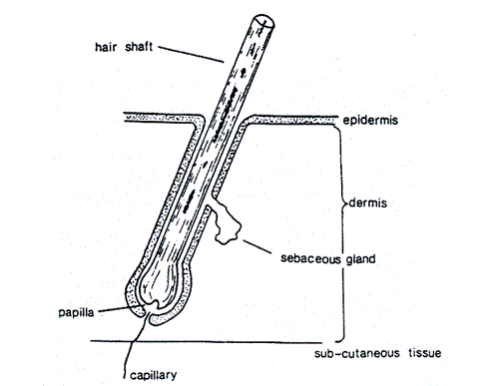
Diagram of hair in the skin

Slide 7
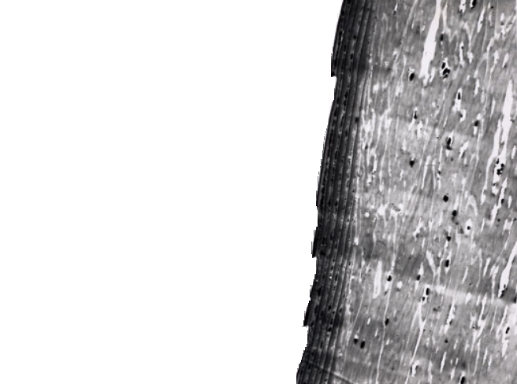
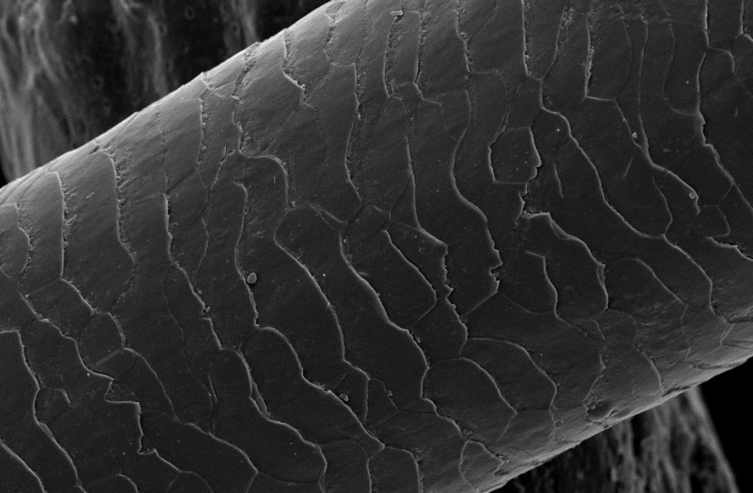
Electron Photomicrograph of Hair
Distal
Proximal

Slide 8
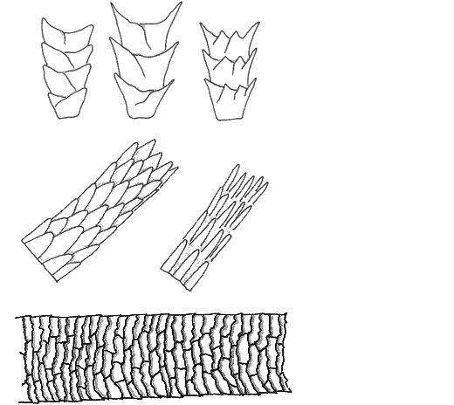
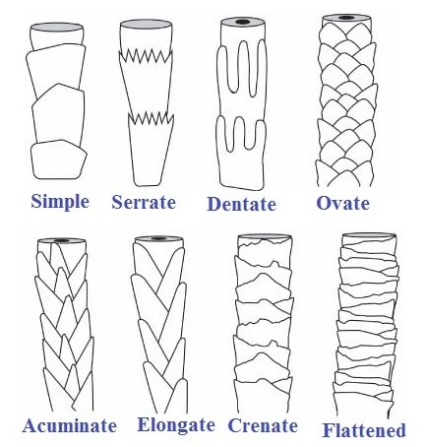
Types of cuticle
Combinations of these types
coronal (crown-like)
spinous (petal-like)
imbricate (flattened)

Slide 9
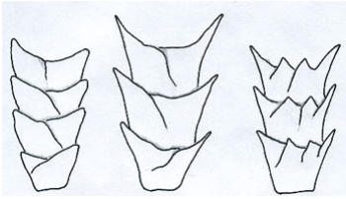
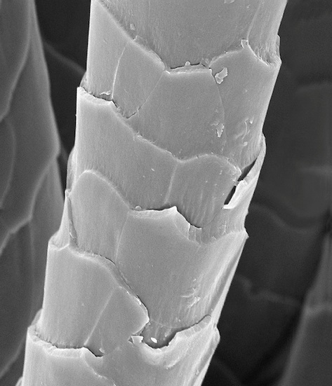
Coronal scale

Slide 10
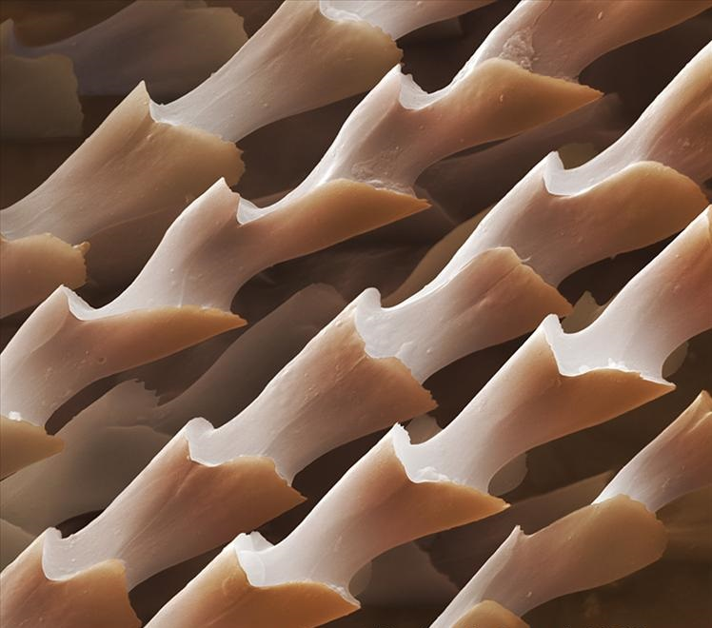
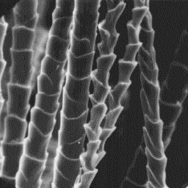
Cuticle of bat’s hair

Slide 11
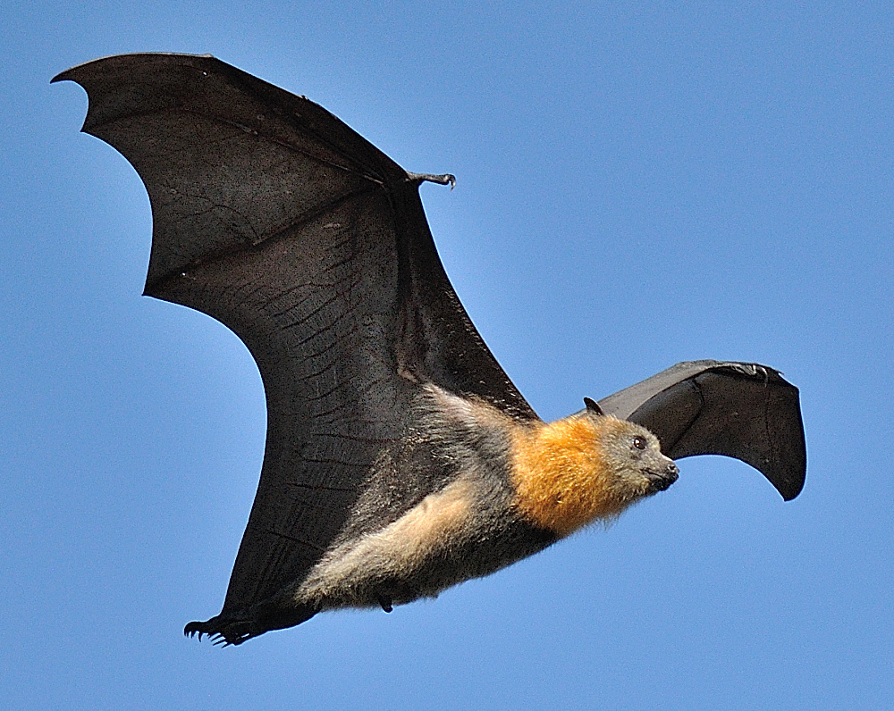
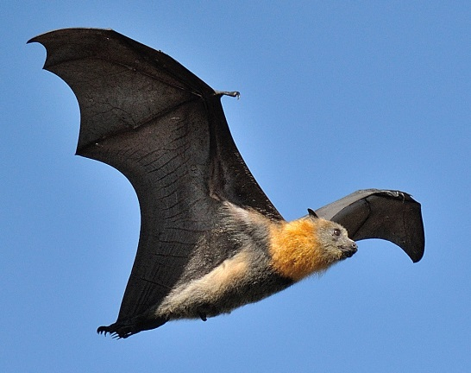
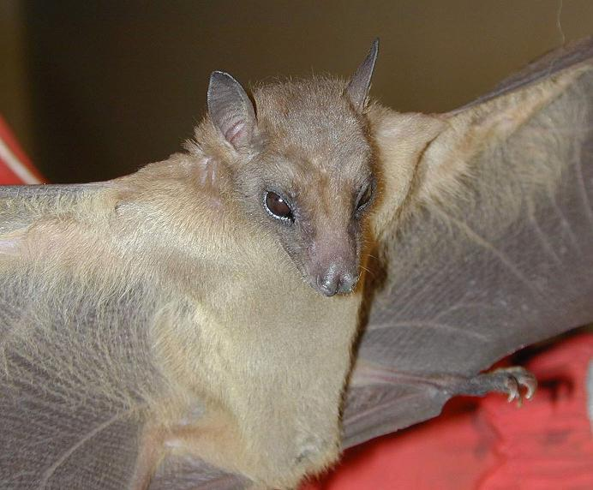
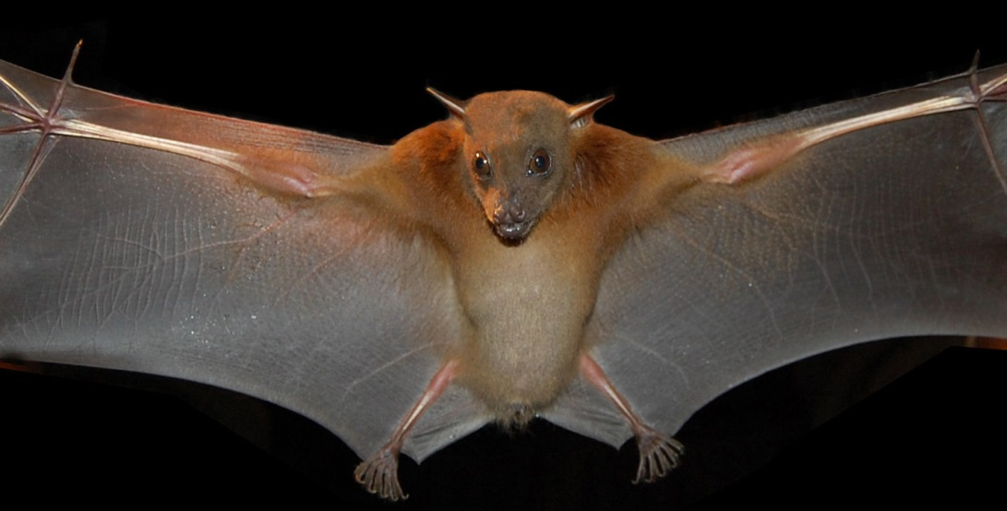
Pteropus giganteus
Rousettus leschenaulti
Cynopterus sphinx

Slide 12
Regions: Dorsal Ventral Neck
P. giganteus
R. leschenaulti
C. sphinx

Slide 13
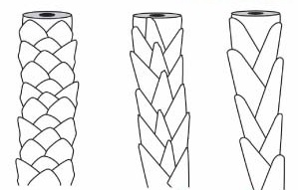
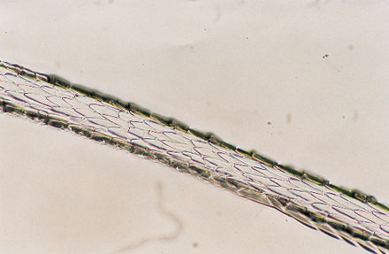
Spinous scale

Slide 14
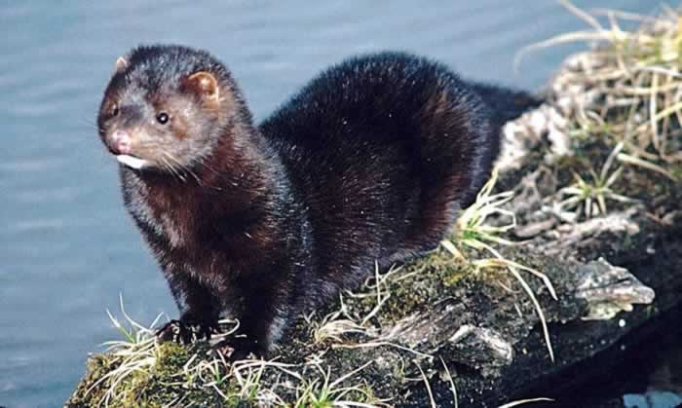
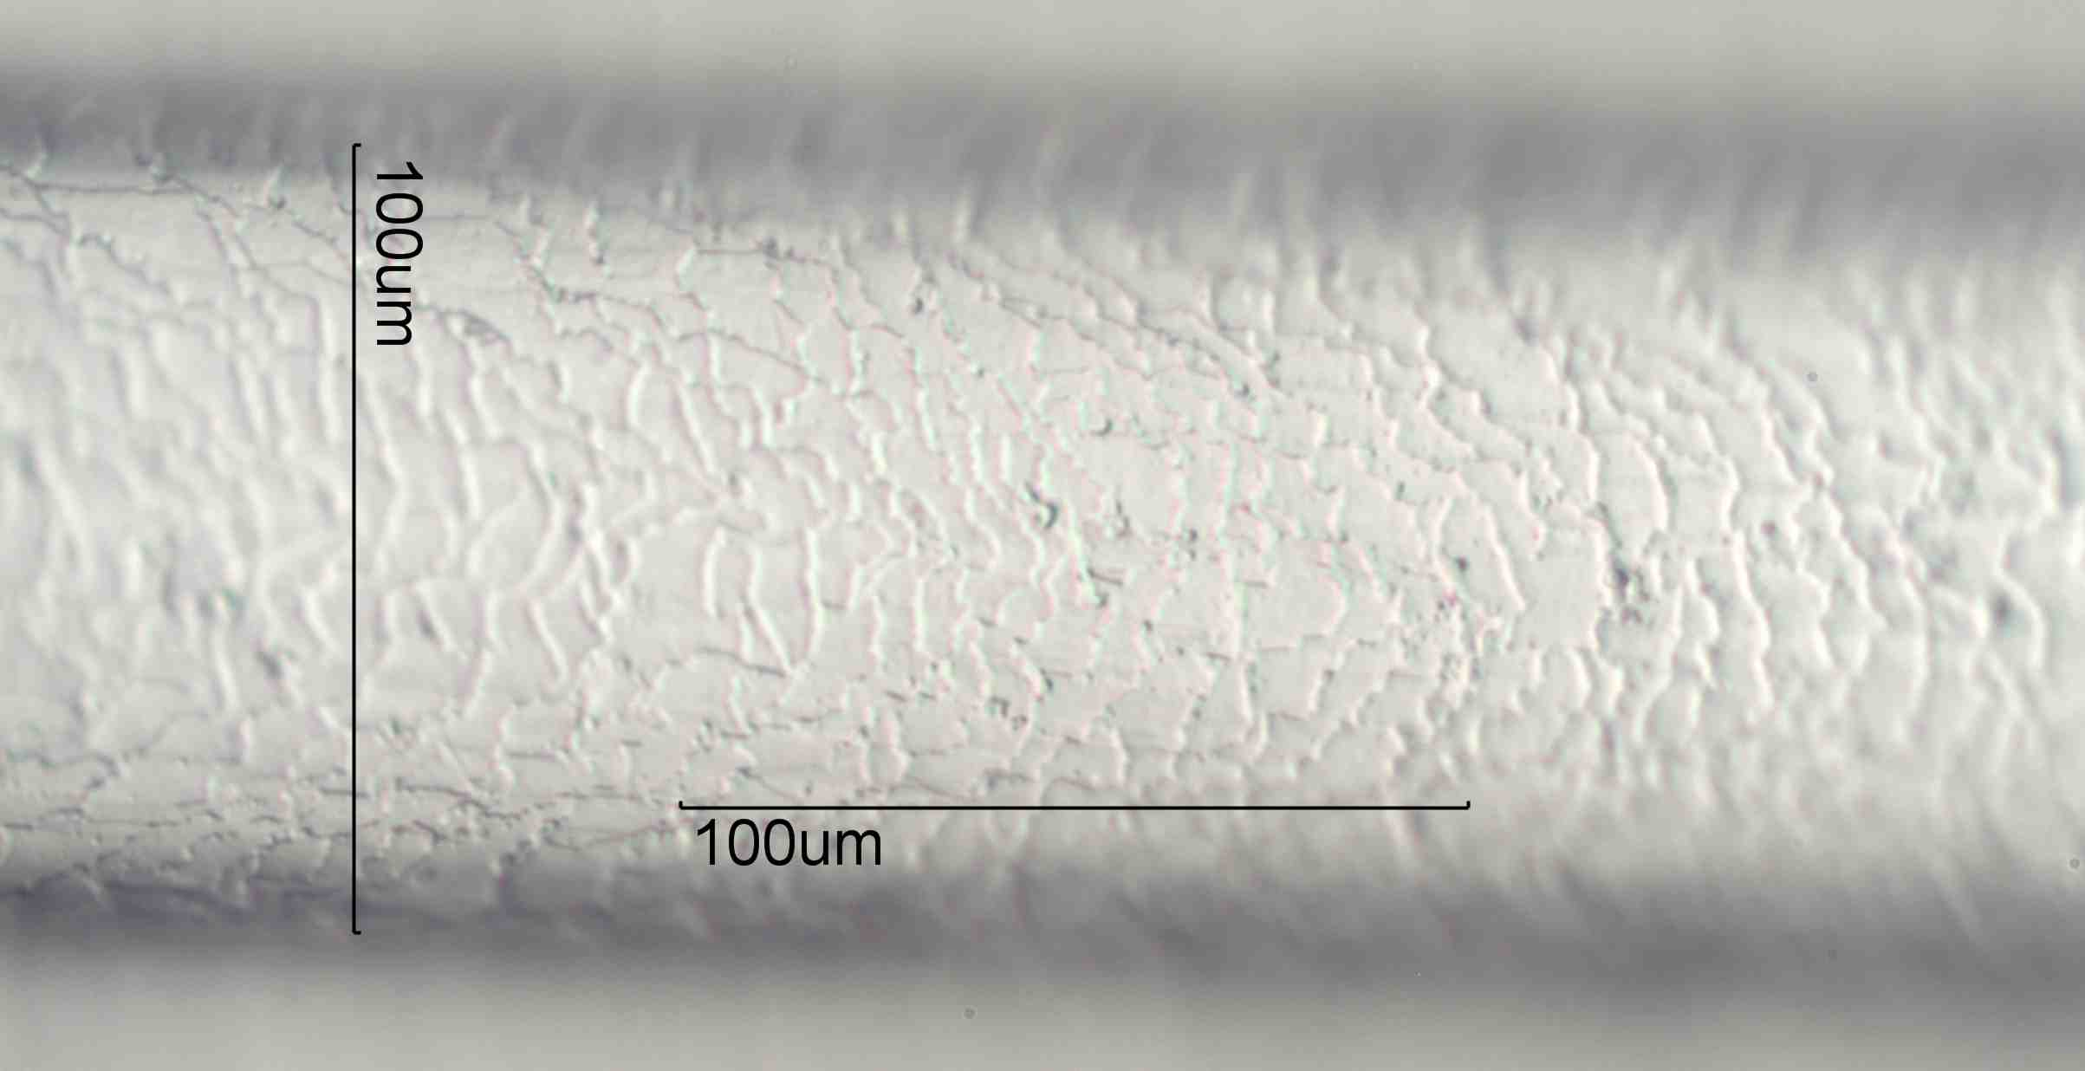
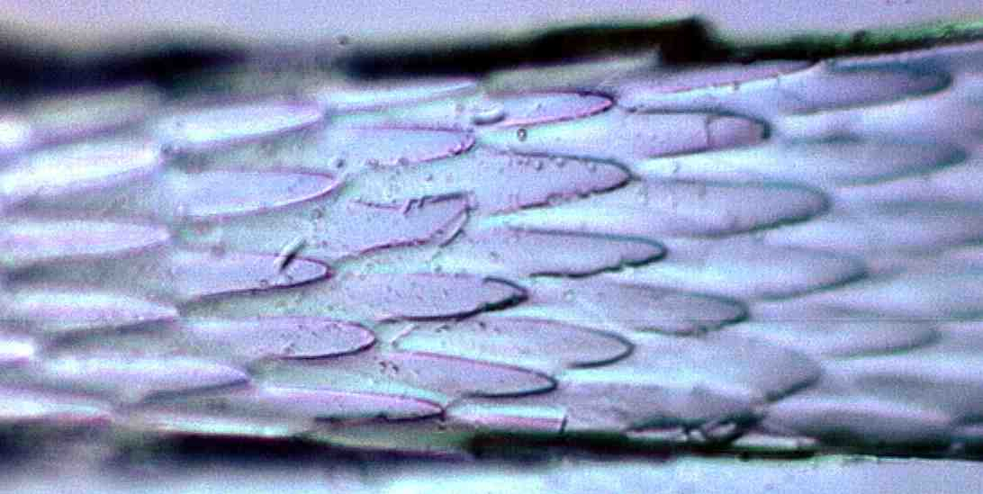
American
mink
Imbricate extreme crenate scale pattern of the thick section of the mink hair
Coronal dentate scale pattern of the first half of the hair from the root

Slide 15
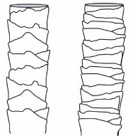
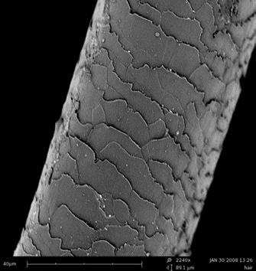
Imbricate scale

Slide 16
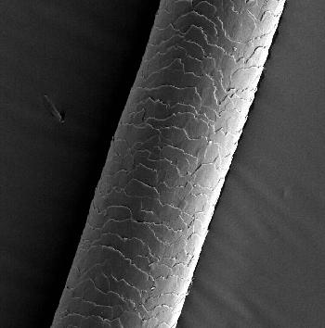
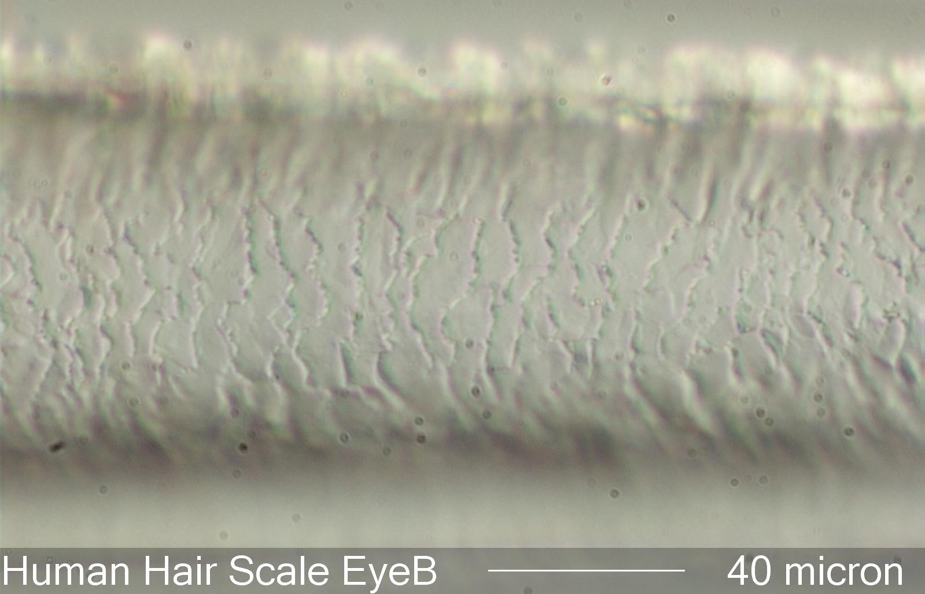
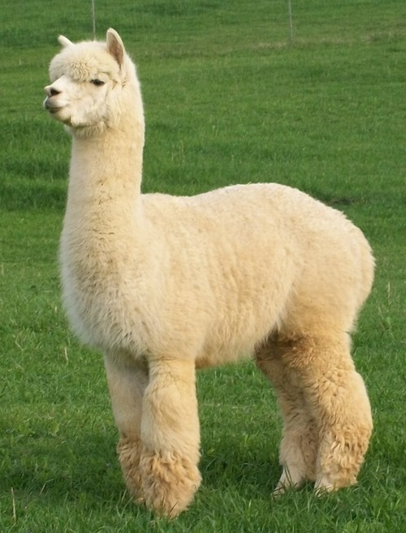
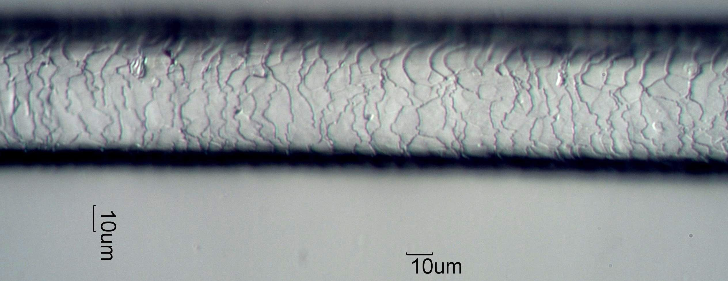
Human
Alpaca

Slide 17
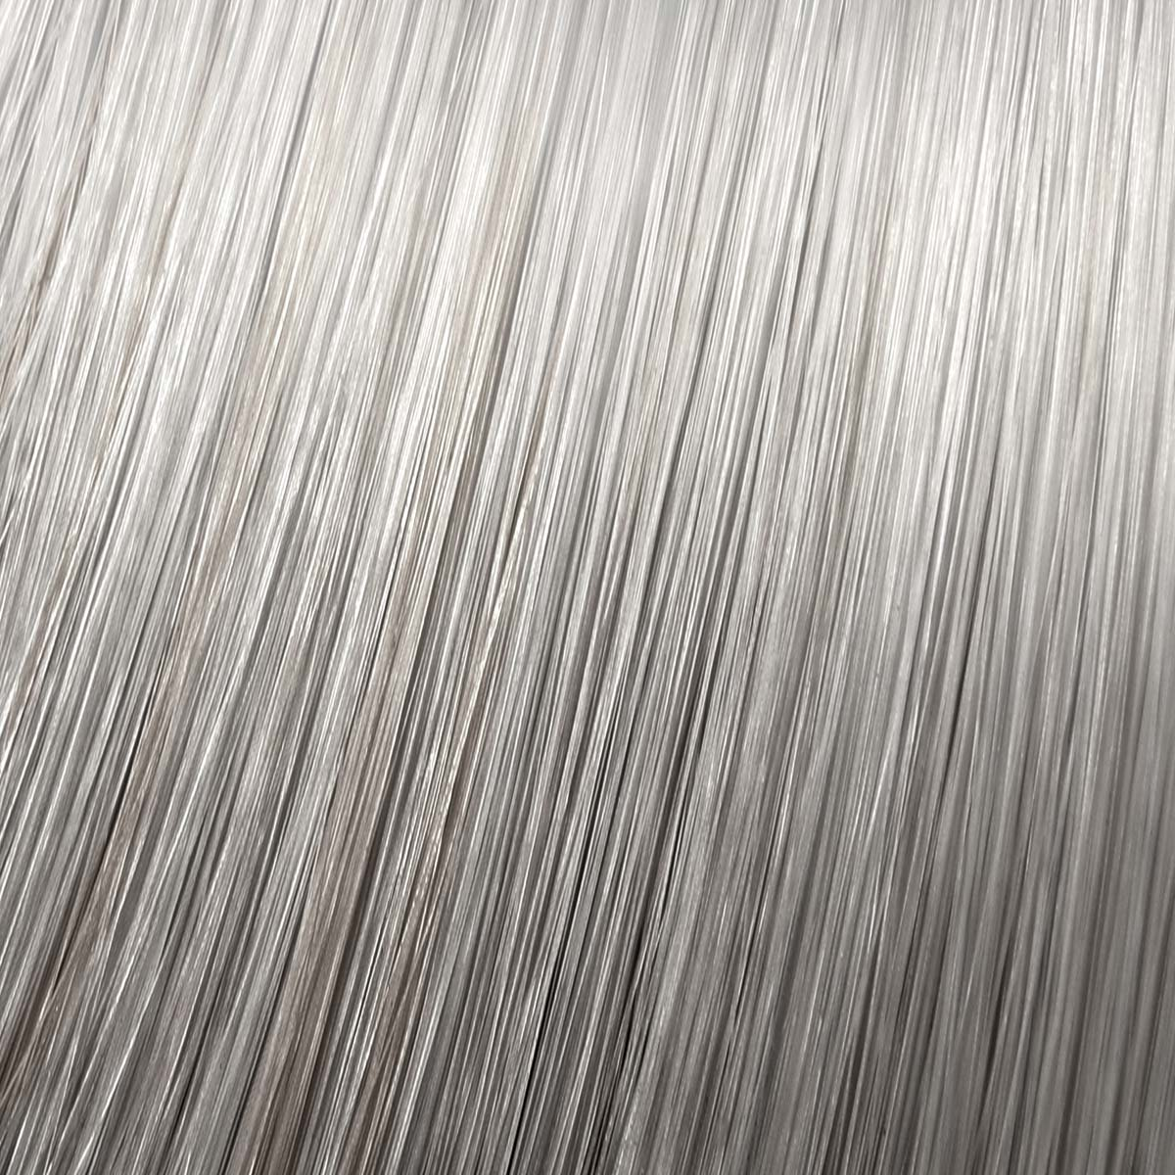
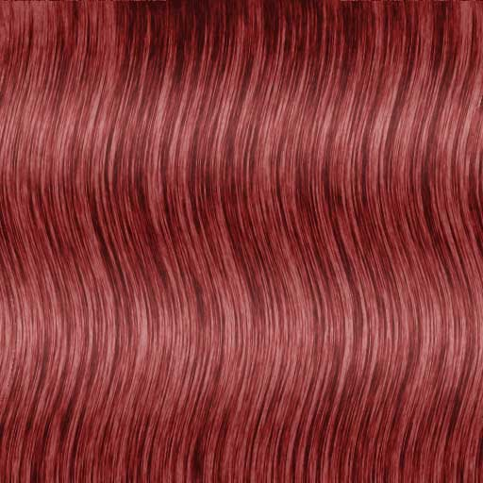
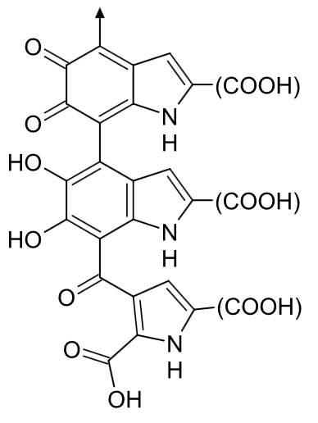
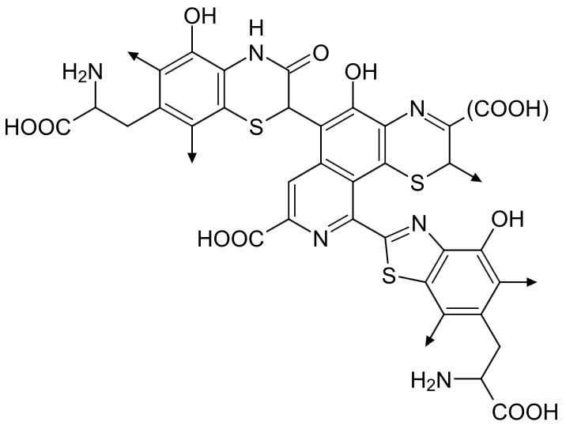
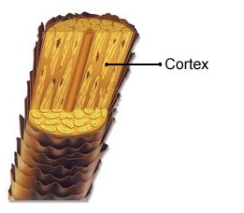
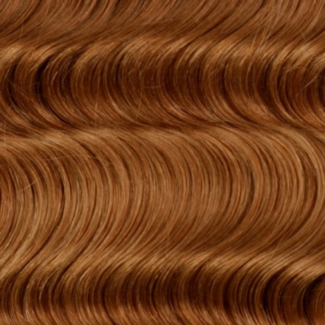
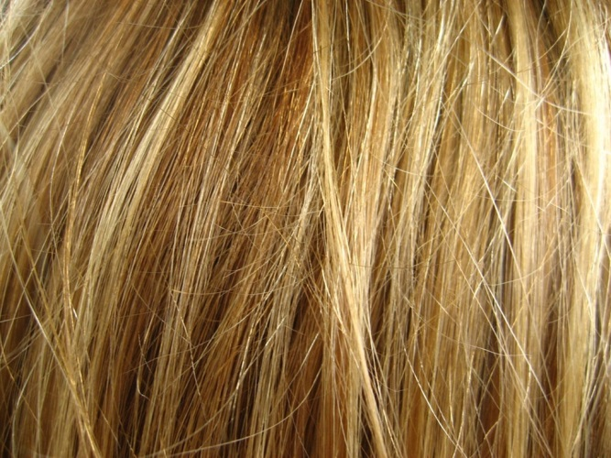
Hair cortex
Eumelanin
Pheomelanin

Slide 18
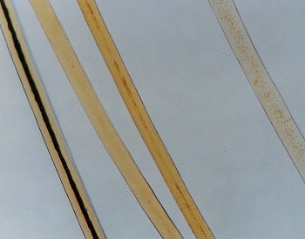
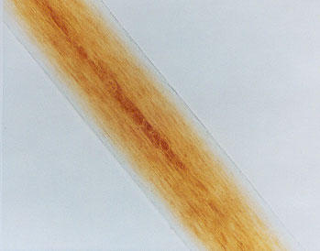
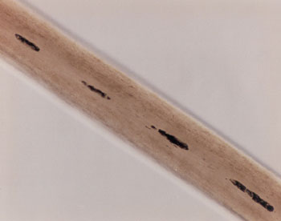
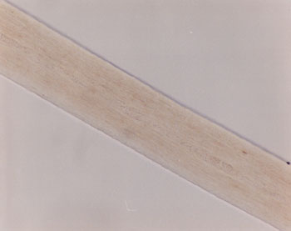
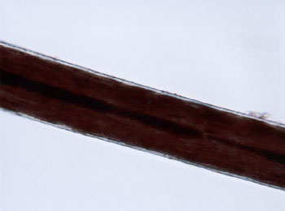
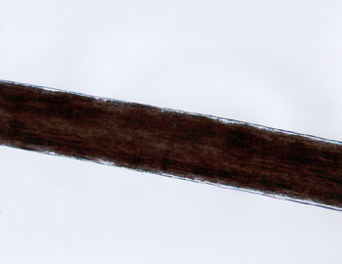
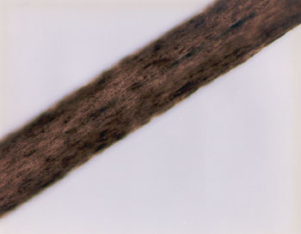
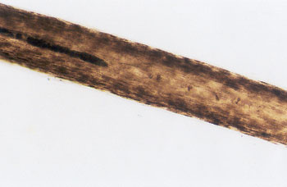
Red hair
Caucasian’s hair
Black hair
Mongoloid
Negroid

Slide 19
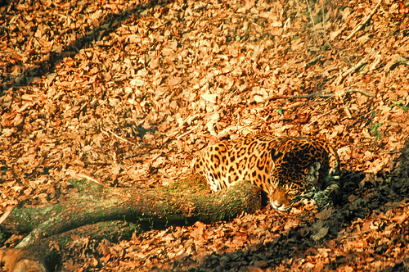
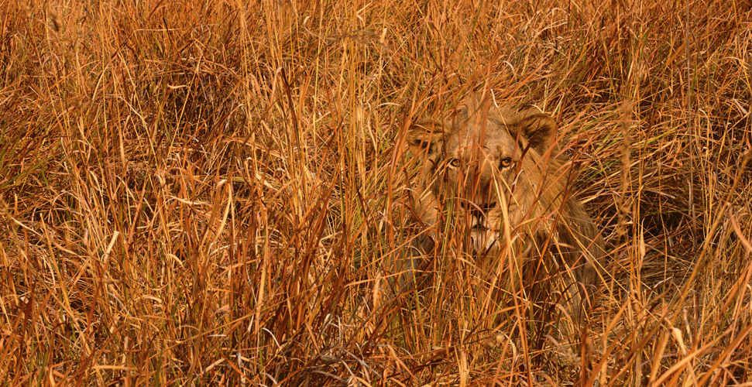
Hair as a camouflage in animals

Slide 21
Hydrogen
Connections

Slide 22
Hair textures
Cross section of hair
Mongoloid
Negroid

Slide 23
3 main amino acids, that are increased in mole’s hair, in comparesion to other animals

Slide 24
Experiment
Water + Hair
Ethanol + Hair

Slide 25
Medulla

Slide 27
References
1) Sherrow, Victoria (2006). Encyclopedia of Hair: A Cultural History. 88 Post Road West, Westport, CT: Greenwood Press. p. iv.
2) Krause, K; Foitzik, K (2006). "Biology of the Hair Follicle: The Basics". Seminars in Cutaneous Medicine and Surgery 25: 2–10.
3) Feughelman, Max (1997). Mechanical Properties and Structure of Alpha-keratin Fibres: Wool, Human Hair and Related Fibres. UNSW Press.
4) Steve Jones, Robert Martin & David Pilbeam, ed. (1994). "The Cambridge Encyclopedia of Human Evolution". Cambridge: Cambridge University Press.
5) Dixson, A.F. Sexual Selection and the Origins of Human Mating Systems. Oxford University Press, USA; 1 edition (2009)

Slide 28
Thanks For Attention!!!

