Slide 1
24. Chemistry
Reporter: Matija Martinčić

Slide 2
Problem
A list of compounds includes CuSO₄, K₂Cr₂O₇, MgCl₂, NaCl. Three of those are in three marked test tubes. Determine the contents of each test tube.

Slide 3
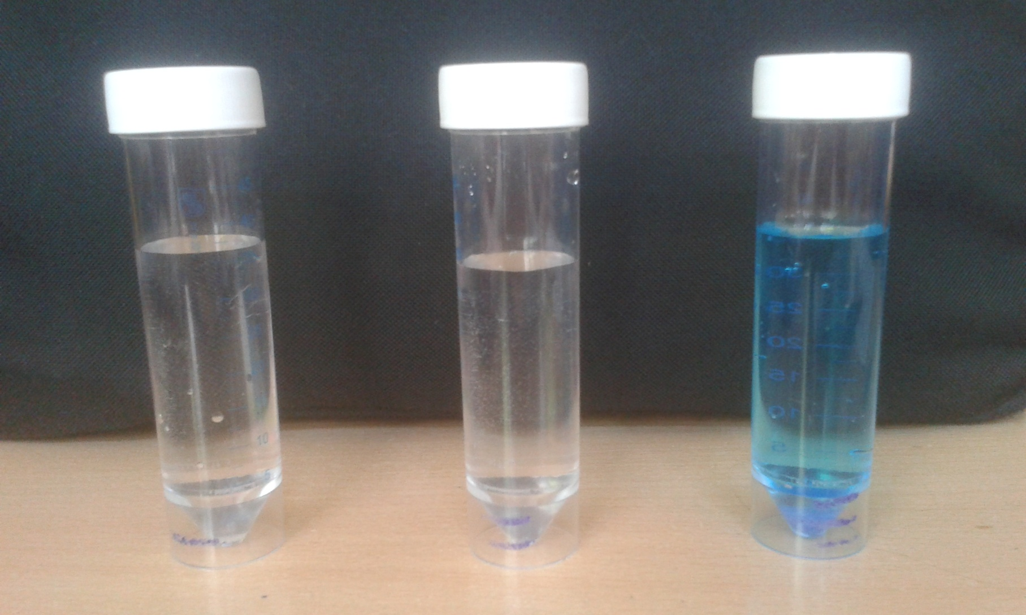

Slide 4
Plan for solving the problem
1. test blue solution by: vapourising water to get blue sediment, heating up sediment to get white sediment, add water
2. Testing first two solutions with flame

Slide 5
Materials
Vials 1, 2 and 3, with solutions
Botle with water
Alcohol lamp
Test tubes
Alcohol
Carbon stick (for pencils)

Slide 6
Vials
Vial number 1 and 2 are colorless solutions, so we firstl need to examine them with the experiments
Vial number 3 had blue solution and blue sediment at the bottom wich we can asume is CuSO₄ * 5 H₂O
There is no orange colored vial, which we asume there is no K₂Cr₂O₇

Slide 7
Hypothesis
Of all four chemicals, we consider that K₂Cr₂O₇ isn’t in the vial since it has characteristic orange color
CuSO₄ is usually blue when combined with water and under influance of fire it will change color to white when the water evaporates
Solution of NaCl in fire will color flame in orange

Slide 8
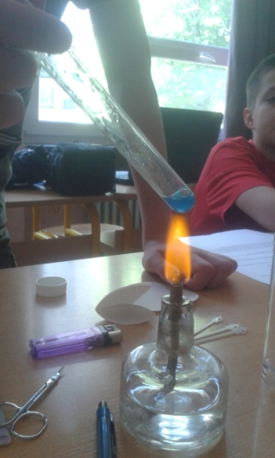
CuSO₄
The experiment was done as expected, and all the water evapourated from the sediment taken from the bottom of the vial, leaving white sediment proving it is CuSO₄
For now our results are that the vial number 3 contains CuSO₄

Slide 9
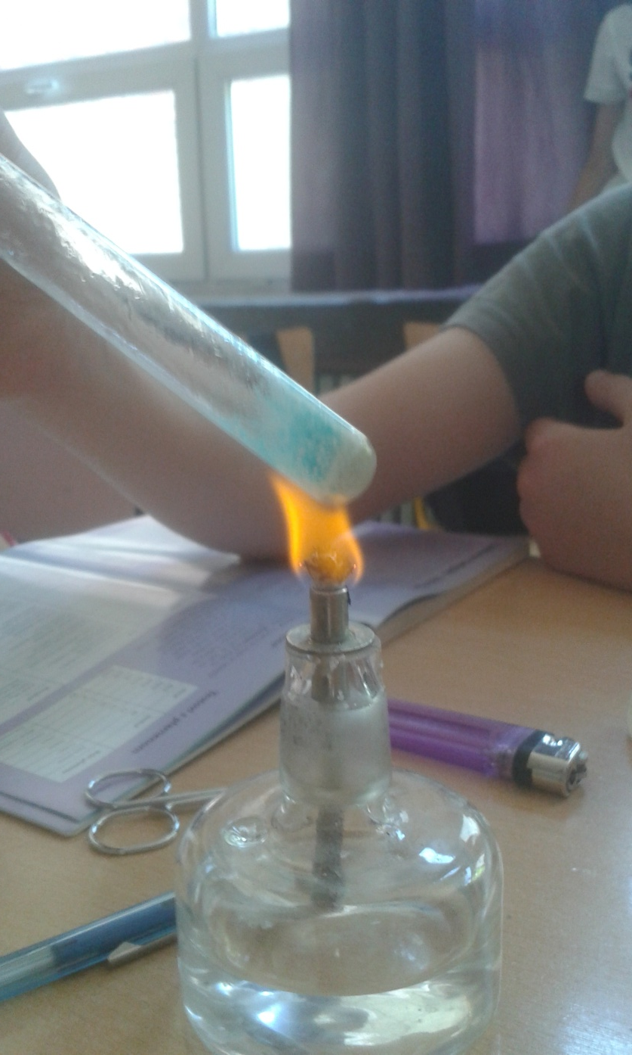
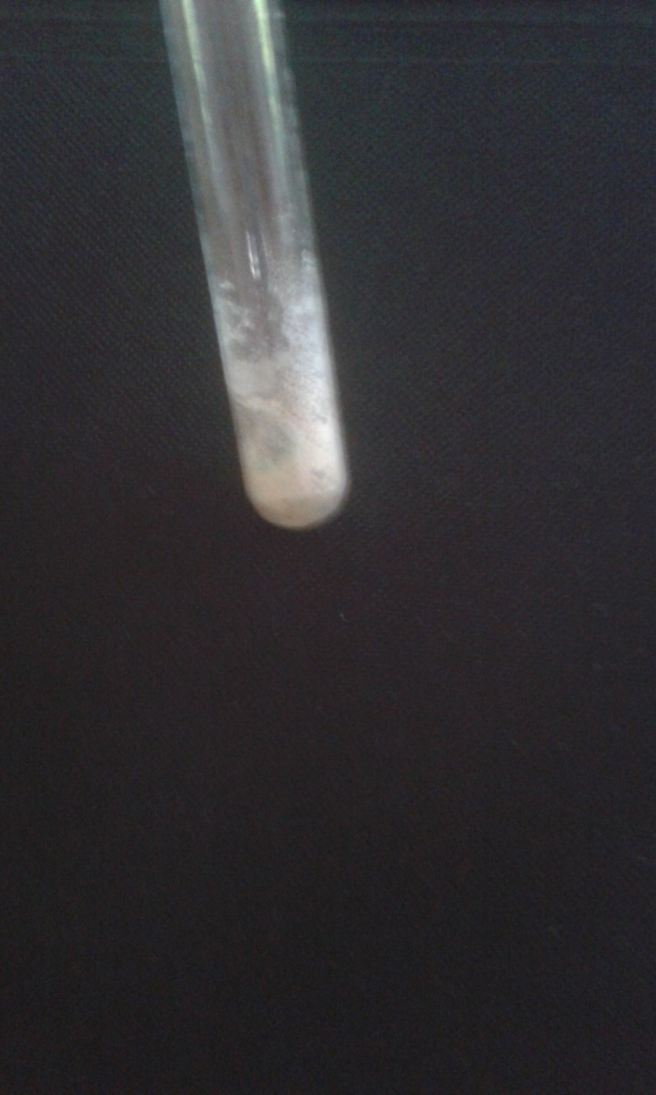

Slide 10
NaCl
The experiment done with the NaCl is proving that by adding a small amount to the fire, we get an orange flame
We have done the experiment and the results were succesful, so we can say that the vial 1 contains NaCl solution

Slide 11
Conclusions
1. vial – NaCl
2.Vial – MgCl₂
3.Vial – CuSO₄
No K₂Cr₂O₇ in vials
Literature: Slikovni rječnik kemije (Ilustrated chemistry glossary)

Slide 12
Thank You for attention!

