Slide 1
8. L I B R A R Y
Tibor Basletić Požar

Slide 2
One person has decided to download all of the fiction existing in the English language
and store it on a single USB stick. He expects to find or generate the respective text files,
compress them, and then index them conveniently. Is this ambition realistic?
Suggest a plan to approach this goal and solve a partial problem of this plan.

Slide 3
One person has decided to download all of the fiction existing in the English language
and store it on a single USB stick. He expects to find or generate the respective text files,
compress them, and then index them conveniently. Is this ambition realistic?
Suggest a plan to approach this goal and solve a partial problem of this plan.
- not so clear how to do it
- legality? free?
- where on internet?
What we did:
- free books: www.gutenberg.org
- ‘.txt’ (ASCII) format (or convert PDF/e-book to ‘.txt’)
- no mass download -> script for automatic download -> wget
- script works for ~12 books
- afterwards: CAPTCHA + 24-hour ban from site
- total books: 130 (enough for testing)
- only fiction books? No.
# bash script
for ((a=number; a <= limit ; a++))
do
wget https://www.gutenberg.org/ebooks/${a}.txt.utf-8
done

Slide 4
One person has decided to download all of the fiction existing in the English language
and store it on a single USB stick. He expects to find or generate the respective text files,
compress them, and then index them conveniently. Is this ambition realistic?
Suggest a plan to approach this goal and solve a partial problem of this plan.
- how many fiction books exist?
- USB stick memory -> typical 128 GB or 256 GB max
We estimate:
- book = 500 pages
- page = 40 rows x 60 chars = 2400 bytes (1 char = 1 byte)
- book total = 1.14 MB
- approx. 1 MB/book
- compressing (zipping) text -> ratio ~ 3:1
- total: 0.3 MB per zipped book
768 000 zipped books
on
256 GB USB stick
(number of existing fiction books?)

Slide 5
One person has decided to download all of the fiction existing in the English language
and store it on a single USB stick. He expects to find or generate the respective text files,
compress them, and then index them conveniently. Is this ambition realistic?
Suggest a plan to approach this goal and solve a partial problem of this plan.
- two non-GUI programs (unix: “do one thing and do it well”):
newbooks.py - reads ‘.txt’ books and populate indexes
searchbooks.py - search index for books (not discussed)
- python language, 2.7 (Linux, debian)
- directory layout:
We assume, each book has:
- unique fields/keys author, title and year in every ‘.txt’ file
- easily discernible fields author, title and year in every ‘.txt’ file
$ tree -d . # lists subdirs
. # .py programs
├── input1 # downladed .txt books (anywhere)
├── input2 # downladed .txt books (anywhere)
└── output # index (00_author, 00_title, 00_year)
# and ZIP files

Slide 6
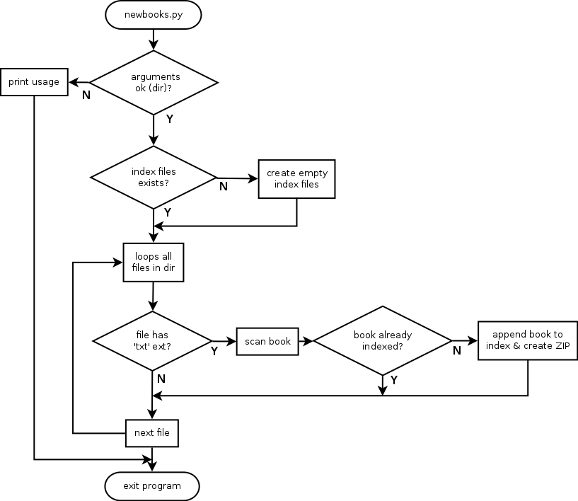
newbooks.py
- three keys: author, title and year
- index files: 00_author, 00_title and 00_year
- every ‘.txt’ book -> creates single ZIP file (no duplicate!)
- books with same (author,title,year) -> identical books
$ cat ./output/00_author # display file
John Milton B1434095749323087.zip
Richard Harding Davis B1434095749380269.zip
Robert W. Service B1434095749454332.zip
Edwin Arlington Robinson B1434095749469361.zip
...
- index file structure: <key> <unique file name>.zip
- <key> - author/title/year
- <unique file name> - ‘epoch time’ in seconds (0.001 ms resolution)
with decimal point removed (python function time.time())

Slide 7
Example of program run:
$ python newbooks.py ./input/
<...cut...>
Examining file 415.txt:
Author: George Borrow
Title: The Bible in Spain
Year: January, 1996 [EBook #415]
Book already exists.
Examining file 207.txt:
Author: Robert Service
Title: The Spell of the Yukon
Year: January, 1995
Book will be added to index.
Zip file name: B1434388540352144.zip
Examining file 14.txt:
Author: United States. Central Intelligence Agency
Title: The 1990 CIA World Factbook
Year: Unknown
Book already exists.
Books added: 49
Books skipped: 81
Total of 130 files examined

Slide 8
One person has decided to download all of the fiction existing in the English language
and store it on a single USB stick. He expects to find or generate the respective text files,
compress them, and then index them conveniently. Is this ambition realistic?
Suggest a plan to approach this goal and solve a partial problem of this plan.
SOME STATISTICS
Memory:
- 130 ASCII books = 67 MB → 1 book ~ 0.5 MB
- 130 ZIP books = 25 MB → 1 ZIP book ~ 0.2 MB
- similar to our initial estimate (0.3 MB per ziped book)
Speed:
- adding 130 books ~ 3.8 sec
- adding 130 duplicate books ~ 0.008 sec
- for 768 000 books (256 GB USB): ~ 22500 sec = 6.25 h
(SPECS: 64 bit processor, 2.8 GHz, SSD)
Yes, this ambition
is realistic!

Slide 9
CONCLUSION
- One could collect (download) large number of ‘.txt’ books, and index them and
store as compressed files on USB stick
- Number of books ~ 768 000 (256 GB USB)
- Simple python programs for indexing and compressing (ZIP)
- Required time: approx 6 hours
- This ambition is realistic
Open questions:
- how many fiction books really exist?
- where to find all books?
- total download time (for almost TB of data)?
- ‘.txt’ format -> we can convert PDF/e-book to ASCII
- extracting key fields (author/title/year) from ‘.txt’ book?
References:
Python language – http://www.python.com/
Free books – https://www.gutenberg.org/
USB stick – https://en.wikipedia.org/wiki/USB_flash_drive

Slide 10
T H A N K Y O U
FOR YOUR ATTENTION

Slide 12
$ python searchindex.py
This program will search index for books by one or more keys.
Usage:
searchindex.py -t TITLE | -a AUTHOR | -y YEAR
If search term contains space, put it in double quotes.
Multiple search conditions (keys) are possible, e.g.:
searchindex.py -t title -a author -y 1982
Note:
- searches index files 00_author, 00_title and 00_year
- single book has unique ZIP filename
- uses ‘set’ python language construct with set union and set intersect,
for multi-key search
- case sensitive search
- outputs list of ZIP files
Improvement:
- case insensitive search
- more identical keys -> -t “War and Peace” -t “Part 2”
- search by first/last name
- more keys? (number of pages, ISBN/ISSN, ...)

Slide 13
$ python searchindex.py -a am
We found 11 books:
...
B143409575299569.zip
B1434388539853344.zip
B1434388539095902.zip
B1434388539021432.zip
B1434095749934556.zip
...
$ python searchindex.py -y 1991
We found 7 books:
...
B1434095752856314.zip
B143409575299569.zip
B1434095751078819.zip
B1434095749934556.zip
$ python searchindex.py -a am -y 1991
We found 2 books:
B143409575299569.zip
B1434095749934556.zip

Slide 14
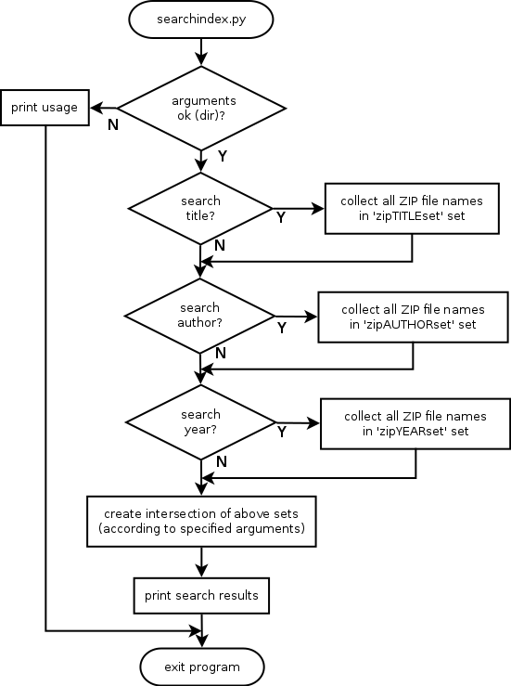
#<...cut...>
Xtitle = Xauthor = Xyear = False
zipset = set()
if '-t' in sys.argv:
# search for title
Xtitle = sys.argv[ sys.argv.index('-t')+1 ]
ziptitleset = set(findtitle(Xtitle))
zipset = zipset | ziptitleset
if '-a' in sys.argv:
# search for author
Xauthor = sys.argv[ sys.argv.index('-a')+1 ]
zipauthorset = set(findauthor(Xauthor))
zipset = zipset | zipauthorset
if '-y' in sys.argv:
# search for year
Xyear = sys.argv[ sys.argv.index('-y')+1 ]
zipyearset = set(findyear(Xyear))
zipset = zipset | zipyearset
if Xtitle:
zipset = zipset & ziptitleset
if Xauthor:
zipset = zipset & zipauthorset
if Xyear:
zipset = zipset & zipyearset
#<...cut...>

Slide 16
Assumptions and requirements:
- programming language: python 2.7.10 (Linux, Debian)
- books are in ‘.txt’ (ASCII) format -> not really a problem (PDF->ASCII, ...)
- has unique fields/keys author, title and year in every ‘.txt’ file
(might be problematic?)
- has easily discernible fields author, title and year in every ‘.txt’ file
(might be problematic?)
- two non-GUI programs (unix: “do one thing and do it well”):
newbooks.py - reads books and populate indexes
searchbooks.py - search index for books
- 130 ‘.txt’ books downloaded from www.gutenberg.org
$ tree -d . # lists subdirs
. # .py programs
├── input1 # .txt books (anywhere)
├── input2 # .txt books (anywhere)
└── output # index and ZIP files

Slide 17
$ python newbooks.py
This program will scann and index books in '.txt.' format.
Usage:
newbooks.py DIR
where DIR is directory with '.txt' books
Note:
- output into 3 ASCII files (indexes): 00_author, 00_title and 00_year
(into directory ./output/)
- for every book, creates single ZIP file (no duplicate!)
- books with same (author,title,year) -> identical books
- index file structure: <key> <unique file name>.zip
- <key> - author/title/year
- <unique file name> - ‘epoch time’ in seconds (0.001 ms resolution)
with decimal point removed (python function time.time())
- example:
$ cat ./output/00_author # display file
John Milton B1434095749323087.zip
Richard Harding Davis B1434095749380269.zip
Robert W. Service B1434095749454332.zip
Edwin Arlington Robinson B1434095749469361.zip
...

Slide 18
$ python newbooks.py ./input/
<...cut...>
Examining file 415.txt:
Author: George Borrow
Title: The Bible in Spain
Year: January, 1996 [EBook #415]
Book already exists.
Examining file 207.txt:
Author: Robert Service
Title: The Spell of the Yukon
Year: January, 1995
Book will be added to index.
Zip file name: B1434388540352144.zip
Examining file 14.txt:
Author: United States. Central Intelligence Agency
Title: The 1990 CIA World Factbook
Year: Unknown
Book already exists.
Books added: 49
Books skipped: 81
Total of 130 files examined

Slide 19
<...cut...>
# loop all files
for txtfile in allfiles:
# check if file ends with +.txt'
if txtfile.endswith('.txt'):
noof += 1
print "Examining file %s:" % txtfile
txtyear, txtauthor, txttitle = discover(
os.path.join(Gtxtpath, txtfile))
print "\tAuthor: %s" % txtauthor
print "\tTitle: %s" % txttitle
print "\tYear: %s" % txtyear
# see if book already exists in index
if not bookexists(txtyear, txtauthor, txttitle):
# book doesn't exist; index book and create zip
print "\tBook will be added to index."
noofadded += 1
# create and print (unique) file name
uniquefn = uniquefilename(Gindexpath)
print "\tZip file name: %s" % uniquefn
addbook(txtyear, txtauthor, txttitle, uniquefn)
addzip(txtfile, Gtxtpath, uniquefn)
else:
print "\tBook already exists."
noofskipped += 1
<...cut...>

