Slide 1
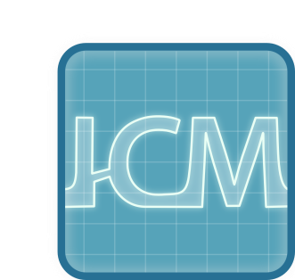
22. Pouring water out
Review: Fran Žužić
Team Croatia

Slide 2
The problem
Compare several methods to empty a bottle of water and indicate the fastest method

Slide 3
Clarifiyng questions
Was the experiment done with destiled or tap water?
Which method is the best for pouring out water?

Slide 4
The Reporter
Good
Not very good ☺
Investigated enough possible solutions
Interesting ways of pouring out the water
Empty presentation, missing possible text
Didn’t test classical pouring (horizontal still)
Didn’t test different shapes of bottles
Lack of theory and hypothesis

Slide 5
The Opponent
Good
Not very good ☺
Asked mostly good clarifiyng questions
Pointed out future experimentation
Gave opinion that the result isn’t the best, no discusion about the best result
Asked some questions, but the discusion was lacking

Slide 6
Conclusion
The reporter had a fun presentation, but it lacks more possible solutions. Ways of doing the experiment are interesting.
The opponent had good questions, but the discusion was lacking.

Slide 7
Advices
Test more ways of poouring water
Test Does it depend on lung capacity
Test bottle shape

