Slide 1
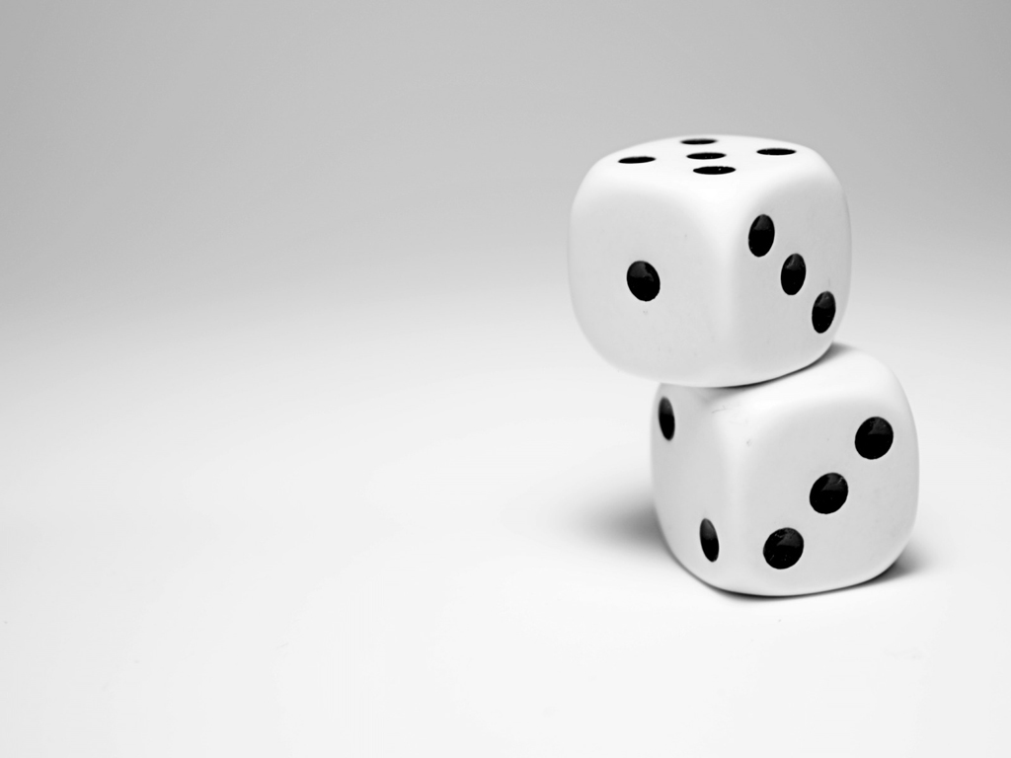
Galton box
Problem 14
Reporter: Krasikov Aleksey
Team: Voronezh One
Belgrade, Serbia 2015

Slide 2
Problem
In the Galton box, a regular 2D lattice of obstacles disperses a thin flow of falling particles. When falling on the bottom of the box, the particles show a normal distribution. Use various types or particles and different arrangements of the obstacles to find the conditions when the distribution is no longer normal

Slide 3
Investigation goals
Explain the occurrence the normal distribution in Galton box
Find numerical border between normal and binomial distribution
Identify the normal distribution break parameter
Set an experiment and investigate this phenomenon

Slide 4
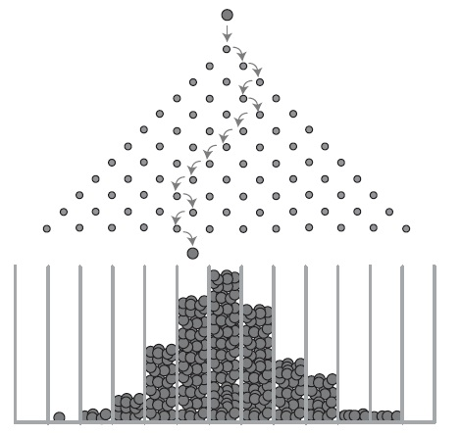
1123
What is a Galton box?
Balls are thrown in the center of the box
The obstacles are arranged in a checkerboard pattern
Balls fall in the cell at the bottom

Slide 5
1123
How does it work?
The ball falls at the first obstacle
Ball
It can bounce in the right and left side
Turn left
Turn right
If conditions are ideal, the probability of a bounce in different directions will be equal
First obstacle
$$p=\frac{1}{2}$$
$$q=\frac{1}{2}$$

Slide 6
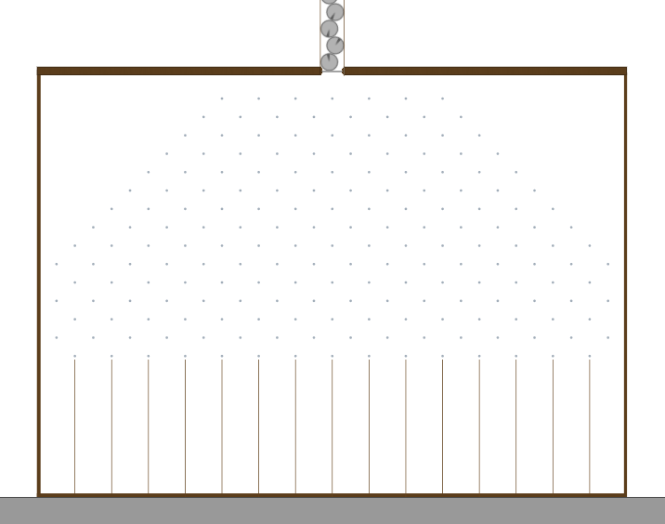
Check it
Modelling our experiments in Algodoo

Slide 7
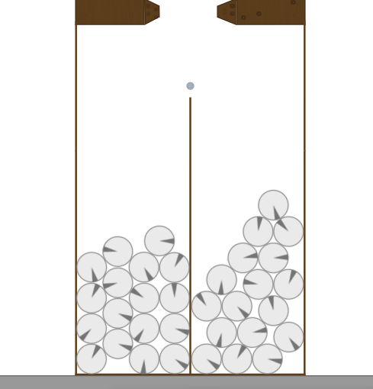
1123
Check it
Modelling in Algodoo Physics

Slide 8
1123
How does it work?
The ball is involved in two independent trials
Turn left (1/2)
Turn right (1/2)
First series
In each such test ball can bounce to the right side or to the left side
Turn left (1/2)
Turn right (1/2)
Second series
Second series
$$p=\frac{1}{4}$$
$$s=\frac{1}{2}$$
$$q=\frac{1}{4}$$
Binomial distribution

Slide 9
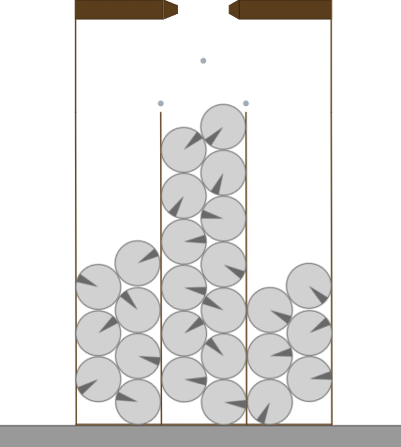
1123
Check it
Modelling in Algodoo Physics

Slide 10
How does it work?
First series
If $n→∞$, the distribution tends to normal
Second series
Second series
. . .
N series

Slide 11
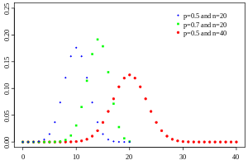
Binomial vs normal distribution
The binomial distribution is a distribution of the numbers of "successes" in n independent experiments (probability is constant)

Slide 12
Binomial vs normal distribution
The binomial distribution is discrete, because it is concentrated at several points.
E.g.: The number of heads (or tails) has binomial distribution

Slide 13
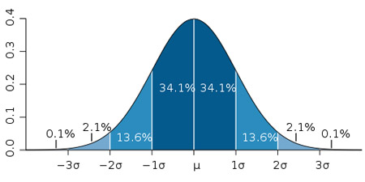
Binomial vs normal distribution
The normal distribution is continuous. It coincides with the Gaussian function

Slide 14
Normal distribution
Binomial distribution turns to normal for certain values of the parameters. E.g.: This occurs when the Galton box has a large number of series with obstacles (n>10)
Binomial distribution $→$ Normal distribution

Slide 15
Check it
n=1
n=3
n=6
Modelling in “Galton box”
Binomial distribution $→$ Normal distribution

Slide 16
Check it
n=9
n=12
Modelling in “Galton box”
Binomial distribution $→$ Normal distribution

Slide 17
When does Galton box work?
R
$$−1δ$$
$$−μ$$
$$μ$$
$$1δ$$
$$μ$$
- expected value
- standard deviation
$$δ$$
Modelling in Algodoo. We can see normal distribution
If $δ≥R$, Galton box works

Slide 18
When doesn’t Galton box work?
Modelling in Algodoo. We don’t see normal distribution
R
If $δ<R$, Galton box doesn’t work
$$−1δ$$
$$−μ$$
$$μ$$
$$1δ$$
$$μ$$
- expected value
- standard deviation
$$δ$$

Slide 19
Experimental investigation
$$f(x)=\frac{1}{δ\sqrt{2π}}e^{−\frac{{(x−μ)}^{2}}{2δ^{2}}}$$
Gaussian function:
$δ$- standard deviation
$μ$- expected value

Slide 20
Experimental investigation
$$δ= \sqrt{\sum_{i=−1}^{−t}{\frac{k_{i}}{k}x_{i}^{2}}+\sum_{i=1}^{t}{\frac{k_{i}}{k}x_{i}^{2}}}$$
$δ$- standard deviation
$2t+2$- number of columns
$x_{i}$- coordinate of i-column
$k_{i}$- the number of balls in the i-column
$k_{i}$- the total number of balls
$$μ balls$$
$$μ balls$$
$$k_{−1} balls$$
$$k_{1} balls$$
$$k_{−2} balls$$
$$k_{2} balls$$
$${−x}_{2}$$
$${−x}_{1}$$
$$−1$$
$$0$$
$$1$$
$$x_{1}$$
$$x_{2}$$

Slide 21
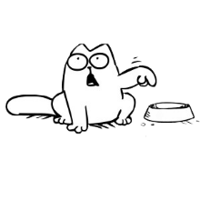
Experimental investigation
Variable parameters:
the ratio between the distance from one pin to another and the radius of the ball;
the shape of particles;
the shape of obstacles
If $δ<R$, Galton box doesn’t work
Find out the $δ$
Experiments
If $δ≥R$, plot the Gaussian functions

Slide 22
1) Ratio between distance and radius
$$S=\frac{L}{d}$$
Ball
First series
d
Second series
Second series
L
S=1
S=6
S=20

Slide 23
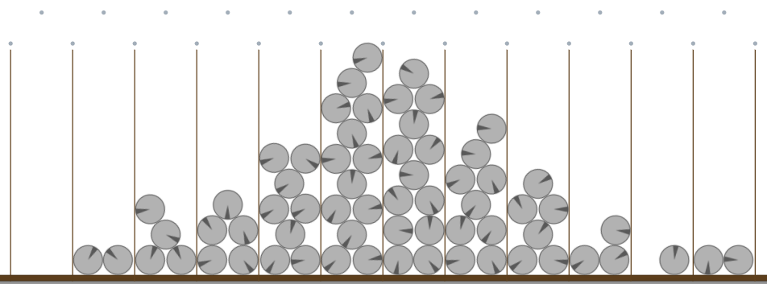
1) Ratio between distance and radius
S=1
R=1
$$−1$$
$$0$$
$$1$$
$$δ=1,54$$

Slide 24
1) Ratio between distance and radius
S=1
$$δ>R$$
$$1,54>1$$
There for we can see, that the Galton box works

Slide 25
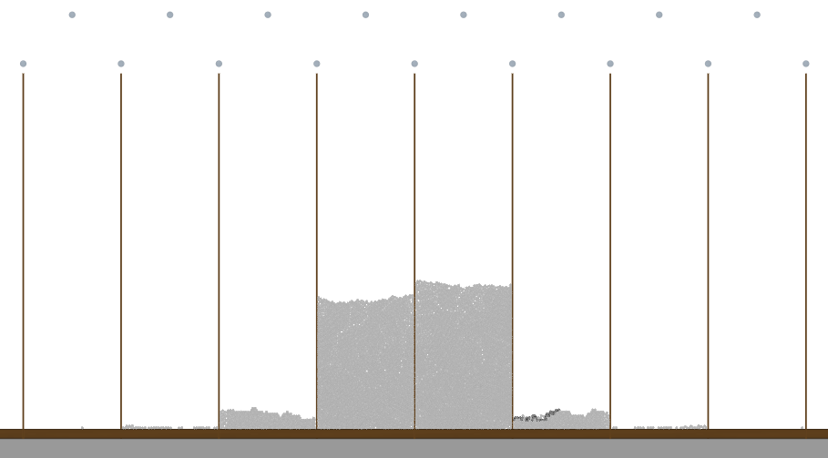
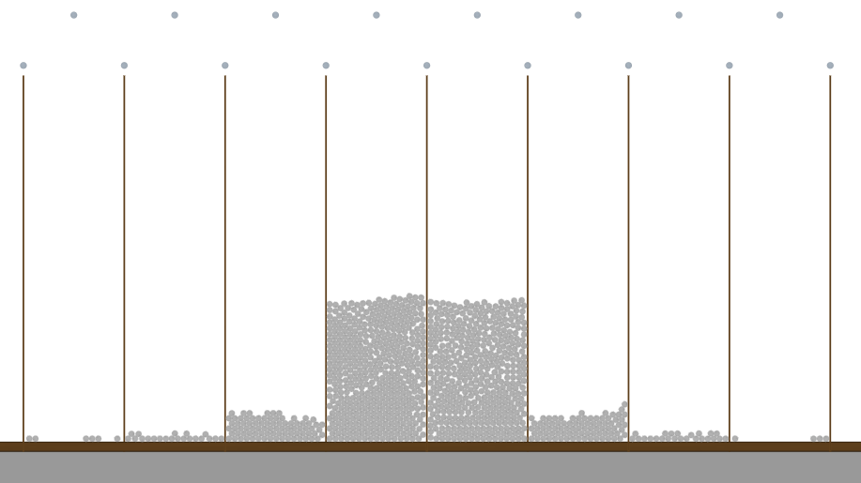
1) Ratio between distance and radius
S=6
S=20
R
R
$δ<R$, that’s why Galton box doesn’t work

Slide 26
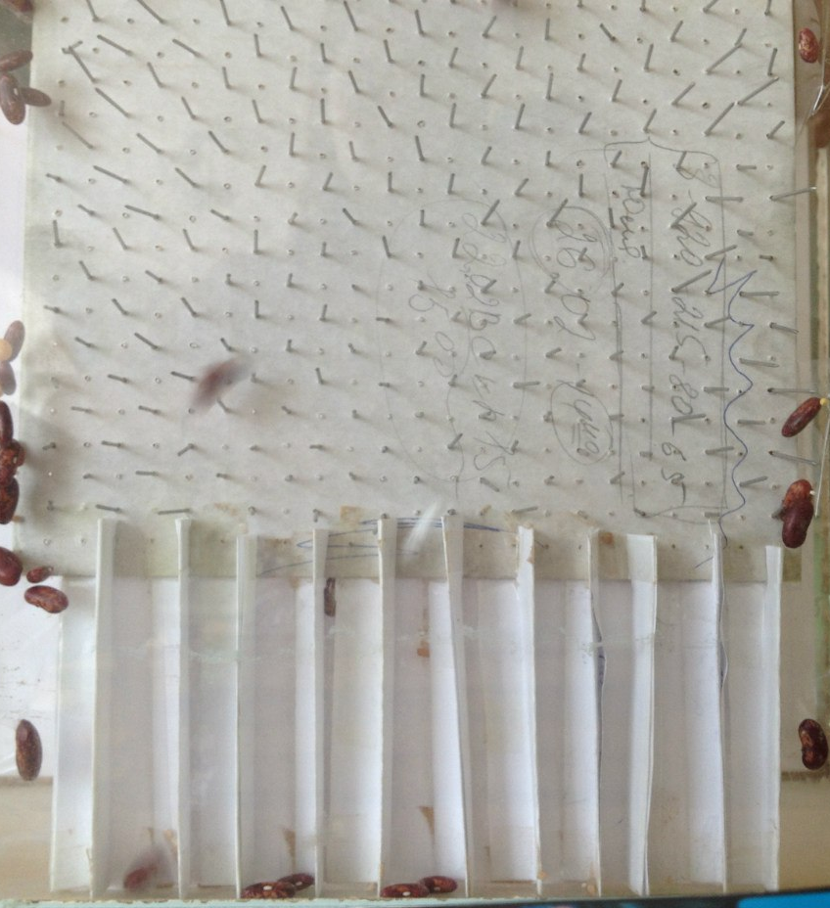
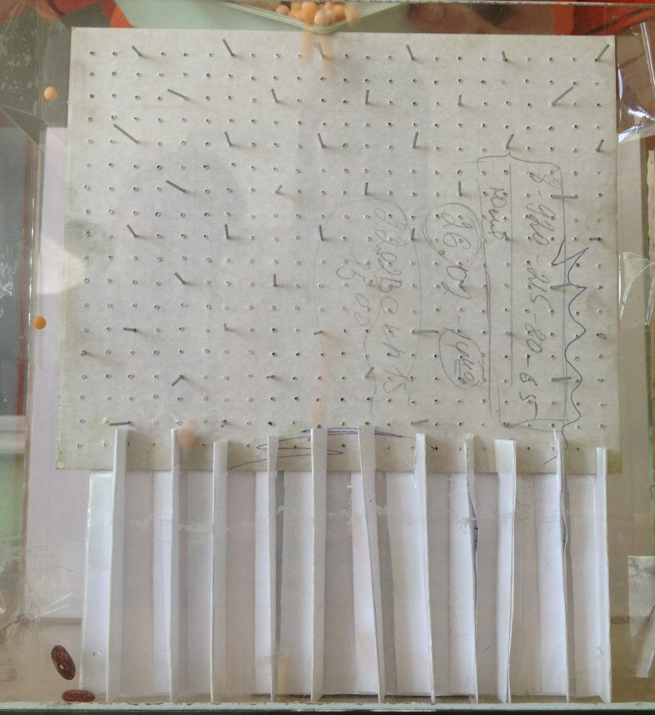
Real experiment setup
L=5 mm
L=10 mm
Changing the frequency of obstacles

Slide 27
1) Ratio between distance and radius
$$δ>R$$
$$1,75>1$$
$$δ>R$$
$$1,43>1$$

Slide 28
1) Ratio between distance and radius
$$δ≈R$$
$$δ≈1$$
$$δ<R$$
$$δ=0,85$$
Galton box doesn’t work

Slide 29
Explanation
Small particles pass through without collision, so particles concentrate in the central column
First series
Second series
Second series

Slide 30
2) Shape of particles
Oval
Triangle
Square
Star
Triangle with a displaced center of mass

Slide 31
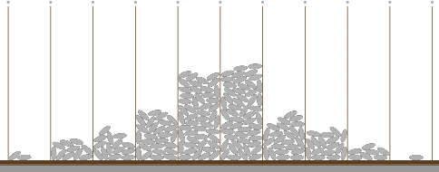
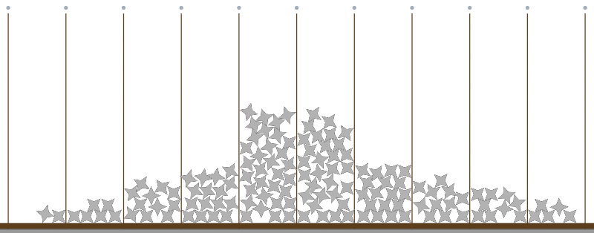
2) Shape of particles
Modelling in Algodoo Physics

Slide 32
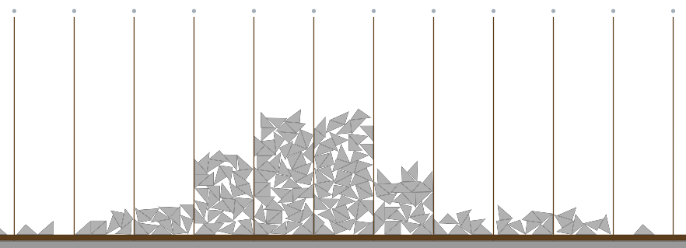
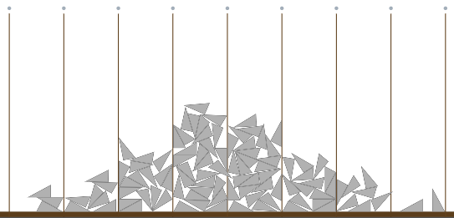
2) Shape of particles
Modelling in Algodoo Physics

Slide 33
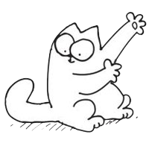
Explanation
Despite the fact that we change the shape of the particles, the possibility of deviation to the right and left side persists.
That’s why we can see the normal distribution

Slide 34
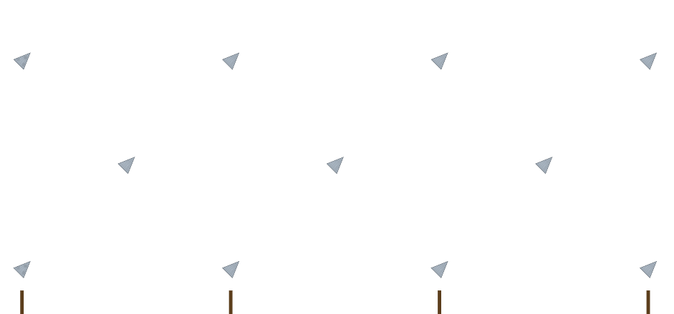
3) Shape of obstacles
Obstacles in the shape of triangles

Slide 35
3) Shape of obstacles
Explanation: we change the shape of obstacles, so the probability of deviation to the left side become bigger. Therefore, the normal distribution was broke

Slide 36
Conclusion
We explained how Galton box works
Modelled and made an experiment in reality
Explained difference between normal and binomial distribution
If the number of series strive to infinity, the distribution tends to normal

Slide 37
Conclusion
If standard deviation smaller then distance between columns, Galton box doesn’t work, in another way it works. If particles is very small, normal distribution will be break
Distribution doesn’t depends on the shape of particles (and center of mass of the one particle)
If we change the probability of deviation (change shape of obstacles), normal distribution will be break

Slide 38
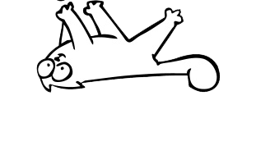
Thanks for attention!

Slide 39
1) Ratio between distance and radius
S | Normal distribution
1 | yes
1,5 | yes
2 | yes
2,5 | no
3 | no
6 | no
20 | no
Critical value is in a range from 2 to 2,5 (theory 1,7)

Slide 40
Some calculations
Ball
Additional slides
$$α=45°$$
$$α$$
First series
40

Slide 41
Some calculations
$$\vec{N}$$
$$\vec{N}=0$$
Ball
$$\vec{a}$$
$$m\vec{g}$$
$$φ$$
r
First series
r
L
41

