Slide 1
Problem 9 Distances in open space
Stekolnikova Daria
Voronezh - 2

Slide 2
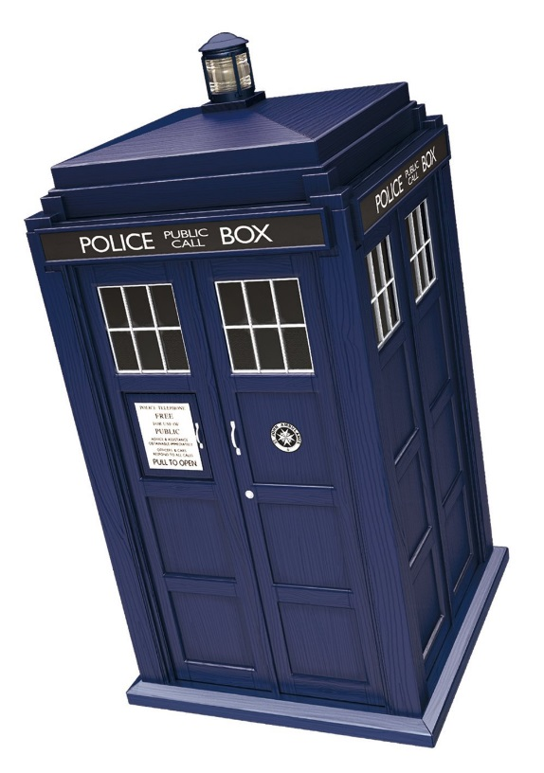
Condition of the problem
How do astronomers measure distances between the planets of the Solar System, between the stars in our Galaxy, or between the galaxies?
Determine the distance between the two space
objects of your choice.

Slide 3
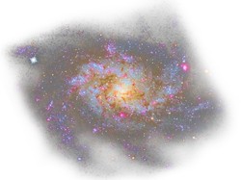
Objectives
Explore different ways of measuring distances in space
Choose the most suitable for using without any special devices.
Determine the distance between two space objects

Slide 4
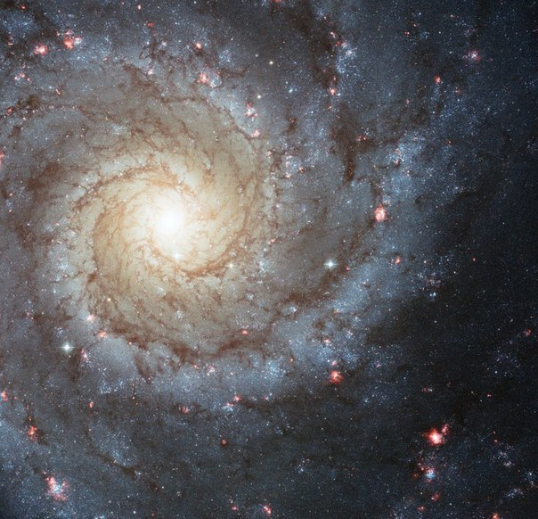
“Cosmonautics has limitless future, and its prospects are infinite as the universe itself.”
Sergei Korolev
Photo made by Hubble

Slide 5
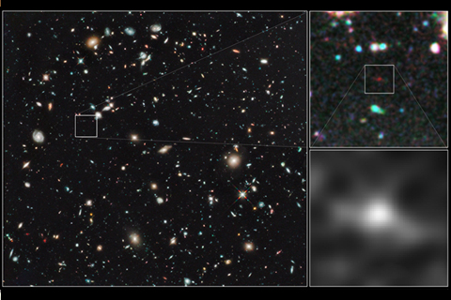
The most distant visible object
Photo made by Hubble
The galaxy UDFj-39546284,
located 13.2 billion light years from Earth.
The oldest object in the universe.
Redshift

Slide 6
Methods for determining the distance
Radiolocation
Cepheids
Redshift
4·${10}^{−8}$
4,2
5000
40ml
3000ml
13,2bml
(Light years)
laser
Trigonometric parallax
Supernova 1a

Slide 7
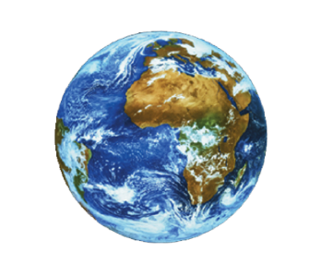
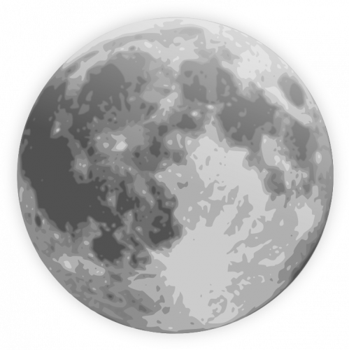
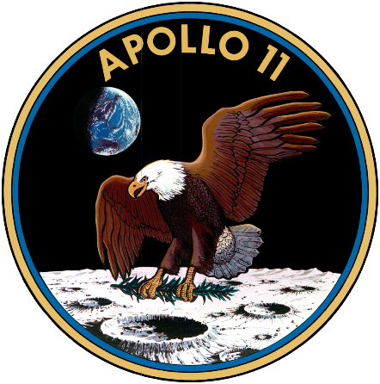
Laser
laser reflector
August 1, 1969: Lick Observatory in California

Slide 8
Radiolocation
Moon – 2,5 s
Venus – 4,5 min
Jupiter – 1 hour
$$V≈300 000{km}/s$$

Slide 9
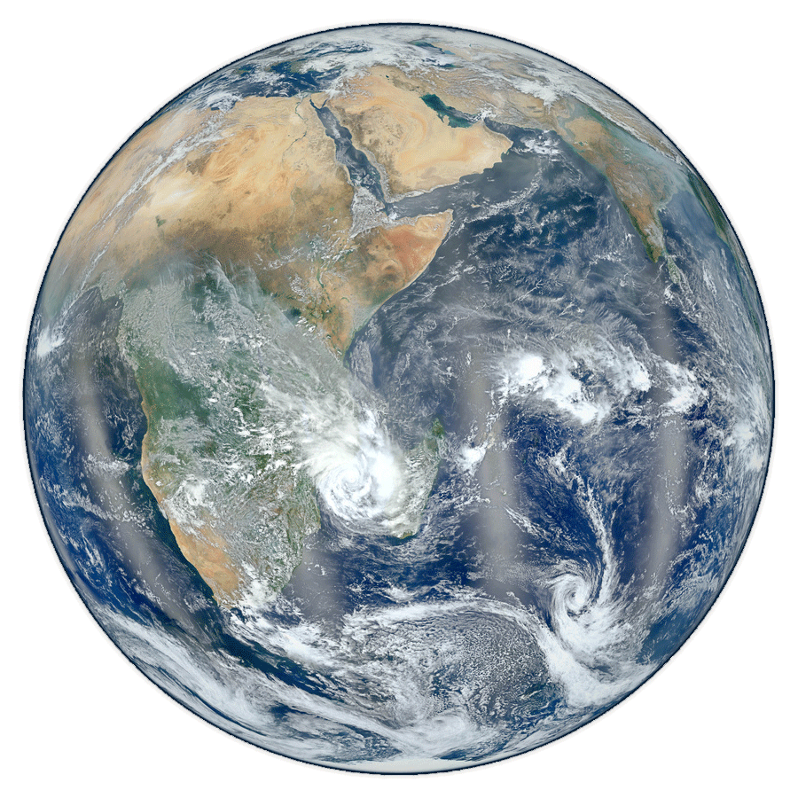
Trigonometric parallax
$$r=\frac{\text{206265}}{π(a.s.)}(a.u.)$$
π
Parsec:
$$1 pc=206265 a.u.=3,086∙{10}^{16}m$$
$$1 l.y. =0,307 pc=9,46∙{10}^{15}m$$

Slide 10
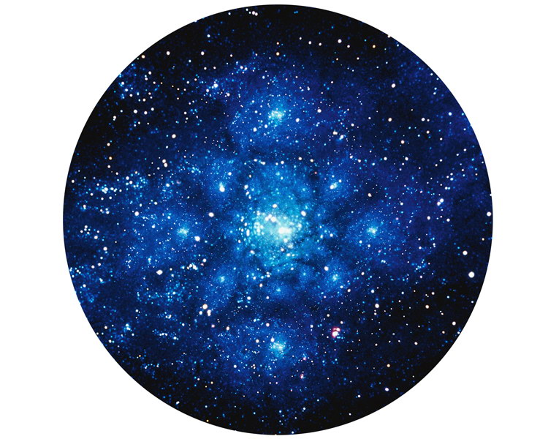
Cepheids
(Standard candles)
Variable stars
$$T\sim M$$
$$L\sim M$$
$$L\sim T$$

Slide 11
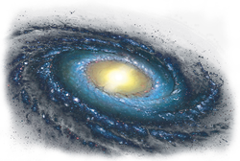
Supernova 1a
$$L_{supernova}≈L_{galaxy}$$
After the exploding:
$$L_{sup}↓$$
Supernova $ε \text{dual} \text{system}$

Slide 12
Redshift
$$\vec{θ}$$
r $=kθ$
k - The Hubble Constant
Spectrum
k = 50-60 ${km}/{pc}$

Slide 13
Kepler's law
$$\frac{{T_{M}}^{2}}{{R_{M}}^{3}}=\frac{{4π}^{2}}{GM}$$
$$M_{E}=5,97∙{10}^{24}kg$$
$$G=6,67∙{10}^{−11}{N∙m^{2}}/{{kg}^{2}}$$
$T_{M}$ - ?
$R_{M}$ - ?

Slide 14
Observations of the Moon
May 4
June 2
Full moon at 07:42
Full moon at 20:19
$T_{Moon}=\text{27,3}$ day

Slide 15
Calculations
$$\frac{{T_{M}}^{2}}{{R_{M}}^{3}}=\frac{{4π}^{2}}{GM}$$
$${R_{M}}^{3}=\frac{{T_{M}}^{2}∙GM}{4π^{2}}$$
$${R_{M}}^{3}=\frac{{27,3}^{2}∙6,67∙{10}^{−11}}{4∙{3,14}^{2}} = 3,84∙{10}^{8}$$

Slide 16
Conclusion
We explored different ways of measuring distances in space
We chose the best way for us
We determined the distance between the Earth and the Moon, compared our results with already known

Slide 17
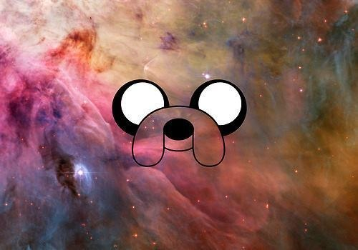
Thank you for your attention!

