Slide 1
Problem 5
Falling ball
Stekolnikova Daria
Voronezh - 2

Slide 2
Condition of the problem
An electronic balance (1) is connected to a PC (5) in order to record the time dependence of the measured weight. A light frame (4) is mounted on a tall beaker (2) filled with water. The frame has a holder (3) allowing controlled release of a small ball such that it falls into the water. The beaker is placed on the balance as depicted in the Figure. Investigate how the readings of the balance reflect the different phases of the motion of the ball.

Slide 3
Balance - device that measure weight.
F
T
T
T
mg
mg
mg
P = mg
T = P = mg
P = T = mg - F

Slide 4
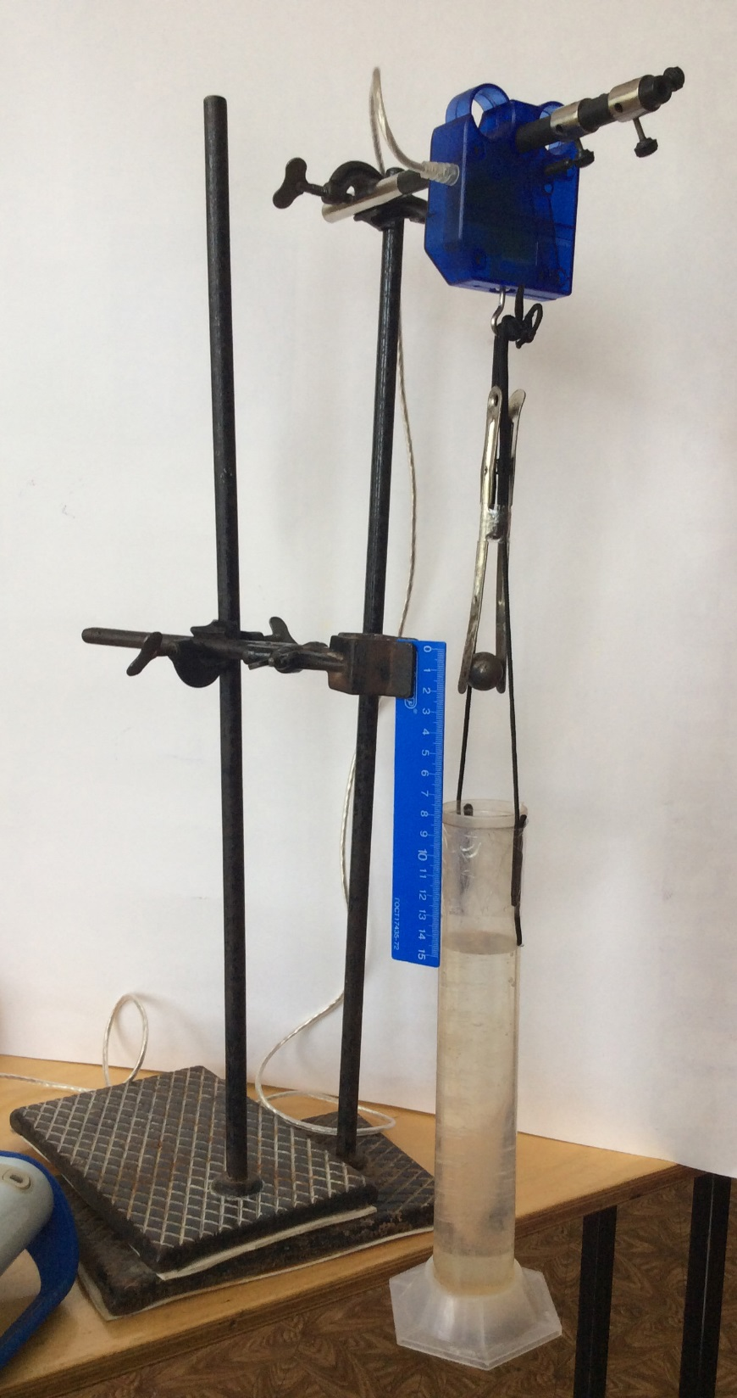
Our setting
Dynamometer
Holder with the ball
Ruler
Beaker
PC

Slide 5
Model
Fixed on the foundation ball
Vessel with water

Slide 6

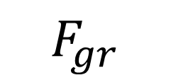
Explanation of the process
P – shows with which force the ball affects on the system
T
$$P= F_{gr}$$
$$F_{gr}$$

Slide 7

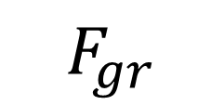
$$P=0$$
$$F_{gr}$$

Slide 8


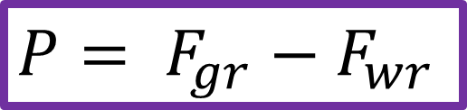

$P= F_{gr}$ $− F_{wr}$
$$F_{wr}$$
$$F_{wr}$$
$$F_{gr}$$

Slide 9



$P= F_{gr}$ $− F_{A}$ $− F_{rf}$
$$F_{rf}$$
$$F_{A}$$
$$F_{gr}$$

Slide 10



$P= F_{gr}$ $− F_{A}$ $− F_{rf}$
$$F_{rf}$$
$$F_{A}$$
$$F_{gr}$$

Slide 11

Hypothesis
$$∆P∼∆a$$

Slide 12
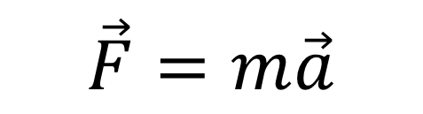

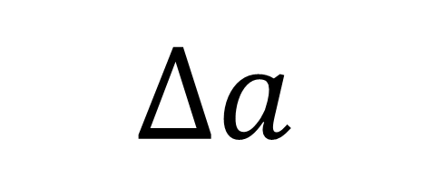



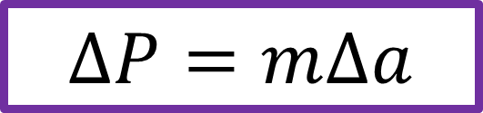
$$F_{st}$$
$$F_{rf}$$
$$\vec{F}=m\vec{a}$$
$$F_{st}$$
$$F_{A}$$
$$F_{gr}$$
$$F_{gr}$$
$$∆P=m∆a$$
$$∆a$$

Slide 13
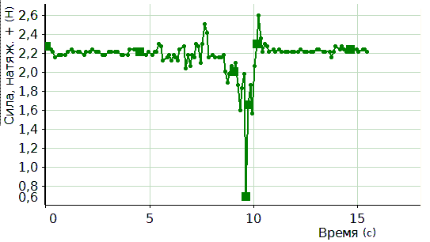
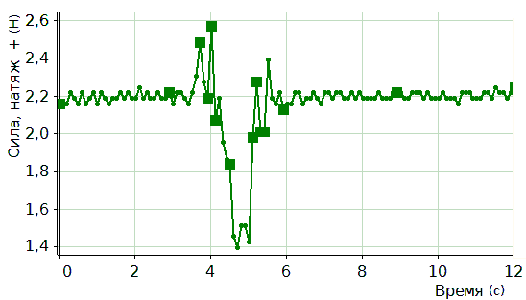
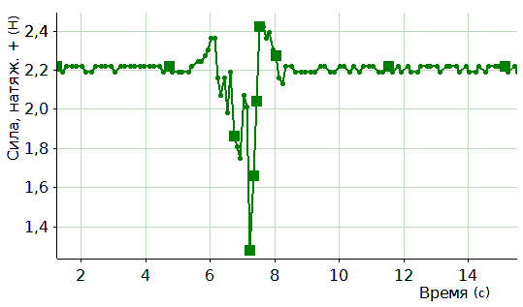
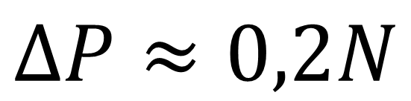
Results
$$∆P≈0,2N$$

Slide 14
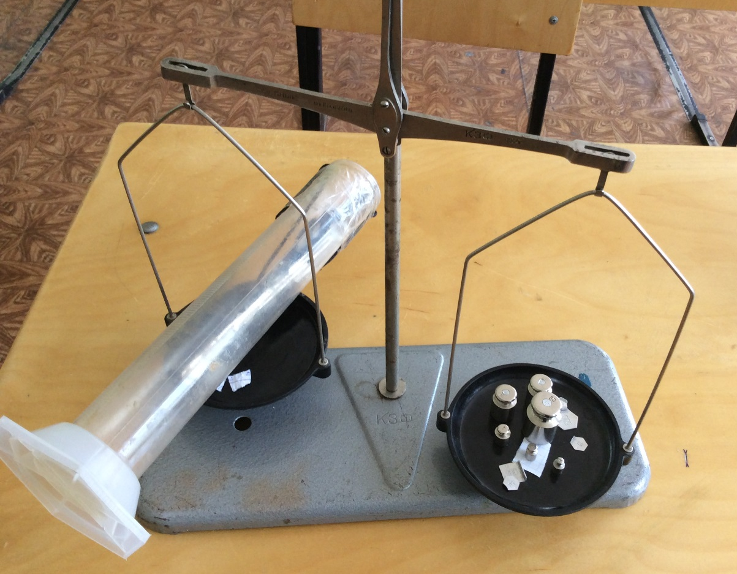
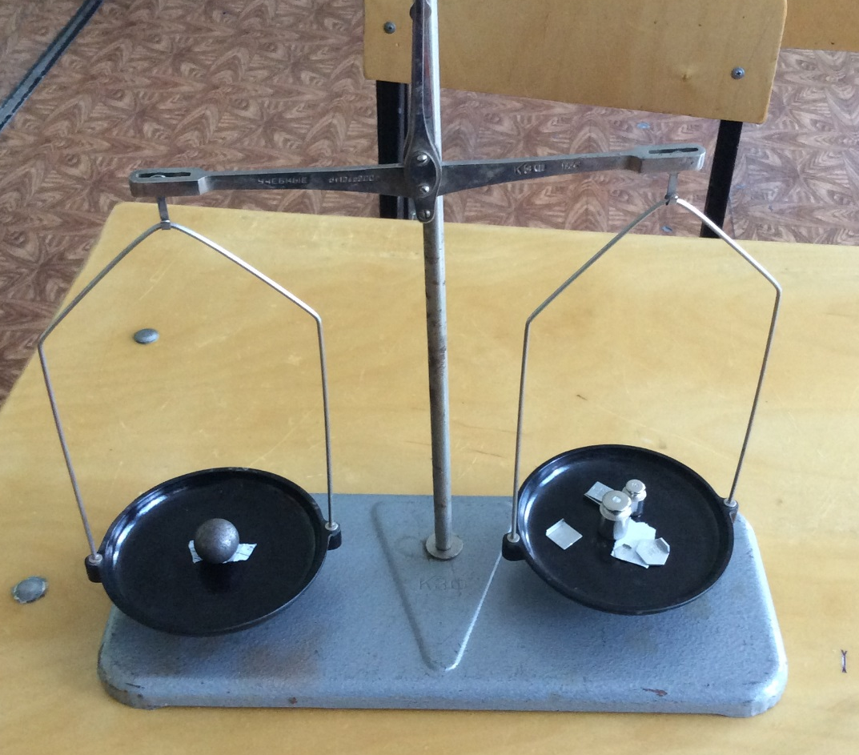
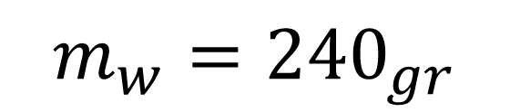
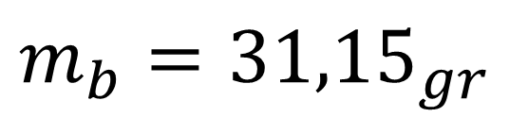
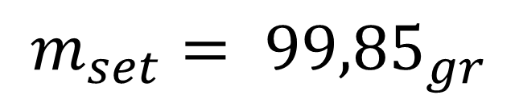
$$m_{set}= {99,85}_{gr}$$
$$m_{b}={31,15}_{gr}$$
$$m_{w}={240}_{gr}$$

Slide 15
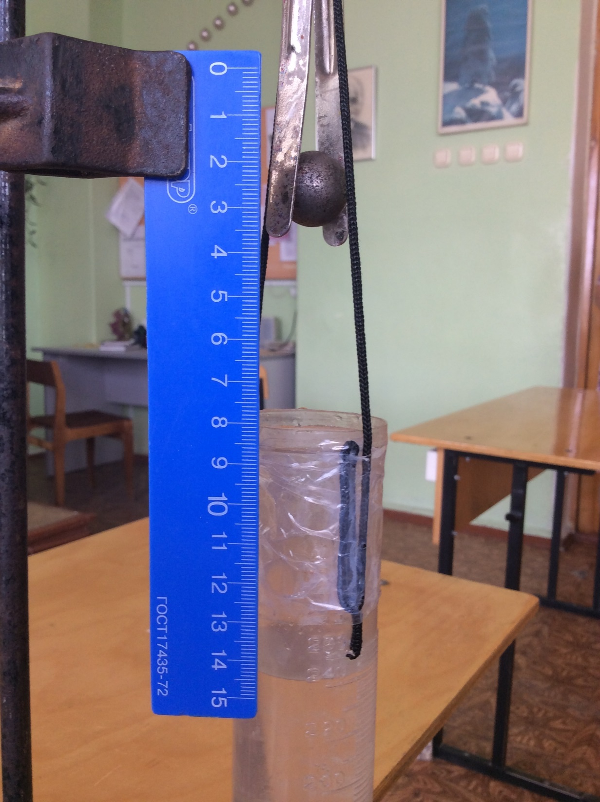
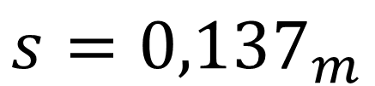
$$s={0,137}_{m}$$

Slide 16
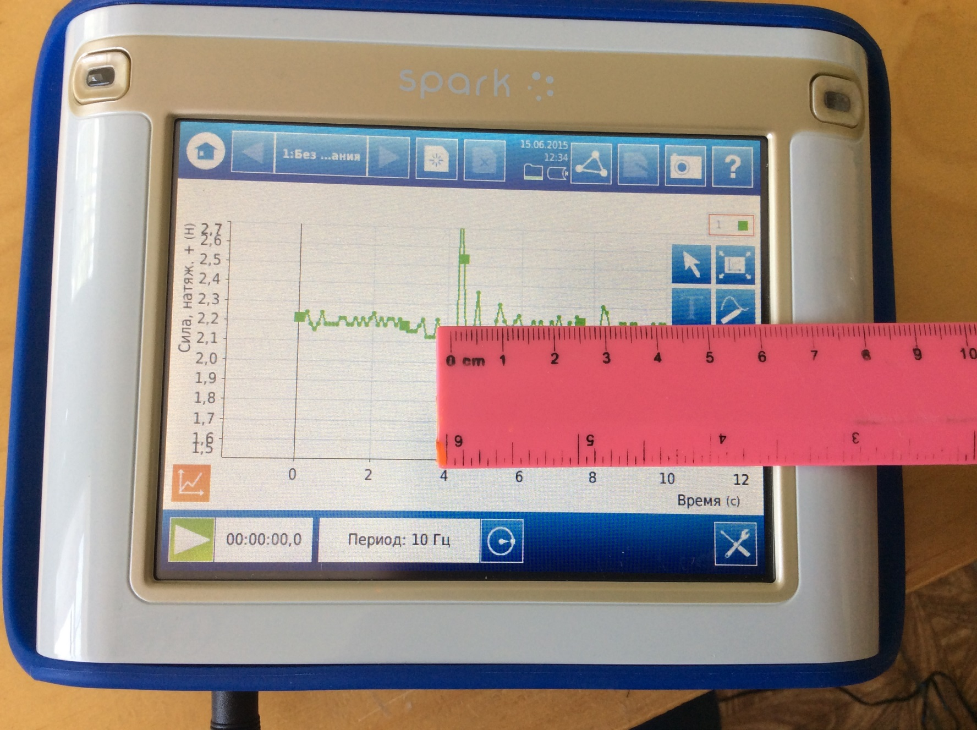
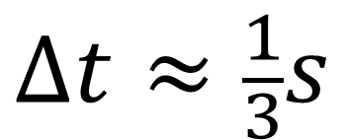
$$∆t≈\frac{1}{3}s$$

Slide 17
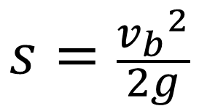
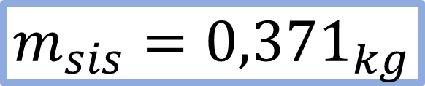
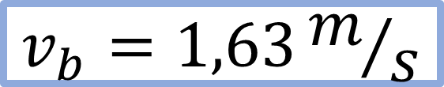
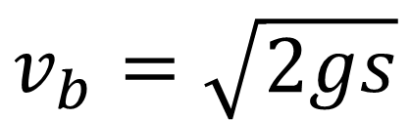
Calculations
$$m_{b}∙v_{b}=(m_{b}+m_{set}+m_{w})∙v_{sis}$$
$$s=\frac{{v_{b}}^{2}}{2g}$$
$$m_{sis}={0,371}_{kg}$$
$$v_{b}=\sqrt{2gs}$$
$$v_{b}=1,63m/s$$

Slide 18
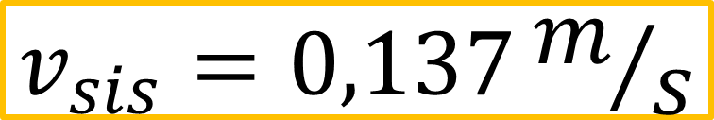
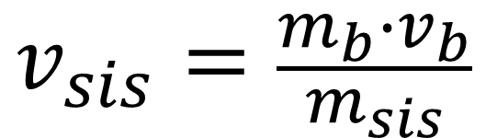
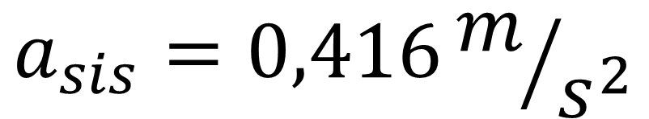
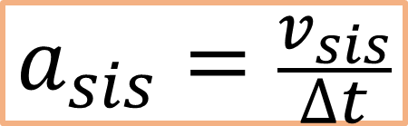
$$v_{sis}=\frac{m_{b}∙v_{b}}{m_{sis}}$$
$$v_{sis}=0,137m/s$$
$$a_{sis}=\frac{v_{sis}}{∆t}$$
$$a_{sis}=0,416m/{s^{2}}$$

Slide 19
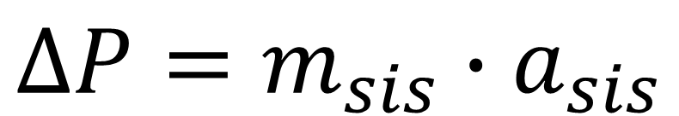

$$∆P=m∆a$$
$$∆P=m_{sis}∙a_{sis}$$
$$∆P={0,371}_{kg}∙0,416m/{s^{2}}=0,154N$$

Slide 20
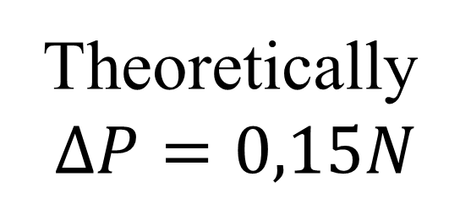
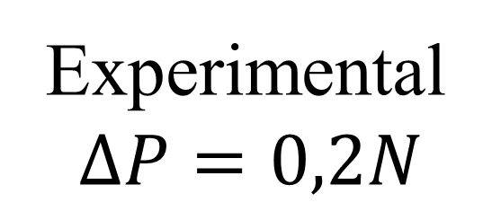
Comparing results
Experimental
$$∆P=0,2N$$
Theoretically
$$∆P=0,15N$$
Error: 0,05N – normal error for such experiments
Our hypothesis was successfully confirmed!

Slide 21

Conclusion
During the traffic the weight of the whole system changes:
$$1. t=o ⟶P_{0}=P_{sis}+P_{b}$$
$$2. The moment of falling ⟶ P_{1}=P_{sis}$$
$$3. The moment of contact with water⟶P_{2}=P_{sis}+m∆a$$
$$4. The end⟶P_{3}=P_{0}$$

Slide 22
Thank you for your attention!

