Slide 1
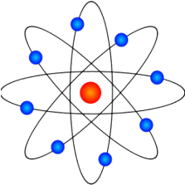
Voronezh-2 IYNT 2015
Russia
Voronezh
Work performed pupil 8B class:
Danil Kozlov
Supervisor:
Lepeshkina Natalia Valeryevna

Slide 2
10.Ice hole
You have drilled two ice holes in a frozen lake on a frosty winter day. One ice hole is close to the shore, while the other ice hole is far from the shore. Surprisingly, the height difference between the ice surface and the liquid water is different for eachhole. How can you explain this? How can one use this height difference to determine the local ice thickness?

Slide 3
The Purpose of the Task
An experiment in the freezer.
To identify patterns of formation of the surface of the ice.
By means of experiment take measurements of ice thickening depending on the temperature and the area of ​​influence

Slide 4
Equipment
Containers of various shapes (flat, high)
A freezer
A centimeter ruler
Scales
A thermometer

Slide 5
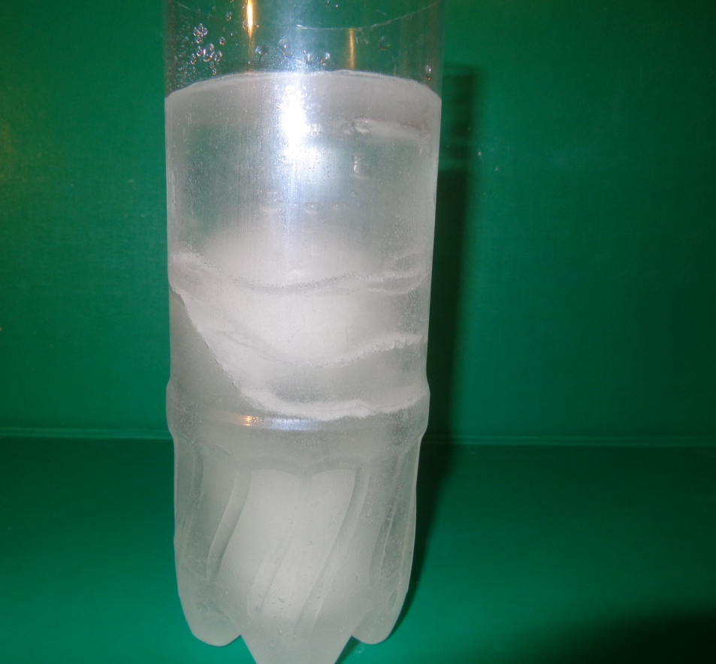
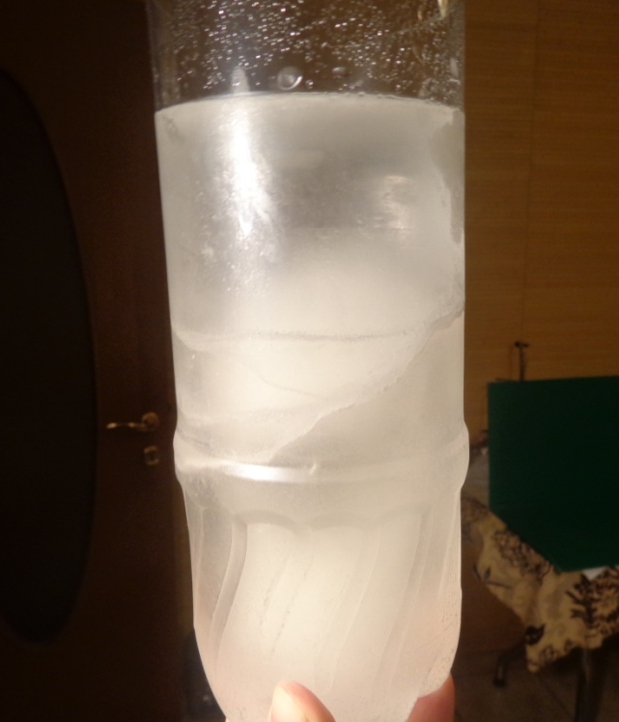
Samples after Freezing

Slide 6
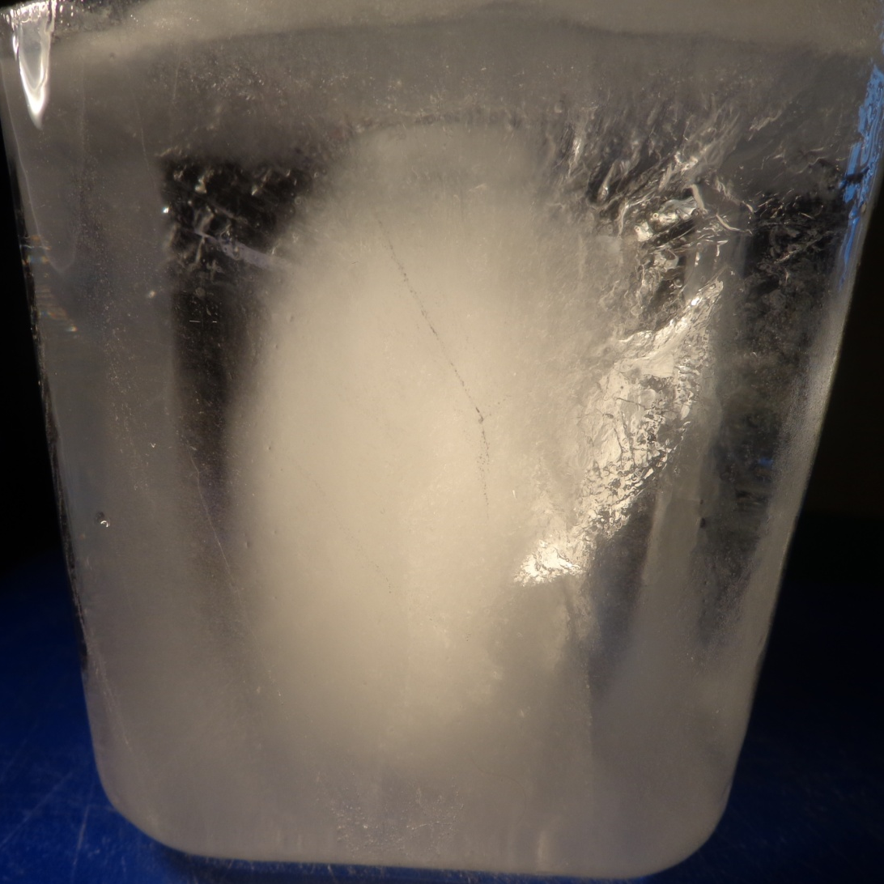
The External Appearance of the Ice
The upper layer is transparent as it contains no air molecules
The lower layer is opaque, since it contains air bubbles, because the growth of ice from below occurs by evaporation of water molecules

Slide 7
Defining the Speed of Freezing
6 hours. - 5 мм
12 hours. - 25 мм
18 hours. - 50 мм
24 hours. –complete freezing
The Ice thickness was defined in a transparent container with a centimeter ruler

Slide 8
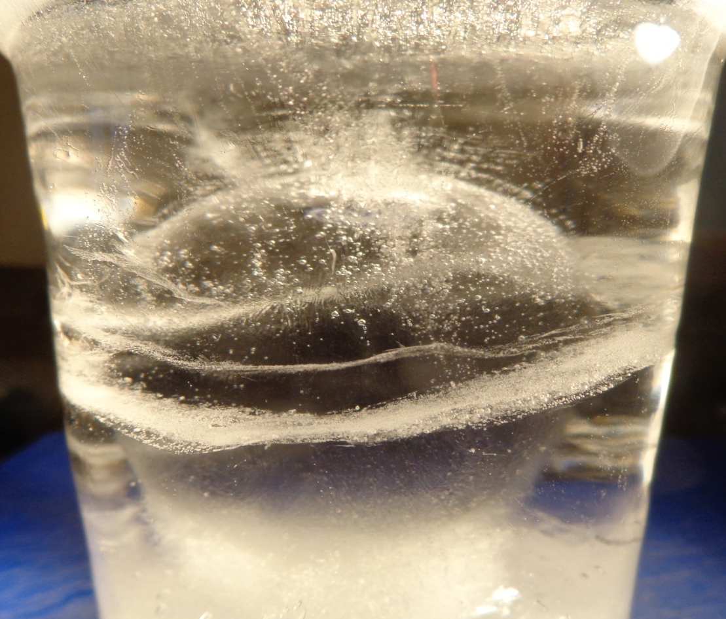
The Form of the Ice
The ice in the central part has a concaved shape

Slide 9
Comparison of the Speed of Freezing (water+ground)
6 hours- 15 мм 12 hours-30 мм 18 hours-60 мм
24 hours- complete freezing

Slide 10
Comparison of the speed of freezing (water)
6 hours -5 мм 12 hours- 25 мм 18 hours-45 мм 24 hours-60 мм
The rate of formation of ice in the tanks with just water is slower than in the tanks with water and bottom soil (under equal conditions t - 15 ° C, cooling time)

Slide 11
Determining the specific heat of the bottom soil
soil –initial temperature 0 °С
water–initial temperature 80 °С
water –initial temperature
56 °С

Slide 12
The calculation of the heat capacity of the bottom soil
The mass of soil (ms) 0.1 kg.
The temperature of the soil (ts) 0 °C
The mass of water (mw) of 0.2 kg.
The water temperature (tw) + 80 ° C
The general temperature (after mixing) +56 ° C.
The heat capacity of water (Cw) 4200 J / kg ° C
Qw = Cw x mw x (STw - ETw) J. Qs = Cs x ms x (STs - ETs), J.
Qw + Qs = 0
The heat capacity of the soil Cs = -Cw x mw x (STw - ETw) / ms x (STs-ETs) Cs = -4200 x 0.2 x (56-80) / 0.1 x (56-0)
Cs = 3600 J / kg ° C
Cs < Cw

Slide 13
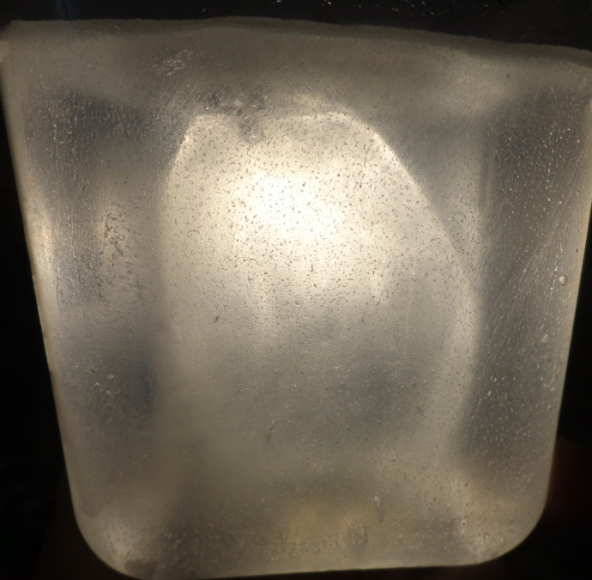
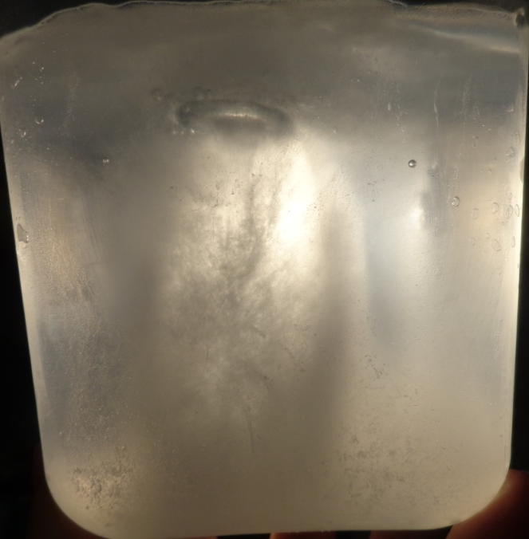
Comparing the speed of ice formation in the center and at the edge of the container
12 hours
In the center-9 мм
3 см. from the edge 18 мм
15 hours
In the center-17 мм
3 см. From the edge 35 мм
18 hours
In the center-25 мм
3 см. From the bottom- complete freezing
t in the freezer -15°С

Slide 14
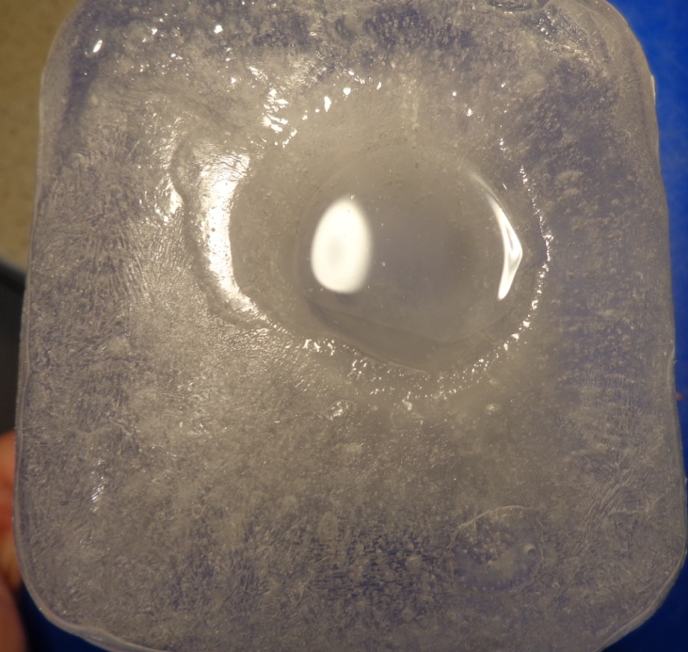
Investigation of the structure after 18 hours of the ice cooling (-15 ° C)
Sideview
Bottomview
The tank with the unfrozen water
depth- 75 мм
diameter 30 мм
In the central part the cooling process and ice formation is slower than in the side portion.

Slide 15
Comparison of the rate of freezing
Measurement of depth А-center В-edge | Temperature. С | Ice thickness after 3 hours, мм | Ice thickness after 6 hours, мм | Ice thickness after 9 hours, мм | Ice thickness after 12 hours, мм | Ice thickness after 15 hours, мм | Ice thickness after 18 hours, мм | Ice thickness after 24 hours, мм
А | -15 | 1 | 3 | 6 | 9 | 17 | 25 | +
В | -15 | 2 | 5 | 12 | 18 | 35 | + | +
А | -20 | 2 | 4 | 8 | 12 | 25 | + | +
В | -20 | 3 | 6 | 15 | 25 | 55 | + | +
А | -25 | 3 | 5 | 10 | 15 | 30 | + | +
В | -25 | 4 | 7 | 19 | 30 | + | + | +

Slide 16
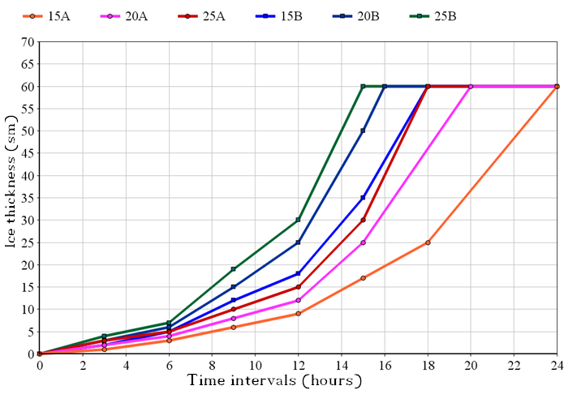
A graph of the ice thickness dependence on the freezing time at different temperatures

Slide 17
The modeling of calculation of the thickness of the ice in the pond
Let’s imagine the thick ice of the reservoir in the form of a trapezoid
h1 - the thickness of the ice in the center of the pond
h2 - thickness of the ice at the edge of the pond
S - the distance between the holes in the center (A) and end (B)
And A1C1C2 & A1B1B2 -like
From the similarity of triangles:
C1C2 = S - Sx = hx - h1
B1B2 S h2 - h1
(S - Sx) x (h2 - h1)
hx = S + h1
For example, if S -6 m. h1- 2cm, h2-3 see
2 meters from the point in the ice thickness will be 2.66 cm
If the ice thickness in the control points and the distance between them is known that it is possible to calculate the thickness of the ice at a given point of the reservoir

Slide 18
Conclusion
*The external appearance ice inside is a concave surface, as the evaporation of water from thawing takes place.
*The ice becomes opaque due to air bubbles which are concentrated in the lower portion of the ice cover. Thickening occurs through freezing water molecules underneath.
*The rate of ice formation is dependent on the ambient temperature, time, during which the temperature is maintained below freezing point.
*The heat capacity of the soil is less than the heat capacity of water, so the water near the shore freezes faster.
*the temperature of the ambient air and the duration of exposure to low temperatures, we can determine the thickness of ice.

