Slide 1
International Young
Naturalists’ Tournament
6. Disappearing ink
Serbian team
Regional Center For Talented Youth
Notes:
http://chemistry.about.com/od/demonstrationsexperiments/ss/disappearink_4.htm

Slide 2
6. Disappearing ink
Suggest a chemical formulation for the ink that would disappear after used to write a text. What parameters determine the time when the text becomes invisible? Is it possible to process the paper in such a manner that the text appears again?

Slide 3
Disappearing Ink Chemistry
acid-base indicator (pH indicator)
phenolphthalein
Notes:
Disappearing ink is a water-based acid-base indicator (pH indicator) that changes from a colored to a colorless solution upon exposure to air.
The most common pH indicators for the ink are thymolphthalein (blue) or phenolphthalein (red or pink).
The indicators are mixed into a basic solution that becomes more acidic upon exposure to air, causing the color change
.
You could use different indicators to make color-change inks, too.
The indicators are mixed into a basic solution that becomes more acidic upon exposure to air, causing the color change.
You could use different indicators to make color-change inks, too

Slide 4
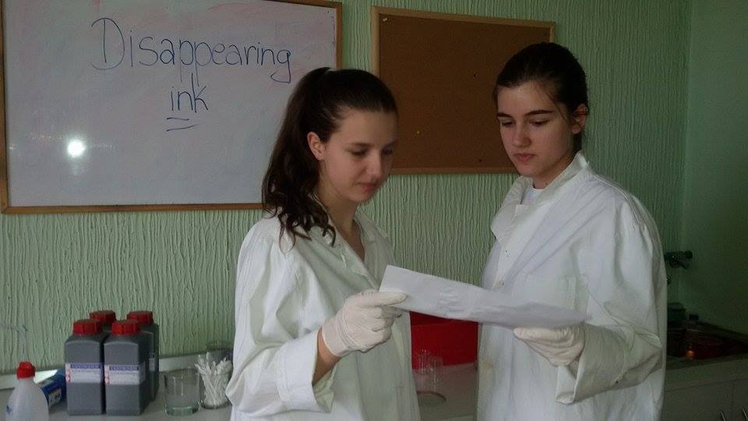
Experimental part
No - it’s science!
It’s magic! It’s a mystery!
Notes:
NASA SLIKA KAKO RADIMO EXP U LABORATORIJI

Slide 5
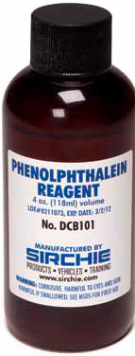
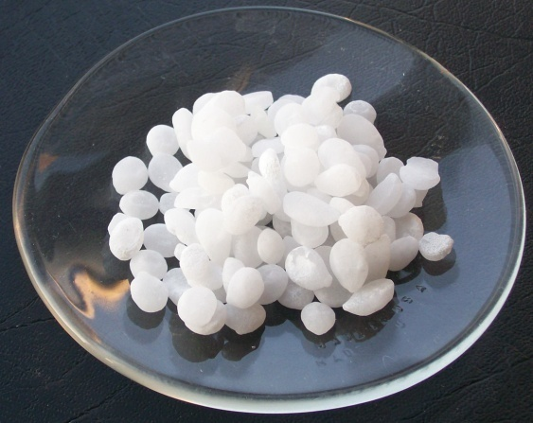
Experimental part I
Chemicals:
0,10 g phenolphthalein
2. 10 ml ethanol
3. 90 ml water
4. 20 drops of NaOH
Notes:
Izbacit posle exp
Dissolve the phenolphthalein in the ethyl alcohol.
Stir in 90 ml of water (will produce a milky solution).
Add sodium hydroxide solution dropwise until the solution turns a dark blue or red (might take slightly more or less than the number of drops stated in the Materials section).
Test the ink by applying it to fabric (cotton tee-shirt material or a table cloth works well). Paper allows less interaction with air, so the color change reaction takes more time.
In a few seconds, the 'stain' will disappear. The pH of the ink solution is 10-11, but after exposure to air will drop to 5-6. The damp spot will eventually dry. A white residue may be visible on dark fabrics. The residue will rinse out in the wash.

Slide 6
Video of the process

Slide 7
How Disappearing Ink Works
Carbon dioxide in the air reacts with water to form carbonic acid:
CO₂ + H₂O → H₂CO₃
The neutralization reaction is sodium hydroxide + carbonic acid → sodium carbonate + water:
2 NaOH + H₂CO₃ → Na₂CO₃ + 2 H₂O
Notes:
Once the sodium hydroxide is neutralized the acidity of the alcohol changes the "ink" to colorless.

Slide 8
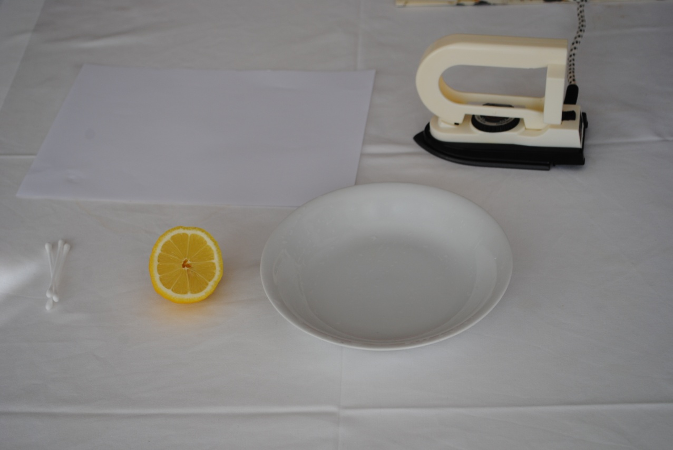
Materials
Cotton bud
White paper
Lemon juice
Small bowl
Iron or a candle

Slide 9
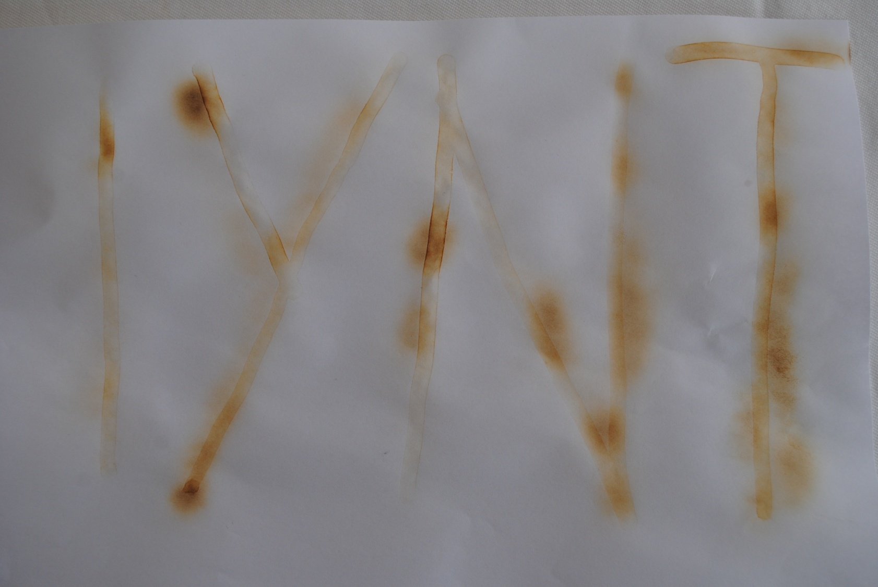
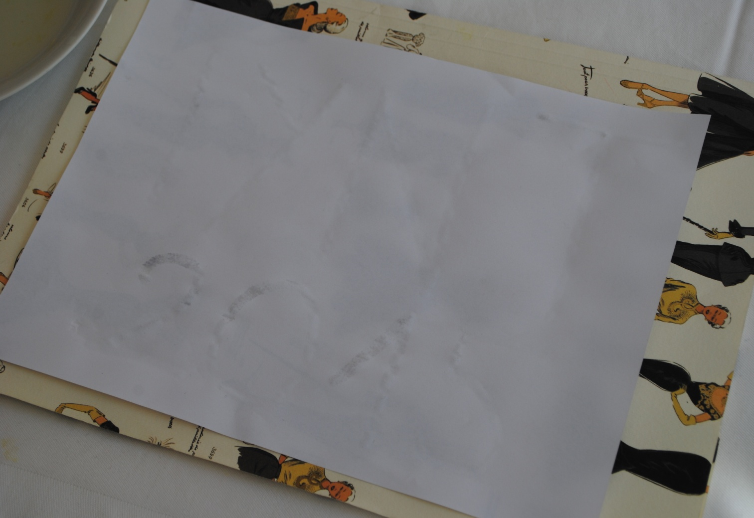
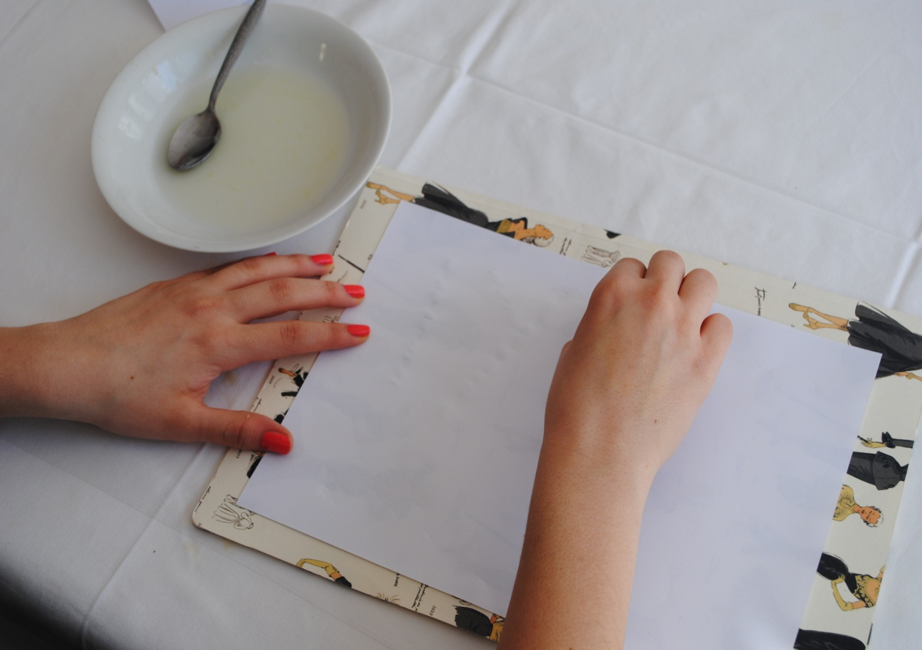
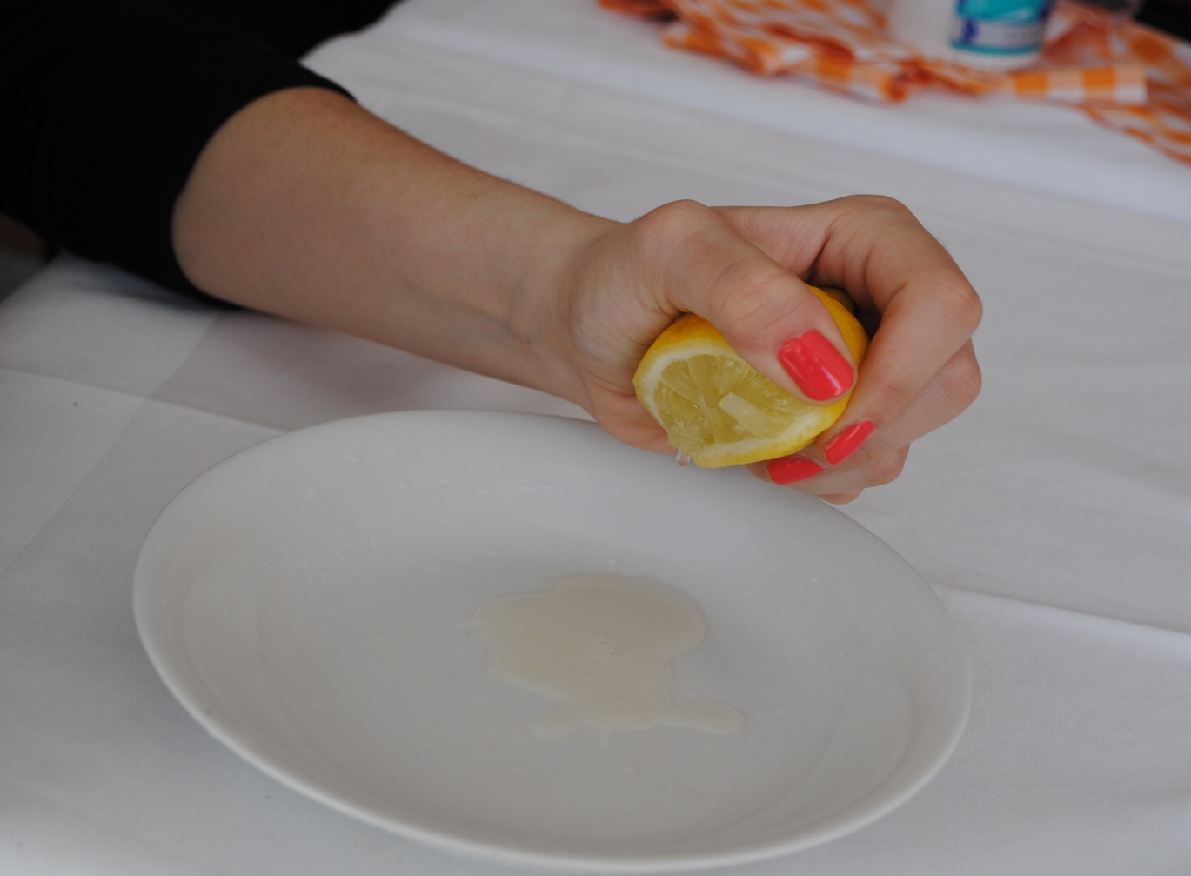
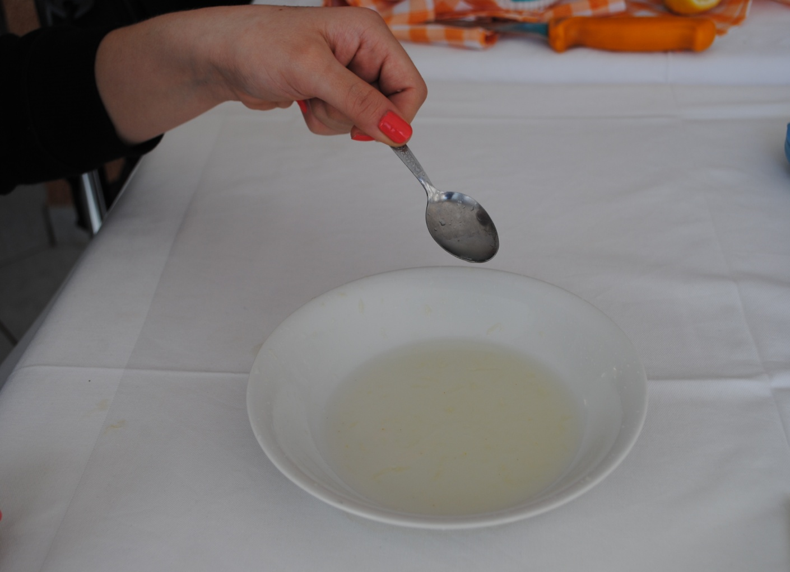
Lemon Juice Invisible Ink
Keep the paper near the candle until the message reappears
Dip a cotton bud in the mixture and
write a message on the white paper
Squeeze half of a lemon in a bowl
Add a few drops of water and stir it with the juice
Allow the invisible ink to dry
Notes:
As the ink dries, your message will disappear
. Squeeze the juice of half of a lemon into a bowl
Add a few drops of water. Stir the juice and water with a spoon.
3.Dip a cotton swab into the lemon juice mixture and write a message on a piece of white paper.
4. Allow the invisible ink to dry

Slide 10
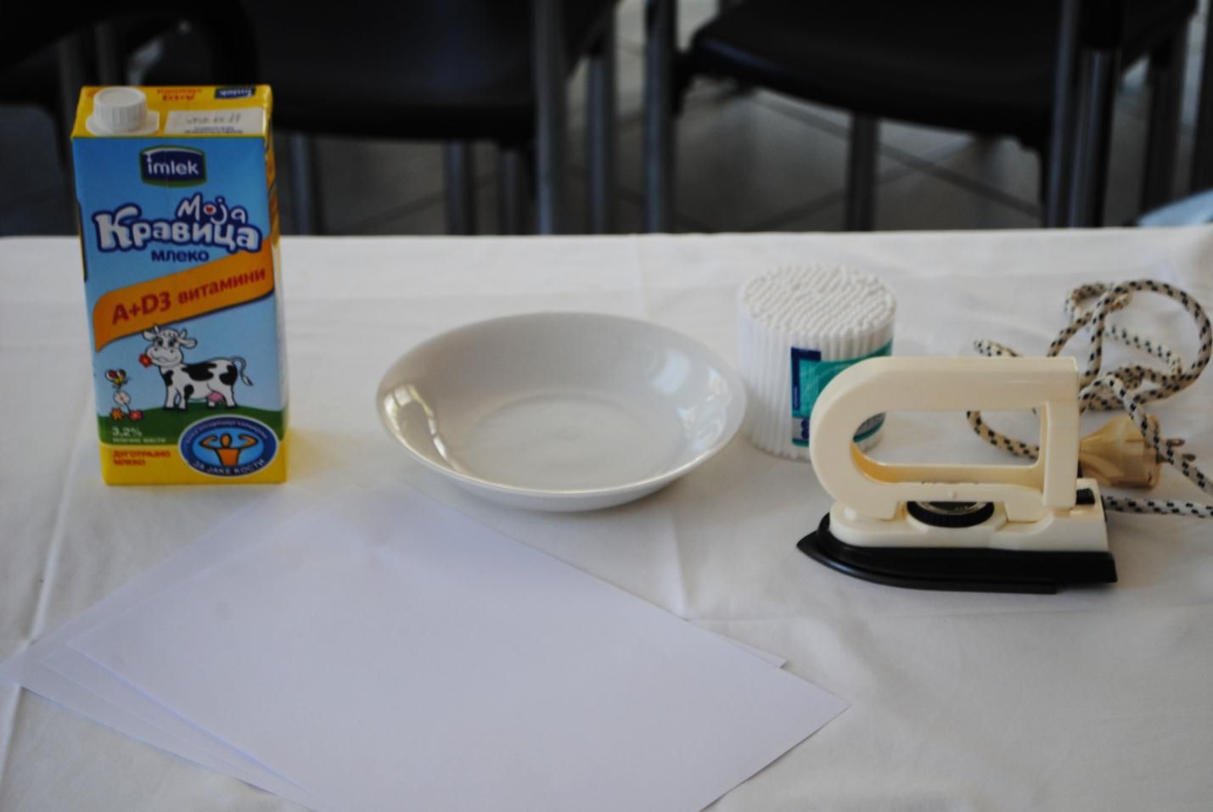
Materials
Milk
Paper
Iron
Cotton swab

Slide 11
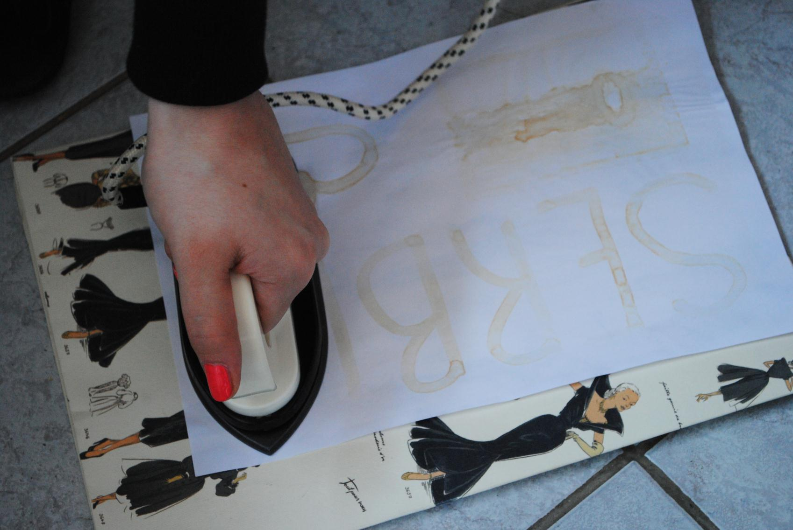
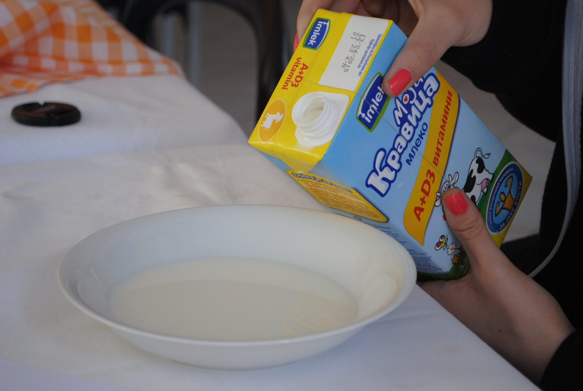
Milky way Invisible Ink
Use the milky cotton tip to write a message on the paper
Allow the milk to dry on the paper and
use an iron to reappear the message
Put a little milk in a bowl
Notes:
Put a little milk in a small bowl. Dip the cotton tip into the milk and make sure it's soaked through
Use the milky cotton tip to write a message on the paper.
Allow the milk to dry on the paper. This should take about 30 minutes.
To read the message just heat the paper.
Use an iron to iron the paper. Run the iron over the paper a few times and the secret message should appear on the paper.

Slide 12
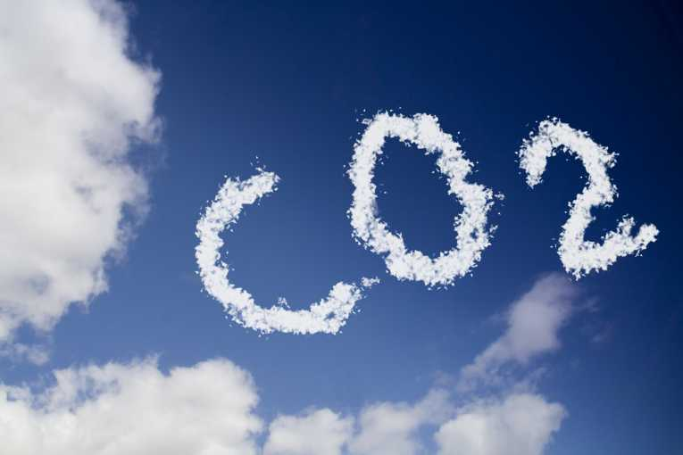
Parameters
Carbon-dioxide concentration
Base concentration
Air temperature

Slide 13
Conclusion
- phenolphthalein
- lemon juice
- milk
it is possible to appear again

Slide 14
THANK YOU FOR YOUR ATTENTION!!

Slide 15
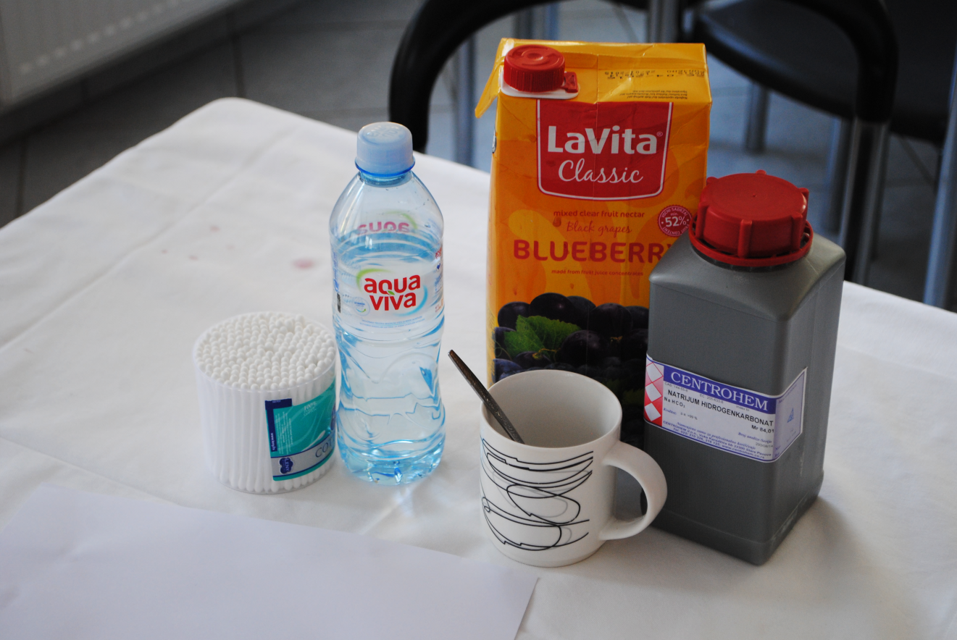
Materials
Baking Soda
Paper
Water
Cup
Cotton bud
Blueberry Juice

Slide 16
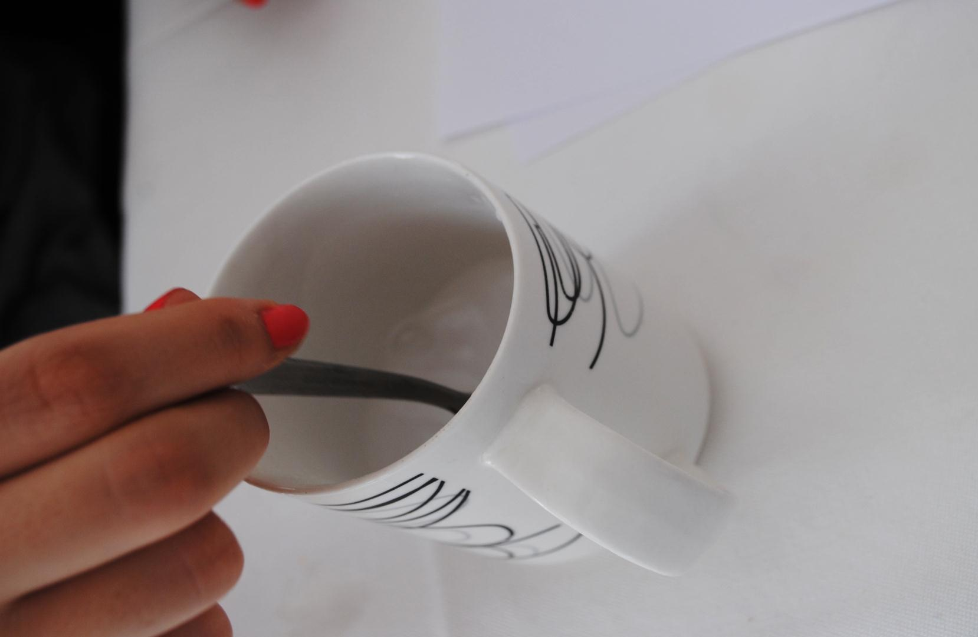
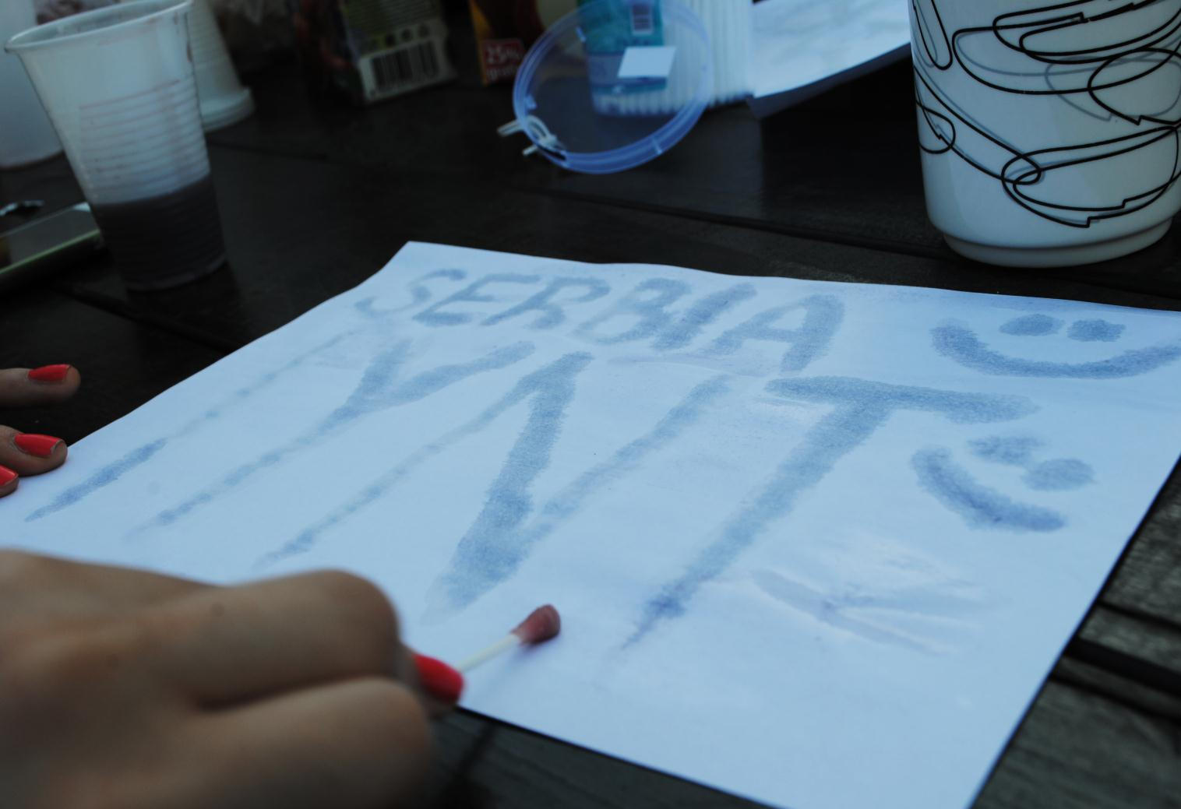
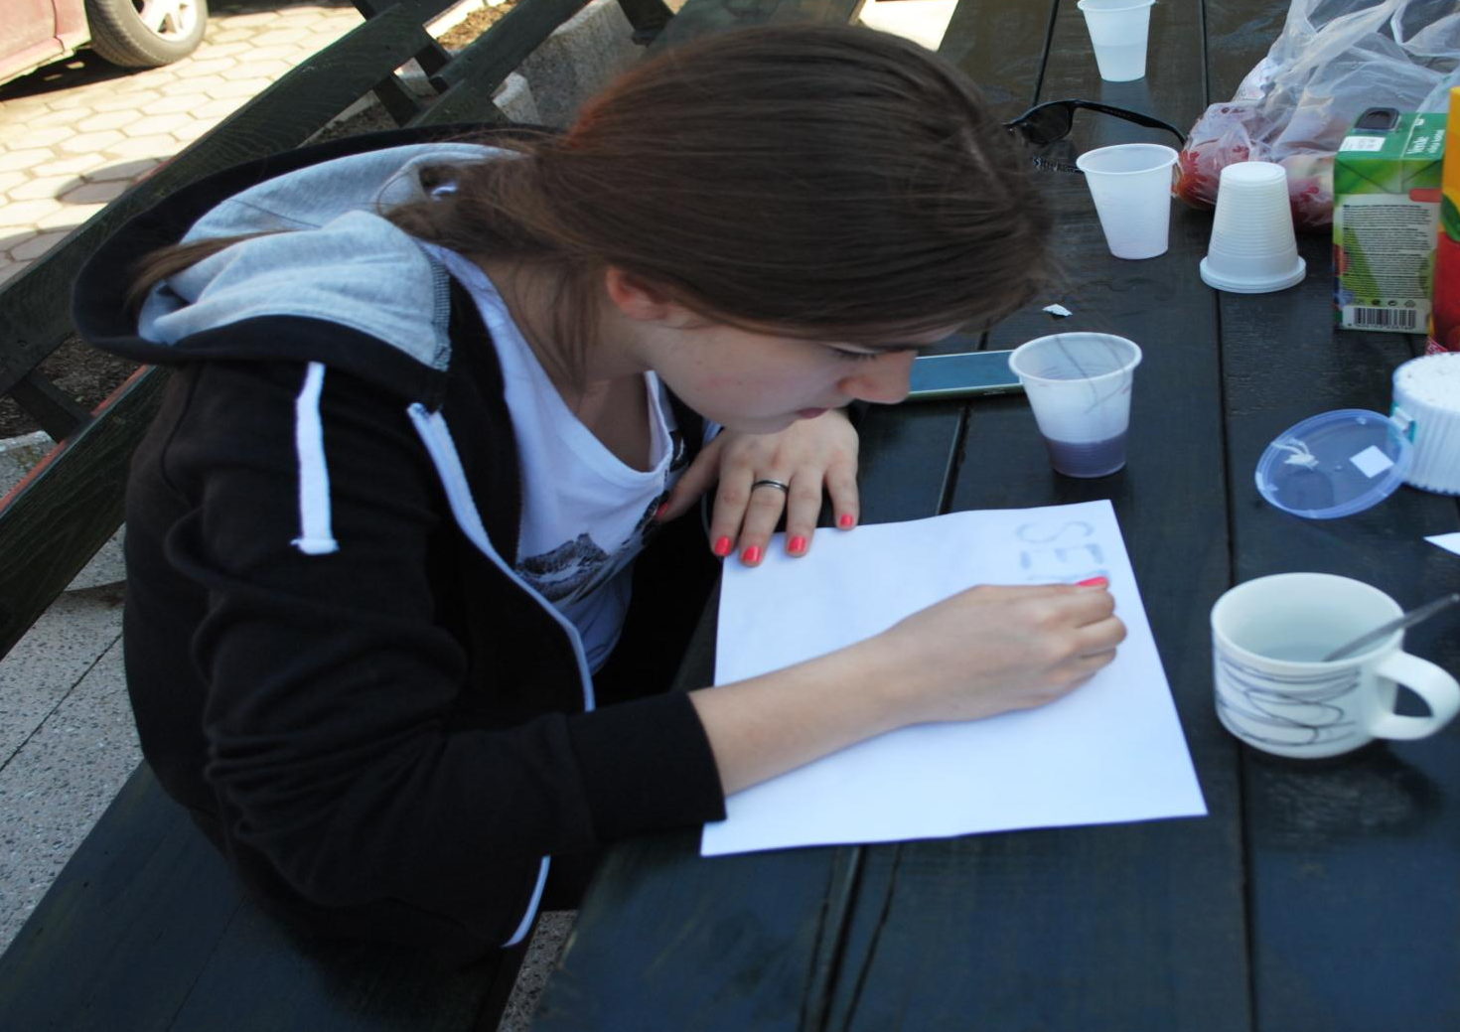
Baking Soda Invisible Ink
Paint over the dried baking soda message using a cottom bud and blueberry juice
Mix together 1/4 cup of water and
1/4 cup of baking soda in a bowl
Dip a cotton swab into the baking soda mixture and write your secret message on a piece of paper
Notes:
Mix together 1/4 cup of water and 1/4 cup of baking soda in a bowl, and combine them with a spoon.
Dip a cotton swab or a paint brush into the baking soda mixture, and write your secret message on a piece of paper. Allow the message to dry, which should only take a few minutes.
Paint over the dried baking soda message using a paint brush and grape juice. The grape juice and baking soda will react, causing the message you've written to appear
There are at least two methods to use baking soda as an invisible ink. Mix equal parts water and baking soda.
2. Use a cotton swab, toothpick, or paintbrush to write a message onto white paper, using the baking soda solution as 'ink'.
3. Allow the ink to dry.
4. One way to read the message is to hold the paper up to a heat source, such as a light bulb.The baking soda will cause the writing in the paper to turn brown.
5. A second method to read the message is to paint over the paper with purple grape juice. The message will appear in a different color.

Slide 17
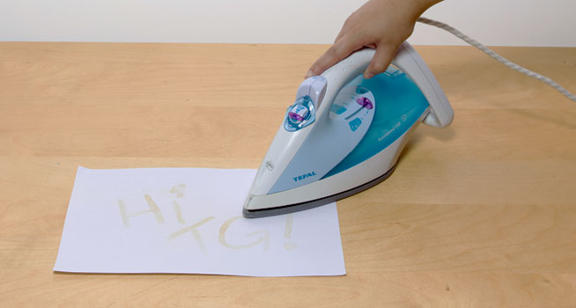
Why it works
Milk is an organic product which means it comes from a living thing. When it's heated, it burns at a slower rate than the paper. The heat from the iron actually burns the fat in the milk causing the colour of the milk to change.Your invisible message shows up brown.

Slide 18
Why it works
-Grape juice has an acid that reacts with the baking soda.
- A different color appears wherever the secret message is written.
- Baking soda and grape juice react with each other in an acid-base reaction, producing a color change in the paper.
- The baking soda mixture can also be used more diluted, with one part baking soda to two parts water.
Grape juice concentrate results in a more visible color change than regular grape juice.
If you are using the heating method, avoid igniting the paper - don't use a halogen bulb.

