Slide 1
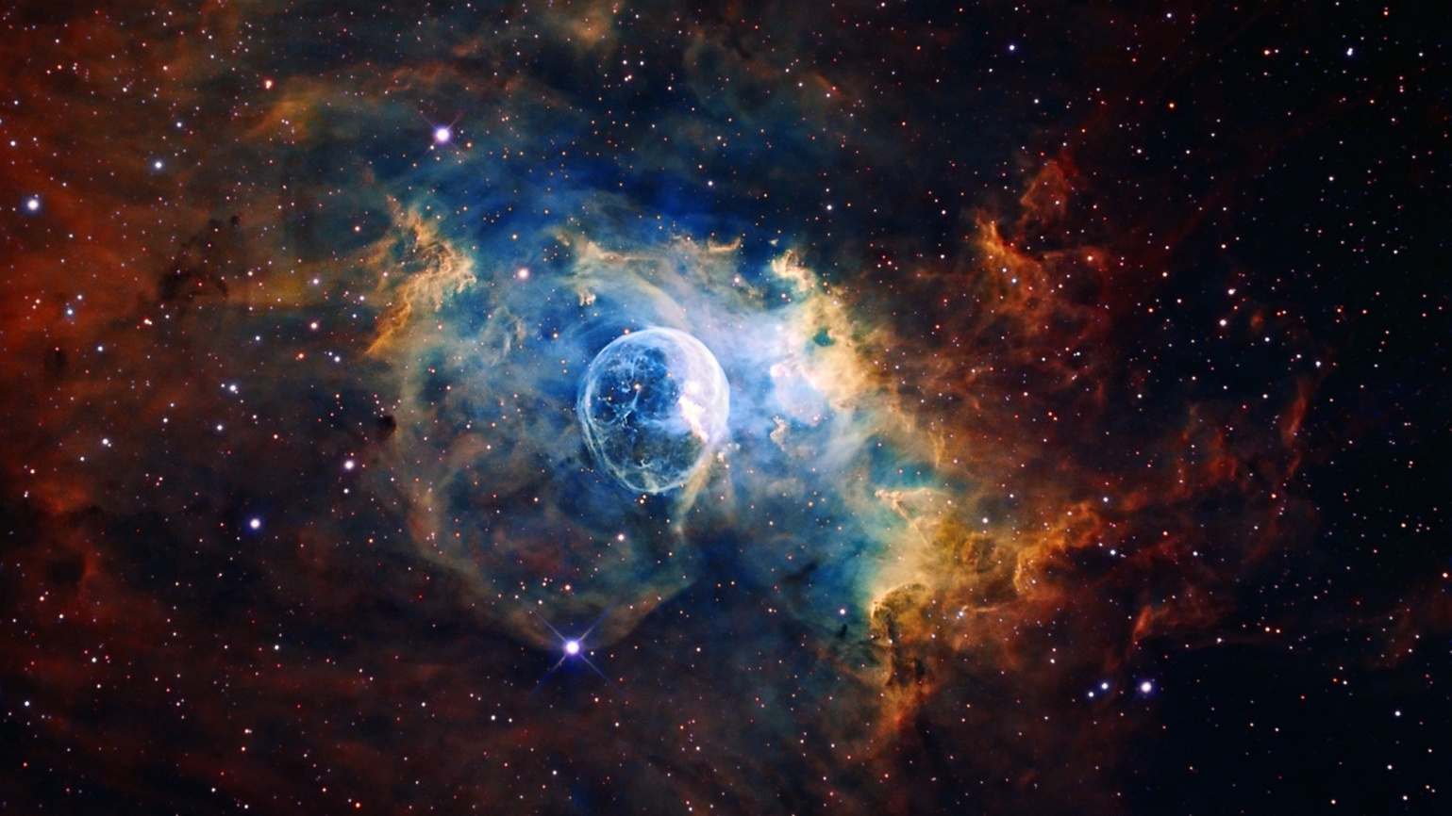
9. Distances in open space
III
IYNT
Team Serbia 1

Slide 2
9. Distances in open space
How do astronomers measure distances between the planets of the Solar System, between the stars in our Galaxy, or between the galaxies? Determine the distance between the two space objects of your choice.

Slide 3
Background of the problem
Units:
1° = 60 arcmin = 3600 arcsec
1 LY = 63 240 AU, LY - light year
1 pc = 3.08567758 × 1016 meters = 3.26163344 LY
1 AU (one astronomical unit) - distance between the Sun and the Earth
1 pc is the distance at which 1 AU subtends an angle of one arcsecond
Parallax angles of less than 0.01 arcsec - difficult to measure from the Earth
Earth based telescopes - 100 pc (about 326.16 light years) away
Space based telescopes - accuracy to 0.001

Slide 4
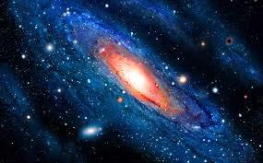
Methods for measuring distances in open space
1. Parallax
2. Standard candles
2.1. Cepheid Variables
2.2. Type Ia Supernovae

Slide 5
1. Parallax
The apparent displacement of an object because of a change in the observer's point of view
Stellar parallax
Distant fixed stars
The Earth
Parallax angle
Nearby star
p
The Sun

Slide 6
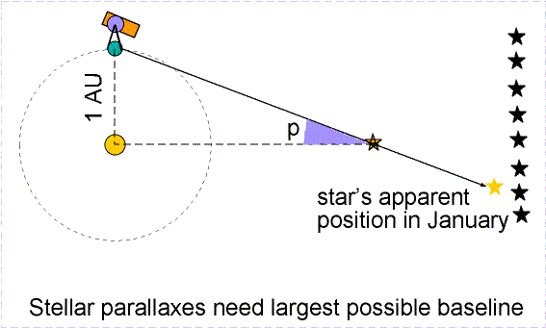
Parallax - explanation

Slide 7
Parallax - explanation
$$\tan\left(90°−p\right)=\frac{x}{d}$$
the direction of Earth’s rotation
$$x=d\tan{(90°−p)}$$
p
x
p
d
90°-p
p
parallax angle
x - the distance between the Sun and the star
d – the distance between the Sun and the Earth
observer from the Earth

Slide 8
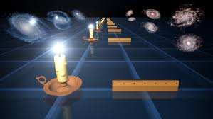
2. Standard candles
Distance indicators - known brightness
The inverse square law

Slide 9
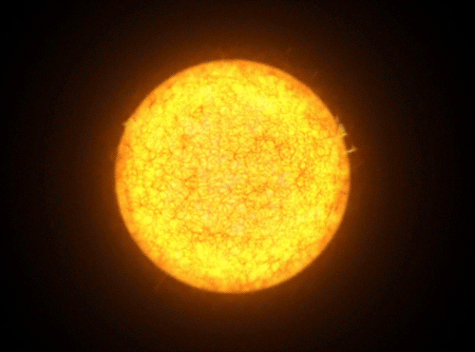
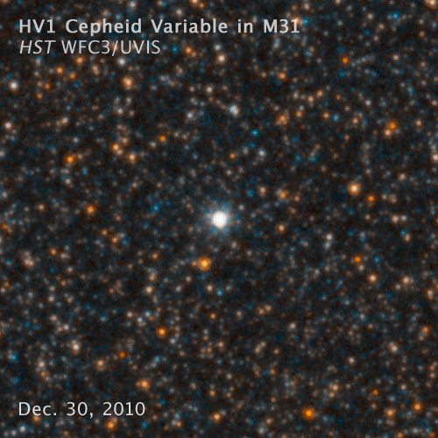
2.1. Cepheid variables
Intrinsic variables which pulsate in a predictable way and their period is directly related to their luminosity

Slide 10
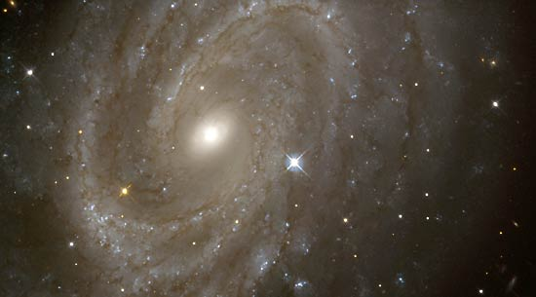
Cepheid variables - explanation
Cepheid variable stars can be used as the method of measuring larger distances (from about 1kpc to 50 Mpc)
The reason that very distant stars can be observed and measured is the extreme luminosity of these stars

Slide 11
Cepheid variables - explanation
Apparent magnitude - how bright an object appears in the sky from Earth
The brighter an object appears, the lower its magnitude
Apparent Magnitude | Celestial Object
-26.7 | Sun
-12.6 | Full Moon
-4.4 | Venus (at brightest)
-3.0 | Mars (at brightest)
-1.6 | Sirius (the brightest star)
+3.0 | Naked eye limit in an urban neighborhood
+5.5 | Uranus (at brightest)
+6.0 | Naked eye limit
+9.5 | Faintest objects visible with binoculars
+13.7 | Pluto (at brightest)
The faintest objects have apparent magnitudes of 30

Slide 12
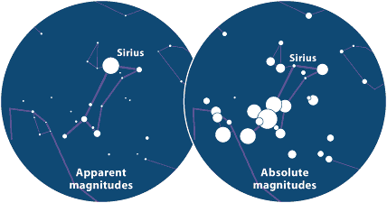
Cepheid variables - explanation
Absolute magnitude - the apparent magnitude an object would have if it was located at a distance of 10 parsecs
Distance modulus equation :
m - M = 5log₁₀(d) - 5
m - apparent magnitude of the object
M - absolute magnitude of the object
d - distance to the object in parsecs
m - M is the distance modulus

Slide 13
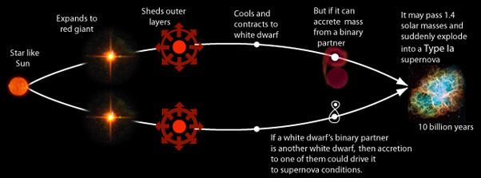
2.2. Type Ia Supernovae
Type Ia Supernovae occur in a binary system - two stars orbiting one another
One of the stars in the system must be a white dwarf star and the other can be a giant star or a smaller white dwarf

Slide 14
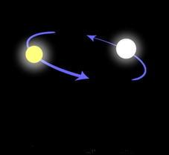
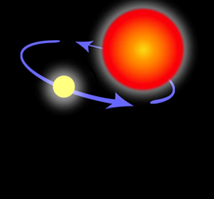
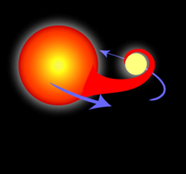
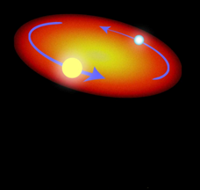
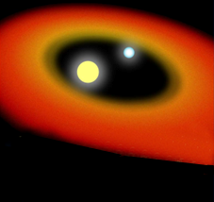
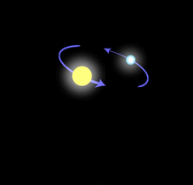
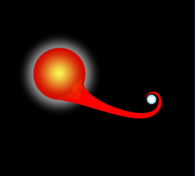
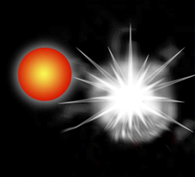
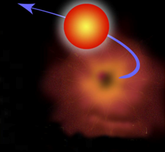
Type Ia Supernovae – explanation
All Type Ia Supernovae have nearly the same luminosity and they have an absolute magnitude of -19.3 ± 0.03
Type Ia Supernovae - distances from about 1 Mpc to over 1000 Mpc

Slide 15
Our calculation using parallax
$$p=0.377arcsec=0.377×\left(2.777777778×{10}^{−4}\right)°=\left(1.047222222×{10}^{4}\right)°$$
$$1°=3600 arcsec⇒1 arcsec=\frac{1°}{3600}=\text{(2.}\text{77777777}\text{8}×{10}^{−4})°$$
$$1 LY=63 115 AU⇒1 AU=\frac{1LY}{63115}=\text{1.58440941}\text{1}×{10}^{−5}LY$$
$$d=1AU=1.584409411×{10}^{−5}LY$$
$$x=?$$
p
63115
90°- p
3600
d
1 LY
x
p
Sirius
$$\tan\left(90°−p\right)=\frac{x}{d}$$
$$x=d×tan⁡(89.99989528°)$$
$$x=1.584409411×{10}^{−5}×547121.5016LY$$
$$x=8.668644561LY$$

Slide 16
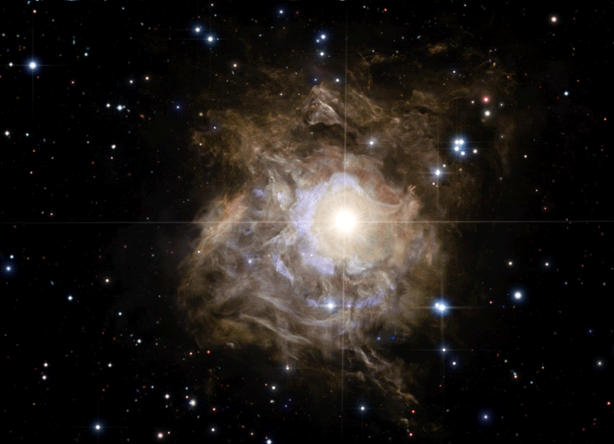
Our calculation using Cepheid variables
T = 34 days
M = -5.65
m = +23.0
$$m−M=5\log{d}−5$$
$$d={10}^{\frac{(m−M+5)}{5}}pc$$
$$d={10}^{\frac{(23−\left(−5.65\right)+5)}{5}}pc$$
$$d={10}^{6.73}pc$$
$$d=5.4×{10}^{6}pc$$
M-absolute magnitude; m-apparent magnitude; d-distance

Slide 17
Conclusion
Methods:
Radar
Parallax
Standard candles
Calculations
Parallax – distance between the Sun and the Sirius (8.668644561𝐿𝑌)
Cepheid variables – 5.4 x ${10}^{6}$pc

Slide 18
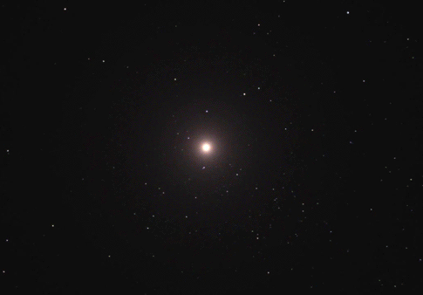
Thank you for your attention!

Slide 19
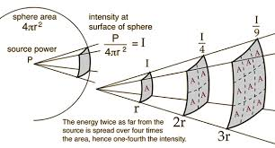
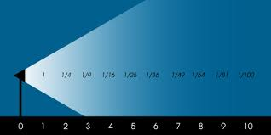
The inverse square law

Slide 20
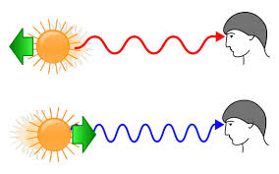
Doppler effect

Slide 22
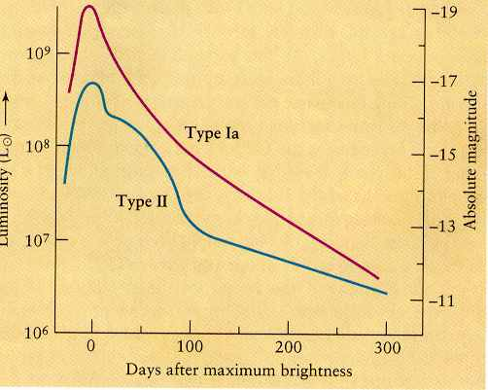
Type Ia Supernovae as a standard candle

