Slide 1
Serbian Team
Problem 15
Regional Center for Talented Youth Belgrade II

Slide 2
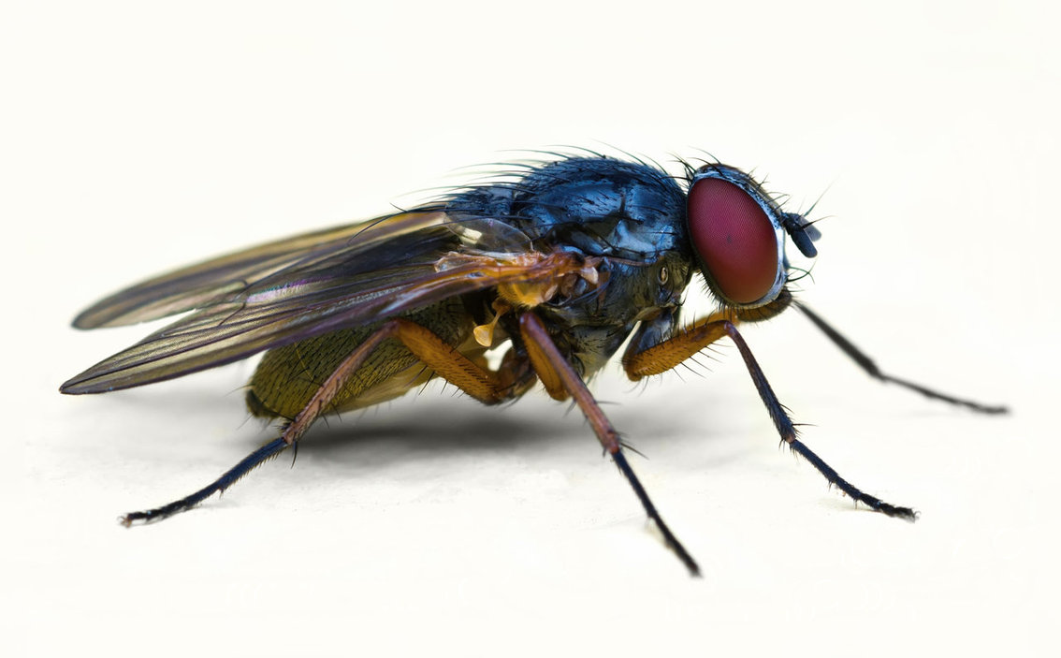
15.
Fly A fly can easily walk on a ceiling. How is this possible? Can one find such a ceiling that the fly would be unable to walk on?

Slide 3
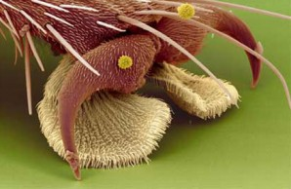
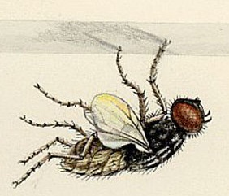
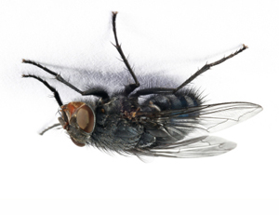
Stages
3. Sticking to the ceiling
1. Upper legs
2. Lower legs

Slide 4
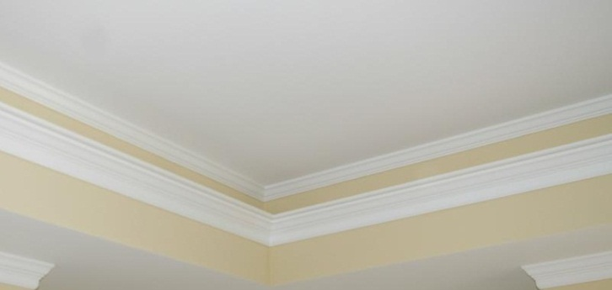
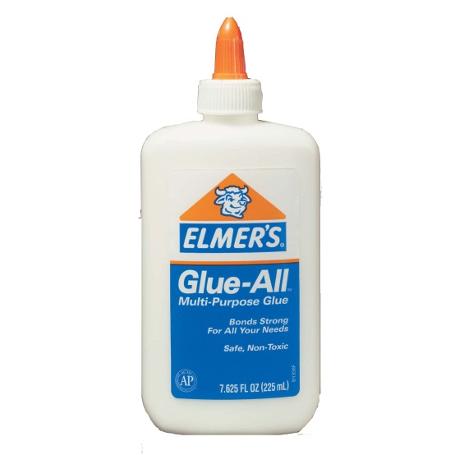
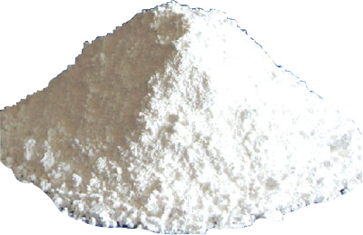
Can one find such a ceiling that the fly would be unable to walk on?
unable to walk on
To be kept stick to the ceiling
To fall off immediately
To be unable to stick to the ceiling

Slide 5
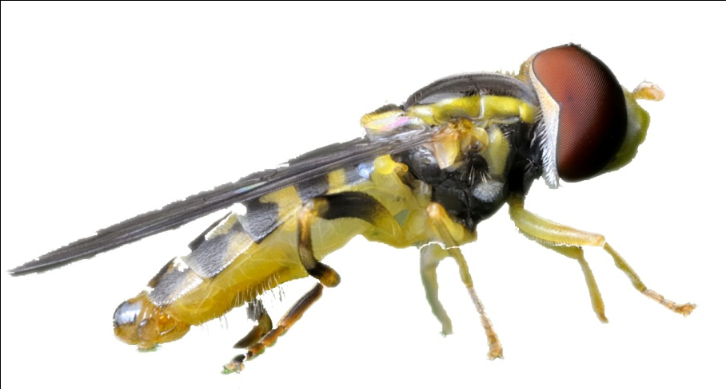
To be kept stick to the ceiling
Glue would permanently keep the fly stick to it

Slide 6
To fall off immediately

Slide 7
To be unable to stick to the ceiling

Slide 8
Thank you for your attention!

