Slide 1
Serbian Team
Problem 14
Regional Center for Talented Youth Belgrade II

Slide 2
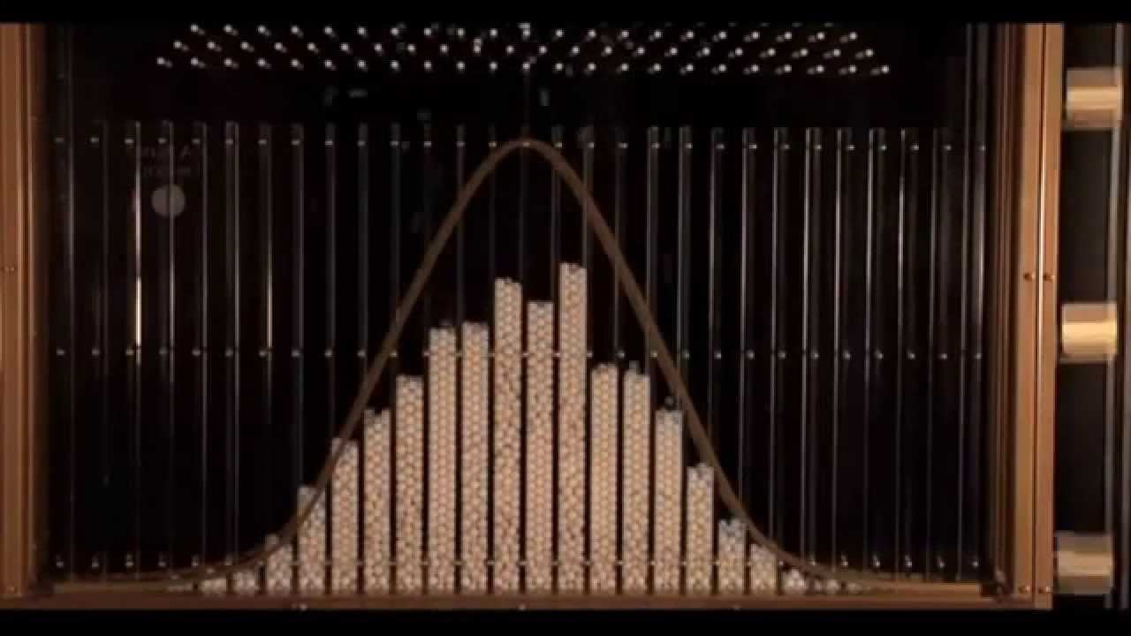
14. Galton box
In the Galton box, a regular 2D lattice of obstacles disperses a thin flow of falling particles. When falling on the bottom of the box, the particles show a normal distribution. Use various types or particles and different arrangements of the obstacles to find the conditions when the distribution is no longer normal.

Slide 3
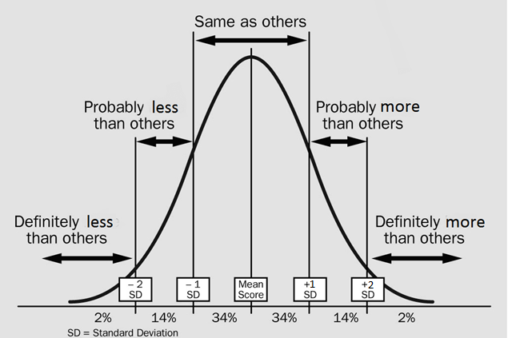
About the Galton Box

Slide 4
Shaping the obstacles like this
Ways of disrupting the normal distribution
Putting just one obstacle

