Slide 1
INTERNATIONAL YOUNG NATURALISTS’ TOURNAMENT
10. Ice Hole
Team Serbia
Regional Center for Talented Youth Belgrade 2

Slide 2
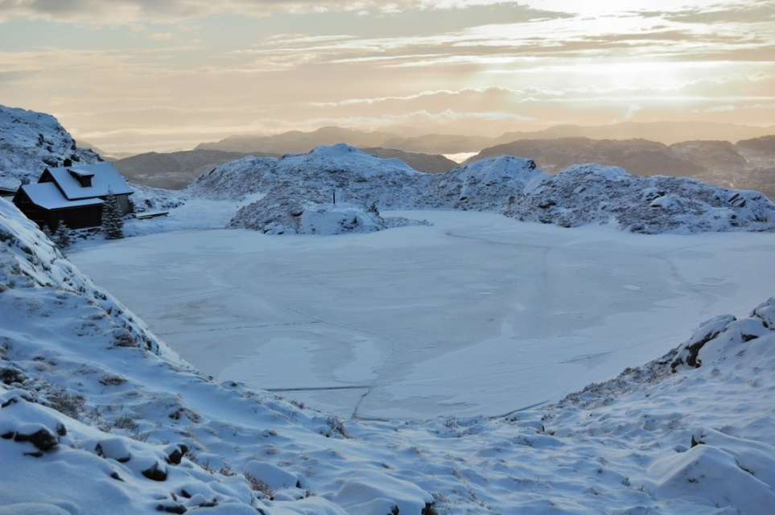
10. Ice hole
You have drilled two ice holes in a frozen lake on a frosty winter day. One ice hole is close to the shore, while the other ice hole is far from the shore. Surprisingly, the height difference between the ice surface and the liquid water is different for each hole. How can you explain this? How can one use this height difference to determine the local ice thickness?
Notes:
Ever wondered whether it was sufficiently cold for sufficiently long to allow you to stand on ice, without falling in? I once did. Here is an estimate for the duration required to reach a given thickness. Actually, it is a lower limit, since we assume a few simplifying assumptions. The most important assumption is that the water beneath the ice is still, such that it could have cooled down to a near freezing temperature (if it cannot, because of constant mixing for example, more heat will be available). In other words, the estimate is a lower limit. Don't try to stand on the ice just because you calculated it to be thick enough! Having cleared that up, we can begin with the estimate. We assume that the time it takes the heat to diffuse across the ice is much shorter than the time it takes the ice to form. This implies that the temperature profile can reach its equilibrium which is a linear change from the bottom to the top. (We will later have to check the validity of this assumption). Thus, at every instant, we assume that the profile has the form:T(z,x)=T0(1−zx),
where x is the width of the ice at the given instant. T₀=-ΔT<0 is the external temperature (again, we assume it be 0 at the inner edge). As time progresses, the thickness increases x→x+δx. This implies two things. First, freezing of a layer δx wide takes place. Second, the whole x wide layer cools. Both require energy. Per unit area of ice, it is:δE=ϵρδx+∫z=x0∣∣∣dT(z,x)dx∣∣∣cρδxdz=ϵρδx+ΔTz22x2∣∣∣z=xz=0cρδx=(ϵρ+cρΔT2)δx.
The absolute sign is there because the layer cools, and we are looking at the total energy we need to take out of it. ε is the latent heat required to melt ice (per unit mass) while c is the heat capacity per unit volume. We assume that this energy leaves the ice only from its top (i.e., there is no heating from the water beneath). The heat flux leaving is thus:dEdt=κΔTx.
By combining the two equations, we obtain an equation for x:κΔTx=(ϵρ+cρΔT)2)dxdt ⇒ xdx=κΔT(ϵρ+cρΔT2)dt,
which has the solution:x2f=2κΔTtf(ϵρ+cρΔT2),
where t_{f} is the final time and x_{f} is the final width. We assumed of course that freezing commences at t=0. The time required to obtain an ice layer with a width x is:tf=x2(ϵρ+cρΔT2)2κΔT.
We see that there are two terms. One depends on the latent heat and another on the heat capacity. The heat capacity term is going to be more important ifΔT≳2ϵc≈160∘C.
where we have plugged in the values of the latent heat and heat capacity of ice: ε=3.3 10⁵ J Kg⁻¹, c=2.1 10³ J Kg⁻¹ K⁻¹. Clearly, the heat capacity is not important under normal terrestrial conditions. Note also that if the heat capacity is neglected, we can easily generalize the result to a time varying temperature. In such a case, the integral over dt is simple enough:∫t=tft=0ΔT(t)dt≡ΔT¯¯¯¯¯¯¯¯tf,
where ΔT is the average temperature. In such a case, we havetf≈x2ϵρ2κΔT¯¯¯¯¯¯¯¯.
Using the actual numbers for the ice density and conductivity (ρ=920 Kg m⁻³, κ = 2.3 J m⁻¹ s⁻¹ K⁻¹), we find that the time in days is given by(tf/[day])≈0.08(x/[cm])2ΔT¯¯¯¯¯¯¯¯/[∘C].
If for example the average temperature is 2 degrees below freezing, then it would require about 4 days to freeze 10 cm of ice, which is about the minimum necessary to safely travel on foot (and do some ice fishing, if it's your cup of tea). If you want to drive your car (e.g., to shorten the way back home to Yellowknife), you'll need 25 days at this average temperature. For 10 degrees below freezing, it would shorten to about 5 days. Again, this assumes optimal conditions, that the water was close to freezing before the ice began forming (and in particular, that there is no constant supply of warm water such as that from a nearby stream inlet). One last point, we assumed in the calculation that the heat diffusion time through the ice is short (thereby allowing us to assume a linear temerature profile). Now we can verify that this assumption is valid. If the diffusion coefficient is λ, the diffusion time scale is t_{diff} = x²/λ. Since the heat diffusion coefficient of ice is λ=1.1 m²/s, t_{diff} ~ 2.5 hrs for 10 cm thick ice, indeed much shorter than a few days (in fact, since the thermal diffusion time is related to the thermal conductivity, one can show that this assumption is valid as long as the heat capacity, which we neglected above, is indeed not important).

Slide 3
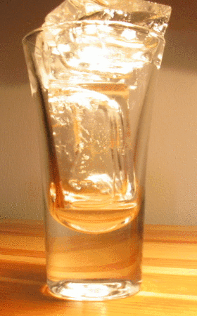
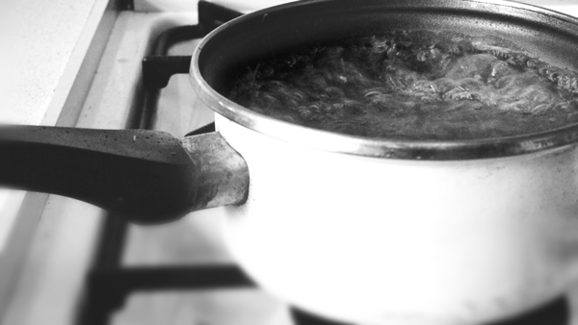
How do the things cool down and warm up?
Atoms get more energy in them and they move faster →heat.
Things are cold if their molecules are moving more slowly.
Notes:
For instance, if you put an ice cube in your mouth, your mouth will get colder, and the ice cube will melt.

Slide 4
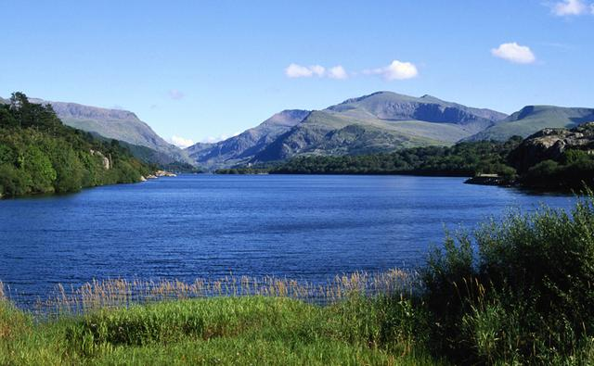
Why does water cool down and warm up slower than soil?
Water loses energy slower than the soil

Slide 5
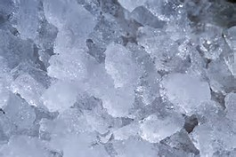
Ice

Slide 6
Ice
Molecule of H2O
Hydrogen bond

Slide 7
Т (°C) | Density of WATER (g/cm³) | Density of ICE (g/cm³)
30 | 0,9957 | /
20 | 0,9982 | /
10 | 0,9997 | /
0 | 0,9998 | 0.9162
-10 | 0,9982 | 0.9189
-20 | 0,9935 | 0.9194
-30 | 0,983 | 0.9200
The values below 0 ºC (for density of water) are for overcooled water (not for ice).

Slide 8
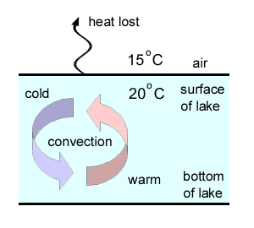
Ice formation

Slide 9
Difference in ice height
The height of the ice and the liquid water is greater closer to the shore than far away from the shore
Greater mass of water further away from the shore
Losses energy harder as there are more particles

Slide 10
Calculation
Fp
S
h
d
mg
Fp = mg
ƍ_{ice} gV = mg
ƍ_{ice} Sd = ƍ_{water}V_{ice2}
ƍ_{ice} Sd = ƍ_{water}S(d - h)
ƍ_{ice} d = ƍ_{water}d - ƍ_{water}h
ƍ_{water}h = ƍ_{water}d - ƍ_{ice} d
ƍ_{water}h = d(ƍ_{water} - ƍ_{ice} )
d= (ƍ_{water}h)/(ƍ_{water} - ƍ_{ice} )
d – the thickness of ice
h – the distance between the surface of ice and the surface of water
S – the surface of ice

Slide 11
Conclusion
Formula that we used to determine ice thickness is :
The ice is thicker near the shore- reason is soil
d= (ƍ_{water}h)/(ƍ_{water} - ƍ_{ice} )

Slide 12
Thank you for your attention!

