Slide 1
Serbian Team
Problem 8
Regional Center for Talented Youth Belgrade II

Slide 2
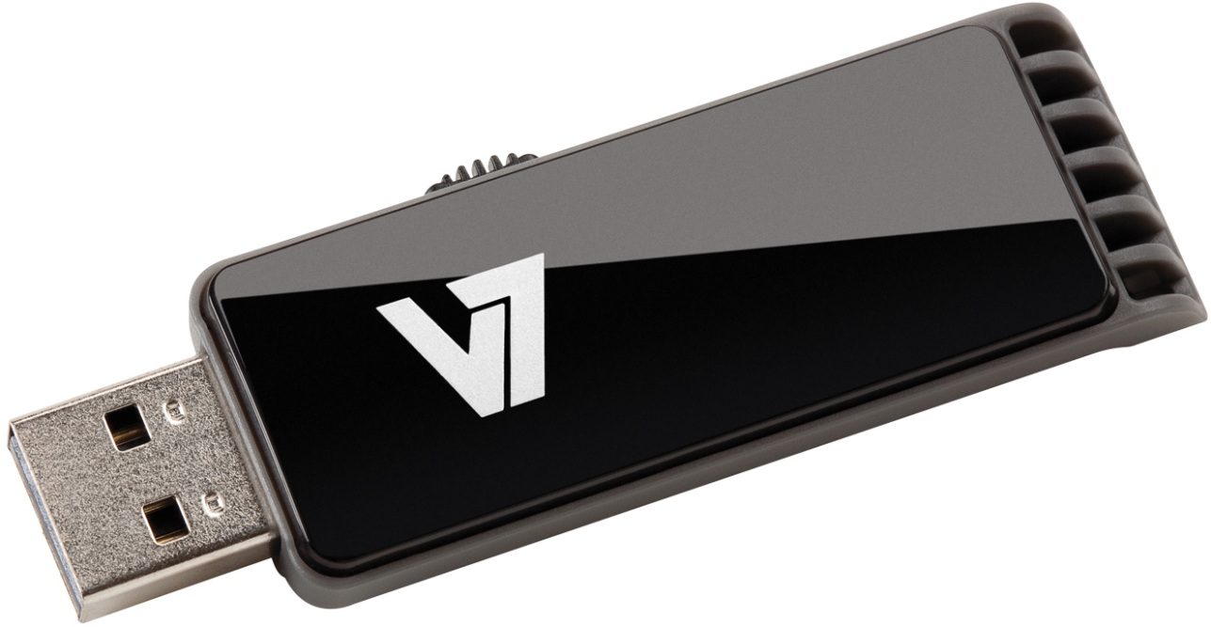
Problem 8
One person has decided to download all of the fiction existing in the English language and store it on a single USB stick. He expects to find or generate the respective text files, compress them, and then index them conveniently. Is this ambition realistic? Suggest a plan to approach this goal and solve a partial problem of this plan.

Slide 3
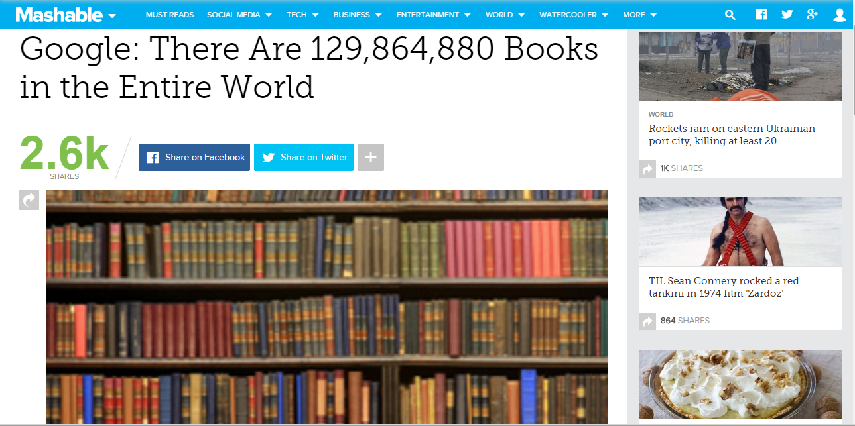
129,864,880
Books until 2010.
2010. – 2015.
Average book size

Slide 4
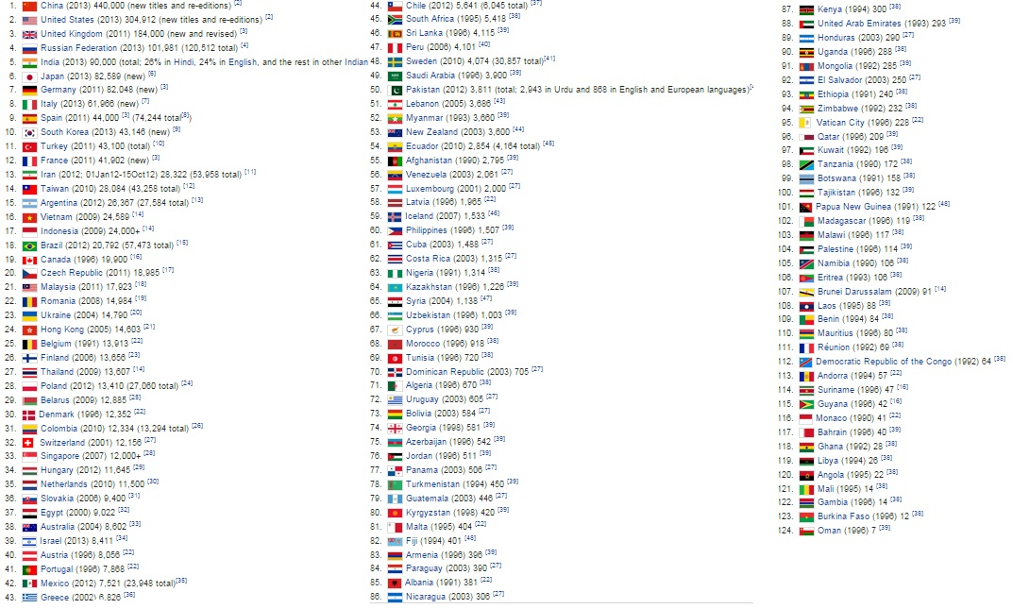
Countries used in research
2 133 974
Books in a year

Slide 5
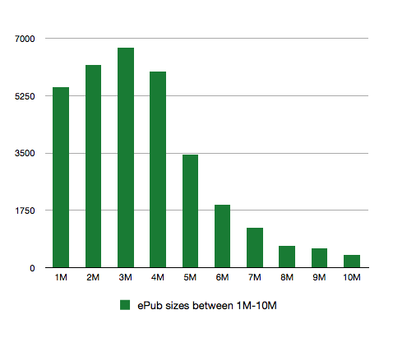
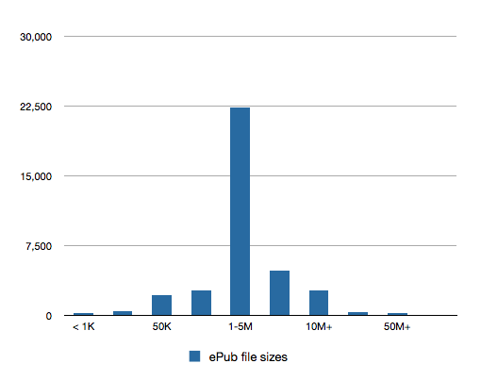
The results for ePUB
Average – 2.4MB

Slide 6
The Effect of Compression
2.4MB
41%
*
Number of books | 1 | 5 | 10
Size in .PDF | 1058kB | 11571kB | 22118kB
Size in .docx | 427kB | 6804kB | 13458kB
Size in compressed folder | 423kB | 6711kB | 13049kB
Percent of saved space | 60% | 58% | 59%
0.9MB

Slide 7
2010 – June 2015
4.2 years
2 133 974 books/year
0.9MB
*
+
129,864,880
138827570.8 books
*
124 944 813.7MB
119.5TB

Slide 8
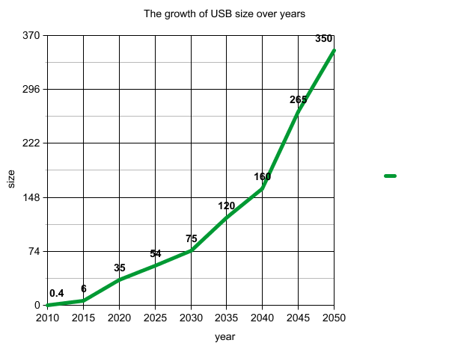
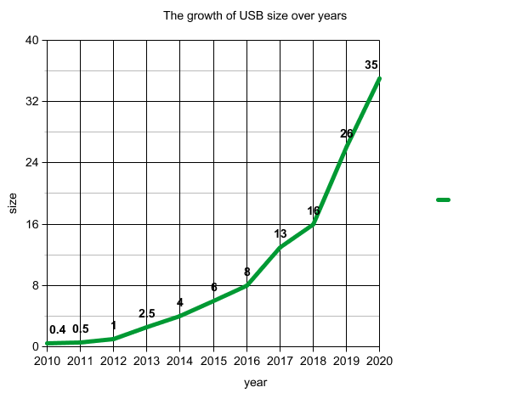
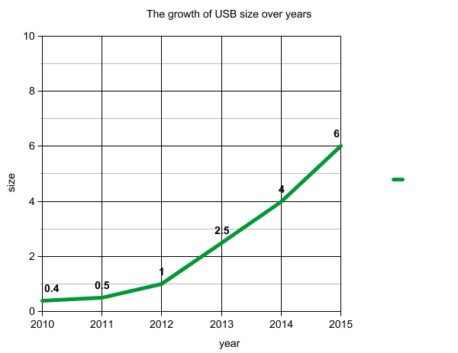
The Future of the USBs

Slide 9
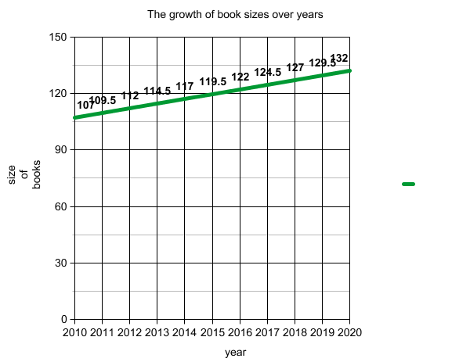
The Future of Books

Slide 10
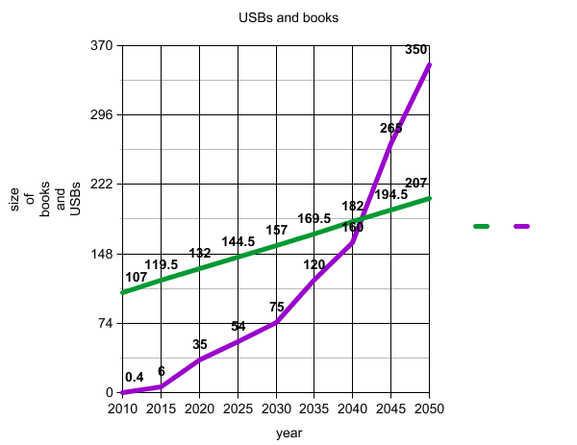
The Possibility to Store the Books
2042. – 2044.
(In TB)

Slide 11
Thank you for your attention!

Slide 12
2 133 974
2.6MB
2 133 974
*
0.9MB
5 121 537.6MB
4.88TB/year

Slide 13
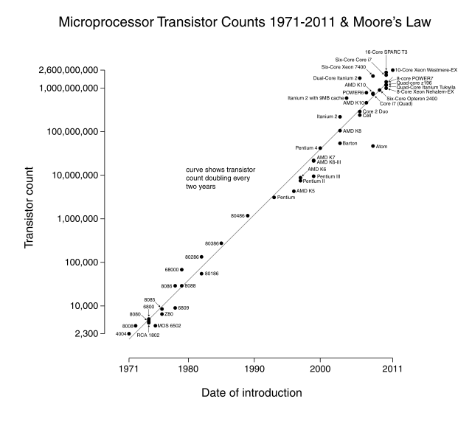
Moore’s Law

Slide 14
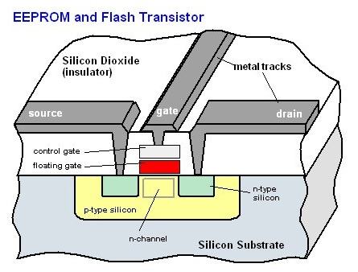
How USBs work

