Slide 1
Serbian Team
Problem 7
Regional Center for Talented Youth Belgrade II

Slide 2
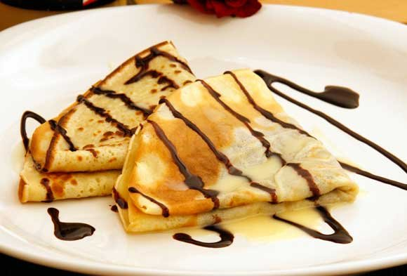
Problem 7
7. Pancakes
It is argued that pancakes can be so good looking that they ignite appetite by their appearance only. Suggest grounded scientific criteria to parameterize how appetizing the pancakes are.

Slide 3
Parameters used to make pancakes
shape
color
taste
Regulated by:
Movements of the pan
Duration of cooking
Number of eggs

Slide 4
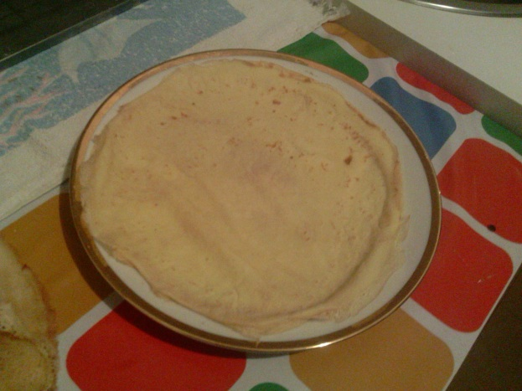
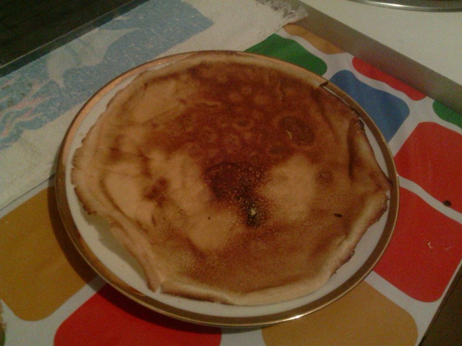
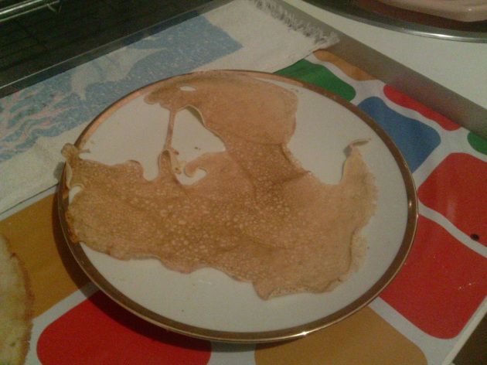
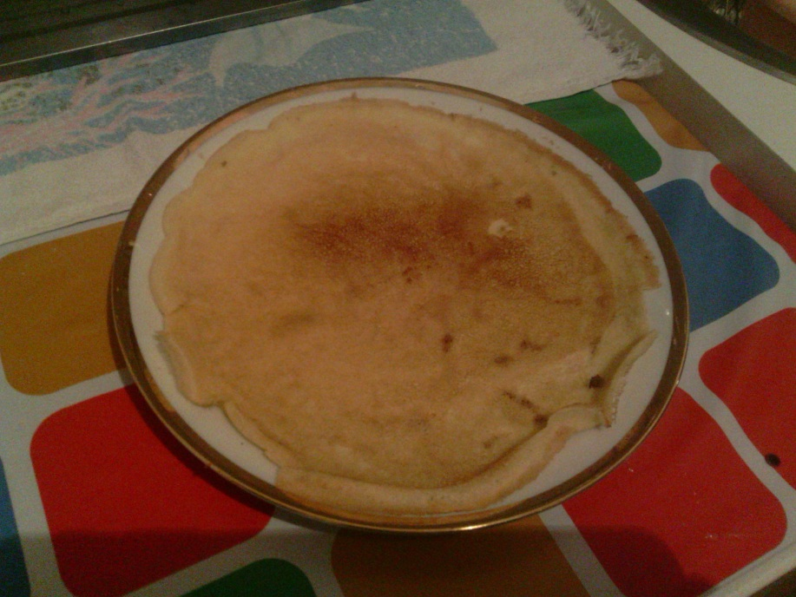
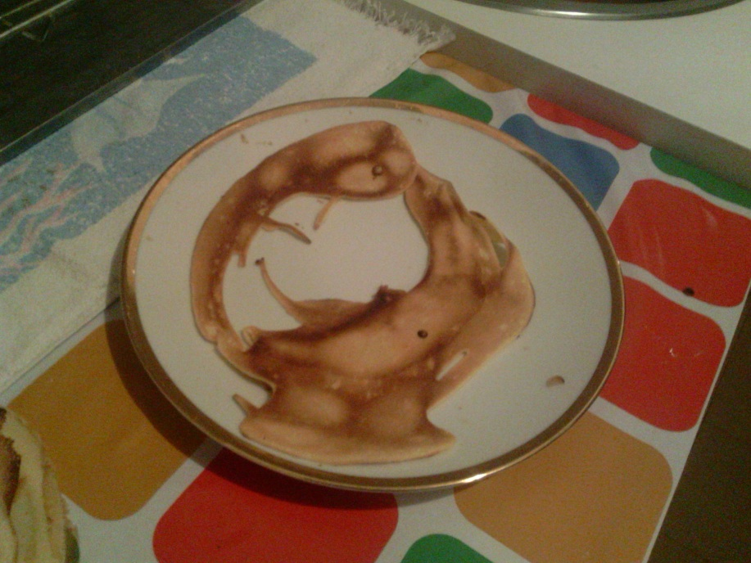
The experiment

Slide 5
The results

Slide 6
Thank you for your attention!

