Slide 1
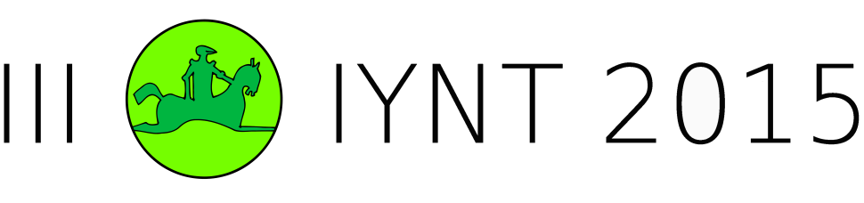
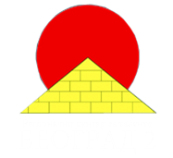
International Young Naturalists’ Tournament
                11. Puzzle in a beaker
                Serbian team
                Regional Center For Talented Youth

Slide 2

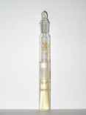
11. Puzzle in a beaker
A researcher decided to measure the diffusion rate of ammonia in gelatin. He added some magnesium sulfate to the hot gelatin solution which set to a gel on cooling. He then poured some aqueous solution of ammonia onto the gel and left the beaker for two days. The researcher was surprised to discover white layers of precipitate in the beaker, as depicted in the Figure. Explain this phenomenon and determine what does the number of bands depends upon.

Slide 3
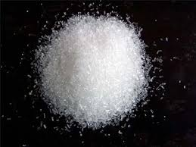
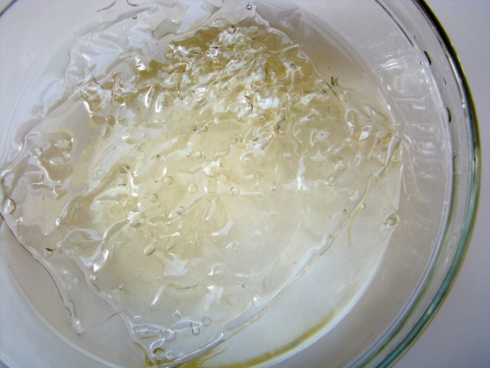
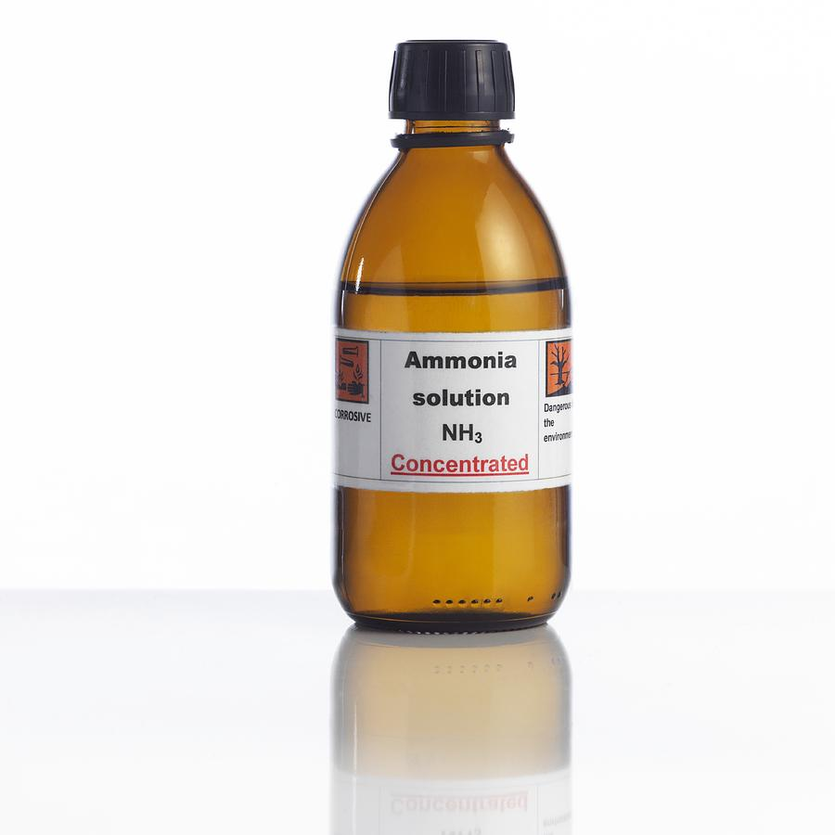
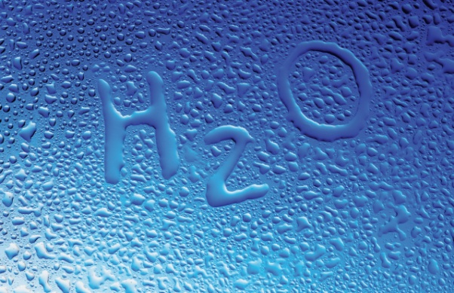
Background of the problem
1. Introduction – Explanation of diffusion
2. Experimental part
  2.1. Chemicals
  2.2. Procedure
3. Results
4. Explanation of results
5. Conclusion

Slide 4
1. Diffusion
high concentration → low concentration
random movement of particles
passive process

Slide 5
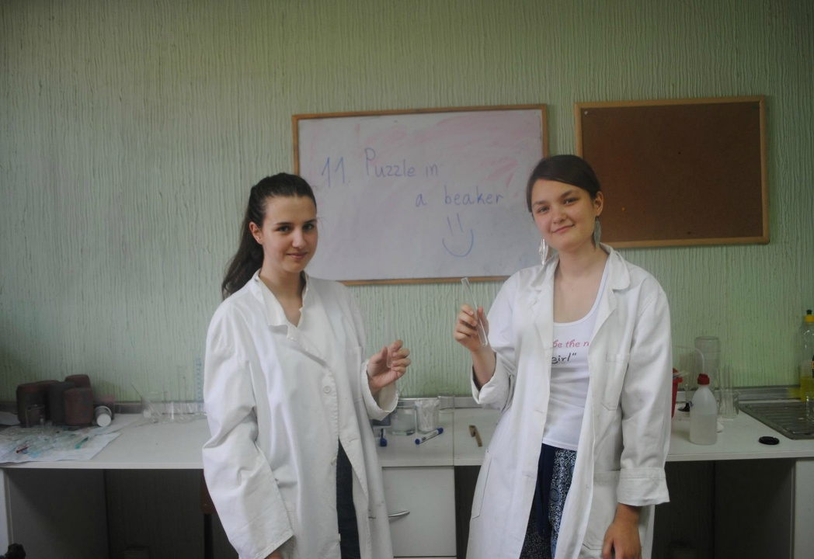
2. Experimental part
Chemicals:
Gelatin
Water
Magnesium-sulfate
Ammonia
Notes:
Liesegang rings are a periodic precipitation phenomenon seen in many chemical systems under special conditions and electrolyte concentrations.
The ammonia will begin to diffuse into the gel. It will then encounter the magnesium-sulfate and will form a continuous region of precipitate at the top of the tube.
Precipitate diffuses through the gel and creates rings.
After some hours, the continuous region of precipitation is followed by a clear region with no sensible precipitate, followed by a short region of precipitate further down the tube. This process continues down the tube forming several, perhaps a couple of dozen regions of clearing, then precipitation rings.

Slide 6
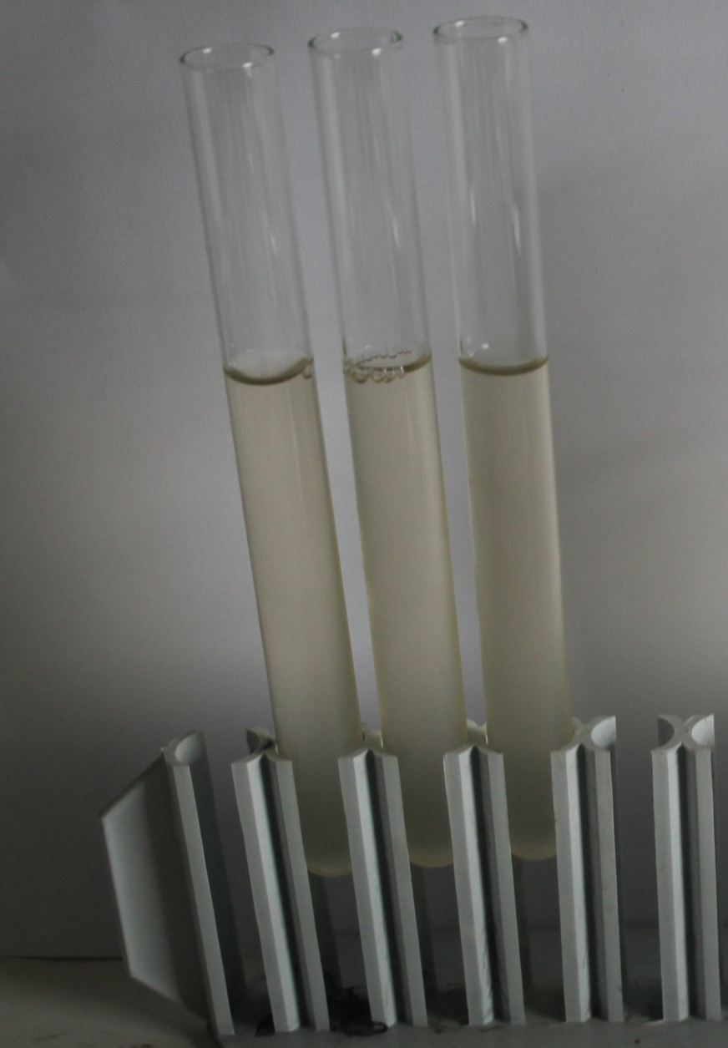
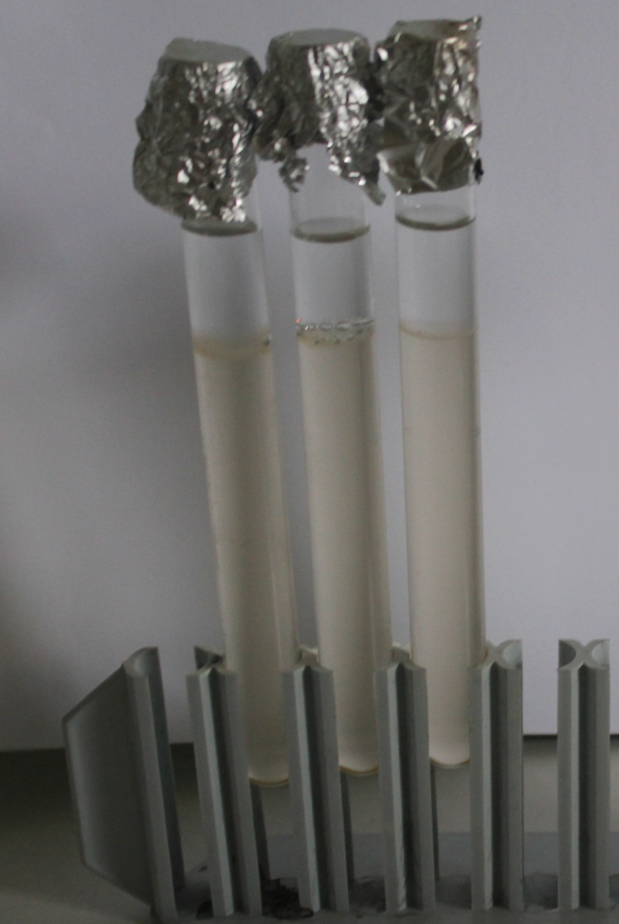
Experimental part

Slide 7
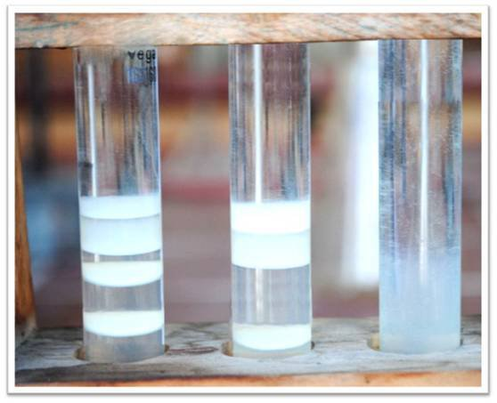
3. The results after 2 days

Slide 8
4. Explanation
Liesegang rings
MgSO₄ + 2NH₃ + 2H₂O → Mg(OH)₂ ↓+ (NH₄)₂SO₄

Slide 9
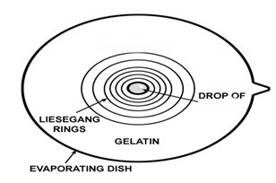
What does the number of bands depends upon?
Concentration of:
  NH3
  Gelatin
  MgSO4
MgSO₄
NH₃

Slide 10
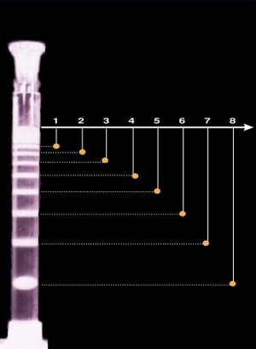


The spacing law
Distances of the adjacent zones form a geometrical series:
- the distance of the n^{th} band measured from the gel surface
- the spacing coefficient, rarely exceeds 1.5

Slide 11
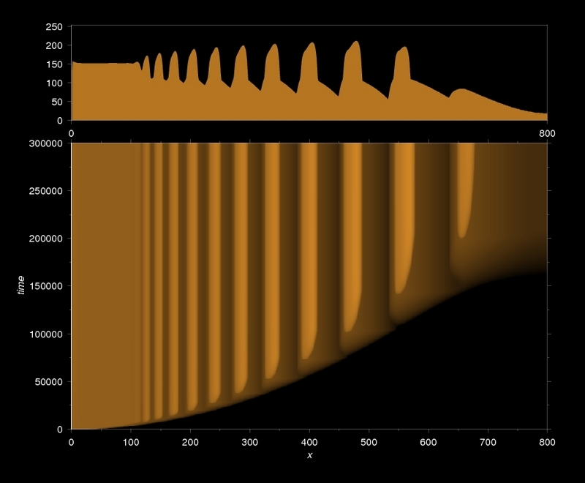


The time law
x_{n}²/t_{n} approaches a constant value as n increases
= const
- the time elapsed until the formation of the n^{th} band

Slide 12
5. Conclusion
Liesegang rings in precipitation reactions are an example of pattern formation in chemical reaction-diffusion systems
In gel, the chemical reaction takes place as follows:
MgSO₄ + 2NH₃ + 2H₂O → Mg(OH)₂ ↓+ (NH₄)₂SO₄
The precipitation is continuous at the beginning and soon clear cut spaces in between are formed at the lower part of the tube
Low concentration of ammonia decreases the number of the bands and the space between them increases

Slide 13


Thank you for your attention!

