Slide 1
International Young
Naturalists’ Tournament
13. Shining orbs
Serbian team 1
Regional Center For Talented Youth

Slide 2
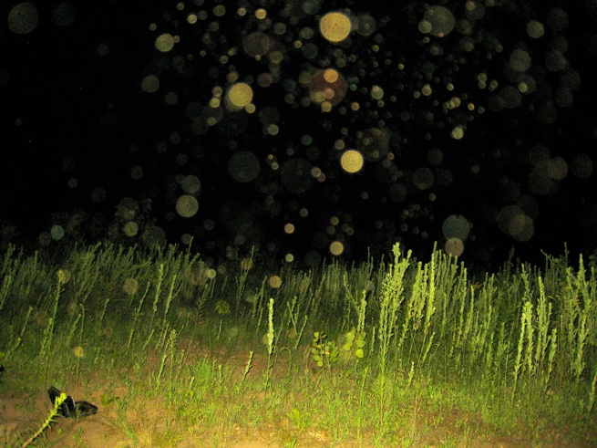
13. Shining orbs
Bright and rather unexpected white disks may appear in a photo taken with a flash in a dark room. Explain why such shining orbs appear in the photos.

Slide 3
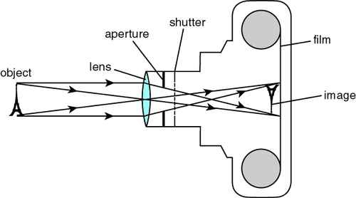
How does a camera work?
Device that captures the image of an object
Image is formed by using lenses
Lenses focus the object creating sharp and defined picture
Notes:
First of all, it is important to explain how does a camera work. Camera is a device that captures the image of an object. But before capturing, it needs to form an image by using lenses. So when we have an object the image is formed on the film by going trough lenses which goal is to focus the object. And it is done using basic optical physics as you can see on the image.

Slide 4
How does a camera work?
In focus

Slide 5
How does a camera work?
Off focus

Slide 6
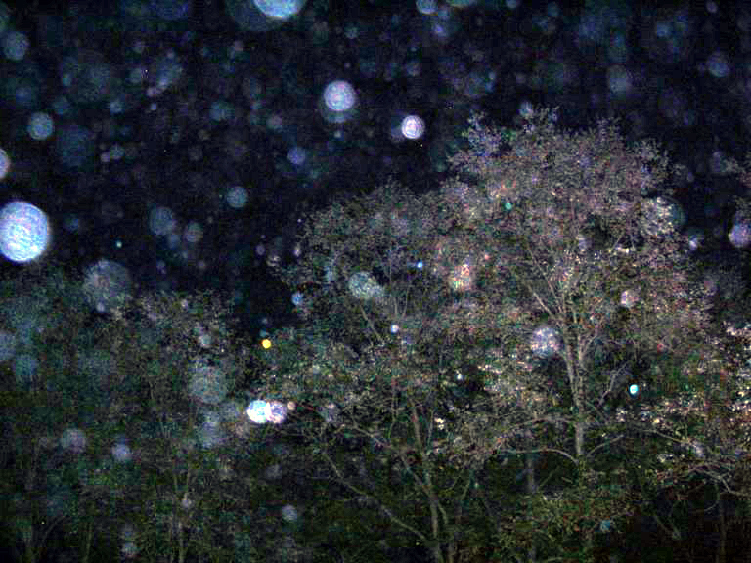
What are shining orbs?
Unexpected, usually circular artifacts that occur in the photos
when small particle is close to the lens, and strongly shined by light
Off focus = Blurred
Close = Larger
Shined by light = Very bright

Slide 7
Particles
Liquid
Solid
Water droplets (rain)
Mist
Dust
Pollen
Insects
Sand
Snowflakes

Slide 8
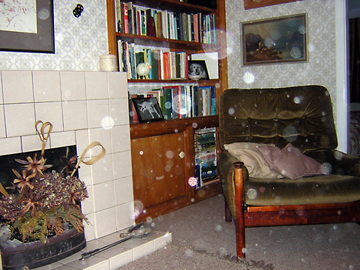
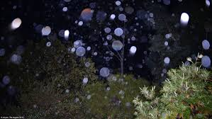
In which conditions do they appear?
They appear in dark surrounding because of using flash
Can appear anywhere only if flash is used

Slide 9
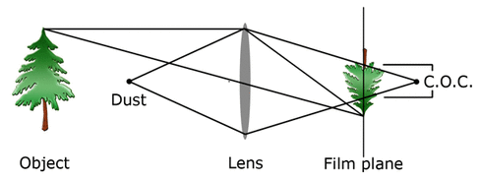
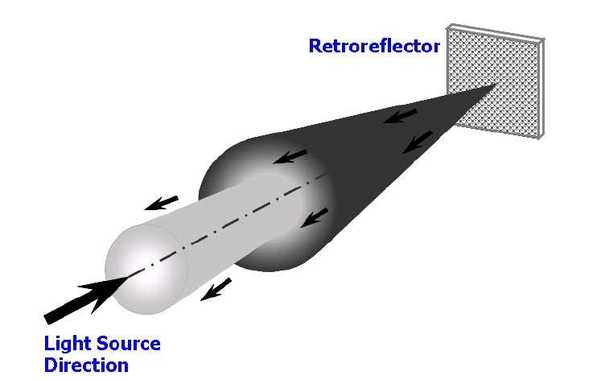
Why do they appear in the photos?
The flash illuminates particles that are drifting very close to it
Retro reflection
“The circle of confusion”
Notes:
Retroreflection is the phenomenon where light is reflected directly back to the source
Also, particle can be projected behind the focused object which makes the effect called The circle of confusion or CoC.

Slide 10
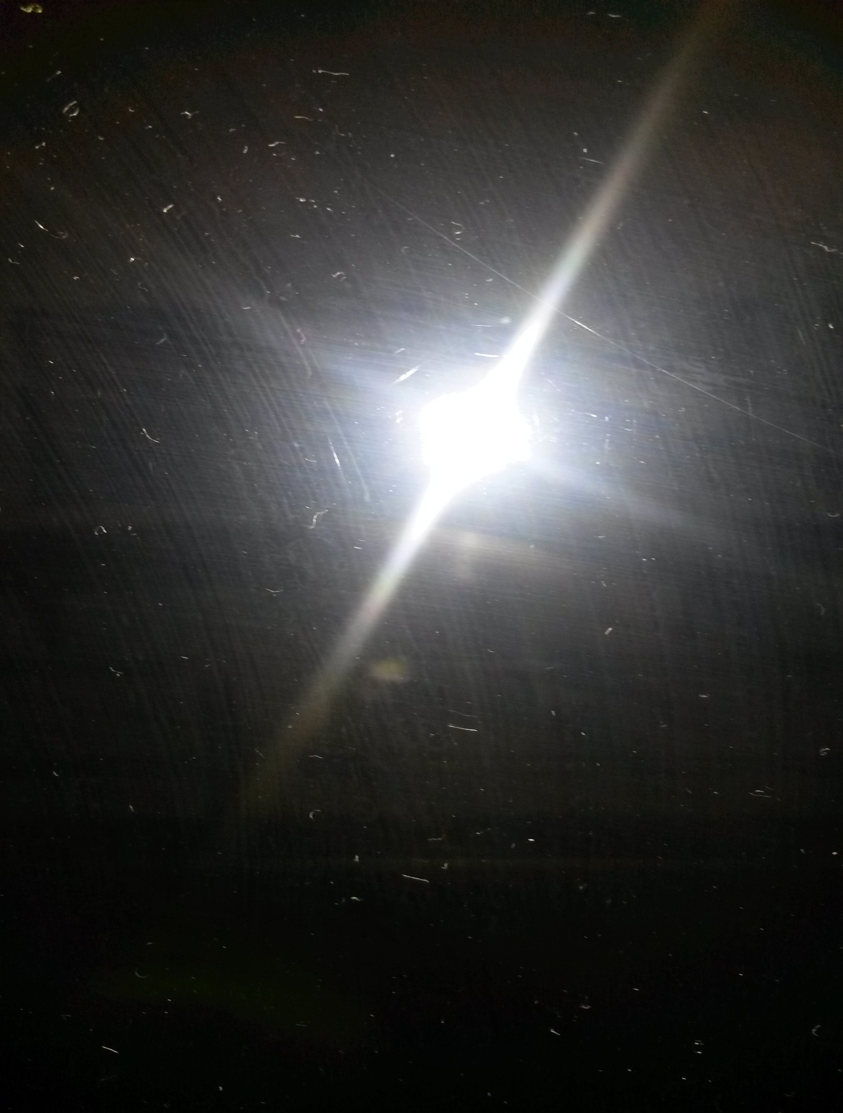
Examples
Experiment 1:
Dirt particles in focus
3 inches
No shining orbs

Slide 11
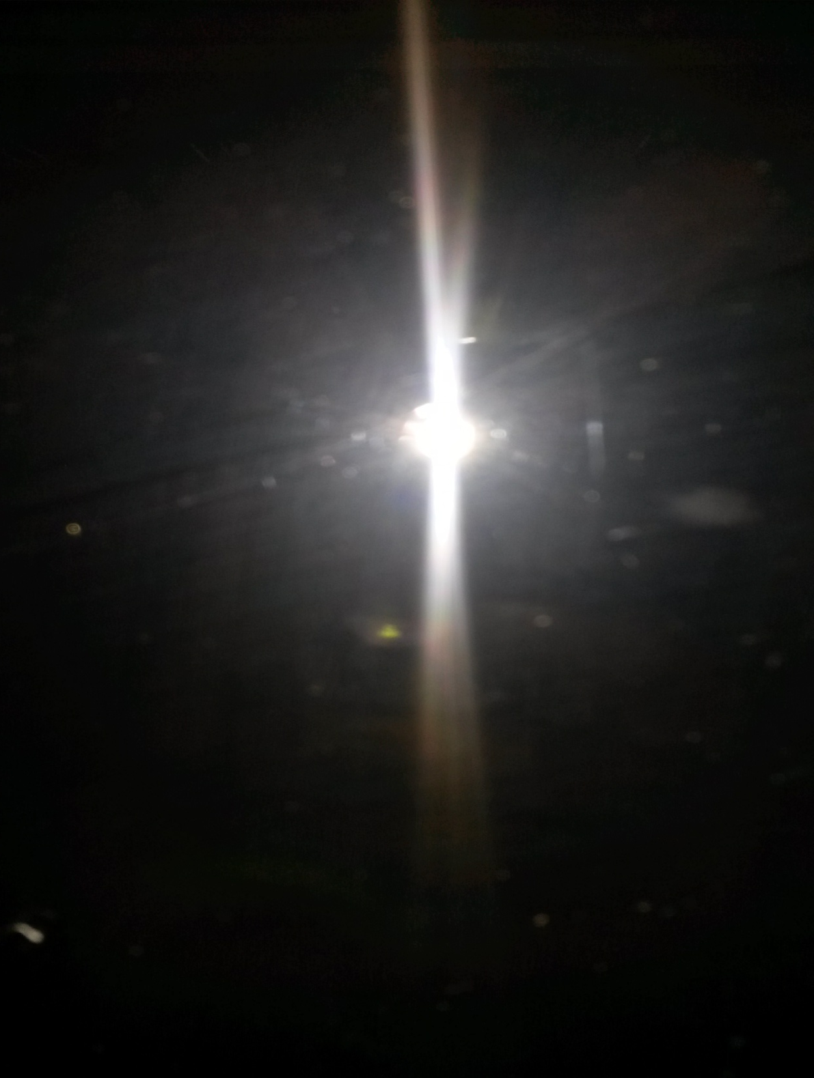
Examples
Experiment 2:
Dirt particles off focus
3 inches
Shining orbs

Slide 12
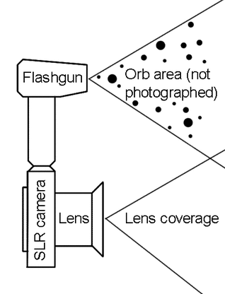
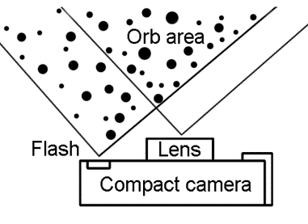
Remark

Slide 13
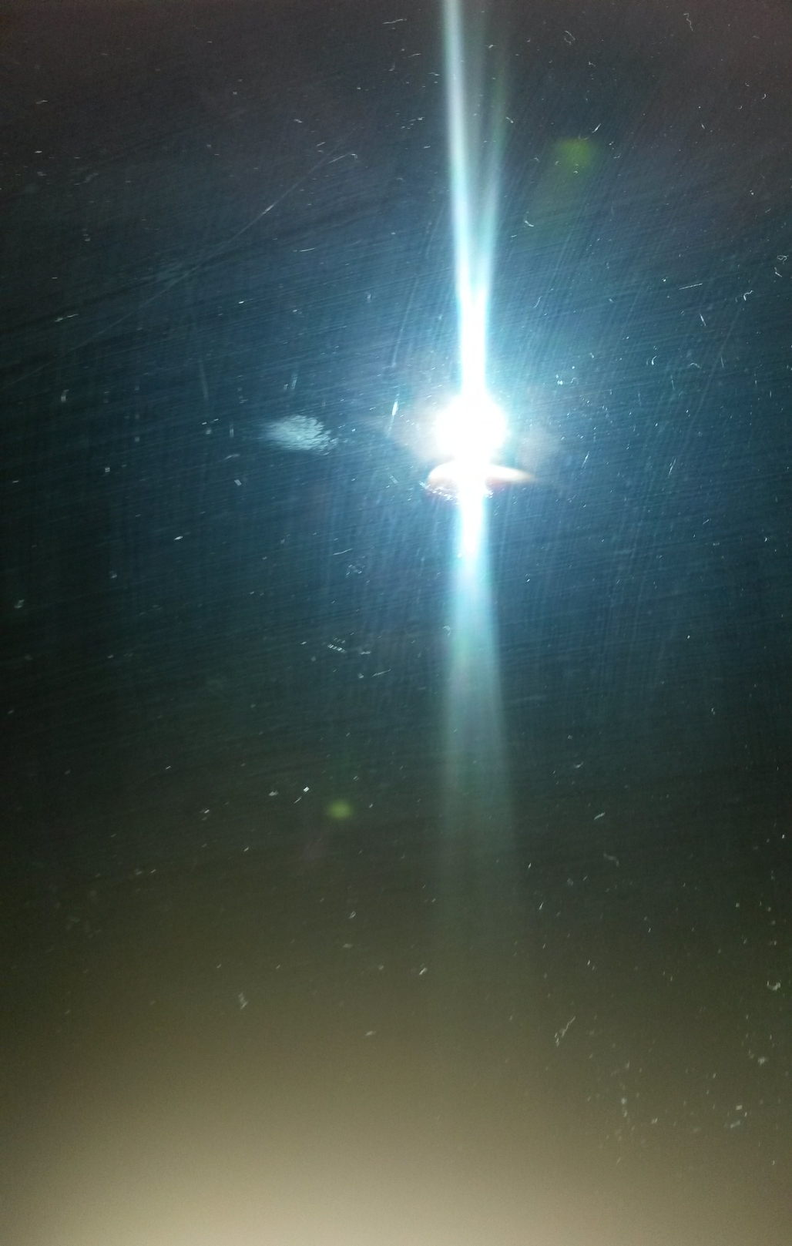
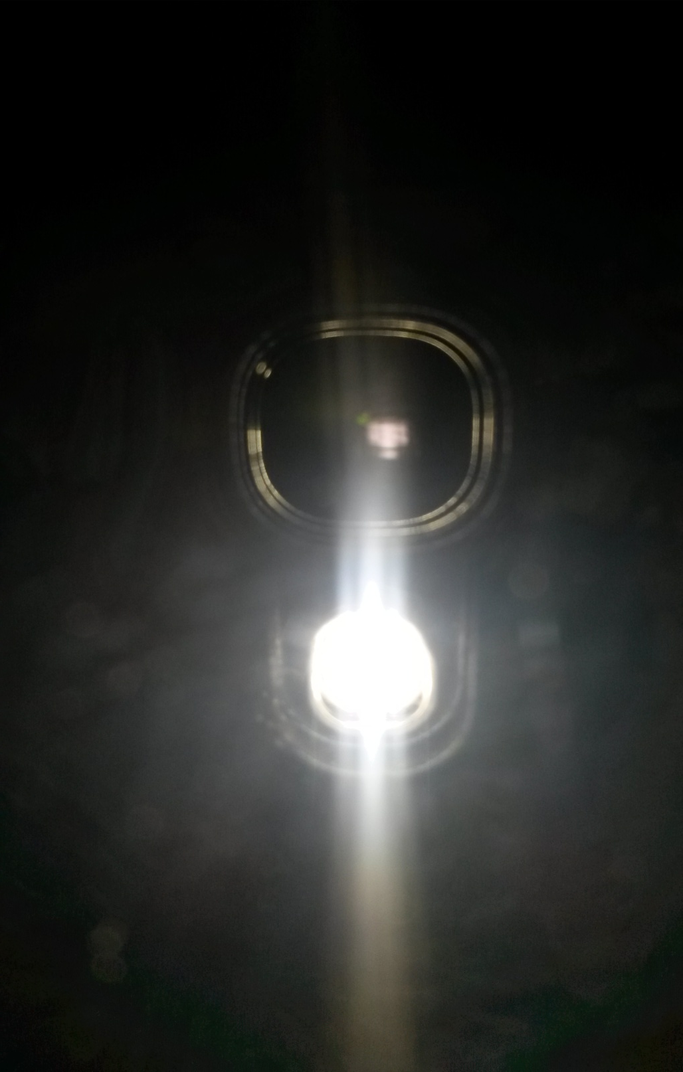

Slide 14
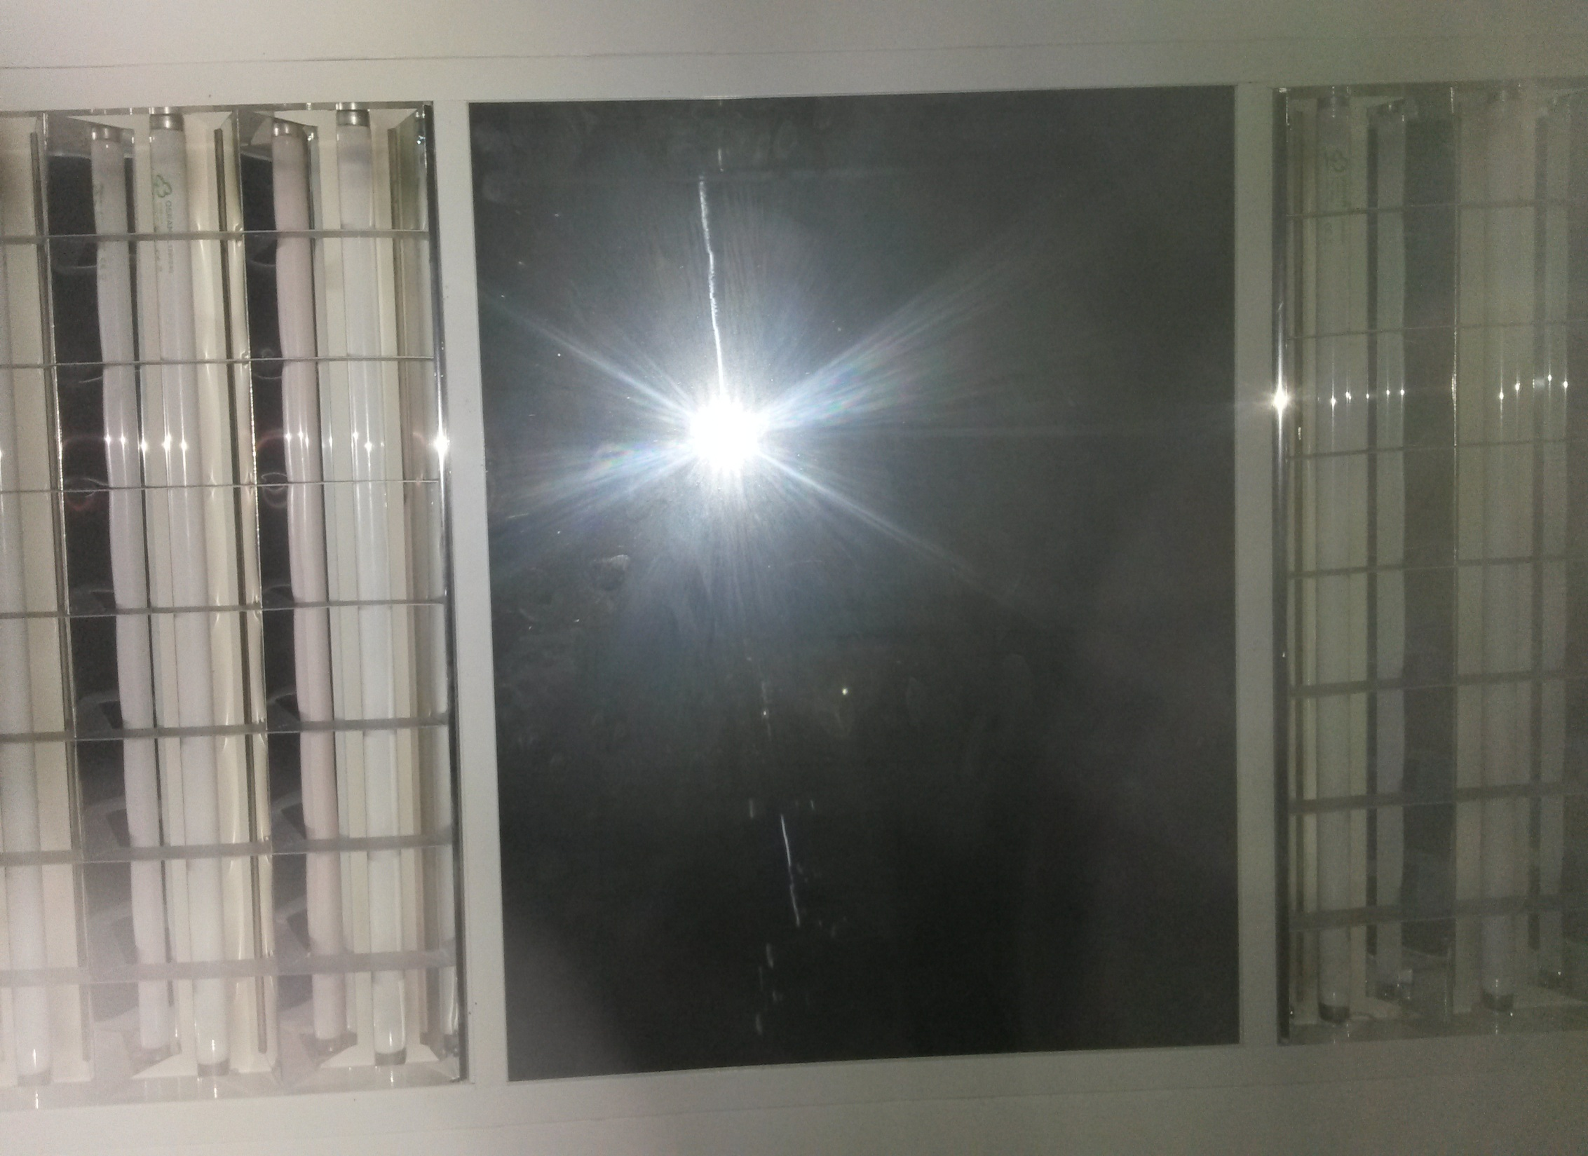

Slide 16
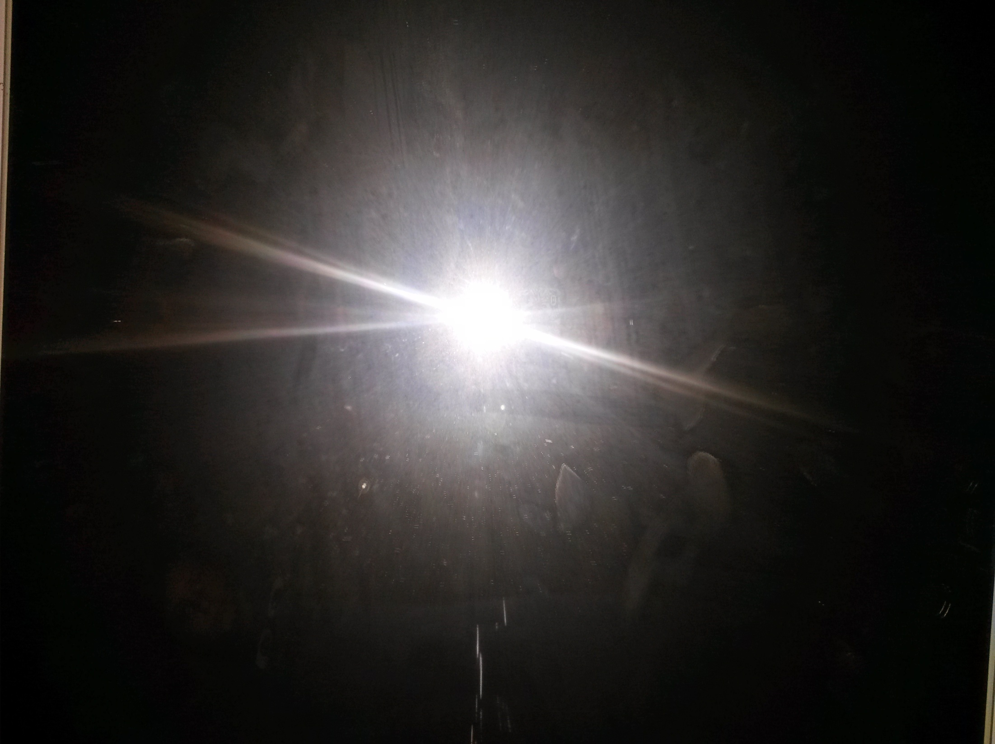
Thank you for your attention!!!
Shining orbs = Ghosts??? :D

