Slide 1
Serbian Team
Problem 16
Regional Center for Talented Youth Belgrade II

Slide 2
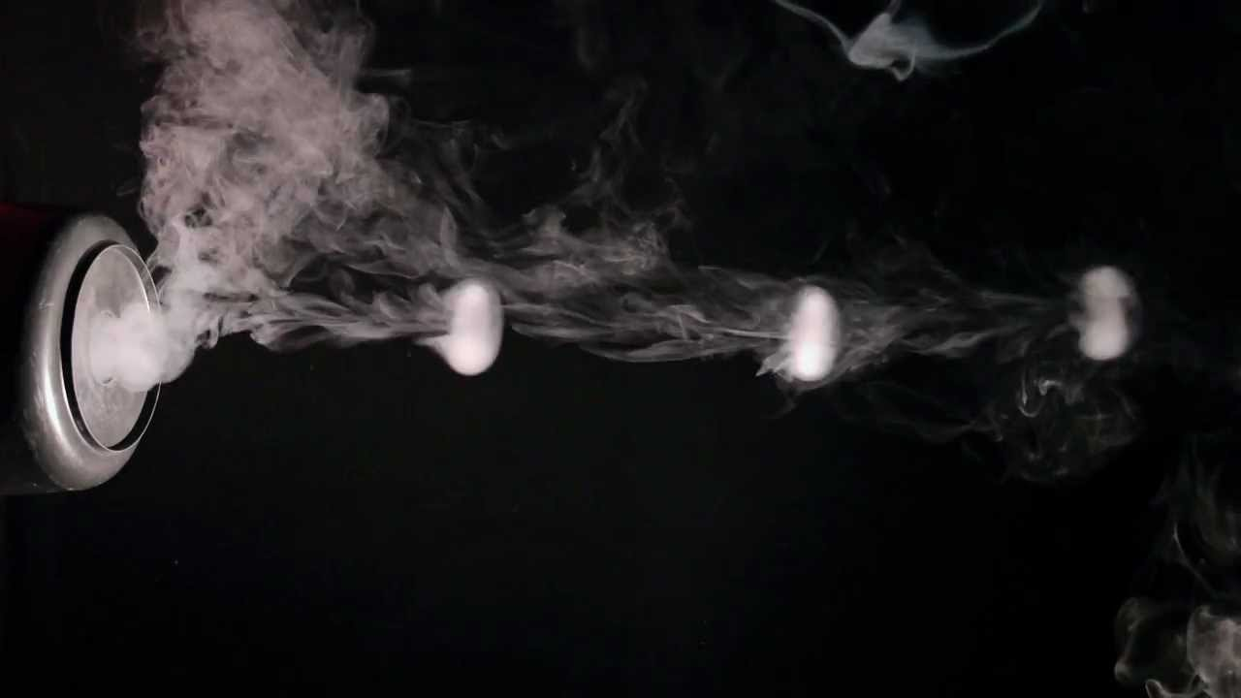
16. Smoke ring cannon
Construct such a vortex ring cannon that would shoot with smoke rings on a distance sufficient to hit the chairperson of your Science Fight.

Slide 3
Cannon Air Pressure
Outside Air Pressure

Slide 5
Thank you for your attention!

