Slide 1
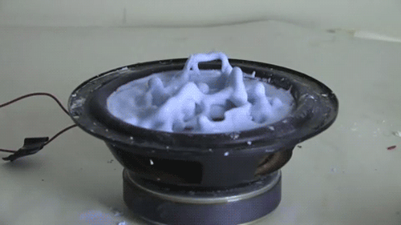
17. Starch monsters
III
IYNT
Team Serbia

Slide 2
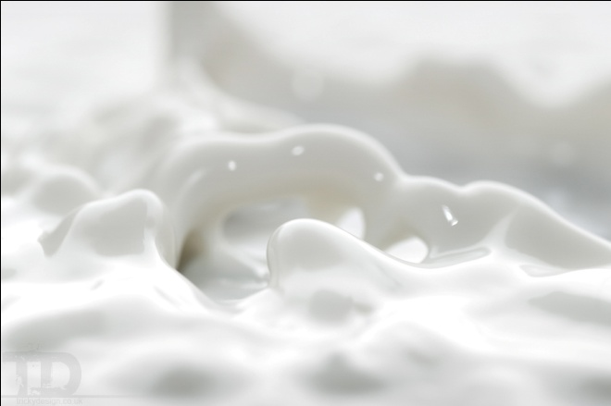
17. Starch monsters
A water suspension of starch is placed on a loudspeaker. Investigate and describe the resulting starch monsters.

Slide 3
1. Introduction

Slide 4
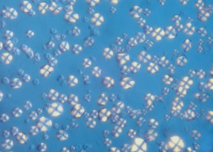
Suspension
Relatively even spacing between the particles of cornstarch
Viscosity – a quantity that describes how resistant a fluid is to flow
Force
Cornstarch magnified by 800X

Slide 5
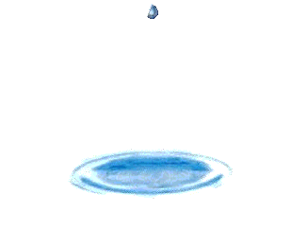
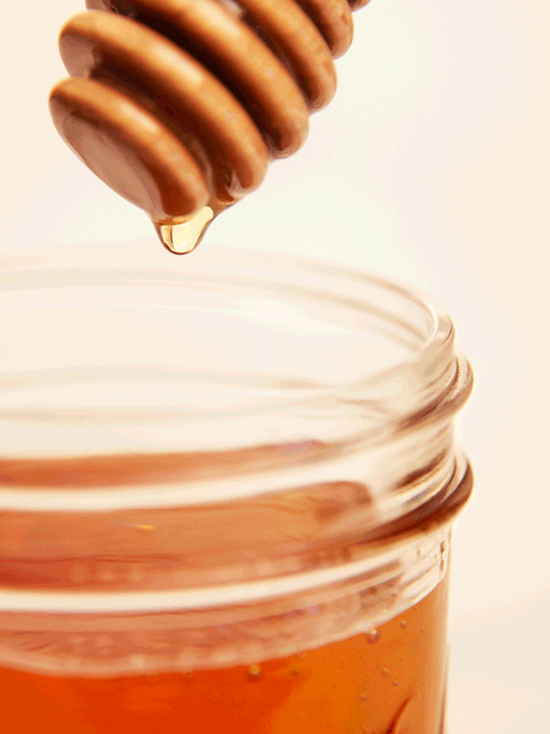
Sir Isaac Newton stated that viscosity depends on the amount of heat applied
Newtonian fluids - viscosity depends only on temperature
Newtonian fluids

Slide 6
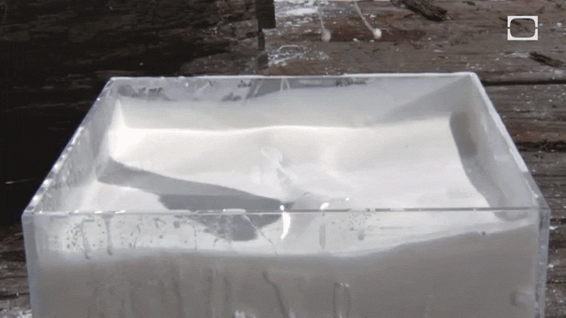
Non-Newtonian fluids - properties of liquids and solids
Viscosity depends on the force applied to the liquid or how fast an object is moving through the liquid
Shear thickening fluid

Slide 7
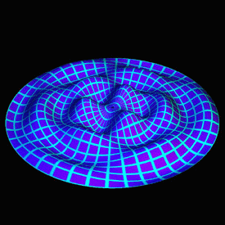
Faraday waves - nonlinear standing waves

Slide 8
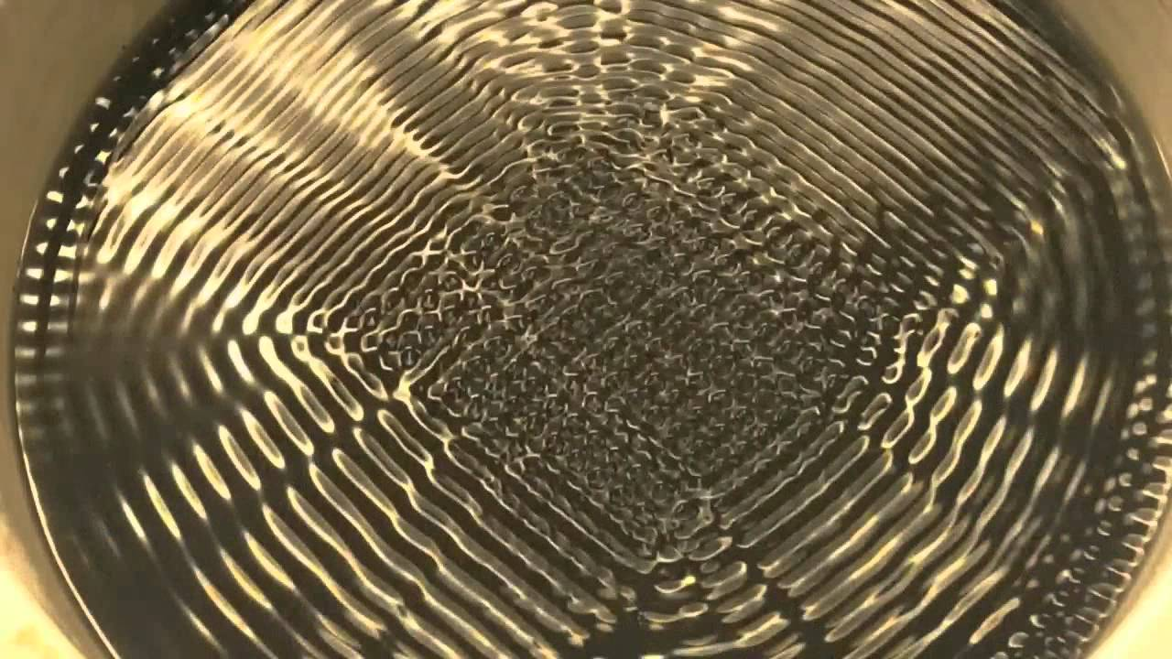
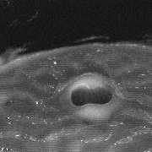
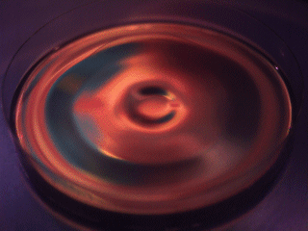
Faraday waves - water
Faraday waves – cornstarch mixture

Slide 9
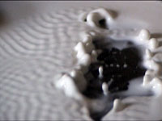
Water - symmetrical geometric patterns of standing waves ; repeating predictably
Our mixture - no specific patterns of Faraday waves; behaves chaotic
Faraday waves – our mixture

Slide 10
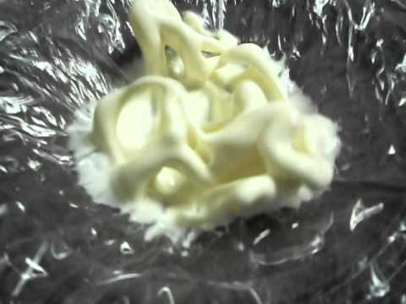
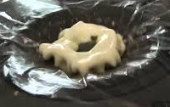
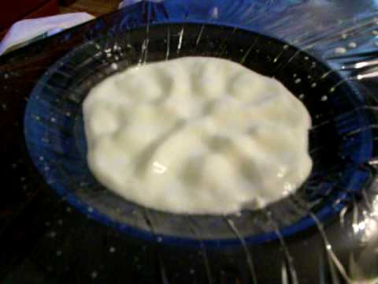
Expectation
Higher frequencies - more motion
ν [Hz]
0
30
60
90
120
150

Slide 11
2. Experiment

Slide 12
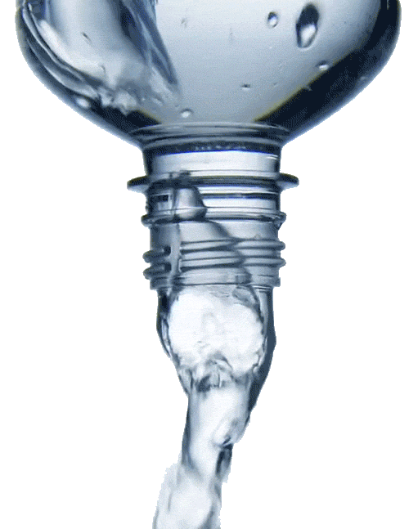
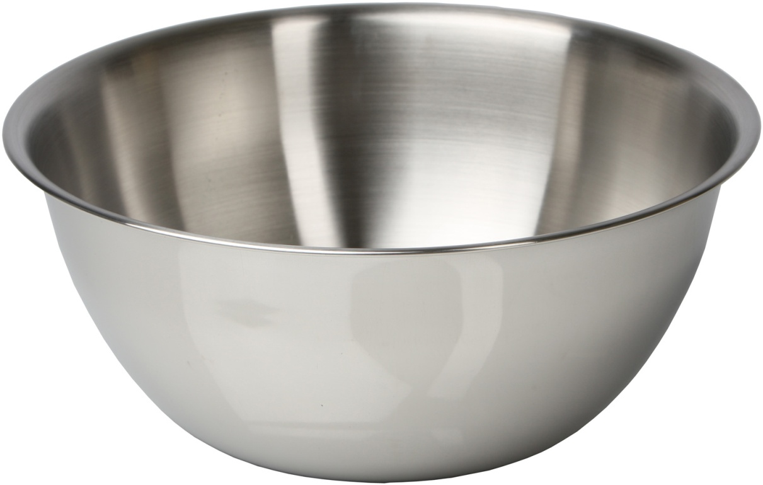
Ingredients:
about 1/4 cup of dry cornstarch
about 1/4 cup of water

Slide 13
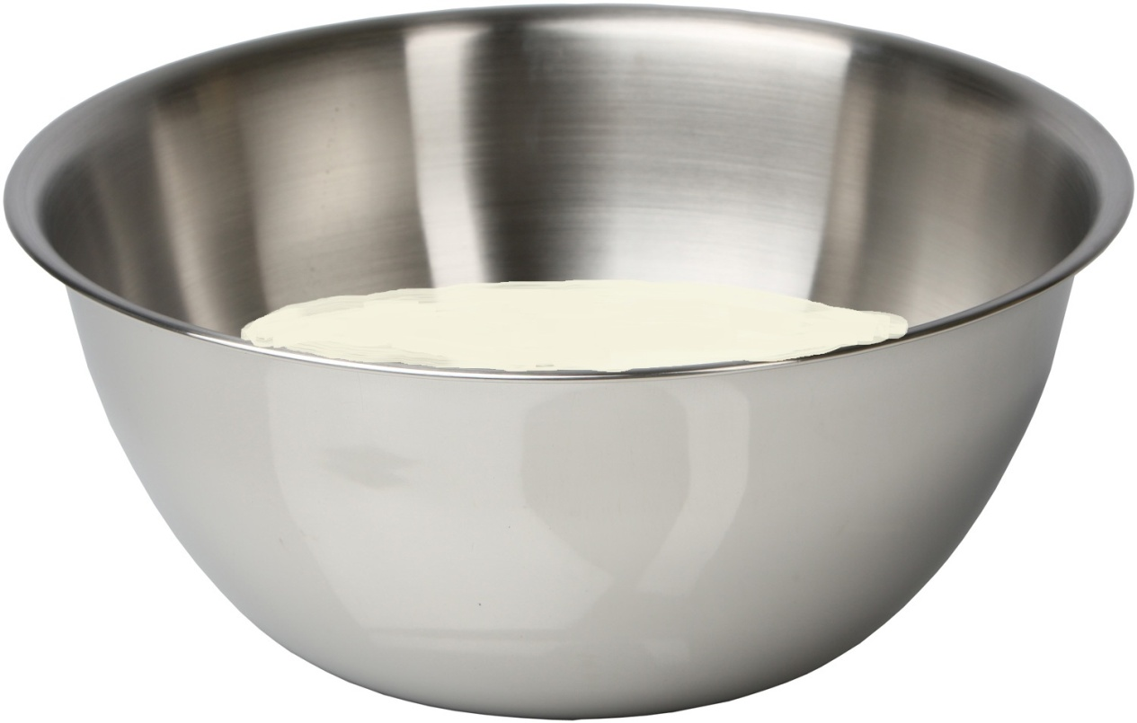
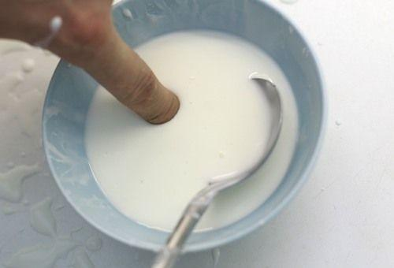

Slide 14
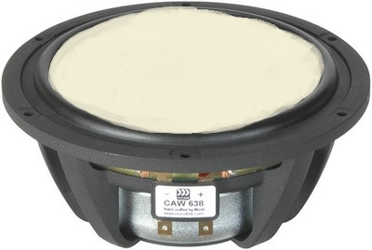
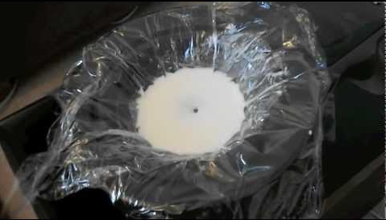

Slide 15
3. The results of the experiment

Slide 16
Frequency number 1 – 150 Hz

Slide 17
Frequency number 2 – 120 Hz

Slide 18
Frequency number 3 – 90 Hz

Slide 19
Frequency number 4 – 60 Hz

Slide 20
Frequency number 5 – 30 Hz

Slide 21
4. Conclusion

Slide 22
ν[Hz]
0
30
60
90
120
150

Slide 23
0
30
60
90
120
150
ν[Hz]

Slide 24
But what about our unexpected results?
Motion of the mixture is wavelength-dependent
→higher frequency equals less movement
Conclusion: The frequency shouldn’t be too high.
Frequency
Movement

Slide 25
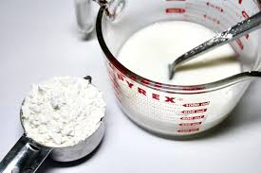
Conclusion: The frequency shouldn’t be too low.
The best option for this particular experiment - frequency number 4 – 60 Hz
The value of the perfect frequency depends on the amount of the mixture and its density.

Slide 26
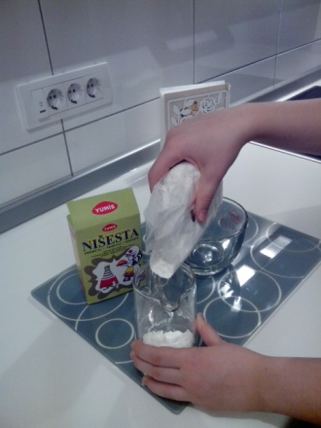
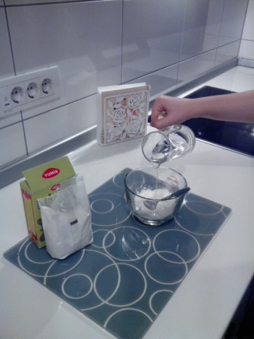
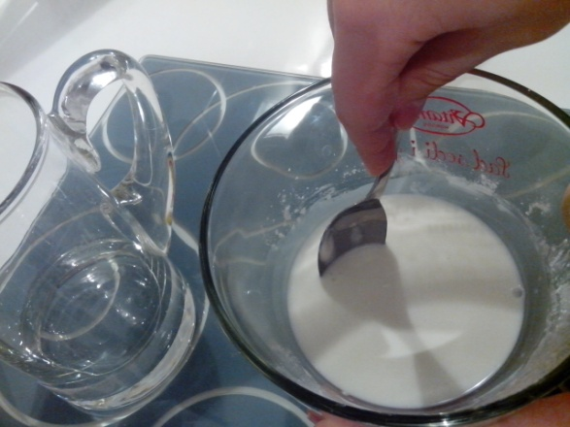
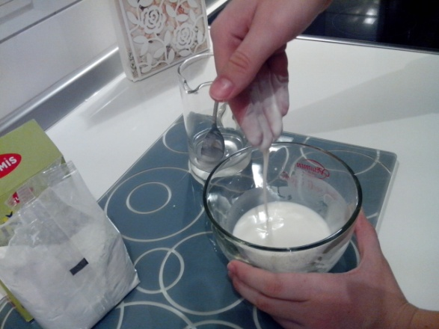
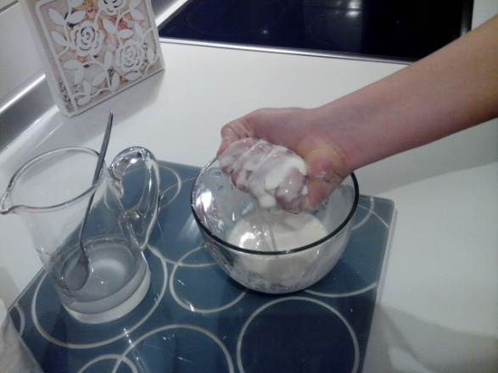
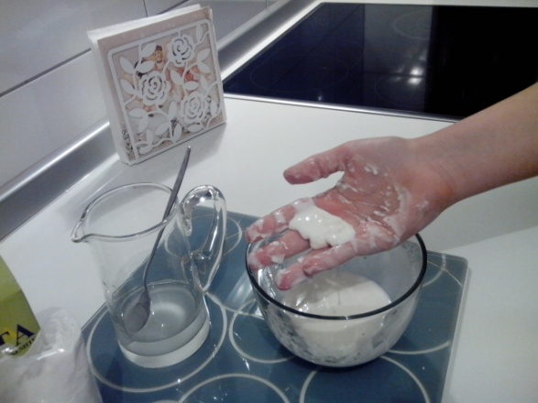
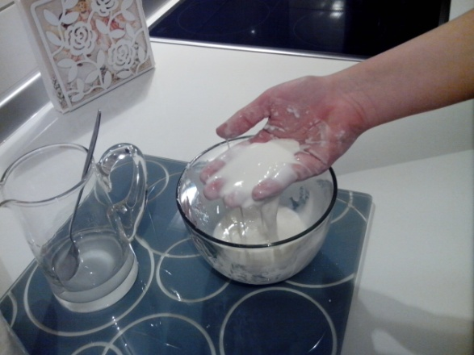
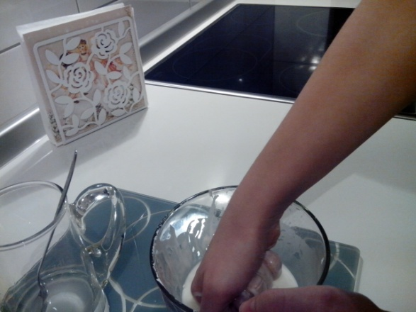
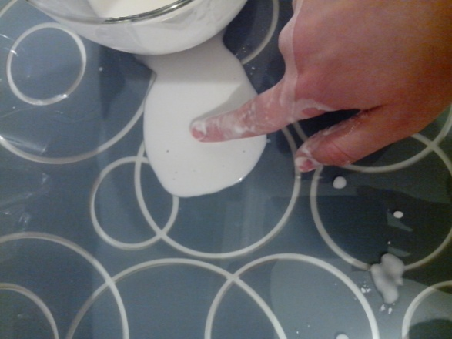
Thank you for your attention!
1.
2.
3.
4.
5.
6.
7.
8.
9.

