Slide 1

Serbian Team
Problem 12
Regional Center for Talented Youth Belgrade II

Slide 2
12. Structure of a hair
The hair of various animals may significantly differ in their structure. What are these differences and how can you explain them?

Slide 3
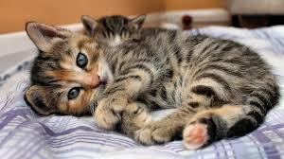
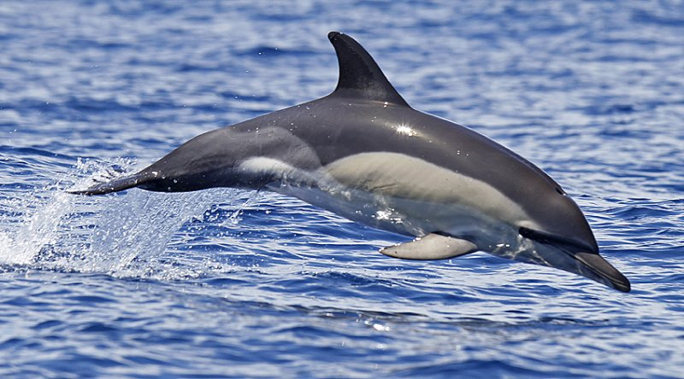
Hair
Mammals have hair
Roles:
- regulate body temperature
- protect from outside
factors
Can be reduced
Notes:
SAMO SAM TI DAO PRIMER ISPOD IMAŠ TEKST SA ONOG SAJTA ali ovde treba da se obavezno kaže ko ima dlaku, uloge i da je neki nemaju ili je redukovana
All mammals have hair. Its main purpose is to regulate body temperature— to keep the body warm by insulating it. It is also used to decrease friction, to protect against sunlight, and to act as a sense organ. In many mammals, hair can be very dense, and it is then referred to as fur. Hair works as a temperature regulator in association with muscles in the skin. If the outside temperature is cold, these muscles pull the hair strands upright, creating pockets that trap air. This trapped air provides a warm, insulating layer next to the skin. If the temperature outside is warm, the muscles relax and the hair becomes flattened against the body, releasing the trapped air. In humans, body hair is mostly reduced; it does not play as large a role in temperature regulation as it does in other animals. When humans are born, they have about 5 million hair follicles, only 2 percent of which are on the head. This is the largest number of hair follicles a human will ever have. As a human ages, the density of hair decreases.

Slide 4
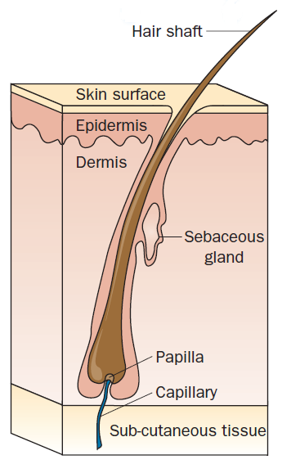
The structure of hair
A hair consists of two parts:
a follicle
a shaft
- Follicle-network of blood vessels
-Hair shaft is composed of the protein keratin
Follicle
Notes:
Šta je a folicle? Mora da bude obeleženo, tj. Obeleži to

Slide 5
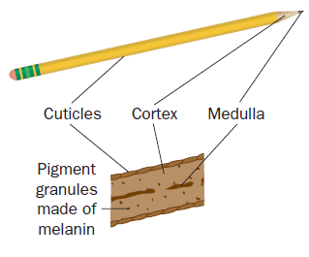
The structure of hair
The hair shaft is made up of three layers:
-an inner medulla
-a cortex
-an outer cuticle
Notes:
I da kažes kada budes pricala kao što i olovka ima tri dela tako moze napraviti analogiju sa strukturnim delovima dlake

Slide 6
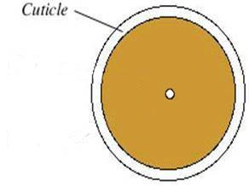
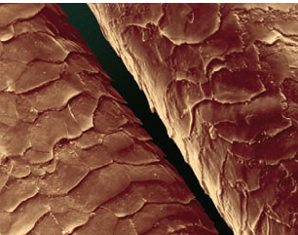
The cuticle
transparent outer layer of the hair shaft
made of scales that overlap one another and protect the inner layers of the hair

Slide 7
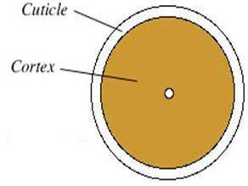
Types of cortex
the largest part of the hair shaft
contains most of the pigment granules
Notes:
1.Sliku kutikule korteksa i medule uvek stavljas ISTU samo kad objasnjavas npr. Korteks na slici je obelezen samo korteks
2. Ili pak prvo krenes od kutikule pa je na slici obelezena samo kutikula, sledeci slajd ista slika ali su obelezeni i kutikula i korteks i slajd za medulu obelezeni su i korteks i kutikula i medula
JEDNO OD OVA DVA NE OBA

Slide 8
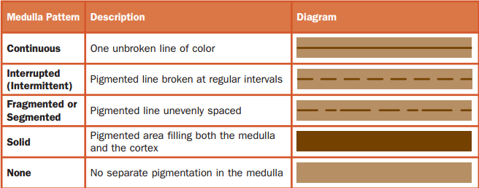
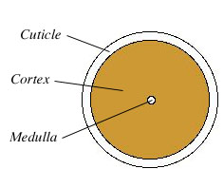
Types of medulla
the center of the hair
Notes:
Od cega potice BOJA MEDULE to sam poslao Olji pa ce ti ona reci

Slide 9
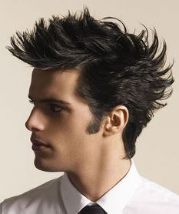
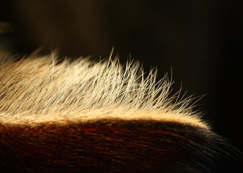
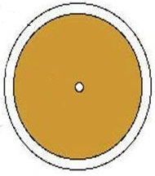
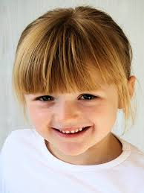
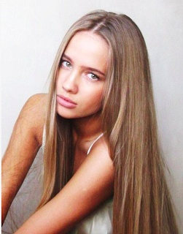
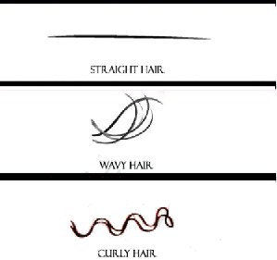
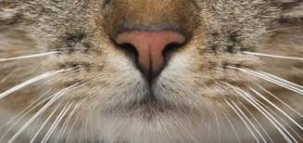
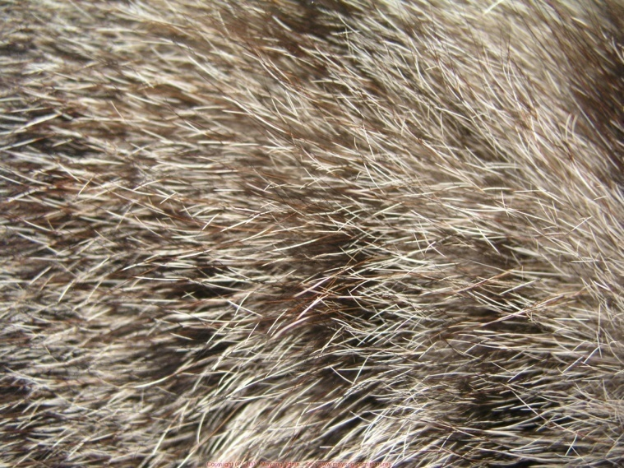
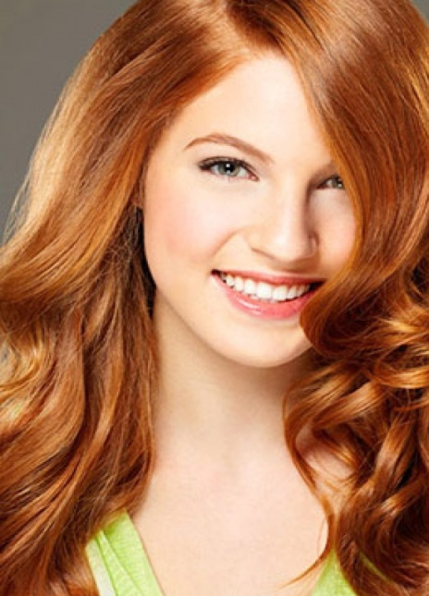
Types of hair
Hair can vary in:
shape
length
diameter
texture
color

Slide 10
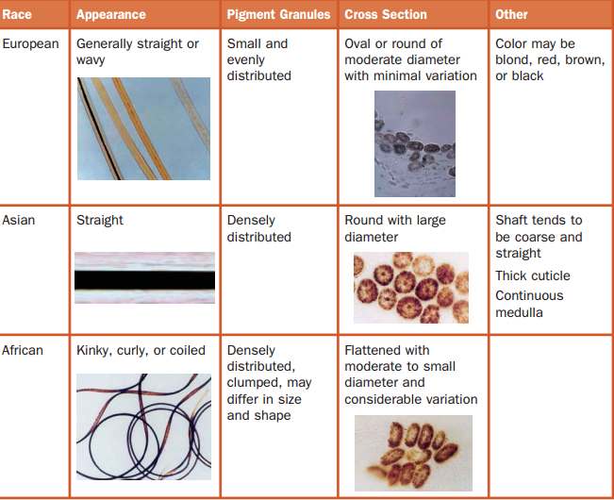
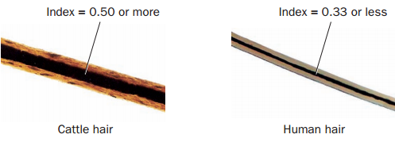
Animal and human hair
Differences:
pattern of pigmentation
the medullary index
the cuticle type
The ratio of the diameter of the medulla to the diameter of the entire hair is known as the medullary index.
Notes:
ideja ovog slajda je da predstavi sve ove razlike izmedju ovih dlaka, prvo ova tabela prati pricu mislim, za ovo pattern, onda imam medula index i u radu ima nesto za kutikulu I tu ide prica toga, ali ne znam da li da ubacim nesto na slajd o tome
SLIKE SAMO UBACI ZA RAZLIKE PORED
Da li su ovo razlike izmedju ljudi ili zivotinja? :D posto pise European, Asiana tj. Razlike u rasama PIŠE TI IME TABELE
Onaj medularnih indeks je ok ;) to je razlika izmedju

Slide 11
Animal and human hair
Differences:
pattern of pigmentation
the medullary index
the cuticle type
The ratio of the diameter of the medulla to the diameter of the entire hair is known as the medullary index.
Notes:
ČITAJ ISPOD OVOG OGROMNOG TEKSTA
Animal hair and human hair have several differences, including the pattern
of pigmentation, the medullary index, and the cuticle type. The pattern of
the pigmentation can vary widely in different animals. While the pigmentation
in human hair tends to be denser toward the cuticle, in animals it
is denser toward the medulla. Animal pigments are often found in solid
masses called ovoid bodies, especially in dogs and cattle. Human hairs are
usually one color along the length. Animal hairs can change color abruptly
in a banded pattern.
In animals, the medulla is much larger than it is in humans (Figure
3-11). The ratio of the diameter of the medulla to the diameter of the entire
hair is known as the medullary index. If the medullary index is 0.5 or greater,
the hair came from an animal. If the medullary index is 0.33 or less, the hair
is from a human.
The cuticle of the hair shaft can also help distinguish human hair from
animal hair. There are different types cuticles in different mammal hair
cuticles. Rodents and bats have a coronal cuticle with scales that give the
appearance of a stack of crowns. Cats, seals, and mink have scales that are
called spinous and resemble petals. Human hair has cuticle scales that are
flattened and narrow, also called imbricate.
Ovo mi je tekst za ovo, ali nisam znala kakve slike da dodam, AKO IMAŠ IDEJU MOLIĆU LEPO BUDI KAO I UVEK LJUBAZAN I POMOZI
SLIKE ZAŠTO JE TO TAKO BOJA, DUŽINA, ADAPTACIAJ NA STANIŠTA ITD. ITD.

Slide 12
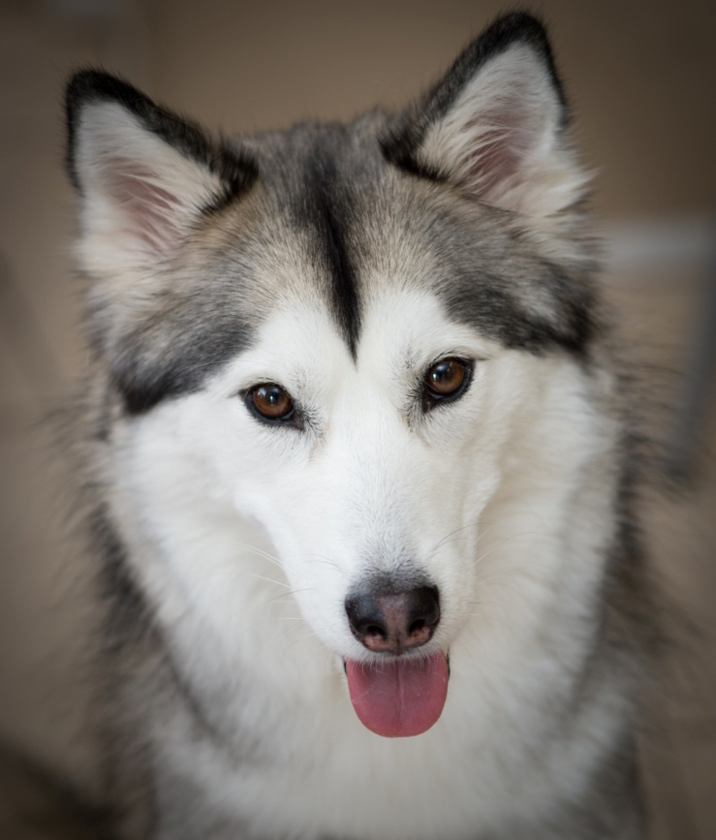
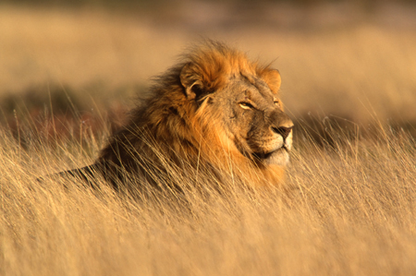
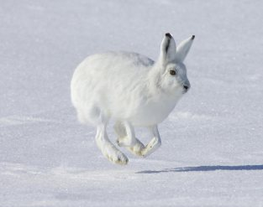
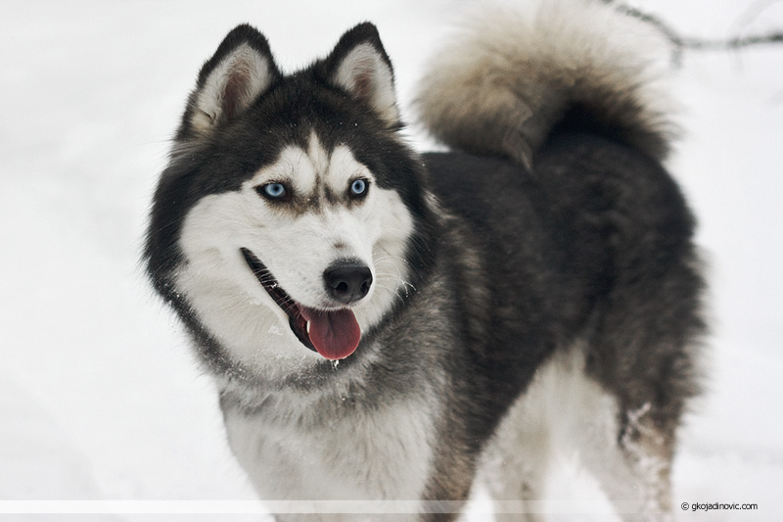
Differences between animals
Notes:
OVDE NE ZNAM DA LI DA UBACUJEM DA ONI KOJI ŽIVE NA HLADNOM MESTU IMAJU DEBELU DLAKU, A ONI KOJI NA TOPLIJIM TANKU I TO SVE, NE ZNAM KAKO, ZAPRAVO NE ZNAM PRIMERE ŽIVOTINJA
A OVO SU KAO ONI ŠTO SE UKLAPAJU U SREDINU, SAMO NE ZNAM KAKO DA MI BUDE NASLOV OVOG SLAJDA
Darvinova selekcija-prirodna selekcija
Glogerovo pravilo-

Slide 13
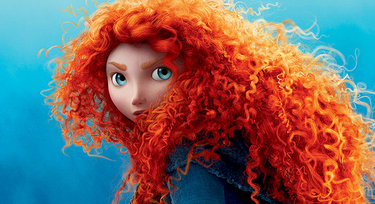
Thank you for your attention!

Slide 14
Notes:
OVA TABELA JE IPAK ZA RAZLIKE IZMEĐU RAZLIČITIH LJUDI, DA LI OVO DA UBACUJEM?

Slide 15
