Slide 1
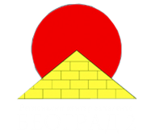
International Young
Naturalists’ Tournament
4. Sunset
Serbian team
Regional Center For Talented Youth

Slide 2
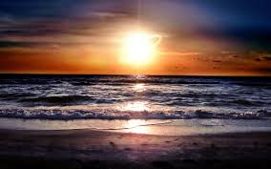
4. Sunset
The visible Sun disk touches the horizon and after a particular time interval disappears behind the horizon. What is the duration of this time interval? Explain the optical phenomena observed during a sunset.
Notes:
Zavisi od : geografske širine
sezone
vremenskih uslova

Slide 3
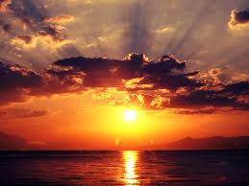
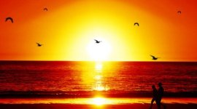
SUNSET
Sunset (sundown) - daily disappearance of the Sun below the western horizon, as a result of Earth's rotation
In astronomy : the time of sunset - moment when the trailing edge of the Sun's disk disappears below the horizon
Notes:
Sunset or sundown - daily disappearance of the Sun below the western horizon, as a result of Earth's rotation
The time of sunset in astronomy is defined as the moment when the trailing edge of the Sun's disk disappears below the horizon
When the sun is low on the horizon, it seems that because of scattered light we see red and yellow, so we therefore sunset looks red.
Sunset is distinct from dusk, which is the time at which the sky becomes completely dark, which occurs when the Sun is approximately eighteen degrees below the horizon.

Slide 4
ANGULAR VELOCITY OF THE SUN
the angle by which an object spins in a certain time - its rotation rate
angular speed for one complete rotation is given as:
t = 23h 54 min 4s

Slide 5
ANGULAR VELOCITY - orthogonal component-
ω
ϕ

Slide 6
DURATION OF SUNSET
equation for the duration of sunset:
Notes:
Where
τ is duration of the sunset
θ is the angular size of the Sun
ω is the Sun’s angular velocity across the sky
φ is the latitude of the point on Earth
This calculation does not account for effects of atmospheric refraction.
The calculation also assumes that the observer is at sea level and that his view is not obstructed by landscape or other objects. If this is the case duration may differ from calculated time.
31,6’=0,52667 degree
4,167 mili degree/sec

Slide 7
DURATION OF SUNSET
The fastest sunset at the time of the equinoxes
(March 21 and September 23
The slowest sunset at the time of solstice
(around 21 June and 21 December)
Notes:
which lasts 128 / cos φ
the latitude to 60 degrees (either North or South)
142 / cos φ

Slide 8
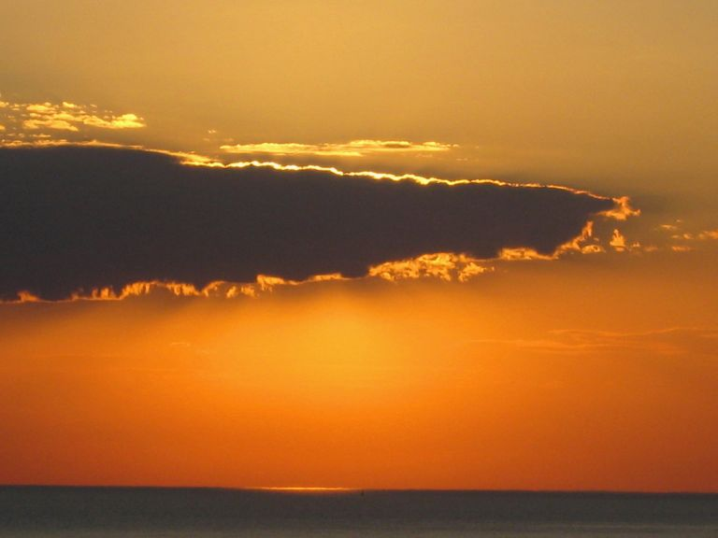
DURATION OF SUNSET
- 2 minutes 47 sec
The slowest sunset - 3 min 23 sec
At the equator, between 128 and 142 sec
(2 min. 8 sec and 2 min. 22 sec)
The fastest sunset

Slide 9
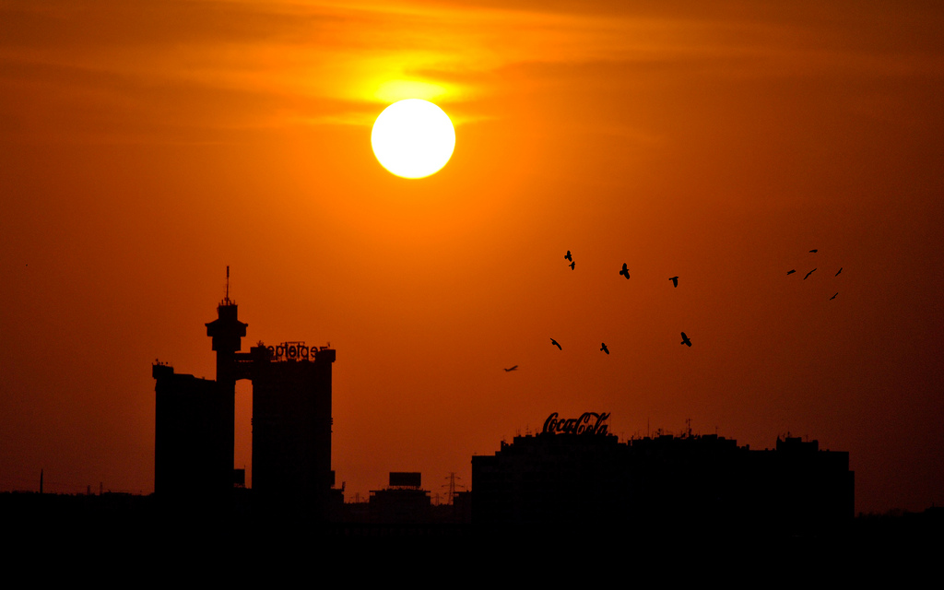
DURATION OF SUNSET
City | Duration of sunset | Latitude
Beijing | 167 s | 39.92°
Belgrade | 183.6 s | 44.82°
Paris | 198 s | 48.86°
London | 209.3 s | 51.51°
Moscow | 231.5 s | 55.75 °

Slide 10
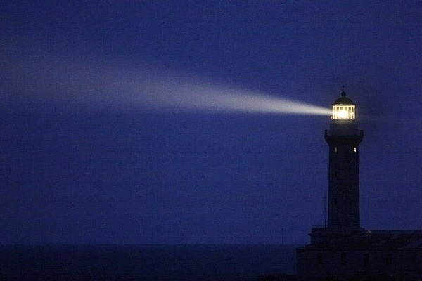
Optics
Laws
Light scattering
Reflection
Refraction

Slide 11
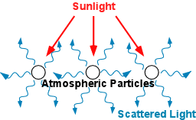
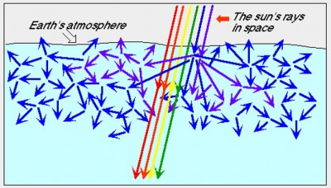
LIGHT SCATTERING
caused by small particles and molecules in the atmosphere
scattered rays go off in many directions
Notes:
The fraction of the light which is deviated by scattering increases with increasing path length, so that at sunset the shorter wavelengths are depleted in direct sunlight and the sun appears orange or red, depending on the amount of haze or dust in the air.
The scattered rays go off in many directions different from that of the incident light

Slide 12
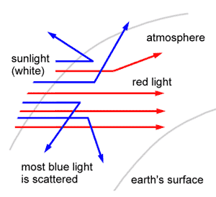
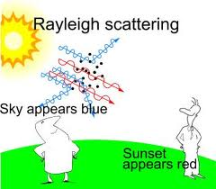
RAYLEIGH SCATTERING
Rayleigh scattering - elastic scattering of light
Blue light from the sun is scattered more than red
Notes:
Rayleigh scattering - elastic scattering of light by molecules and particulate matter much smaller than the wavelength of the incident light. It occurs when light penetrates gaseous, liquid, or solid phases of matter.
- Rayleigh scattering is wavelength-dependent.
- Shorter wavelengths scatter more

Slide 13
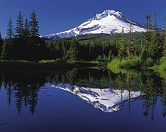
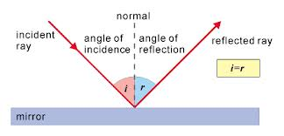
LAW OF REFLECTION
Notes:
-The incident ray, the reflected ray and the normal to the reflection surface at the point of the incidence lie in the same plane.
-The angle which the incident ray makes with the normal is equal to the angle which the reflected ray makes to the same normal.
-The reflected ray and the incident ray are on the opposite sides of the normal.
The law of reflection states that when a ray of light reflects off a surface, the angle of incidence is equal to the angle of reflection.

Slide 14
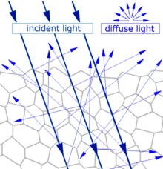
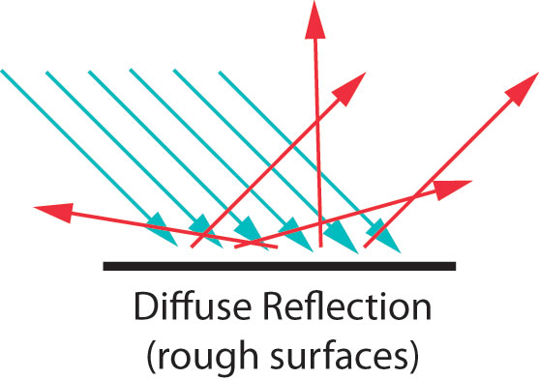
DIFFUSE REFLECTION
It occurs when a rough surface causes reflected rays to travel in different directions
Notes:
When light strikes the surface of a (non-metallic) material it bounces off in all directions due to multiple reflections by the microscopic irregularities inside the material ( the grain boundaries of a polycrystalline material, or the cell or fiber boundaries of an organic material) and by its surface, if it is rough.
Thus, an 'image' is not formed. This is called diffuse reflection.
Diffuse reflection occurs when a rough surface causes reflected rays to travel in different directions. Most everyday objects exhibit diffuse reflection because of the tiny imperfections on the surface of the material. A piece of paper may look smooth on the surface, but at the microscopic level, the tiny fibers make it rough. Upholstery and clothing exhibit diffuse reflection because of the minute roughness of the fabric. Even a leaf has an element of roughness to it because of the multidimensional nature of the cells on the surface.
In diffuse reflection, each individual ray strikes a part of the surface that is oriented in a different direction. The law of reflection still applies, but the normal is different for each ray. So, the reflected rays end up going in all directions. This incident ray reflects over in this direction. This incident ray reflects here, and this one reflects way over here. The effect of all these rays going everywhere is that all of the waves are spread out. Diffuse reflection is the reason why you don't see your image reflected in most everyday objects.

Slide 15
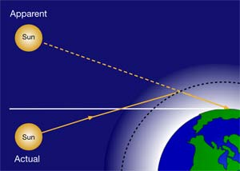
ATMOSPHERIC REFRACTION
the shift in apparent direction of a celestial object caused by the refraction of light rays as they pass through Earth’s atmosphere
Notes:
Atmospheric refraction is the shift in apparent direction of a celestial object caused by the refraction of light rays as they pass through Earth’s atmosphere.

Slide 16
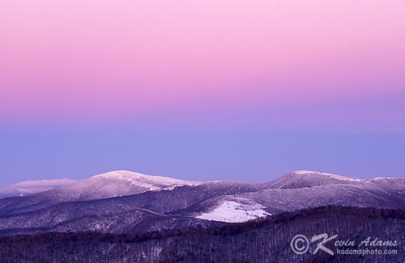
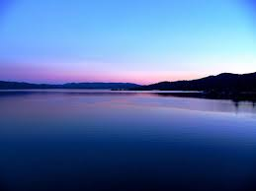
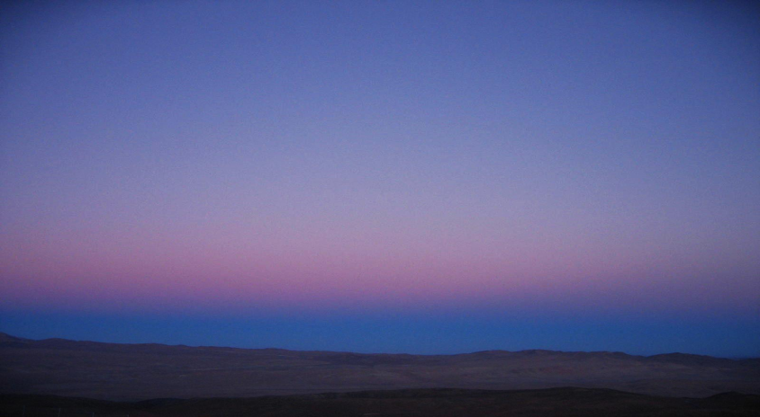
MORE OPTICAL PHENOMENA
Twilight Wedge
Belt of Venus
Earth’s shadow

Slide 17
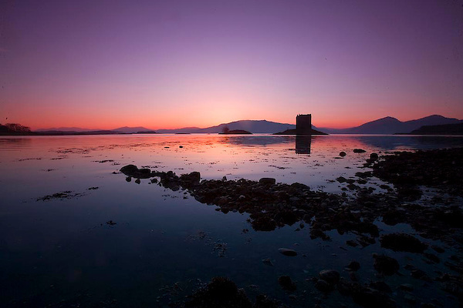
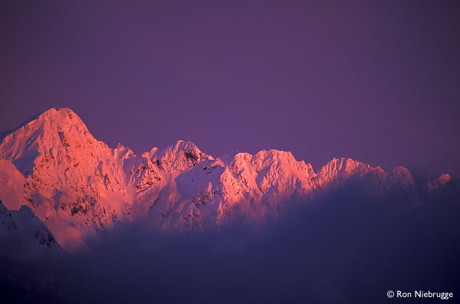
Afterglow
Alpenglow

Slide 18
CONCLUSION
During the sunset:
Light scattering - Rayleigh scattering
Reflection - Diffuse reflection
Atmospheric refraction
– The fastest sunset is 2 minutes 47 sec
– The slowest sunset is 3 minutes 23 sec

Slide 19
THANK YOU FOR YOUR ATTENTION!!

Slide 20
http://solar-center.stanford.edu/spin-sun/angvel.html
https://www.itp.uni-hannover.de/~zawischa/ITP/scattering.html
http://ww2010.atmos.uiuc.edu/(Gh)/guides/mtr/opt/mch/sct.rxml
http://www.physicsclassroom.com/class/refln/Lesson-1/Specular-vs-Diffuse-Reflection
http://www.tutorvista.com/content/science/science-ii/human-eye-colourful-world/atmospheric-refraction.php
http://hyperphysics.phy-astr.gsu.edu/hbase/atmos/redsun.html
http://www.webexhibits.org/causesofcolor/14E.html

Slide 21
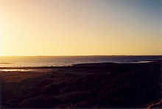

Slide 22
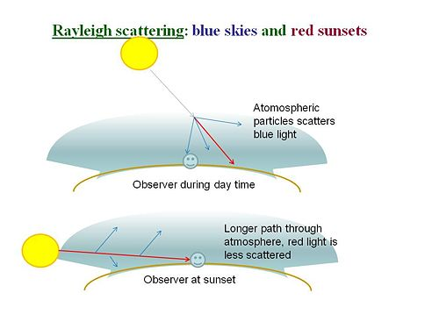

Slide 23
I₀ - intensity of light before entering the atmosphere
I - intensity of light upon arrival at the detector

Slide 24
SUNSET
Sunset creates unique atmospheric conditions such as the often intense orange and Sunset creates unique atmospheric conditions such as the often intense orange and red colors of the Sun and the surrounding sky
Locations north of the Arctic Circle and south of the Antarctic Circle experience no sunset or sunrise at least one day of the year, when the polar day or the polar night persists continuously for 24 hours.

Slide 25
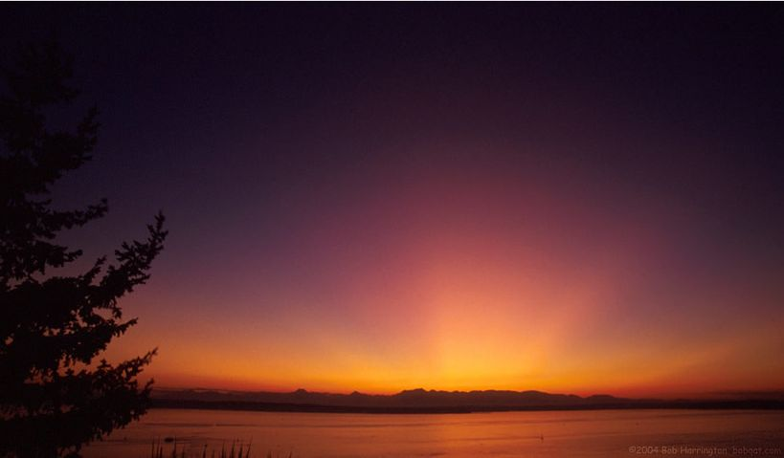
THE COLOR OF THE SKY
Sunlight - mixture of light of all colors which is usually seen as white
The ray path of light from the setting Sun is highly distorted near the horizon because of atmospheric refraction, making the sunset appear to occur when the Sun’s disk is already about one diameter below the horizon.

Slide 26
When the sun is at the zenith, sunlight travels a short distance before it reaches the eye. At sunset (or sunrise) sunlight travels a much bigger distance before it reaches the observer's eyes. In the first case blue light is scattered towards the eye and the sky appears blue. In the second case, most of the blue light has been scattered away before it can have a chance to reach the eye
Only red-green light reaches the observer's position which explain why the sky looks red-orange when the sun is at the horizon.

Slide 27
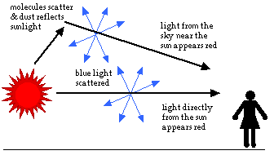
WHY IS THE SUNSET RED?
As the sun begins to set, the light must travel farther through the atmosphere before it gets to you. More of the light is reflected and scattered. As less reaches you directly, the sun appears less bright. The color of the sun itself appears to change, first to orange and then to red.
This is because even more of the short wavelength blues and greens are now scattered.
Only the longer wavelengths are left in the direct beam that reaches your eyes.

Slide 28
1 arcsec = 4.84813681 * 10⁻⁶ rad

