Slide 1
International Young Naturalists’ Tournament
6.Disappearing Ink
Serbian team
Regional Center for Talented Youth Belgrade 2

Slide 2
6. Disappearing ink
Suggest a chemical formulation for the ink that would disappear after used to write a text. What parameters determine the time when the text becomes invisible? Is it possible to process the -paper in such a manner that the text appears again?

Slide 3
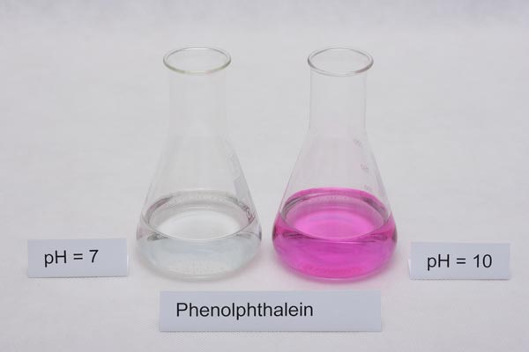
pH Indicators
Weak acids or weak bases
Indicators are weak organic acids or bases that have different colors in their protonated and deprotonated states
Phenolphthalein is a weak organic acid that behaves as an acid–base indicator
It exists in two different forms - an acid form HInd, which is colorless, and a corresponding base form Ind–, which is pink

Slide 4
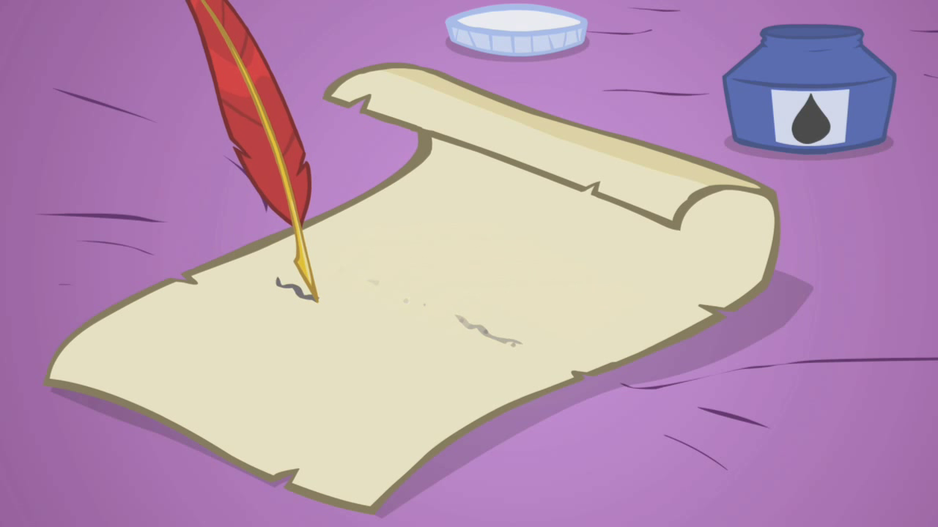
Ink formulation
Water (100ml)
Sodium hydroxide (5 drops of 6 mol\dm3 NaOH solution)
Ethanol (20ml)
Phenolphthalein (3g)

Slide 5
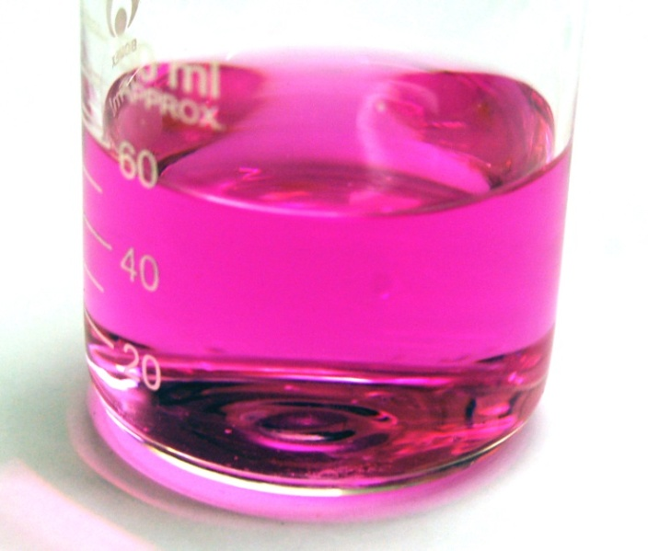
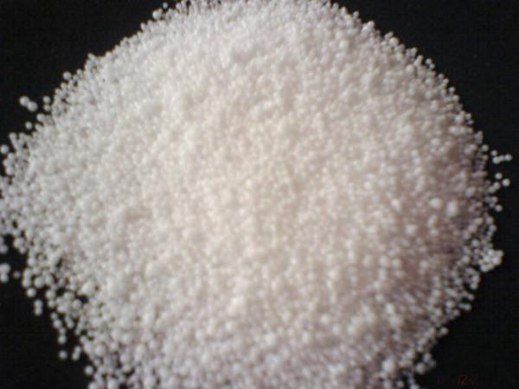
Making of the ink
sodium hydroxide
disappearing ink
CO₂ + H₂O → H₂CO₃
2 NaOH + H₂CO₃ → Na₂CO₃ + 2 H₂O

Slide 6
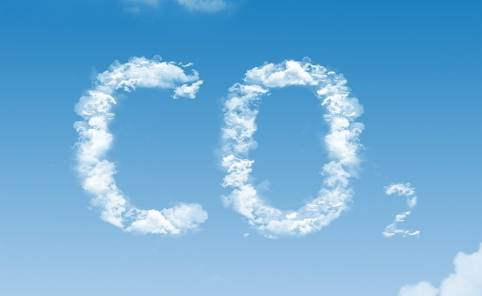
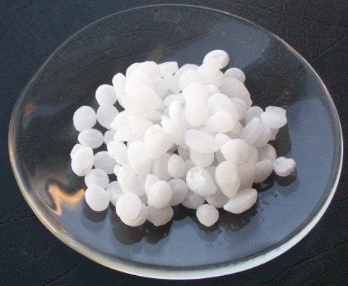
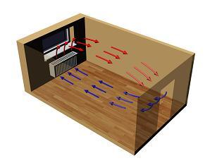
Parameters
Carbon-dioxide concentration
Air temperature
Air circulation in the room
Base concentration
Notes:
Gasovi se bolje rastvaraju kada je hladnije

Slide 7
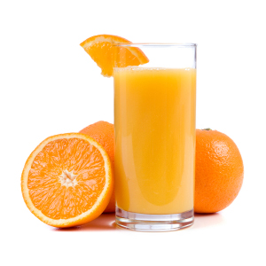
Orange juice
Invisible inks that respond to heat
Notes:
When you painted the orange juice solution onto the paper, the carbon-based compounds were absorbed into the paper's fibers. When you heated the paper, the heat caused some of the chemical bonds to break down, freeing the carbon. Once the carbon came into contact with the air, it went through a process called oxidation, one effect of which is to turn a darker color.

Slide 8
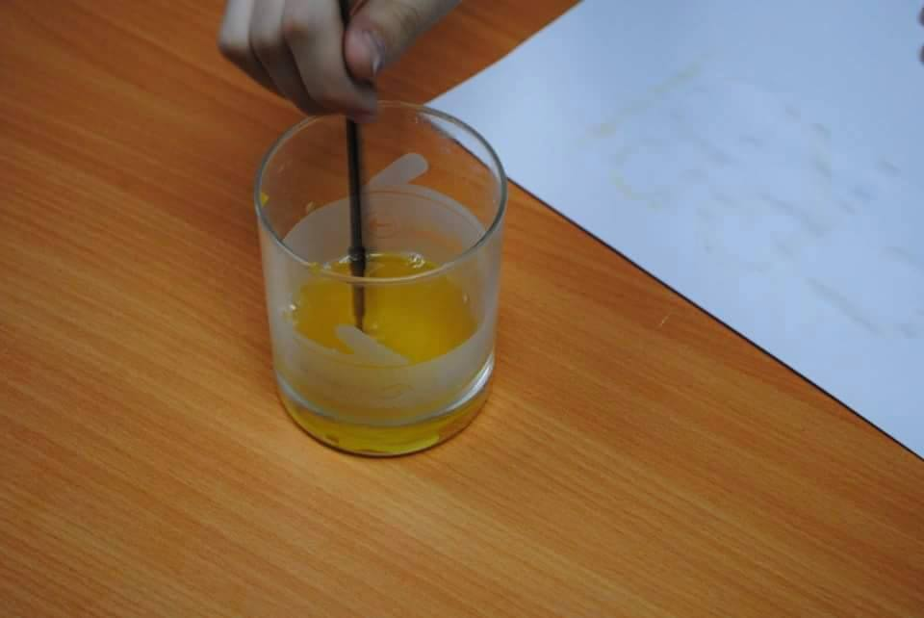
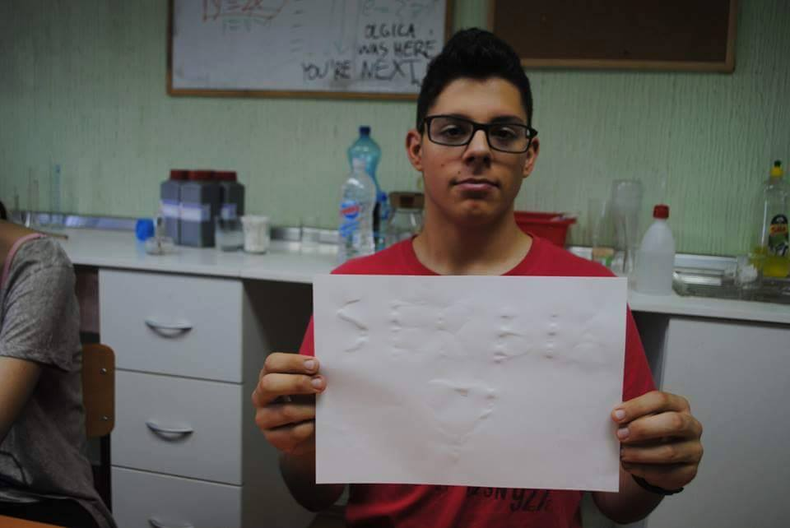
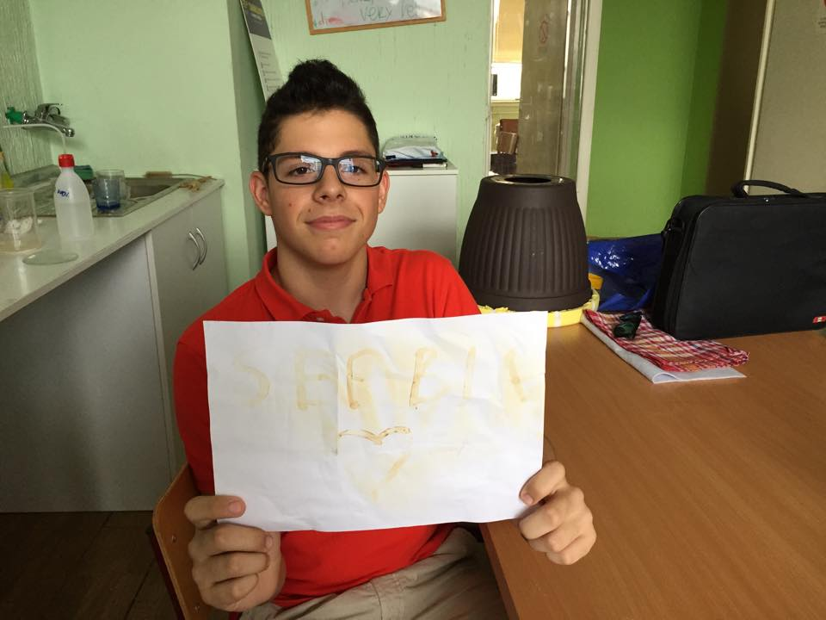
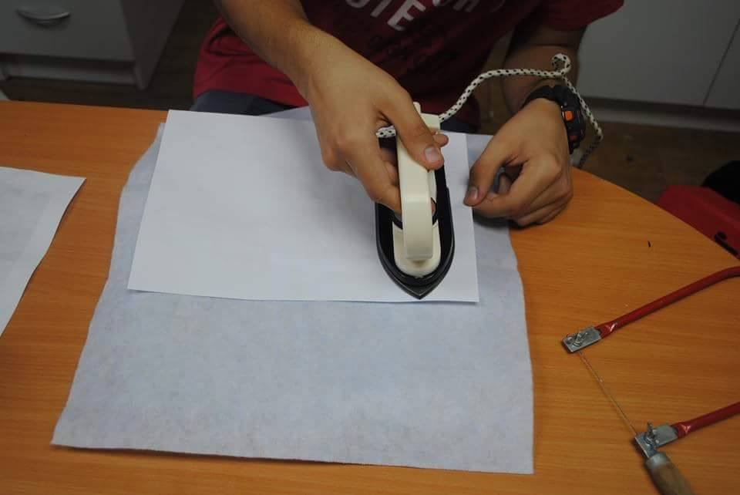
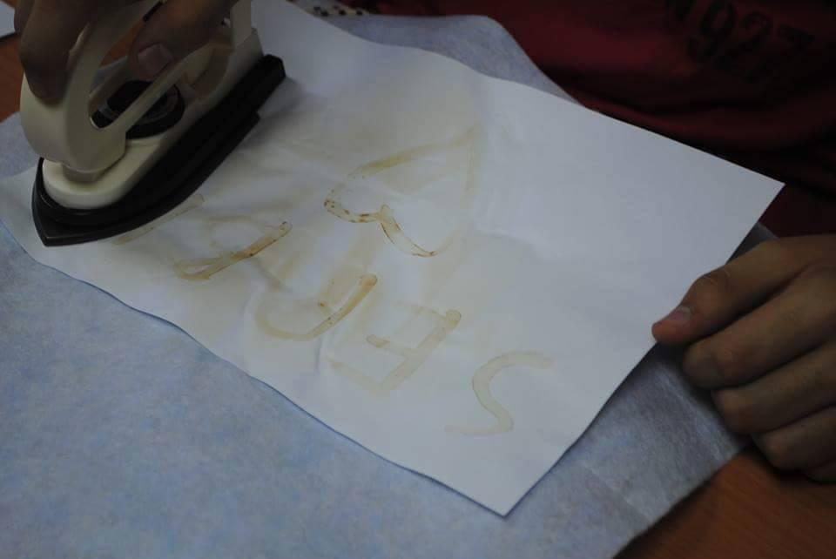

Slide 9
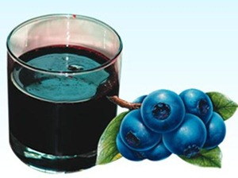
baking soda + blueburry juice
Notes:
Bluberry juice has an acid that reacts with the baking soda. A different color appears wherever the secret message is written.

Slide 10
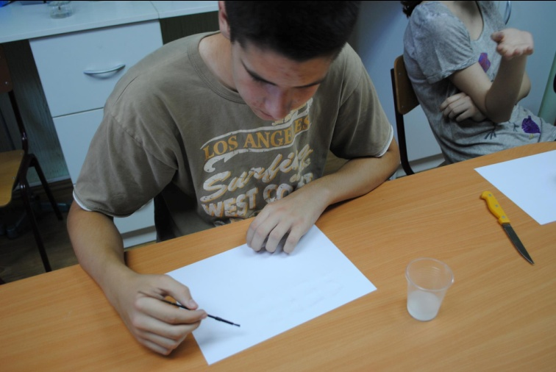
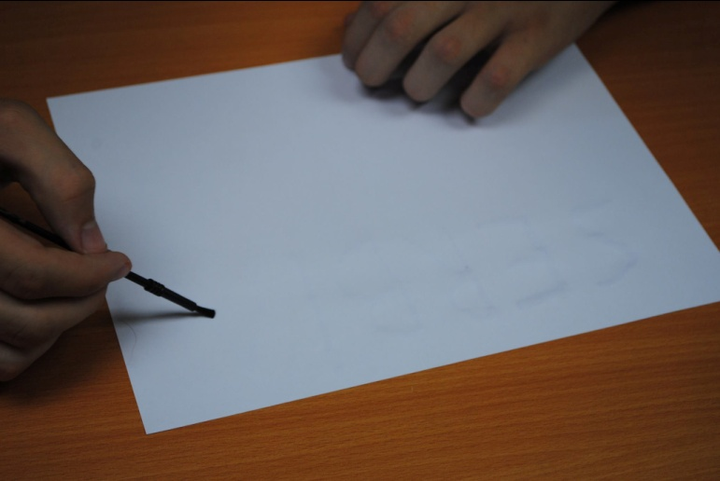
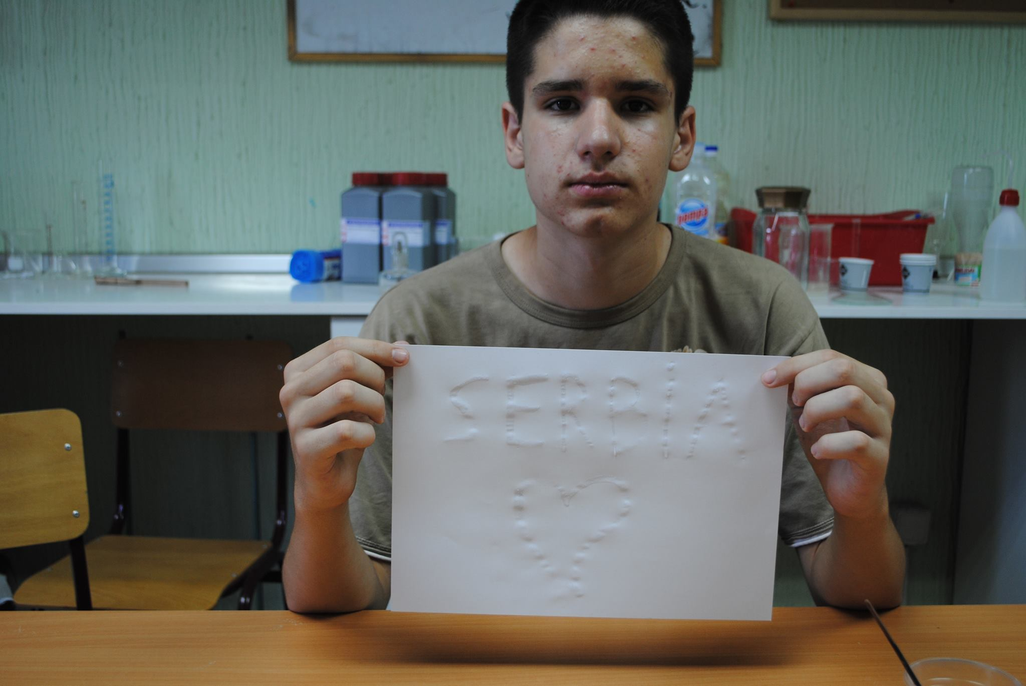
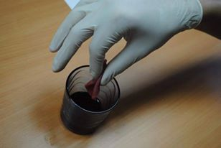
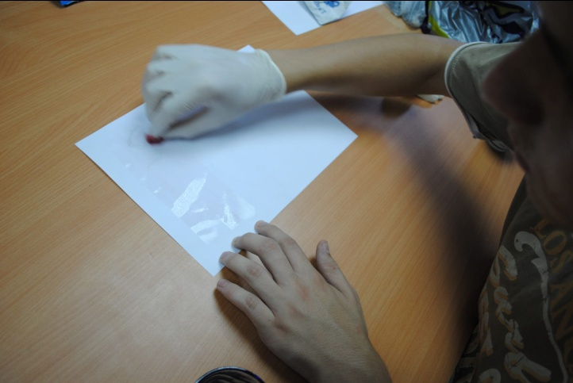

Slide 11
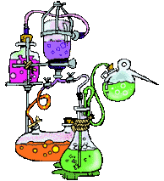
Thank you on your attention!!!

Slide 12
Phenolphthalein-Experiment

