Slide 1
International Young Naturalists’ Tournament
9. Distances in open space
Serbian team
Regional Center For Talented Youth Belgrade II

Slide 2
9. Distances in open space
How do astronomers measure distances between the planets of the Solar System, between the stars in our Galaxy, or between the galaxies?
Determine the distance between the two space objects of your choice.

Slide 3
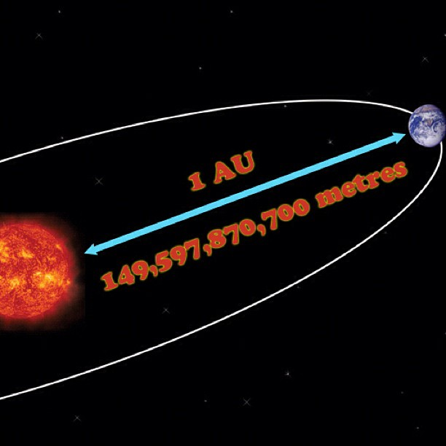
Units in astronomy
Astronomical Unit - AU
150 million kilometers
93 million miles
Light-Year –ly
9,5 trillion kilometers
63 250 AU
Parsec – pc
3,26 light-years
Notes:
Distances in the solar system are commonly measured in Astronomical Units (AU). An AU is simply the average distance between the Earth and the Sun. Because the Earth's orbit around the Sun is an ellipse, the Earth is not always the same distance from the Sun. An AU is equal to ~149,600,000 km. It takes 8 minutes for light to travel from the Sun to the Earth,traveling at the speed of light, of course.
Distances in the solar system are often measured in astronomical units (abbreviated AU). An astronomical unit is the average distance between the Earth and the Sun:
1 AU = 1.496 × 10⁸ km = 93 million miles
Jupiter is about 5.2 AU from the Sun and Pluto is about 39.5 AU from the Sun. The distance from the Sun to the center of the Milky Way is approximately 1.7 × 10⁹ AU.
To measure the distances between stars, astronomers often use light-years (abbreviated ly). A light-year is the distance that light travels in a vacuum in one year:
1 ly = 9.5 × 10¹² km = 63,240 AU
Proxima Centauri is the nearest star to Earth (other than the Sun) and is 4.2 light-years away. This means light from Proxima Centauri takes 4.2 years to travel to Earth.
Parsecs:
Many astronomers prefer to use parsecs (abbreviated pc) to measure distance to stars. This is because its definition is closely related to a method of measuring the distances between stars. A parsec is the distance at which 1 AU subtends and angle of 1 arcsec.
1 pc = 3.09 × 10¹³ km = 3.26 ly

Slide 4
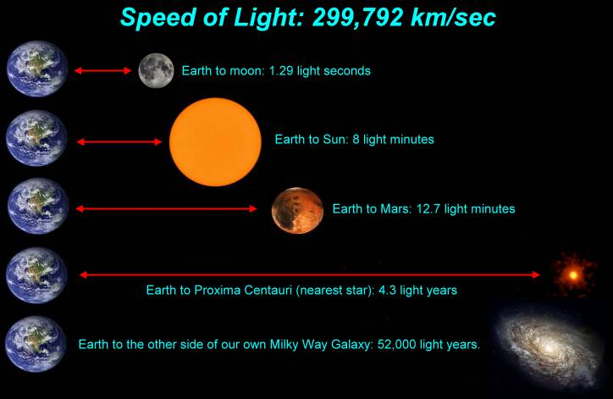
Light year

Slide 5
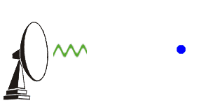
Methods of measuring distances
Radar
Stellar parallax
Standard candles
Redshift and Hubble’s Law

Slide 6
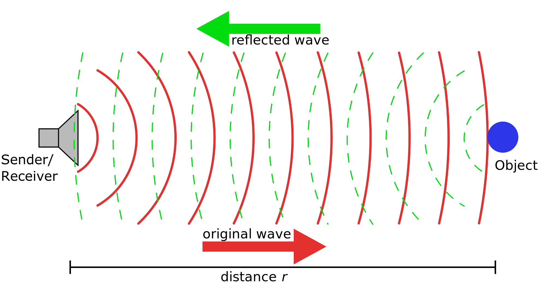
What is radar astrometry?
Notes:
This modern method of measuring distances is based on the fact that light (whether in the form of radio waves, microwaves, visible light, or X-rays) travels with a speed of 300,000 km/sec. Therefore, based on the fact that distance traveled equals to the speed at which you travel times the length of time you travel at that speed, we can determine distances in our solar system.
One of the most accurate ways to measure the distances to the planets is by bouncing radar off them, or sending a spacecraft there, which can send a radio signal back to the Earth that can be timed.
Radar is essentially microwave electromagnetic radiation (microwaves fall under the radio spectrum). Since electromagnetic radiation, in all of its forms, is light, we know that radar travels at the speed of light - 2.99 x 10⁵ km/s. Simply, distance traveled is equal to the time multiplied by the velocity. If we bounce radar off a planet, and measure the time it takes the signal to go there and back, we can use this information to calculate the distance of the planet.

Slide 7
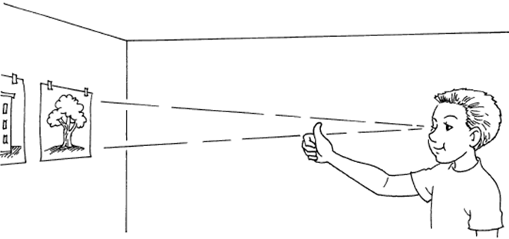
What is a parallax?
Notes:
If you hold your finger in front of your face, close one eye and look with the other, then switch eyes, you'll see your finger seem to "shift " with respect to more distant objects behind it. This is because your eyes are separated from each other by a distance of a few inches - so each eye sees the finger in front of you from a slightly different angle. The amount your finger seems to shift is called its "parallax".
Parallax is the apparent shift of an object's position relative to more distant background objects caused by a change in the observer's position. In other words, parallax is a perspective effect of geometry. It is the observed location of one object with respect to another – nothing more.

Slide 8
Stellar parallax
Notes:
Method of measuring the distance between Earth and stars by observing the apparent change in their position resulting from the movement of the Earth.
We observe the position of the star two times, six months apart, for example in January and in July. Let’s call the location of Earth in January point A and its location in July point B. The Sun will be point O. Movement of the star is negligible compared to its distance to Earth so we can consider it stationary and we’ll call its location point S. Because the Earth’s orbit is nearly circular the Sun is the center of the line AB and AO⊥OS. Triangle AOS is right triangle and angle OSA, which we call the parallax angle θ is half of the angle ASB.

Slide 9
Calculation of stellar parallax
When we apply trigonometry we have:
if we use a small angle
approximation

Slide 10
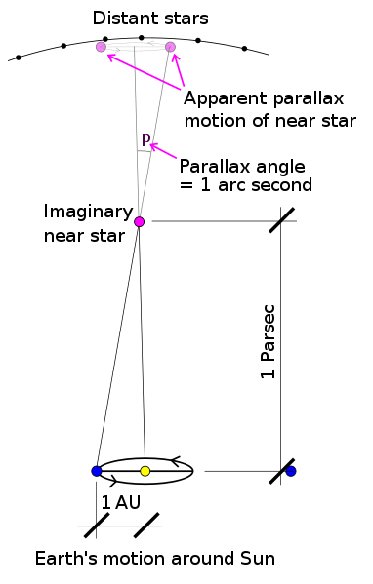
Stellar parallax
If we use parsec as a unit of measurement distance is:

Slide 11
Measuring distances in solar system using parallax
A method of parallax can be used to determine distance to planets in the solar system, only observations are made at the same time from two points on the Earth’s surface
Notes:
In the late 17th century, Giovanni Cassini used the parallax technique to measure the distance to Mars. Cassini knew that a larger parallax would be easier to measure - but this required a larger baseline (ie, the baseline would be like the distance between your eyes). He took measurements of the position of Mars from Paris and sent a fellow astronomer to French Guiana in South America to do the same. This gave him a baseline of several thousand kilometers - using geometry, he was able to calculate a distance for Mars that is only 7% off today's more precise measurements!

Slide 12
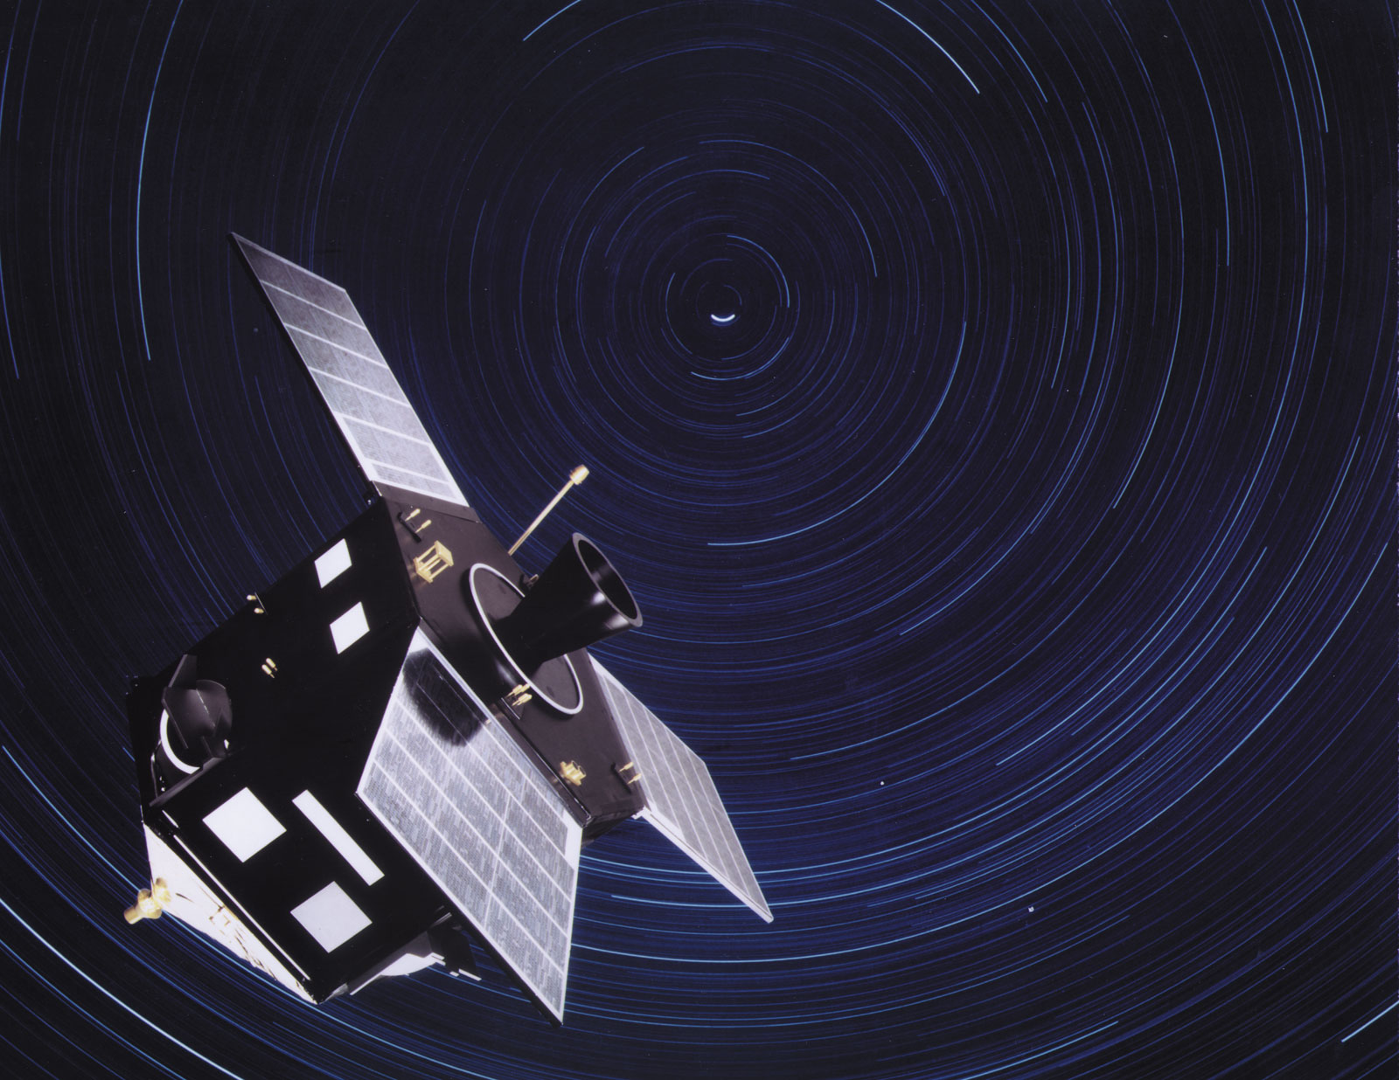
What is Hipparcos?
The “range” for ground telescopes is about 100 parsec (326 light years)
The “range” for space telescopes is up to 500 parsecs (1630 light years)
Notes:
Hipparcos and Gaia
Parallactic angles of stars are difficult to measure. The European Space Agency launched the Hipparcos satellite which was in operation from 1989 to 1993. It could measure a parallactic angle of about 0.001 arcsecond. Before Hipparcos, literally only a hundred or so parallactic angles were known to any accuracy. Due to Hipparcos, the distances to several thousand stars are known to better than 5% accuracy.
Several thousand stars, however, is still only a very small fraction of the galaxy. The next satellite planed is Gaia (Global Astrometric Interferometer for Astrophysics). It aims to increase the angular resolution of Hipparcos by a factor of over a 1000. Scheduled to be launched in 2011, Gaia will dramatically increase the number and accuracy of known distances to stars in the Milky Way.

Slide 13
Standard candles
Notes:
Third method of measuring distances in space is standard candles.

Slide 14
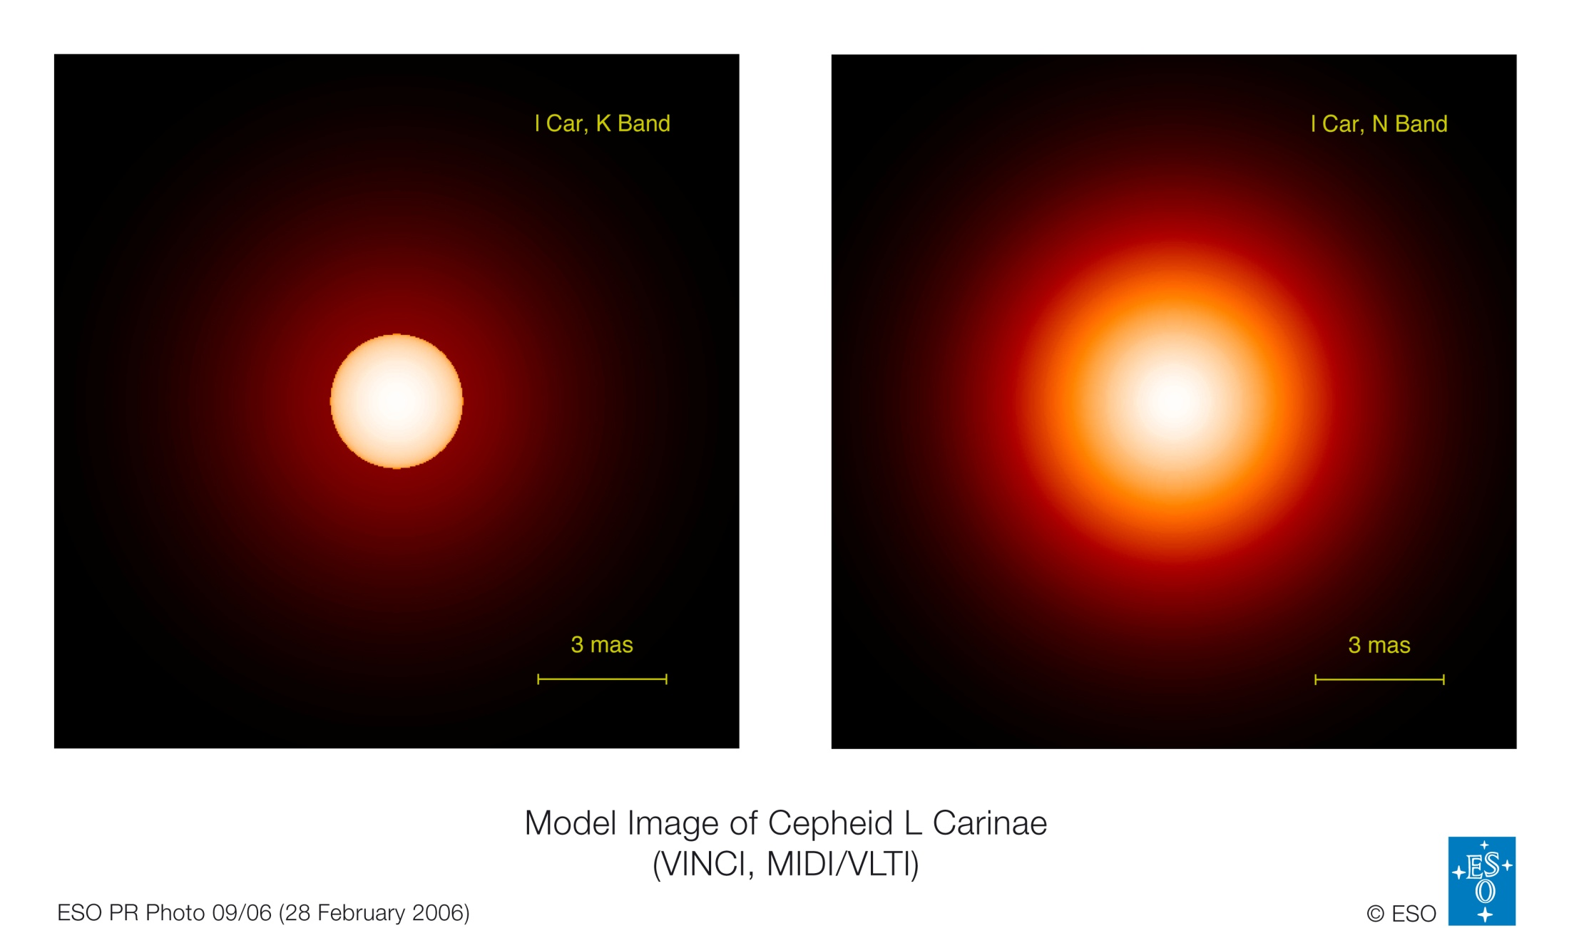
Cepheid variable
Notes:
Cepheid variables are stars whose light intensity changes periodically. This happens because the star volume itself changes, with greater emitting surface corresponding to higher light intensity. Their pulsation period ranges from days to months. There is a known relationship between their luminosity and pulsation period. Thus by measuring the pulsation period we can calculate their brightness. Because brightness decreases with distance squared, if apparent brightness is measured it is possible to calculate the distance to the star.

Slide 15
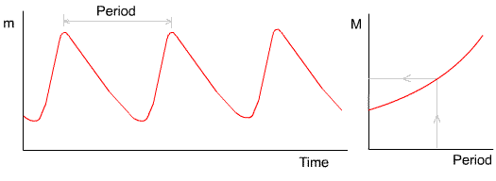
Cepheid variable
Cepheid variables are stars whose luminosity varies periodically
Notes:
One type of standard candle is a Cepheid Variable. The first example of these was discovered in the constellation of Cephius, hence the name.
The absolute magnitude (luminosity) of this type of star varies with time. The first graph below shows how the apparent magnitude (the brightness) changes, getting brighter and dimmer again with a fixed, measurable period. This is to do with the balance between the nuclear and gravitational forces within the star. In most stars these forces are balanced over long periods but in Cepheid variables they seem to take turns, a bit like a mass bouncing up and down on a spring.
There is a clear relationship between the period of a Cepheid variable and its absolute magnitude. The greater the period then the greater the maximum luminosity of the star. Cephieds typically vary in brightness over a period of about 7 days. Delta Cephius, the first discovered, has a period of 5.3 days.
So to find out how far away it is:
1. Measure how long it takes to get brighter and dimmer
2. Use the graph on the right to find its absolute magnitude M
3. Measure how bright it appears (maximum)
4. Calculate how far away it is.

Slide 16
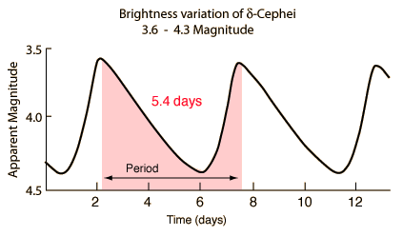
Cepheid variable
Range” of this method is 95 million light years.
Range” of this method is 95 million light years.
“Range” of this method is 95 million light years.
Notes:
Thus by measuring the pulsation period we can calculate their brightness. Because brightness decreases with distance squared, if apparent brightness is measured it is possible to calculate the distance to the star.
This method can also be used to calculate the distance of galaxies. However this can be done only as long as it is possible to differentiate individual stars in distant galaxies. The “range” of this method is about 95 million light years (the most distant Cepheid variable yet found is about 95 million light years away)

Slide 17
Type Ia supernova
Notes:
Type Ia supernovae occur in binary systems (two stars orbiting one another) in which one of the stars is a white dwarf while the other can vary from a giant star to an even smaller white dwarf. A white dwarf is the remnant of a star that has completed its normal life cycle and has ceased nuclear fusion. However, white dwarfs of the common carbon-oxygen variety are capable of further fusion reactions that release a great deal of energy if their temperatures rise high enough. Physically, carbon-oxygen white dwarfs with a low rate of rotation are limited to below 1.38 solar masses. Beyond this, they re-ignite and in some cases trigger a supernova explosion. This category of supernovae produces consistent peak luminosity because of the uniform mass of white dwarfs that explode via the accretion mechanism. The stability of this value allows these explos
ions to be used as standard candle to measure the distance to their host galaxies because the visual magnitude of the supernovae depends primarily on the distance.

Slide 18
What is type I a supernova ?
Occurs in binary systems where a white dwarf is present
Notes:
Because of that its mass would increase, increasing the pressure inside it and thus temperature. As it becomes hotter and it reaches a point where it starts to fuse carbon and oxygen. That fusion reaction releases huge amounts of energy causing the star to explode and launching matter at speed of more than 5000km/s. Nadji sliku siguran sam da ima I doradicu sta pise na slajdu

Slide 19
Type Ia supernova
Notes:
Because of this mass of every type Ia supernova is the same during explosion
So its brightness is always the same and it can be used as a standard candle
We can use these supernovas to measure larger distances than with Cepheid variables because they are one of the brightest objects in universe. Range about 1000Mpc

Slide 20
What is redshift?

Slide 21
Hubble’s Law
Notes:
This redshift appeared to be larger for faint, presumably further, galaxies. Hence, the farther a galaxy, the faster it is receding from Earth. You can see this trend in Hubble's data shown in the images above. The velocity of a galaxy could be expressed mathematically as
v = H x dwhere v is the galaxy's radial outward velocity, d is the galaxy's distance from Earth, and H is the constant of proportionality called the Hubble constant.
The exact value of the Hubble constant is still somewhat uncertain, but is generally believed to be around 65 kilometers per second for every megaparsec in distance. (A megaparsec is given by 1 Mpc = 3 x 10⁶ light-years). This means that a galaxy 1 megaparsec away will be moving away from us at a speed of 65 km/sec, while another galaxy 100 megaparsecs away will be receding at 100 times this speed. So essentially, the Hubble constant reflects the rate at which the universe is expanding.
So to determine an object's distance, we only need to know its velocity. Velocity is measurable thanks to the Doppler shift. By taking the spectrum of a distant
So to determine an object's distance, we only need to know its velocity. Velocity is measurable thanks to the Doppler shift. By taking the spectrum of a distant object, such as a galaxy, astronomers can see a shift in the lines of its spectrum and from this shift determine its velocity. Putting this velocity into the Hubble equation, they determine the distance. Note that this method of determining distances is based on observation (the shift in the spectrum) and on a theory (Hubble's Law). If the theory is not correct, the distances determined in this way are all nonsense. Most astronomers believe that Hubble's Law does, however, hold true for a large range of distances in the universe.
It should be noted that, on very large scales, Einstein's theory predicts departures from a strictly linear Hubble law. The amount of departure, and the type, depends on the value of the total mass of the universe. In this way a plot of recession velocity (or redshift) vs. distance, which is a straight line at small distances, can tell us about the total amount of matter in the universe and may provide crucial information about the mysterious dark matter.

Slide 22
What is cosmological redshift?
$$z=\frac{v}{c}=\frac{Δλ}{λ_{\text{emit}}}$$
Notes:
z=v/c=delta lamba/lambda emitovano→v=z*c → d=v/H0

Slide 23
Our calculation distance to Proxima Centauri
We used the method of parallax
The parallax angle for Proxima Centauri is 0,769’’
=> The distance is 1.3 parsec or 4.24 light years

Slide 24
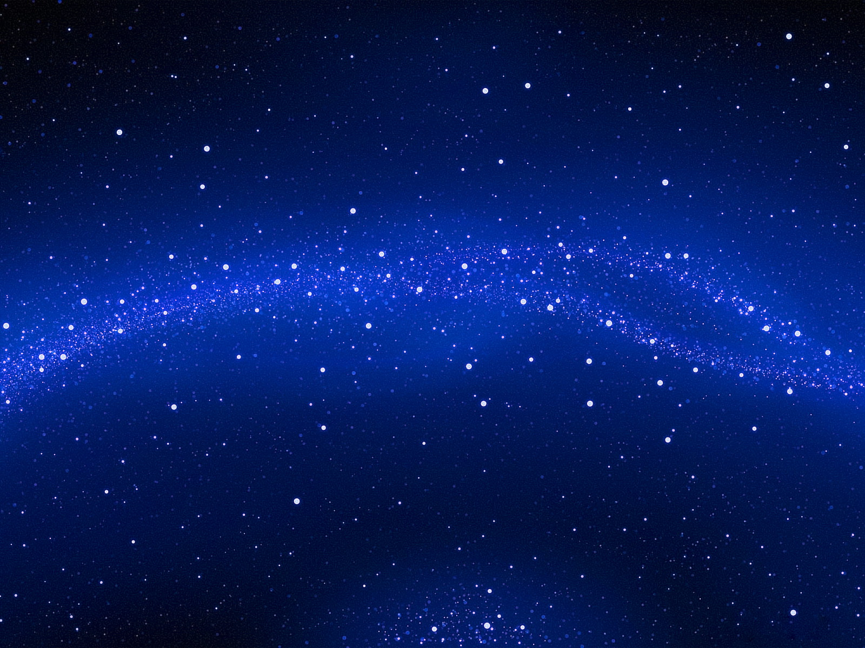
Thank you
for your attention!
☺
Thank you for your attention! ☺

Slide 25
https://www.astro.virginaia.edu/class/whittle/astr553/Topic16/Lecture_16.htm
http://starchild.gsfc.nasa.gov/docs/StarChild
http://www.crh.noaa.gov/mkx/?n=using-radar
http://locgt.net/spacebook/redshift

