Slide 1
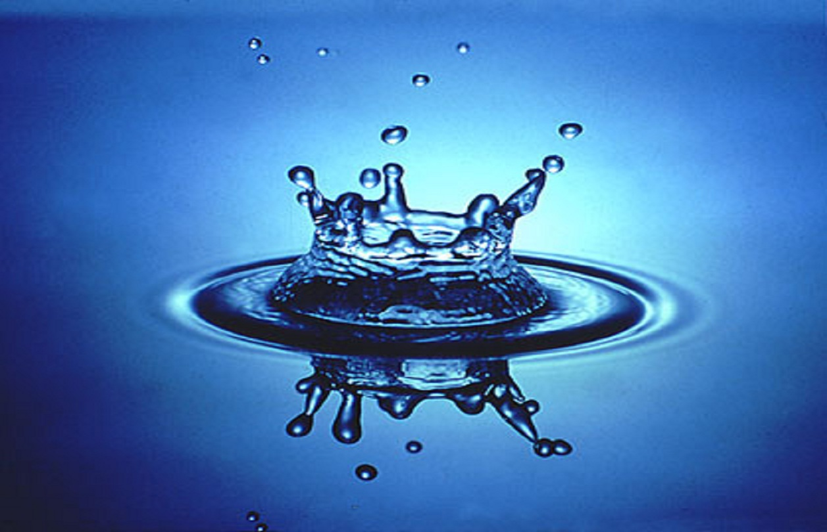
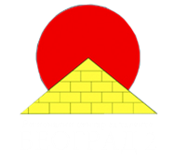
International Young
Naturalists’ Tournament
5.Falling Ball
Serbian team
Regional Center For Talented Youth

Slide 2
Problem
An electronic balance (1) is connected to a PC (5) in order to record the time dependence of the measured weight. A light frame (4) is mounted on a tall beaker (2) filled with water. The frame has a holder (3) allowing controlled release of a small ball such that it falls into the water. The beaker is placed on the balance as depicted in the Figure. Investigate how the readings of the balance reflect the different phases of the motion of the ball.

Slide 3
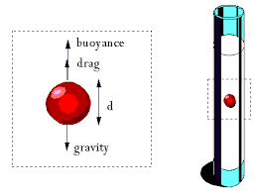
The motion of the ball
$$F_{p}=ρ_{0}∙V∙g−\text{Buoyant} \text{force}$$
$$ρ_{0}−\text{density} \text{of} \text{the} \text{liquid}$$
$$V−\text{volume} \text{of} \text{the} \text{body}$$
$$F_{g}=mg−\text{Gravity}$$
Notes:
Buoyance-potisak
Buoyant force is cause by difference in pressure below and above the object that is placed in a fluid.

Slide 4
Viscosity
Representing the internal resistance of the fluid to motion
Notes:
All liquids have a natural internal resistance to flow termed viscosity. Viscosity is the result of frictional interactions within a given liquid and is commonly expressed in two different ways.
The viscosity of a liquid is the property reppresenting the internal resistance of the fluid to motion (Çengel & Cimbala, 51). The viscosity of a liquid is created due to the movement of particles within the liquid creating friction. The higher the value of the viscosity, the more the liquid resists motion due to a large amount of friction. The same theory applies to low viscosity fluids; they resist motion far less due to minimal friction in the molecular structure of the fluid itself. Liquid is not the only state of matter that has the property of viscosity.
A fluid with low viscosity flows easily because its molecular makeup results in very little friction when it is in motion.
Picture :A simulation of substances with different viscosities. The substance above has lower viscosity than the substance below
Common symbols η, μ SI unitPa·s = kg/(s·m)Derivations from other quantities μ = G·t
Treba naci o dynamic and kinetic viscosity

Slide 5
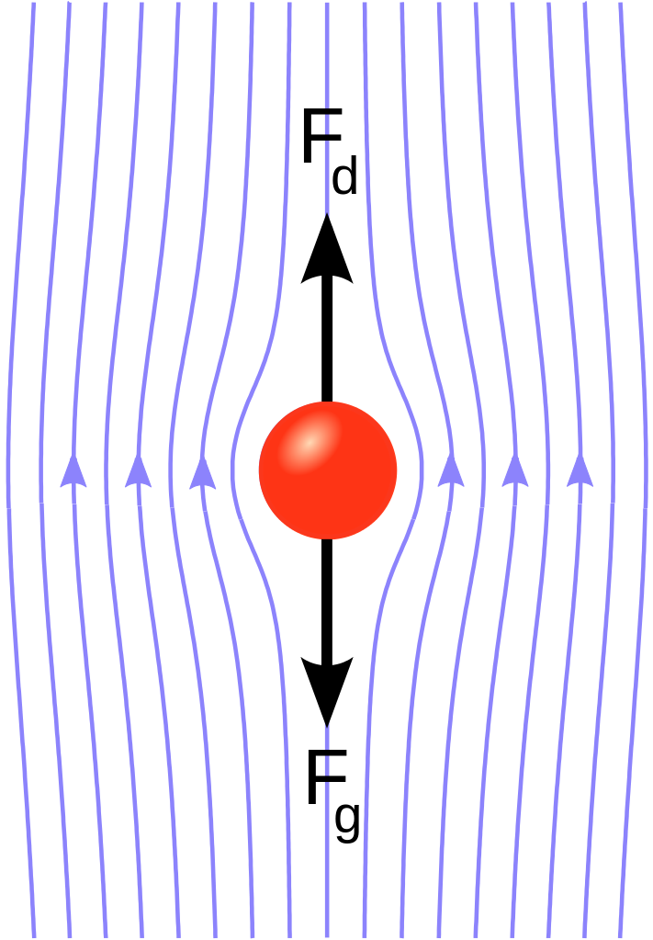
Stokes’ law
$$F_{d}=6πμRv$$
$$μ−\text{viscosity} \text{coefficient}$$
$$R−\text{radius} \text{of} \text{the} \text{ball}$$
$$v− \text{velocity} \text{of} \text{the} \text{ball}$$
Notes:
The force of viscosity on a small sphere moving through a viscous fluid is given by:
where F_{d} is the frictional force – known as Stokes' drag – acting on the interface between the fluid and the particle, μ is the dynamic viscosity, R is the radius of the spherical object, and V is the flow velocity relative to the object. In SI units, F_{d} is given in Newtons, μ in Pa·s, R in meters, and V in m/s.

Slide 6
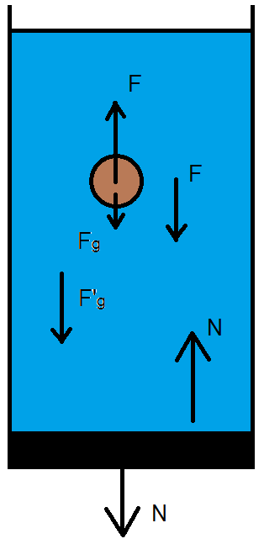
Why does the weight change?
$$N=F+{F′}_{g}$$
$${F′}_{g}−Gravitational force acting on the water$$
$$F_{g}−Gravitational force acting on the ball$$
$$F −\text{resulting} \text{buoyant} \text{force} \text{and} \text{drag}$$

Slide 7
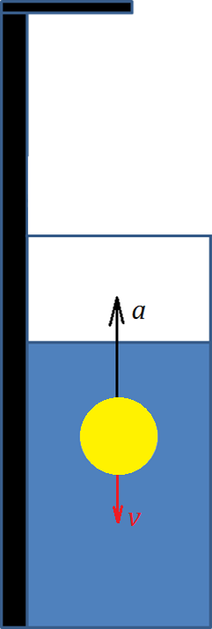
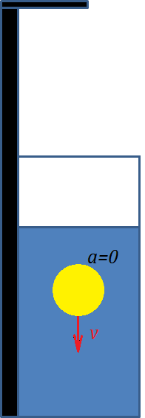
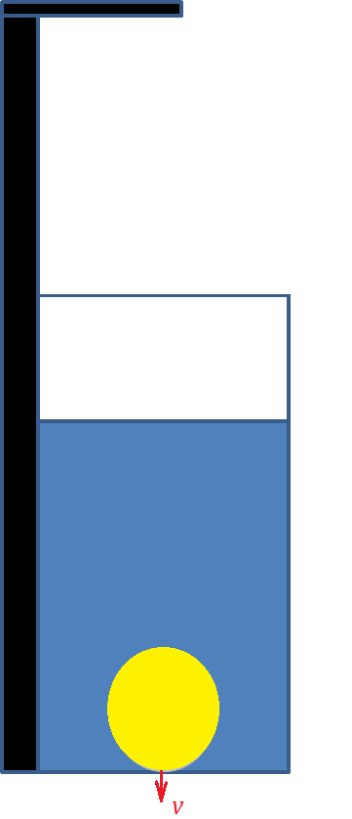
Phases in motion of the ball
Phase 1
Phase 2
Phase 3
Phase 4

Slide 8
Readings of the Balance

Slide 9
Thank you for your attention!
Notes:
As the sphere falls so its velocity increases until it reaches a velocity known as the terminal velocity. At this velocity the frictional drag due to viscous forces is just balanced by the gravitational force and the velocity is constant. At this speed: Viscous drag = 6phrv = Weight = mg Frictional force (F) = 6phrv (Stokes' law) If the density of the material of the sphere is r and that of the liquid s, then effective gravitational force = weight – up thrust = 4/3pr³(r – s) Therefore we have for the viscosity (h): Viscosity (h) = 2gr²(r – s)/9v where v is the terminal velocity of the sphere. From the formula it can be seen that the frictional drag is smaller for large spheres than for small ones, and therefore the terminal velocity of a large sphere is greater than that for a small sphere of the same material

Slide 10
Fluids
Notes:
A fluid is defined as a substance that continually deforms (flows) under an applied shear stress regardless of the magnitude of the applied stress. It is a subset of the phases of matter and includes liquids, gases, plasmas and, to some extent, plastic solids. The study of fluids is fluid mechanics, which is subdivided into fluid dynamics and fluid statics, depending on whether the fluid is in motion or not.
Fluids are also divided into liquids and gases.
Liquids form a free surface (that is, a surface not created by their container) while gases do not. The distinction between solids and fluids is not so obvious. The distinction is made by evaluating the viscosity of the matter:
In physics, a fluid is a substance that continually deforms (flows) under an applied shear stress. Fluids are a subset of the phases of matter and include liquids, gases, plasmas and, to some extent, plastic solids.
Fluids display properties such as:
not resisting deformation, or resisting it only lightly (viscosity), and
the ability to flow (also described as the ability to take on the shape of the container).This also means that all liquids have the property of fluidity.

Slide 11
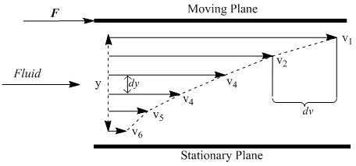
Newton's law of viscosity
Notes:
Newton's law of viscosity states that the shear stress between adjacent fluid layers is proportional to the negative value of the velocity gradient between the two layers.
Therefore, (3.1.3) also states that the rate of momentum transfer per unit area, between two adjacent layers of fluid, is proportional to the negative value of the velocity gradient between them.

Slide 12
Coefficient of viscosity
Notes:
The first is dynamic viscosity, also known as absolute viscosity, which measures a fluid’s resistance to flow. In precise terms, dynamic viscosity is the tangential force per unit area necessary to move one plane past another at unit velocity at unit distance apart. As one plane moves past another in a fluid, a velocity gradient is established between the two layers .
The existence and nature of viscosity can be demonstrated by suspending two horizontal, parallel plates in a liquid so that they are separated by a very small distance, Y (Fig. 3.1). Now, if the upper plate is kept stationary while the lower plate is set to motion with a velocity uo, the layer of liquid right next to this plate will also start to move. With time, the motion of the bottom layer of fluid will cause the fluid layers higher up to also move.

Slide 13
Newtonian and Non- Newtonian fluids

Slide 14
Newtonian and Non-Newtonian fliuds
Newtonian fliuds- water, milk
Non –Newtonian fliuds – ketchup, mayonnaise, liquid chocolate
Notes:
One of the invaluable applications of the determination of viscosity is identifying a given liquid as Newtonian or non-Newtonian in nature.
Newtonian liquids are those whose viscosities remain constant for all values of applied shear stress.
A Newtonian fluids (named after sir Isaac Newton) are any fluid whose stress versus strain rate curve is linear and starts at zero. In other words in a valve, a light valve actuation pushed this fluid, and heavier actuations push it more. How much more is a linear function.
Non-Newtonian liquids are those liquids whose viscosities vary with applied shear stress and/or time.

Slide 15
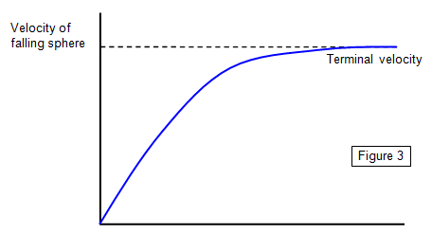
Terminal velocity
Notes:
The method applies Newton’s law of motion under force balance on a falling sphere ball when it reaches a terminal velocity. In Newton’s law of motion for a falling ball, there exist buoyancy force, weight force, and drag force, and these three forces reach a net force of zero. The drag force can be obtained from Stokes’ law, which is valid in Reynolds numbers less than 1.

