Slide 1
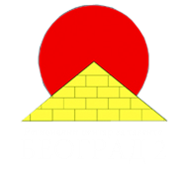
15.Fly Serbian team Regional Center For Talented Youth
International Young Naturalists’ Tournament

Slide 2
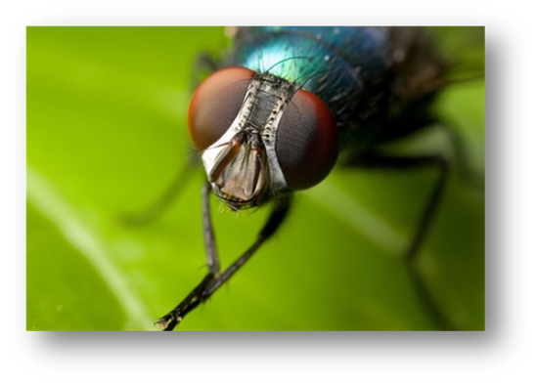
15. Fly
A fly can easily walk on a ceiling.
How is this possible?
Can one find such a ceiling that the fly would be unable to walk on?

Slide 3
Fly
Kingdom: | Animalia
Phylum: | Arthropoda
Class: | Insecta
Superorder: | Panorpida
(unranked): | Antliophora
Order: | Diptera
Over 120,000 species

Slide 4
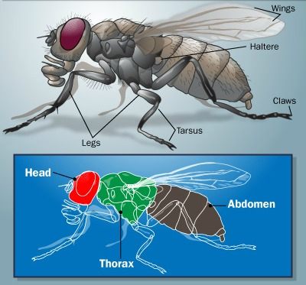
Anatomy of the fly
1) Tagma (head)
2) Thorax
3) Abdomen
Notes:
1) Tagma of the fly, the head, consists of ocelli, antennae, compound eyes, and the mouthparts.
2) Thorax, bears the wings and contains the flight muscles on the second segment
3) Abdomen

Slide 5
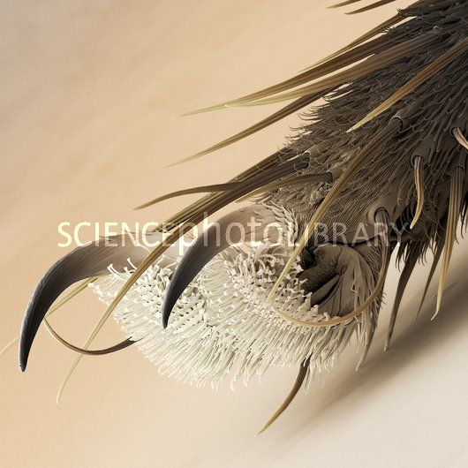
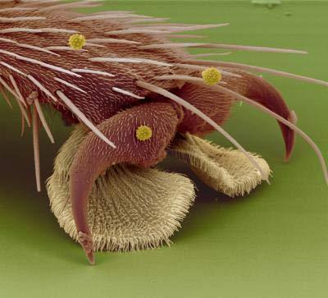
Scientists used to think that the little hairs on the fly’s feet allowed them to grip tiny cracks in surfaces they walked on, which is shown uncorrect in 2006
Notes:
Tiny Hairs on Foot
Insect feet often have microscopic bristle-like hairs, that are stiff enough to find the small inconsistencies in surfaces. Most ceiling and wall materials such as wood, drywall, ceiling tile and even concrete and glass, have very tiny pits and holes, making them porous. Insects can feel the holes and pits in the surface and grab into them with the stiff hairs on the bottoms of their feet. This keeps the insect tethered to the surface.

Slide 6
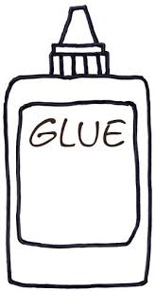
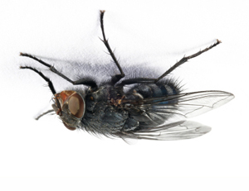
So how does fly walk on the ceiling?
Substance secreted by the hairs on a fly’s feet is actually a very sticky glue compound
Notes:
Walking upside-down requires a careful balance of adhesion and weight, and specialized trekking tools to combat the constant tug of gravity.
Each fly foot has two fat footpads that give the insect plenty of surface area with which to cling. The adhesive pads on the feet, called pulvilli, come equipped with tiny hairs that have spatula-like tips. These hairs are called setae.
Scientists once thought that the curved shape of the hairs suggested that flies used them to grip onto the ceiling. In fact, the hairs produce a glue-like substance made of sugars and oils.

Slide 7
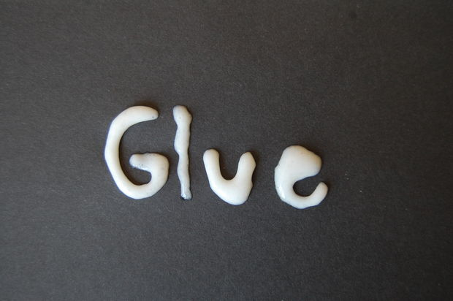
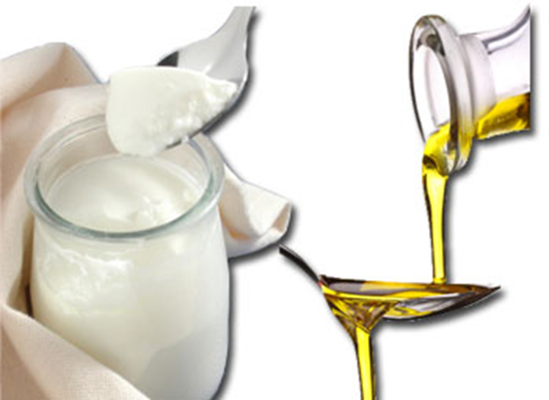
Structure of the glue
Glue is made of sugar and oil

Slide 8
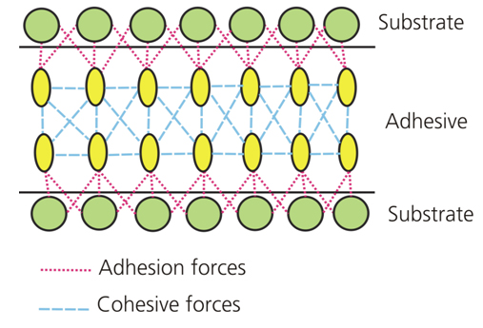
Adhesion and cohesion of glue
Notes:
Cohesive Forces
Cohesive forces are the intermolecular forces (such as those from hydrogen bonding and Van der Waals forces) which cause a tendency in liquids to resist separation. These attractive forces exist between molecules of the same substance. For instance, rain falls in droplets, rather than a fine mist, because water has strong cohesion which pulls its molecules tightly together, forming droplets. This force tends to unite molecules of a liquid, gathering them into relatively large clusters due to the molecules' dislike for its surrounding.
Adhesive Forces
Adhesive forces are the attractive forces between unlike molecules. They are caused by forces acting between two substances, such as mechanical forces (sticking together) and electrostatic forces (attraction due to opposing charges). In the case of a liquid wetting agent, adhesion causes the liquid to cling to the surface on which it rests. When water is poured on clean glass, it tends to spread, forming a thin, uniform film over the glasses surface. This is because the adhesive forces between water and glass are strong enough to pull the water molecules out of their spherical formation and hold them against the surface of the glass, thus avoiding the repulsion between like molecules.

Slide 9
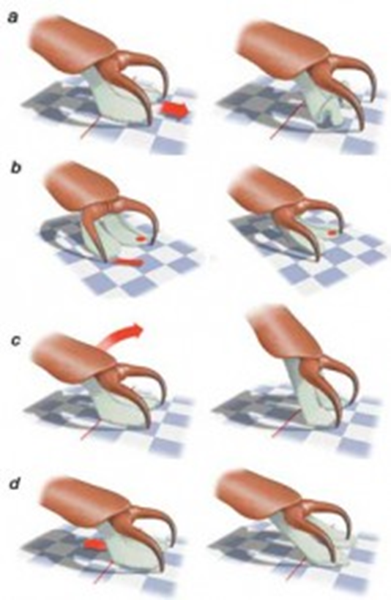
How to separate the foot from the surface?
fly can push the leg of his body, causing it to bend the foot pads and to rise free
twisting the foot
separating the back part of the foot using claws and swinging foot forward
or simply jerked backward pushing claws over the top of the foot

Slide 10
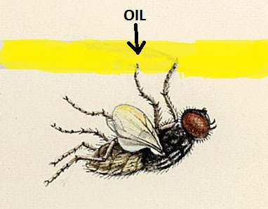
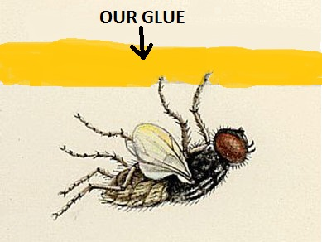
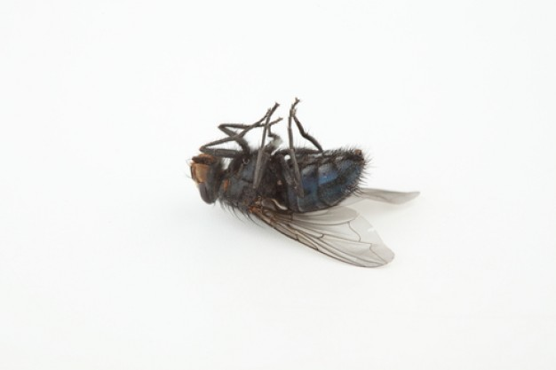
At which ceiling fly can’t walk on?
If we put glue on the ceiling, fly will be stuck, so she won’t be able to walk on it
If we put the same oil that she has
she will only slip down of the ceiling

Slide 11
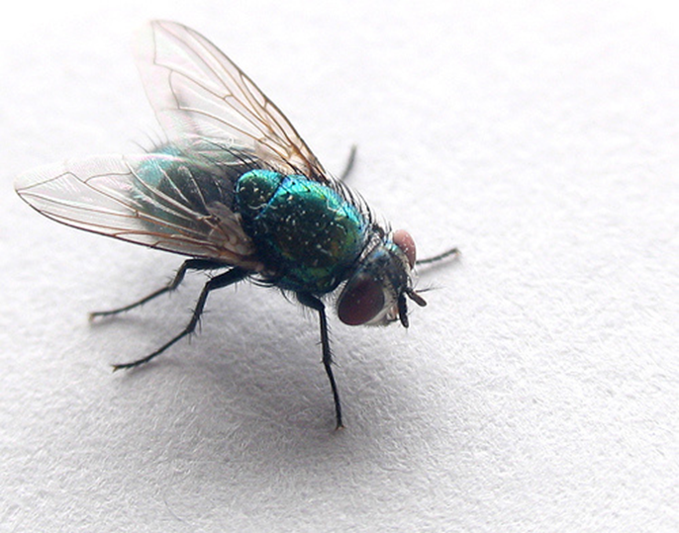
Conclusion
The specific walking on the ceiling isn’t allowed by little hairs on the fly’s feet
The glue made of sugar and oil is strong enough to keep fly on the ceiling, but not too strong so she get stuck on it
That glue applies forces adhesion and cohesion

Slide 12
THANK YOU FOR YOUR ATTENTION!!!

