Slide 1

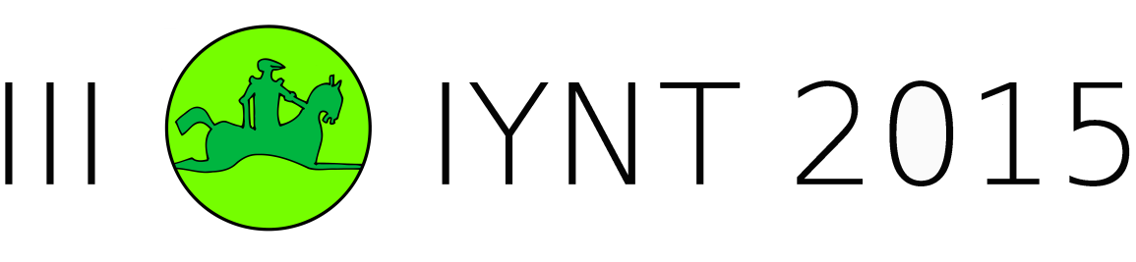
International Young
Naturalists’ Tournament
14. Galton box
Serbian team 2
Regional Center
For Talented Youth Belgrade II

Slide 2
14. Galton box
In the Galton box, a regular 2D lattice of obstacles disperses a thin flow of falling particles. When falling on the bottom of the box, the particles show a normal distribution. Use various types or particles and different arrangements of the obstacles to find the conditions when the distribution is no longer normal.
Notes:
U objasnjenju problema je pisalo kako tokom galtonovog ekperimenta uz pomoc galtonove kutije dobijamo normalnu distribuciju i nas zadatak je glasio da koristimo razlicite tipove i oblike prepreka kako ta distribucija vise ne bi bila normalna

Slide 3
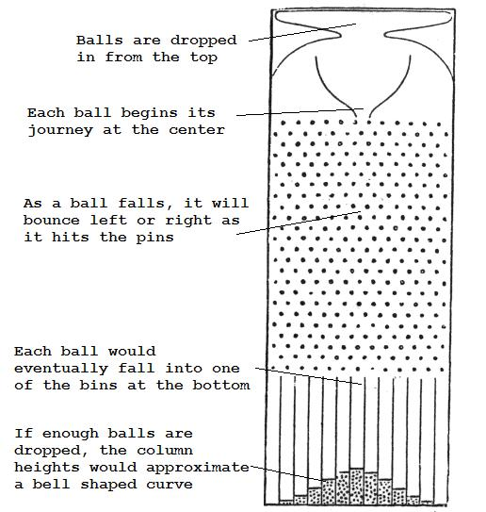
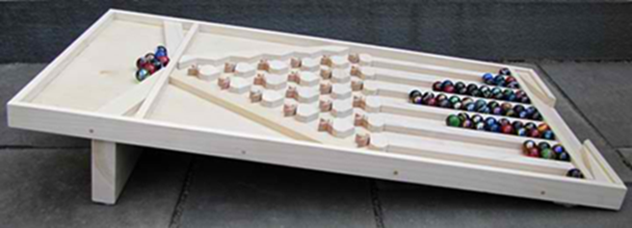
Galton box
50%-50% chance – Bernoulli principle
Galton box is a machine which was made by Frensis Galton
The rolling of marbles through Galton box is called Pascal movement
Notes:
Prvo trebamo da znamo nesto uopsteno o galtonovoj kutiji. Galtonova kutija je uredjaj koji je napravio Frensis Galton kako bi mogao uraditi galtonov eksperiment i dokazati da slucajno bacena zrna pasulja mogu ciniti normalnu distribuciju. A sad da objasnimo nacin rada galtonove kutije. Prvo kroz levak na vrhu uredjaja bacamo loptice i svaka loptica svoj put pocinje od centra. Kako loptica stigne do prepreke ona moze da skrene levo ili desno i verovatnoca za to je 50-50%. Kada je verovatnoca da se nesto desi 50-50% onda se to naziva bernulijev eksperiment. Takvo kretanje klikera u galtonovoj kutiji se naziva paskalovo kretanje. Posle odredjenog vremena svaki od klikera ce pasti na dno uredjaja u jedan od pretinaca. Kada padne dovoljan broj klikera pojavice se normalna distribucija.

Slide 4
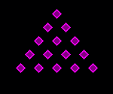
Working principle of Galton box
Notes:
Ovde smo prikazali princip rada galtonove kutije o kome smo pricali na prethondnom slajdu.

Slide 5
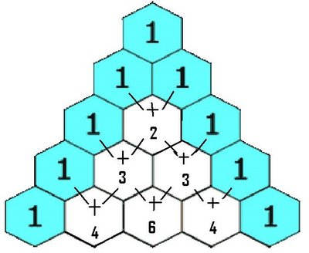
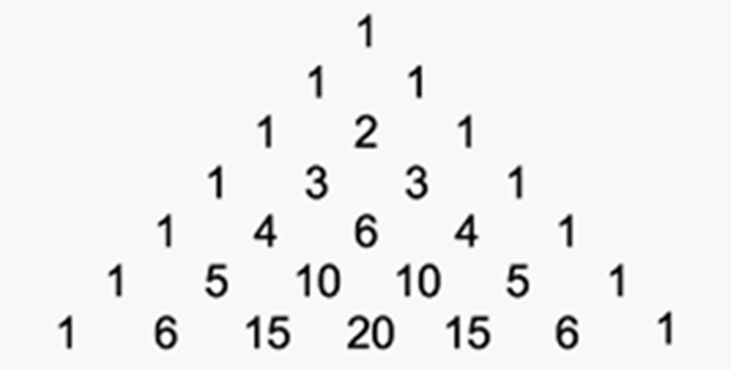
Pascal triangle
Galton box uses the principle of work of Pascal triangle
Notes:
Galtonova kutija koristi princip rada paskalovog trougla.

Slide 6

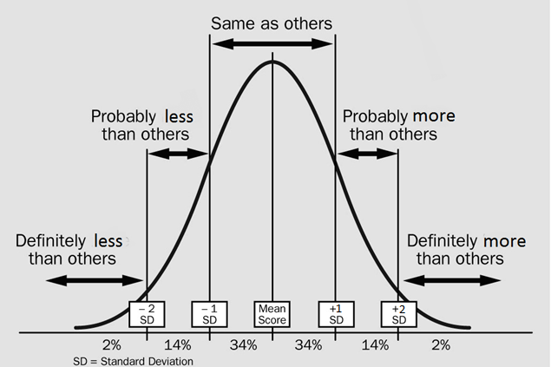
Normal distribution
If the number of rows of pins is large enough, this would approximate a normal distribution due to the central limit theorem.
x=the bin position e.g. x=0 could be treated as the left-most bin, and x=N could be treated as the right-most bin
P=the probabilaty of x
p=the probability of bouncing right (if x=0 represents the left-most bin). In an unbiased machine: p=0.5
N=the number of rows of pins i.e. The number of times a ball bounces

Slide 7
ANIMATION
http://teacherlink.org/content/math/interactive/flash/quincunx/quincunx.html

Slide 8
What effects a result or normal distribution is the space between obstacles
SOLUTION number 1

Slide 9
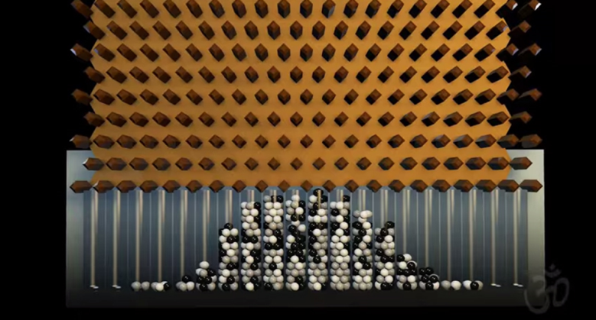
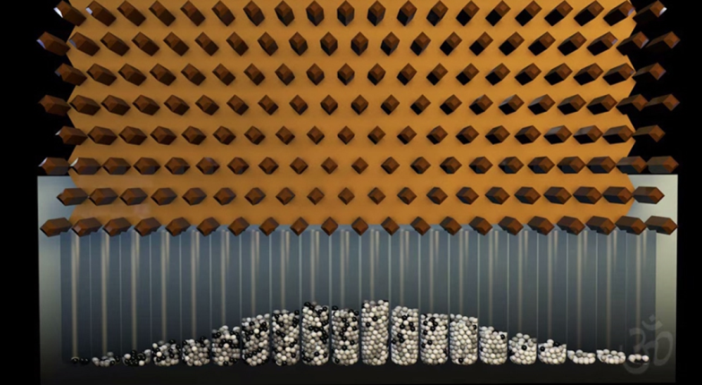
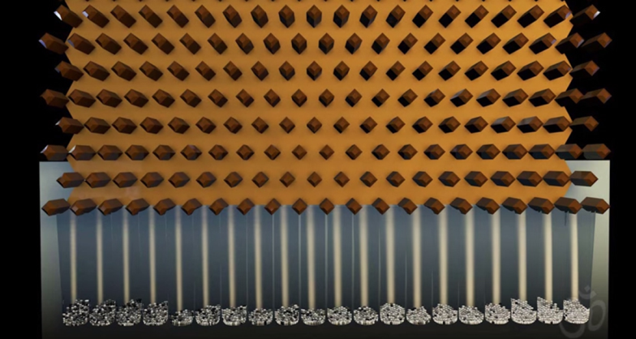
1) Size of balls or objects that we throw
BIG BALLS = LESS SPACE
MEDIUM BALLS = MEDIUM SIZE OF THE SPACE
SMALL BALLS = MORE SPACE

Slide 10
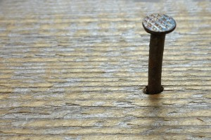
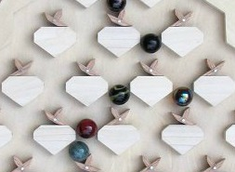
2) Size of obstacles
MORE SPACE
Plain obstacle like nail
LESS SPACE
More complicated and bigger obstacle

Slide 11

3) The way of placing obstacles

Slide 12
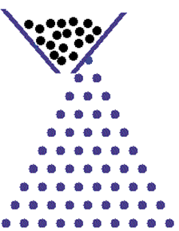
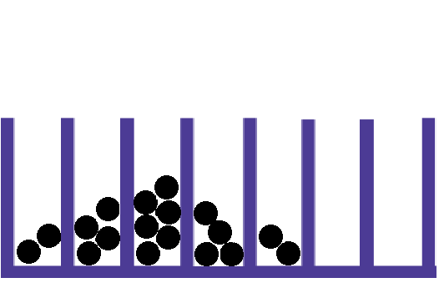
SOLUTION number 2

Slide 13

SOLUTION number 2
Notes:
If we would change the positioning of the obstacles into a circulate shape or a shape we would get a different distrubution than the normal one

Slide 14
SOLUTION number 3
Notes:
By changing the volume of the obstacles positioning we would get more obstacles in less space and that would change the movement of the particles and that would cause the particles to form a different distribution.
If we change the distance between the obstacles so that we have no more triangles with equal sides we won’t get the normal distribution.

Slide 15
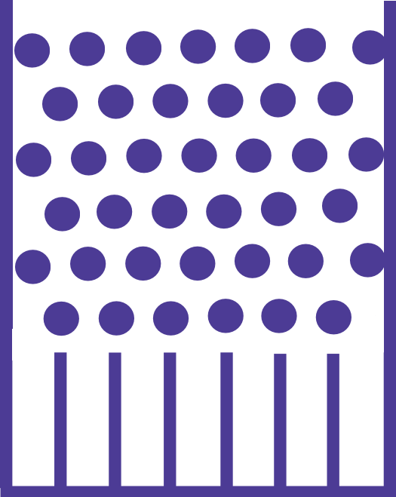
SOLUTION number 1
We drop all the particles at the same time
they hit each other and bounce back
Notes:
If we dropped all the particles at the same time they would hit each other and bounce back which would also cause them to form a different distribution.

Slide 16
SOLUTION number 3
Obstacles are one bellow the other
Notes:
Obsticals in square

Slide 17
SOLUTION number 2
Notes:
If we turn obstacles upside-down.

Slide 18

SOLUTION number 3
Notes:
There isn’t enough number of the columns at the bottom of the galton box.

Slide 19
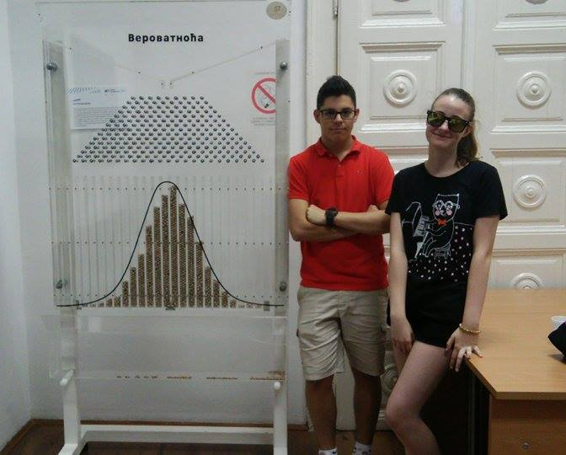
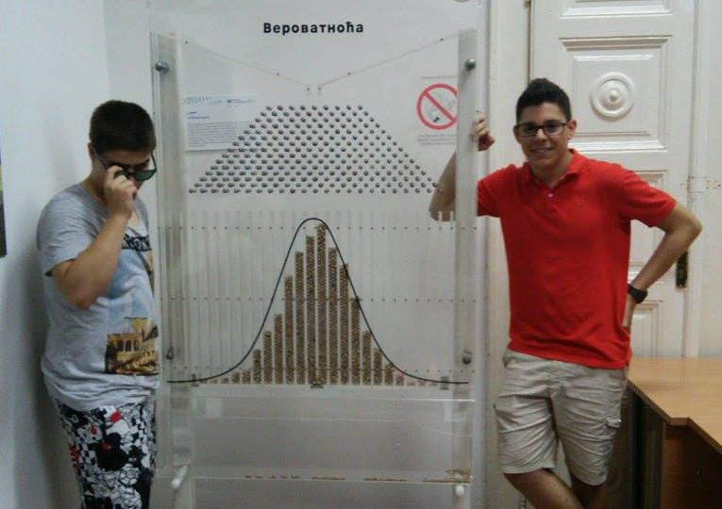
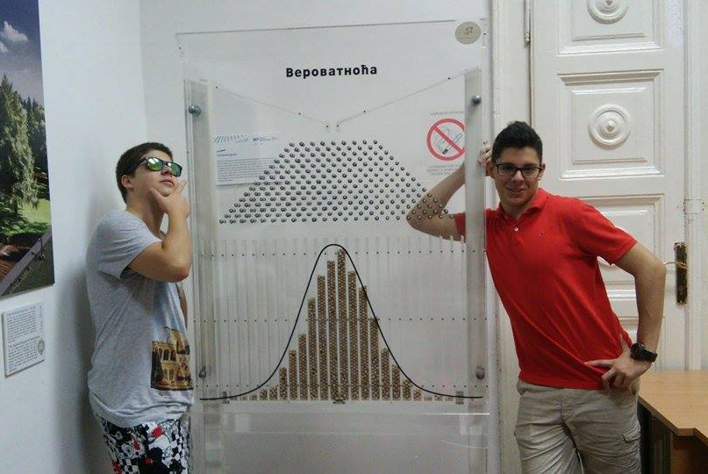
Our visit...

Slide 20
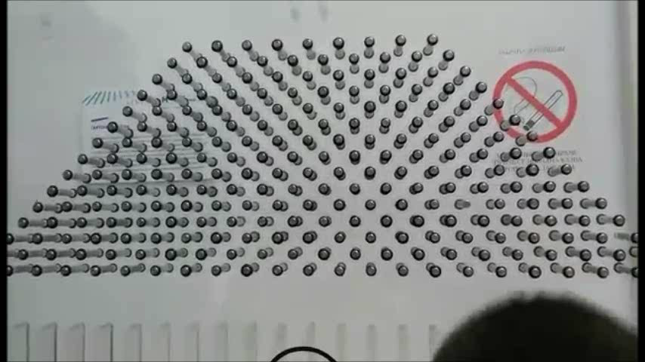
Our visit...

Slide 21
CONCLUSION
The ways the normal distribution can be changed is by not having the funnel, turning that part with obstacles upside-down and by changing the number of the columns.

Slide 22


THANK YOU FOR YOUR
ATTENTION!!!

Slide 23
Reference
http://www.statisticalconsultants.co.nz/blog/the-galton-box.html
http://teacherlink.org/content/math/interactive/flash/quincunx/quincunx.html
http://www.mathsisfun.com/data/quincunx.html
http://www.mathsisfun.com/data/standard-normal-distribution.html

Slide 24
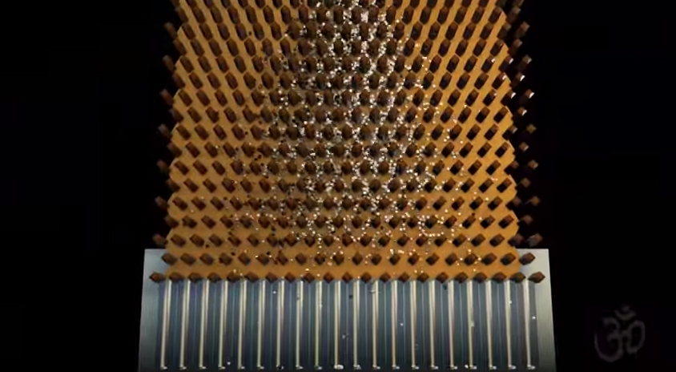

Medium balls

Slide 25
Size of the balls or other objects that we throw matters

Slide 26
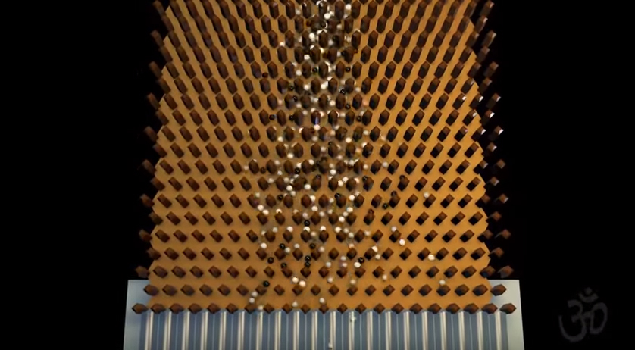

Big balls

Slide 27
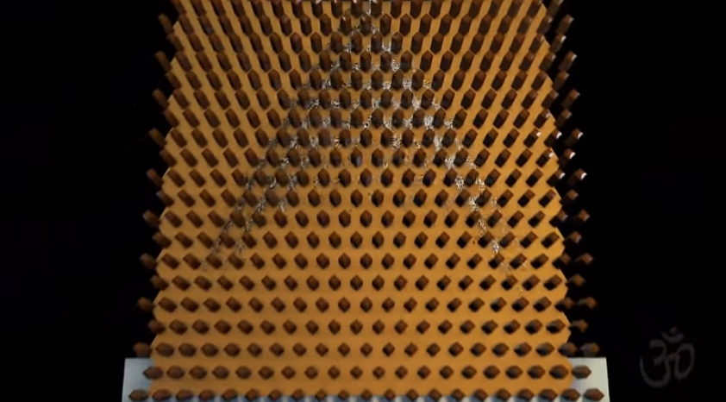

Small balls

