Slide 1
International Young Naturalists’ Tournament
21. Level
Serbian team
Regional Center For Talented Youth
Belgrade II

Slide 2
Problem 21: Level
A red dot is marked on a wall in your Science Fight room. Put a blue dot on another wall at exactly same horizontal level

Slide 3
Horizontal plane
Horizontal plane, also known as the axial plane is an imarigary plane that devides the body into superior and inferior parts.

Slide 4
Materials
Wooden Planks
Rope
Ductape
Rulers

Slide 5
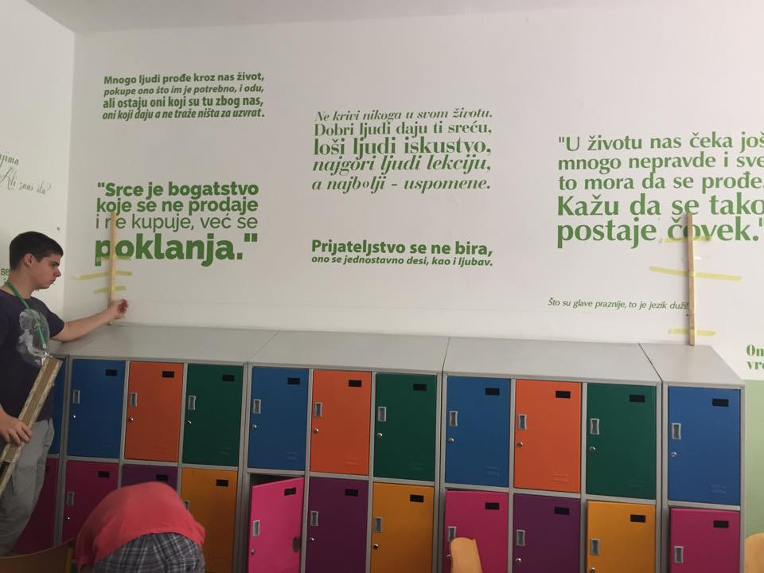
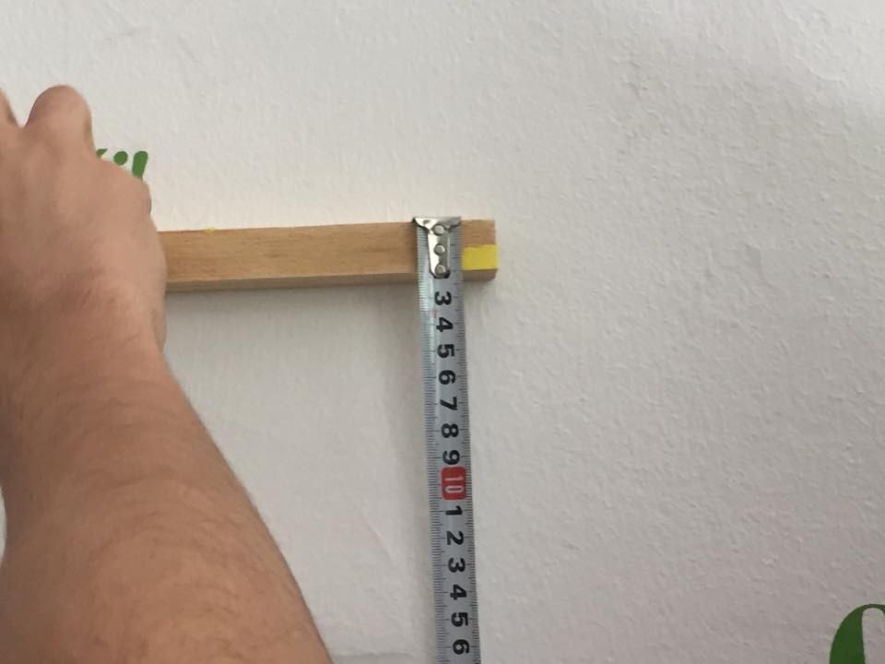
Experiment

Slide 6
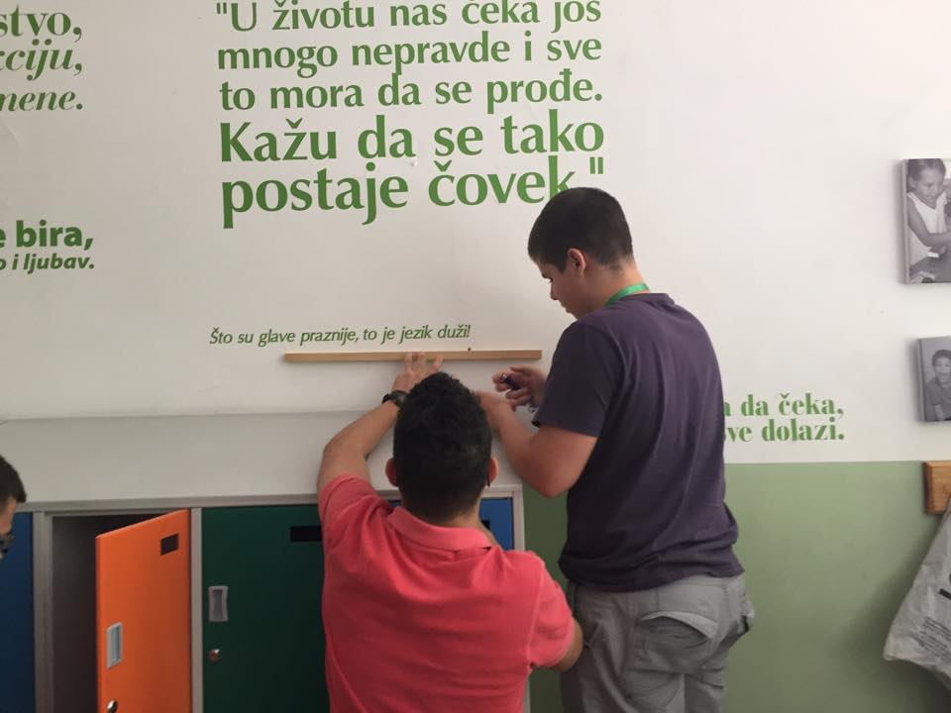
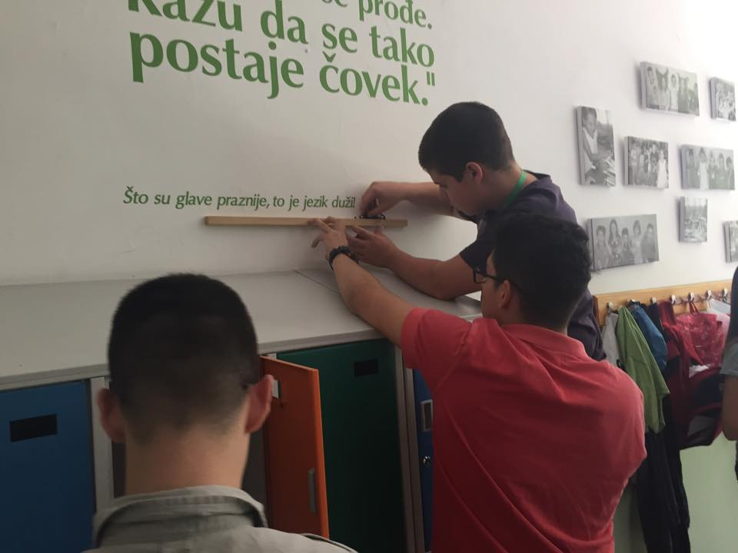

Slide 7
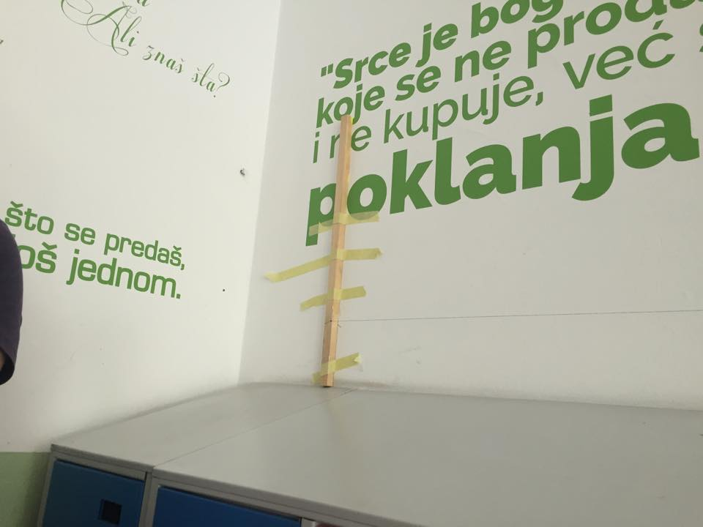
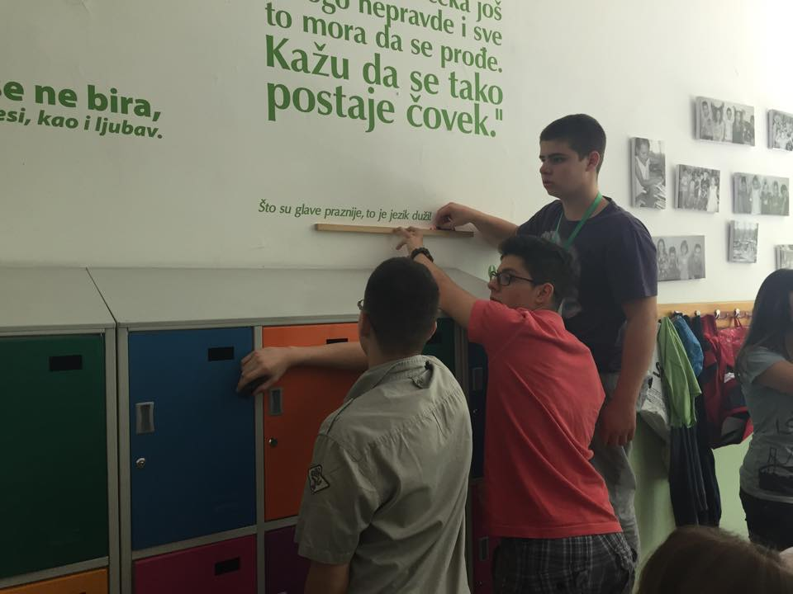

Slide 8
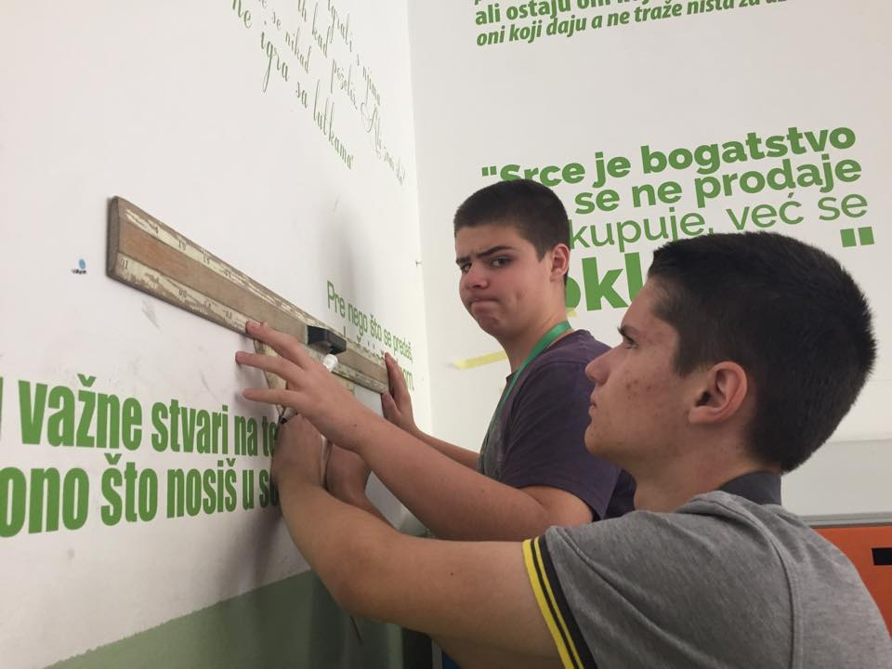

Slide 9
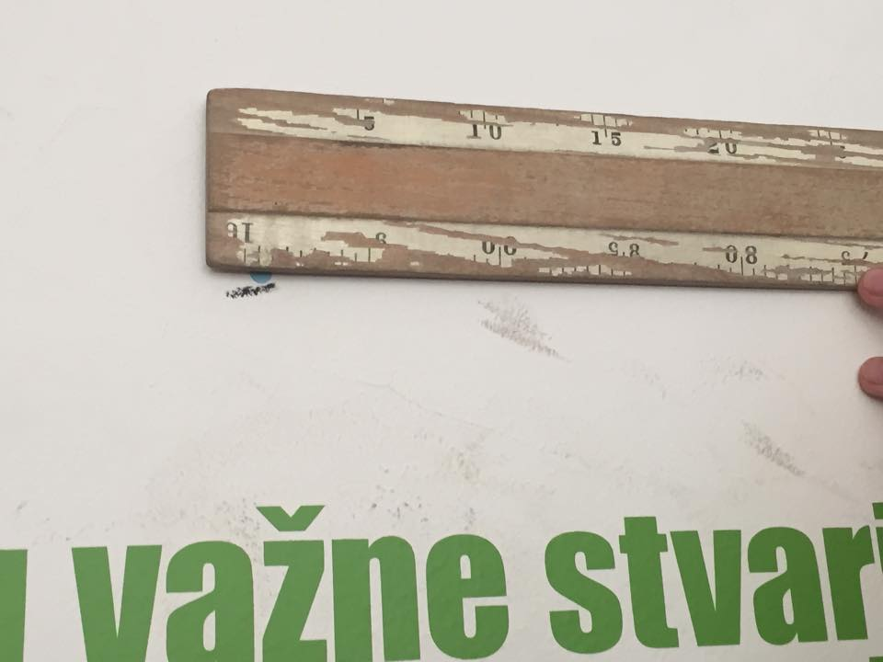
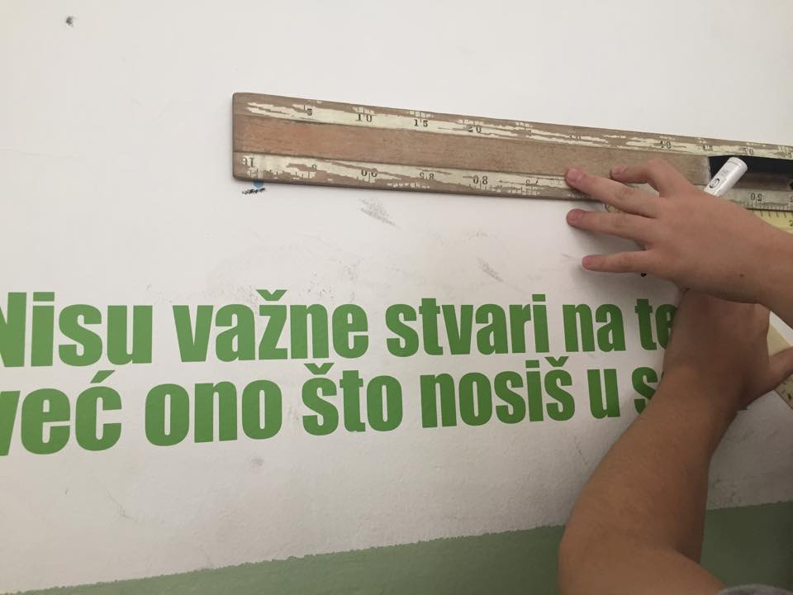
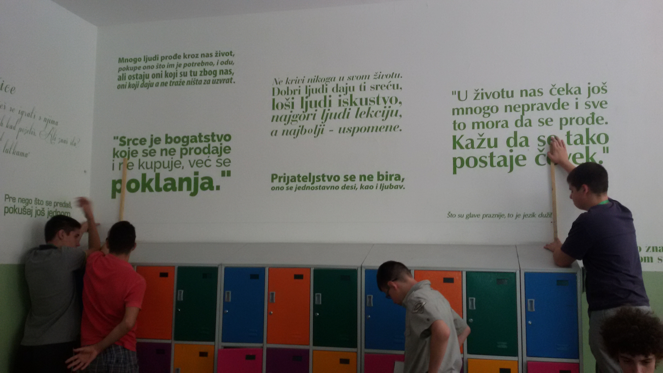

Slide 10
Thank you for your attention

