Slide 1
International Young
Naturalists’ Tournament
10. Ice hole
Serbian team
Regional Center For Talented Youth

Slide 2
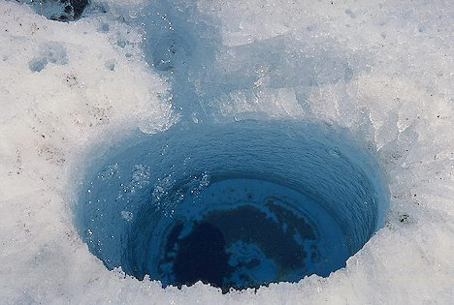
10. Ice hole
You have drilled two ice holes in a frozen lake on a frosty winter day. One ice hole is close to the shore, while the other ice hole is far from the shore.
Surprisingly, the height difference between the ice surface and the liquid water is different for each hole. How can you explain this? How can one use this height difference to determine the local ice thickness?

Slide 3
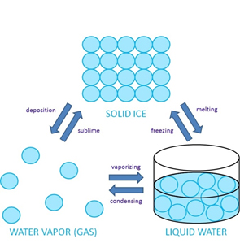
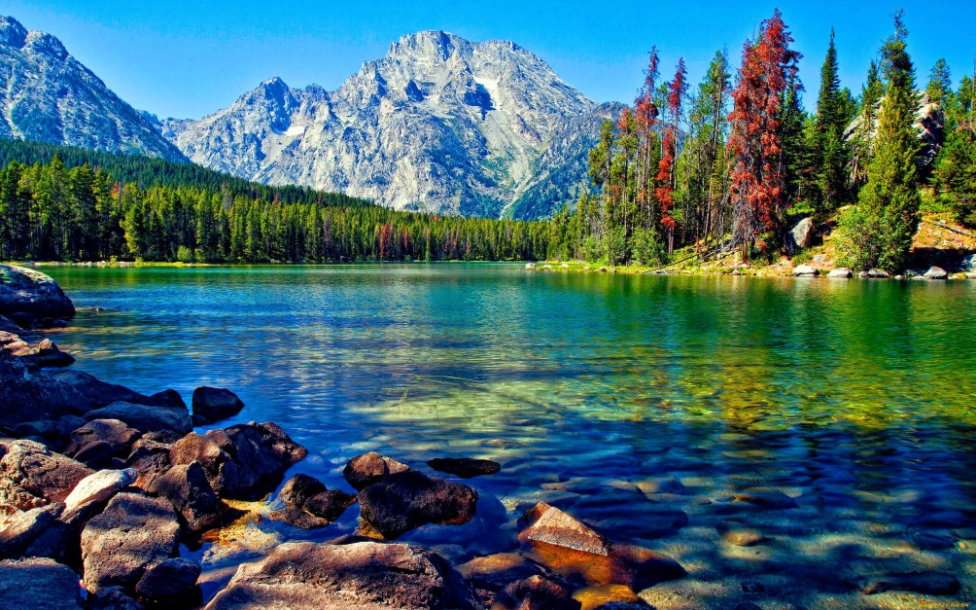
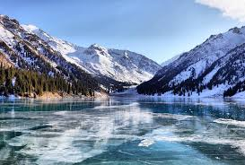
Water
Ice
- Liquid
Freezing point at 0°C
Maximum density at 4°C
Expands as it solidifies
Volume expands as it vaporizes by 1600 kg/m³
Solid (Crystal)
Melting point at 0°C
Lower density then water

Slide 4
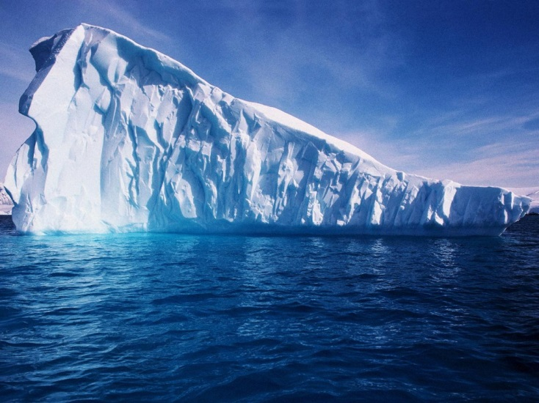
Density
Water
Ice
More space = less dense

Slide 5
Freezing water
Cooled to the freezing point Heat loss
Air temperature > Water temperature

Slide 6
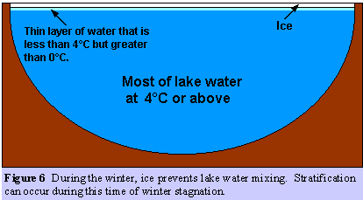
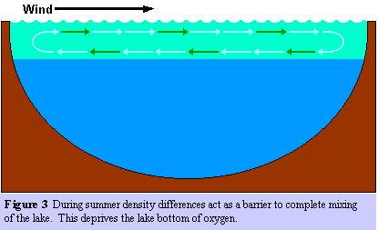
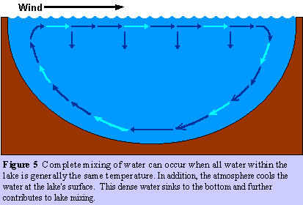
Stratification (different temperature layers form)
Vertical circulation (isothermal water)
Thermocline (preventive barrier)

Slide 7
Calculating depth of ice
$p_{1}=ρ_{\text{ice}}∙h_{\text{ice}}∙g$
$p_{2}=ρ_{\text{water}}∙h_{\text{water}}∙g$
$ρ_{\text{ice}}∙h_{\text{ice}}∙g=ρ_{\text{water}}∙h_{\text{water}}∙g$
$ρ_{ice}∙h_{ice}=ρ_{\text{water}}∙h_{\text{water}}$
$\frac{h_{\text{water}}}{h_{\text{ice}}}=\frac{ρ_{\text{ice}}}{ρ_{\text{water}}}≈0.918$
$h_{\text{water}}=h_{\text{ice}}∙\frac{ρ_{\text{ice}}}{ρ_{\text{water}}}$
$d=h_{\text{ice}}−h_{\text{water}\text{ = }}h_{\text{ice}}∙\frac{ρ_{\text{water}}−ρ_{\text{ice}}}{ρ_{\text{water}}}$
$h_{ice}=d∙\frac{ρ_{\text{water}}}{ρ_{\text{water}}−ρ_{\text{ice}}}≈d∙12.18$
Equations for calculating the water level in the hole
Formula used to calculate depth of ice

Slide 8
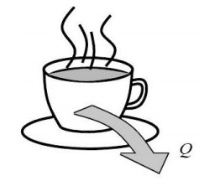
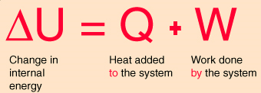
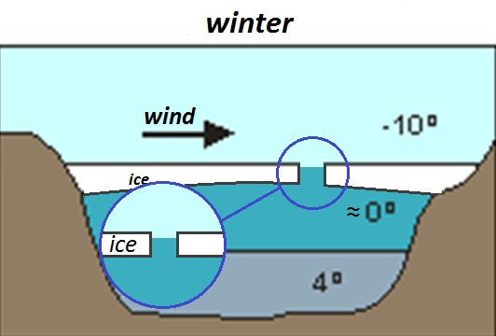
-First law of thermodynamics
Simple example of first law

Slide 9
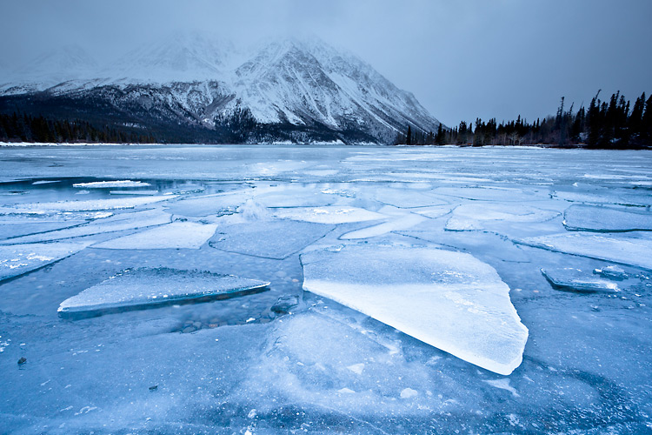
Conclusion
Lake water has the thermocline barrier
Mathematically we can calculate the thickness of ice
Lake ice isn’t same thickness everywhere
Ice is thicker as it is closer to shore
Lake is isothermal in spring and autumn

Slide 10
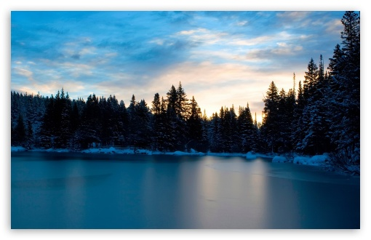
THANK YOU FOR YOUR ATTENTION!!

Slide 11
Dodatno znanje
Naucnici vezani za prvi zakon termodinamike:Sadi Carnot, Wiliam Thomson, Rudolf Clausius, James Maxwell, Ludwig Boltzmann, Willard Gibbs, Gustav Zeuner, Johannes der Waals

