Slide 1
International Young Naturalists’ Tournament
11. Puzzle in a beaker
Serbian team
Regional Center For Talented Youth

Slide 2
11. Puzzle in a beaker
A researcher decided to measure the diffusion rate of ammonia in gelatin. He added some magnesium sulfate to the hot gelatin solution which set to a gel on cooling. He then poured some aqueous solution of ammonia onto the gel and left the beaker for two days. The researcher was surprised to discover white layers of precipitate in the beaker, as depicted in the Figure. Explain this phenomenon and determine what does the number of bands depends upon.

Slide 3
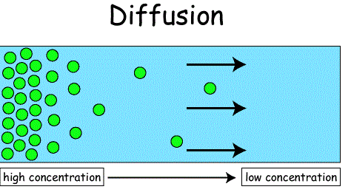
What is diffusion?
The net movement of particles from an area of heigh concentration to an area of low concentration
Due to the random movement of particles
A passive process which means that no energy needed

Slide 4
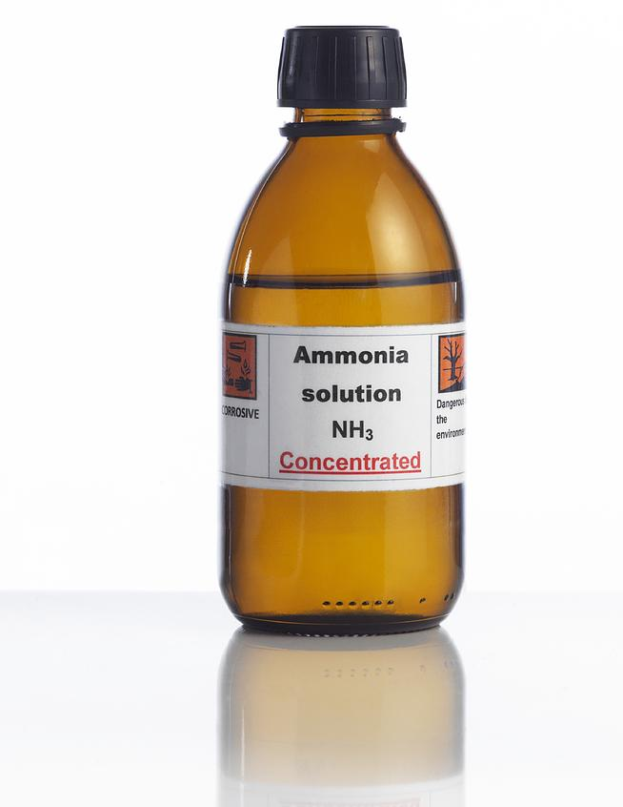
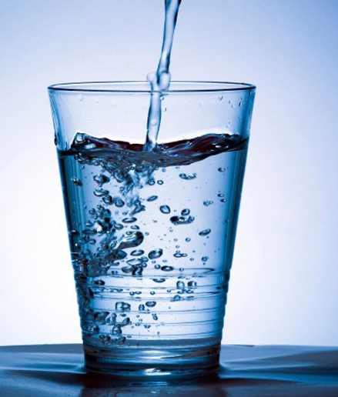
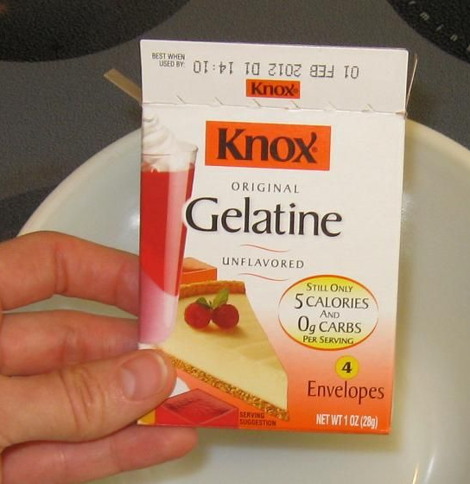
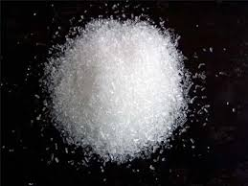
Diffusion of ammonia in gelatin
Chemicals:
Gelatin
Ammonia
Magnesium-sulfate
Water

Slide 5
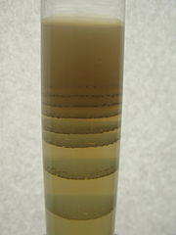
Experiment
.
Liesegang rings are a
periodic precipitation phenomenon
Reaction of ammonia
and magnesium-sulfate
MgSO₄ + 2NH₃ + 2H₂O → Mg(OH)₂ ↓+ (NH₄)₂SO₄
Notes:
Liesegang rings are a periodic precipitation phenomenon seen in many chemical systems under special conditions and electrolyte concentrations.
The ammonia will begin to diffuse into the gel. It will then encounter the magnesium-sulfate and will form a continuous region of precipitate at the top of the tube.
Precipitate diffuses through the gel and creates rings.
After some hours, the continuous region of precipitation is followed by a clear region with no sensible precipitate, followed by a short region of precipitate further down the tube. This process continues down the tube forming several, perhaps a couple of dozen regions of clearing, then precipitation rings.

Slide 6
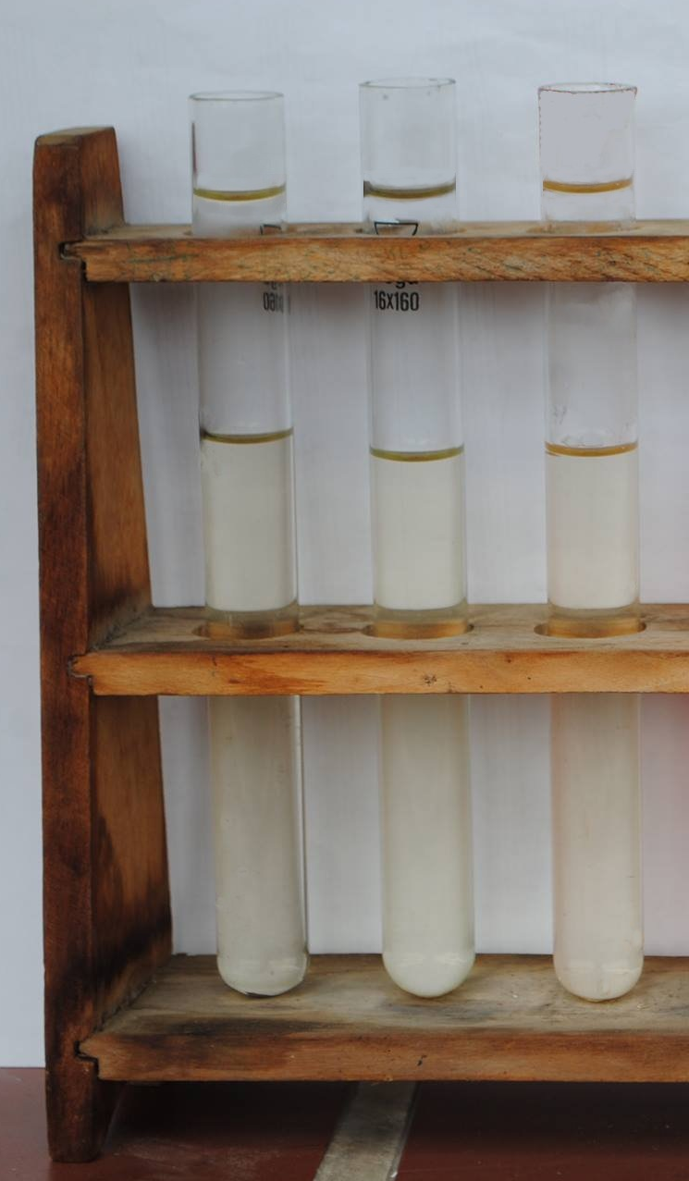
Experimental part

Slide 7
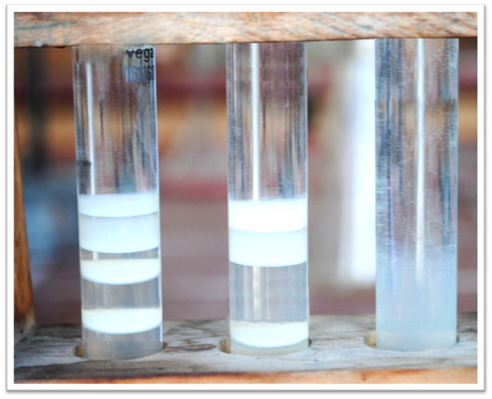
Results
Liesegang rings
MgSO₄ + 2NH₃ + 2H₂O → Mg(OH)₂ ↓+ (NH₄)₂SO₄

Slide 8
Explanation for number of rings
MgSO₄
Liesgang rings
NH₃
Notes:
The concentration ranges over which the rings form in a given gel for a precipitating system can usually be found for any system by a little systematic empirical experimentation in a few hours.
Often the concentration of the component in the gelatin gel should be substantially less concentrated than the one placed on top of the gel.

Slide 9
Conclusion
Liesegang rings in precipitation reactions are an example of pattern formation in chemical reaction-diffusion systems In gel, the chemical reaction takes place as follows:
MgSO4 + 2NH3 + 2H2O → Mg(OH)2 ↓+ (NH4)2SO4
The precipitation is continuous at the beginning and soon clear cut spaces in between are formed at the lower part of the tube
Low concentration of ammonia decreases the number of the bands and the space between them increases

Slide 10
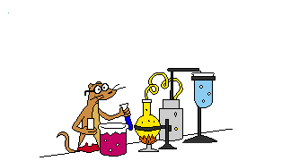
Thank you for your attention !!!

