Slide 1
International Young Naturalists’ Tournament
13. Distances in open space Serbian team Regional Center For Talented Youth

Slide 2
13. Distances in open space
How do astronomers measure distances between the planets of the Solar System, between the stars in our Galaxy, or between the galaxies? Determine the distance between the two space objects of your choice.

Slide 3
Shining orbs
“We can easily forgive a child who is afraid of the dark; the real tragedy of life is when men are afraid of the light.” ― Plato

Slide 4
Formulation of the problem
Bright and rather unexpected white disks may appear in a photo taken with a flash in a dark room.
Explain why such shining orbs appear in the photos.

Slide 5
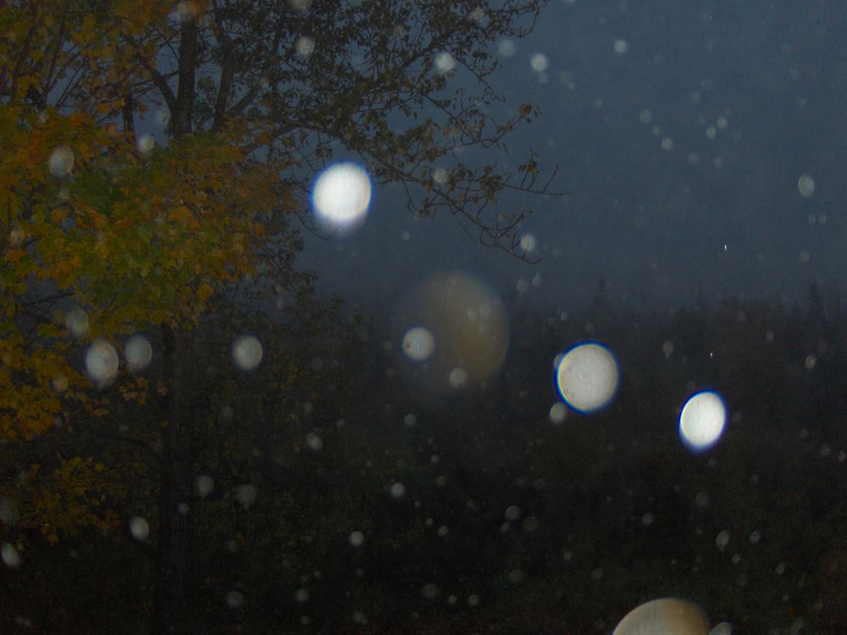
What are shining orbs?
Shining orbs that appear on photos represent light coming from the flash reflecting off particles in the air, such as dust and water droplets.
Notes:
Orbs occur mostly on darker pictures because they would be nearly impossible to see in the presence of a bright light source in the photo like the Sun.

Slide 6
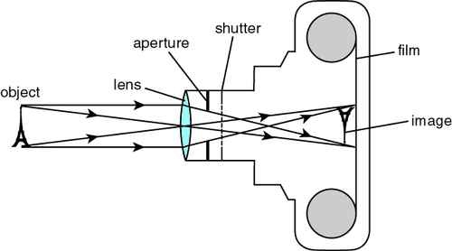
How does camera work?
Main components of the camera are the lens, aperture and film or sensor in modern digital cameras
Notes:
). Outdoor light comes in it is refracted through the lens, goes through the aperture and finally hits the film or sensor. Lens is used to focus the beam of light onto sensor/film. Aperture is an opening with a size that can be changed to adjust the width of the beam of light.

Slide 7
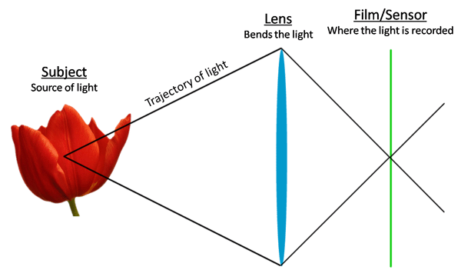
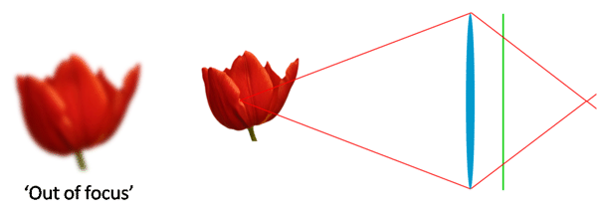
what does ‘out of focus’ mean?
Notes:
When light from a point source is refracted through a lens, rays of light converge into one point. This can be easily seen from the lens equation.
$$\frac{1}{p}+\frac{1}{l}=\frac{1}{f}$$
Here 𝑝 is the distance of the object from the lens, 𝑓 is the focal length of the lens and 𝑙 is the distance of the object image from the lens.
However if that point is not on the sensor (or film for non-digital cameras) we say that point is out of focus and it will appears like circle on a photo.

Slide 8
What is circle of confusion?
Notes:
If the point of convergence is not on the film/sensor of camera we say that point is not precisely focused and it will appear like circle on a photo. That circle is called the circle of confusion
Only points on the plane parallel to the lens and a specific distance away from it are precisely focused. All other points appear as blur circles. Size of those circles increases gradually on both sides of point B.
This means blurring is also gradual. Due to gradual blurring objects close to object plane will appear sharp (we say they are in focus) while object further of the object plane will be out of focus.

Slide 9
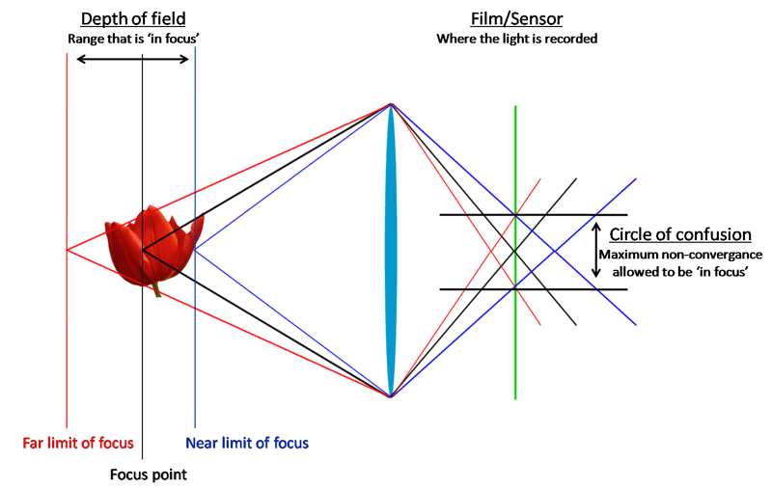
What is depth of field?
Notes:
The depth of field is the range between the farthest and the nearest object lying within the circumference of an image.

Slide 10
Its big world out there
Notes:
The depth of field is the only characteristic of the image that creates a tremendous sharpness factor to the image.
Basically the zone size is dependent on three key factors, lens aperture, focal length of the lens and the clicking distance. by varying the three characteristics one by one photographers can simply adjust the whole sense of image.

Slide 12
Water drops can make orbs
Notes:
Dust and water droplets are very small and we would expect they would show up as dots on photographs. Instead we see orbs which are large and circular. This is because dust and water droplets are out of focus.
Two factors are crucial when it comes to appearance of orbs:
Distance of particles from the light source - their brightness depends on intensity of light reflecting of particles in the air.
Size of the blur circle for these particles. Important property of the blur circle is its decrease in brightness with increase in size. This happens as a result of dispersing the same amount of light over a larger area.
As a result to get an orb:
Particles should not be too much out of focus of the camera or they would be too faint to see.
Particles should not be too far away from the camera because reflected light would not be bright enough.
There is a specific zone where the particles must be to be able to appear as orbs.Size and location of this zone depends on camera settings and since digital cameras usually automatically change parameters for each picture this ‘orb zone’ can vary significantly.

Slide 13
Notes:
Another thing that influences the appearance of orbs is the proximity of light source to the lens. It affects size of the ‘orb zone’ as seen on Figure 4. It should be noted that using flash is not necessary as long as there is a bright source of light close to the camera.

Slide 14
Beautiful snow orbs
Notes:
One of the settings which affect appearance of orbs is depth of field. Cameras with greater depth of field take pictures of orbs easier because ‘beginning’ of their out of focus zone that faces the camera (the area of the first butterfly on figure 3) is close to the lens and the flash. Blur circle of the particles in front of the camera is not too large as they are also relatively close to the object plane. In addition, they are close to a source of light (for example camera flash in night scenes) and thus brighter.
We can change depth of field in a three ways:
Changing the aperture. Wider aperture will cause decreasing depth of field. The smaler aperture will cause increasing depth of field.
Changing focus distance. The closer you are to the subject, the less depth of field you will capture on camera.
Changing focal length. The shorter the focal length will cause the more depth of field you capture.

Slide 15
THANK YOU FOR YOUR ATTENTION!!!

