Slide 1
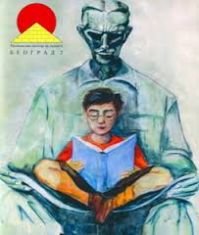
International Young Naturalists’ Tournament
16. Smoke ring cannon
Serbian team
Regional Center For Talented Youth
Belgrade II

Slide 2
Problem 16: Smoke ring cannon
Construct such a vortex ring cannon that would shoot with smoke rings on a distance sufficient to hit the chairperson of your Science Fight.

Slide 3
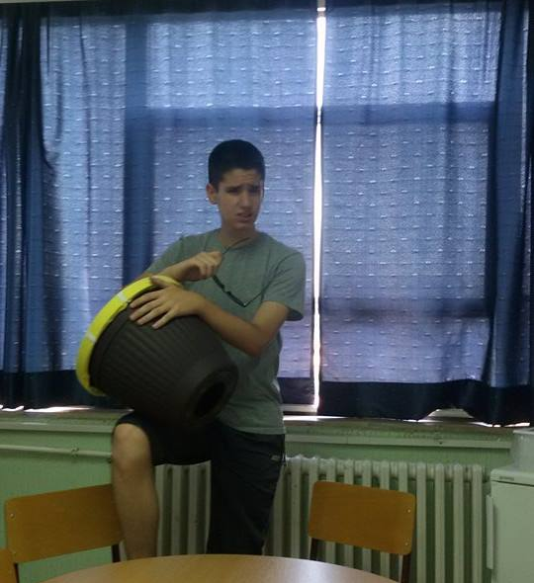
Materials
Flowerpot
Rubber band
Stretchable fabric
Rope
Tools
Drill
Jigsaw

Slide 4
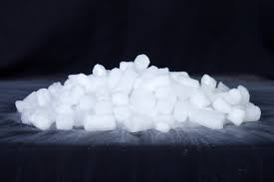
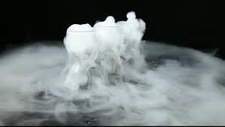
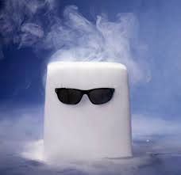
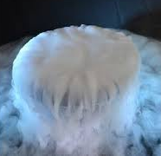
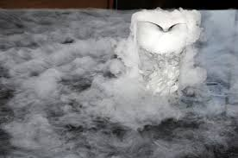
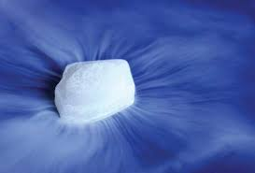
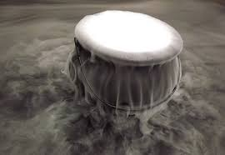
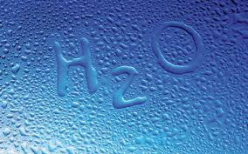
Substances
Dry ice
Water

Slide 5
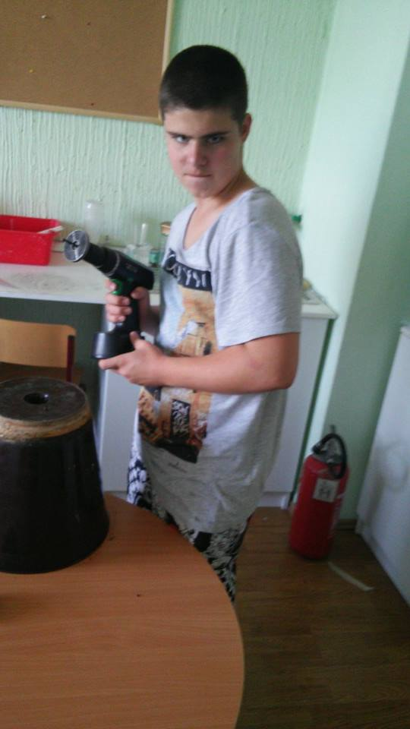
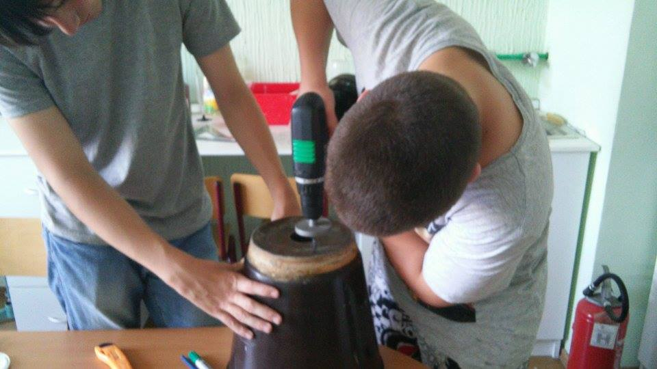
Making of.....
Drilling hole for air flow
Covering the back hole
Strengthen it using rubber bands

Slide 6
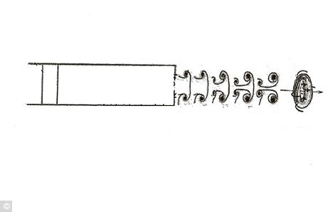
Air flow in the cannon
Air molecules start to move by hitting the membrane

Slide 7
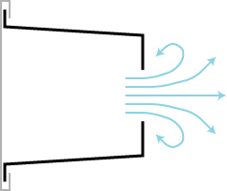
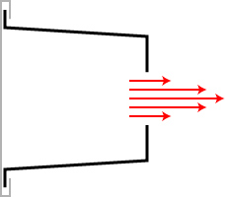
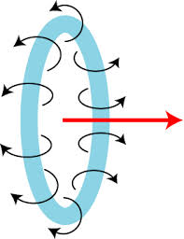
Smoke ring

Slide 8
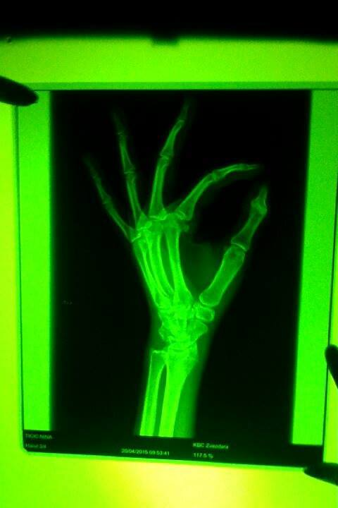
Thank you for your attention! ☺

