Slide 1
International Young Naturalists’ Tournament
4. Sunset
Serbian team
Regional Center For Talented Youth Belgrade II

Slide 2
Problem:4. Sunset
The visible Sun disk touches the horizon and after a particular time interval disappears behind the horizon
What is the duration of this time interval?
Explain the optical phenomena observed during a sunset

Slide 3
Sun’s apparent motion
Notes:
Description of sun apparent motion

Slide 4
Angular velocity of the Sun
Angular velocity of the Sun’s apparent motion in the sky is given by:
T=23h 54 min 4s
From this we have:
$ω≈ 7.302∙{10}^{−5}\frac{\text{rad}}{\text{s}}$
$$ω ≈15\frac{\text{arcsecond}}{\text{s}}$$
$$T ∙ ω=2π \text{rad}$$
$$ω=\frac{2π \text{rad}}{T}$$
Notes:
Description calculation angular velocity of Sun

Slide 5
Finding the angular diameter of the Sun
$$\sin{\frac{θ}{2}}{=\frac{AO}{PO}}=\frac{r}{R+r}$$
$$\frac{θ}{2}=arcsin({\frac{r}{R+r})}$$
$$∢APB=θ=2\arcsin{(\frac{r}{R+r})}$$
Calculated values (between 31.48’ and 31.55’) vary from the real angular diameter (31.6’-32.7’)
Notes:
How big does the Sun appear in the sky from the surface of the Earth? Finding angular diameter of Sun:
The angular diameter of an object is the angle the object makes (subtends) as seen by an observer. This is demonstrated in the diagram below, where the angular diameter of the object appears larger to an observer at A (closer to the object) than to an observer at B.
So, even though the Moon is much, much smaller than the Sun, it's also much, much closer and looks about the same size in our sky (half a degree). That's why solar eclipses are possible - the Moon can block our view of the Sun

Slide 6
Sun’s apparent motion, again ☺
Notes:
Earth’s rotational axis is perpendicular to the plane of the Sun’s apparent movement around Earth.

Slide 7
Plane of horizon and equatorial plane
Notes:
The axis is also perpendicular to Earth’s equatorial plane. It follows that the plane of Sun’s apparent movement is parallel to the equatorial plane. if the latitude of a certain point on Earth is φ, then the angle between the plane of the horizon and plane of Sun’s motion across the sky equals the angle between the equatorial plane and plane of horizon and is 90°-φ

Slide 8
Orthogonal component of angular velocity
$$\cos{φ}=\frac{ω_{\text{n}}}{ω}$$
$$ω_{\text{n}}=ω∙\cos{φ}$$
Notes:
Only the component of the Sun’s angular velocity perpendicular to the plane of horizon affects the time it takes for the Sun to set

Slide 9
Duration of sunset
The equation for the duration of sunset is:
$$τ=\frac{θ}{ω_{\text{n}}}$$
$$τ=\frac{θ}{ω∙\cos{φ}}$$
Notes:
Where
τ is duration of the sunset
θ is the angular size of the Sun
ω is the Sun’s angular velocity across the sky
φ is the latitude of the point on Earth
This calculation does not account for effects of atmospheric refraction.
The calculation also assumes that the observer is at sea level and that his view is not obstructed by landscape or other objects. If this is the case duration may differ from calculated time.
31,6’=0,52667 degree
4,167 mili degree/sec

Slide 10
Duration of Sunset

Slide 11
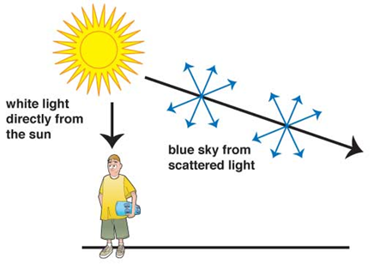
Optical phenomena observed during sunset
Light scattering
Scattering of light is caused by photons bouncing’ of atoms when they hit them: photons are then re-emitted in another direction
Notes:
Our atmosphere is made mostly of nitrogen and oxygen. These two atoms are most effective at scattering light with higher frequencies and thus shorter wavelengths (amount of scattering varies proportionally to f ⁴).
Shorter wavelengths are scattered more intensely than longer wavelengths. This means that blue light has a higher probability of being scattered than red light.
This is the reason the sky appears to be blue. Sunlight, which is made up of a continous spectrum of wavelengths, scatters from atmospheric particles. Since the particle size is much smaller than the wavlengths of light, the shorter wavlength blue light is scattered more intensely.
Light (photons) of higher frequencies is scattered by molecules in atmosphere and when it reaches our eyes it certainly wasn’t coming from the direction of the sun.

Slide 13
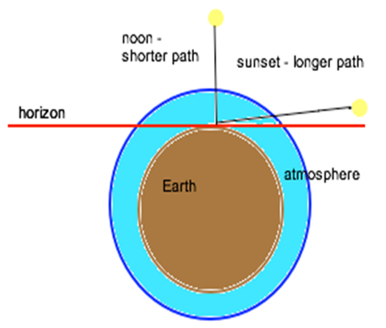
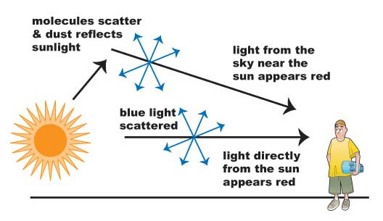
Optical phenomena observed during sunset
Light scattering
Notes:
During the day yellow is the most abundant color from the spectrum that didn’t scatter. As they didn’t scatter they are coming from the direction of the Sun, and this is why Sun appears yellow. During the sunset the light has to go a longer path to get from Sun to us.
Because the path light has to travel through atmosphere is longer, there will be more scattering and more yellow and orange light will be scattered. Remaining colors, red and orange, have the lowest frequencies and are going to scatter the least and light of these colors will be coming from the direction of the Sun, coloring it red and orange. Small part of these colors however does scatter at small angles causing western part of the sky around the Sun to be orange and red while the rest of the sky remains blue

Slide 14
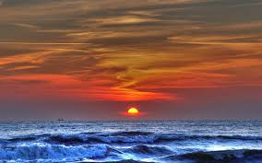
Atmospheric refraction
Law of refraction - the angle of incidence will be greater than the angle of refraction
Because of this, Sun is still visible even when it is below the horizon
Notes:
Because light moves slower in atmosphere than in vacuum, it refracts when entering Earth’s atmosphere and also when travelling through its layers of different density.

Slide 15
Atmospheric refraction
Notes:
From the same reason at all times Sun appears to be higher than it actually is. This means the sunset has actually begun by the time we see that happen. This causes both the setting of Sun’s upper and lower rim below the horizon to happen before we see it, and the sunset is later than we expect it to be. However since the light covers longer path when Sun is below the horizon than when it is above effects of refraction are very slightly greater in the first case. This means that if sunset begins time t₁before we see it happen and sunset ends time t₂ before we see it, t₂will be very slightly greater than t₁ and */Sunset will last slightly longer than we calculated.

Slide 16
Atmospheric refraction

Slide 17
Other atmospheric phenomena
Green flash

Slide 18
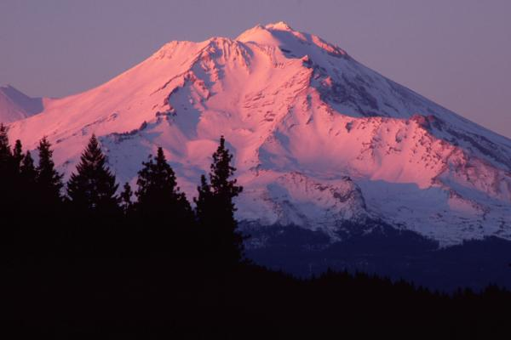
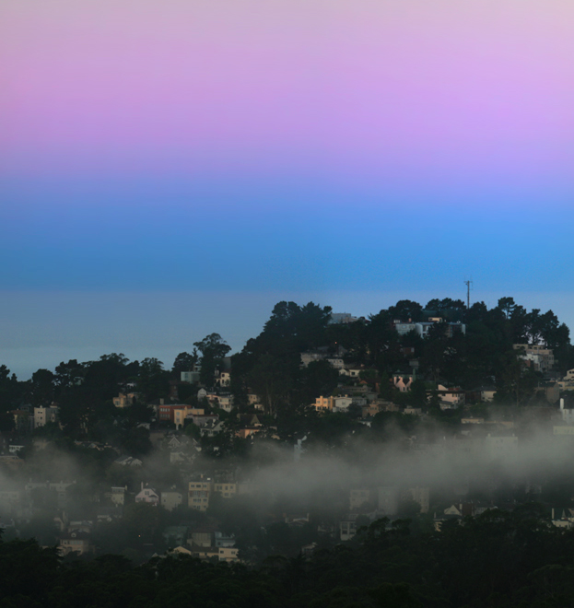
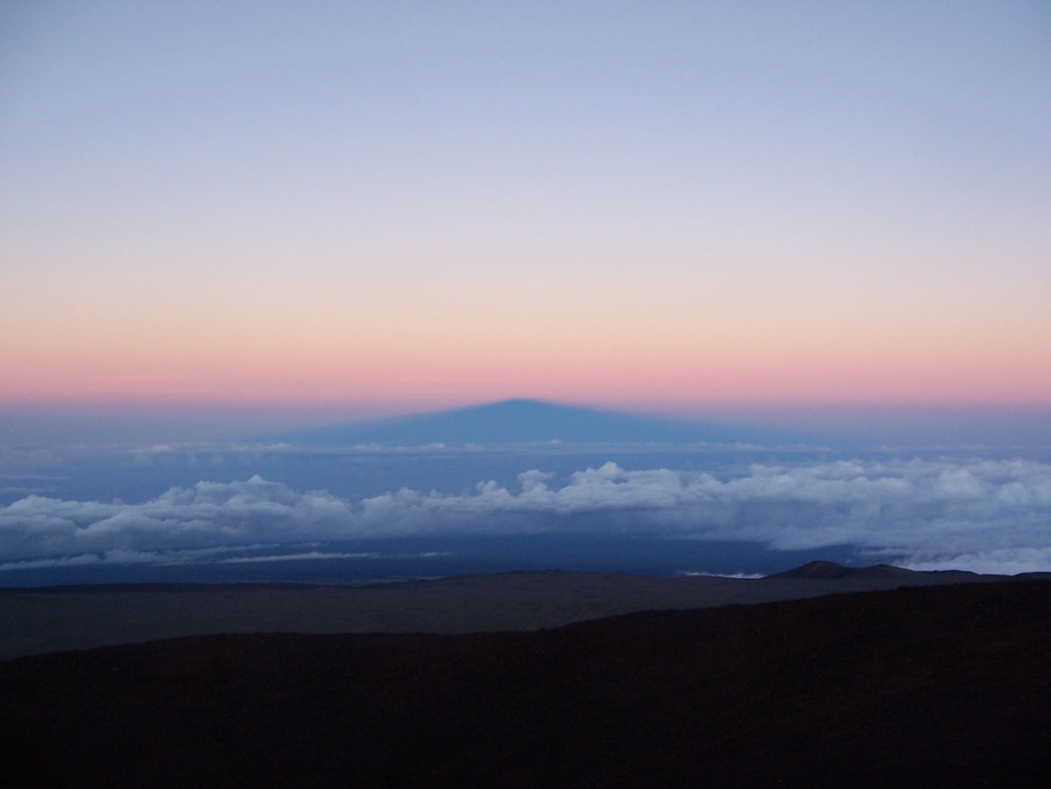
Other atmospheric phenomena

Slide 19
Green flashes
Notes:
While observing at the Vatican Observatory in 1960 D.K.J. O'Connell produced the first color photographs of a green flash at sunset
A green flash also may be observed in association with the Moon and bright planets at the horizon, including Venus and Jupiter. With an unrestricted view of the horizon, green flashes are regularly seen by airline pilots, particularly when flying westwards as the sunset is slowed. If the atmosphere is layered the green flash may appear as a series of flashes.

Slide 20
Green flash
Notes:
Green flashes and green rays are optical phenomena that sometimes occur right after sunset or right before sunrise. When the conditions are right, a green spot is visible above the upper rim of the disk of the sun. The green appearance usually lasts for no more than a second or two. Rarely, the green flash can resemble a green ray shooting up from the sunset (or sunrise) point. Green flashes occur because the atmosphere can cause the light from the sun to separate out into different colors. Green flashes are a group of phenomena which stem from slightly different causes, and therefore some types of green flashes are more common than others.
Green flashes may be observed from any altitude. They usually are seen at an unobstructed horizon, such as over the ocean, but are possible over cloud tops and mountain tops as well. They may occur at any latitude, although at the equator the flash rarely lasts longer than a second.

Slide 21
Afterglow
Notes:
An afterglow is a broad high arch of whitish or rosy light appearing in the sky due to very fine particles of dust suspended in the high regions of the atmosphere. An afterglow may appear above the highest clouds in the hour of deepening twilight, or reflected from the high snowfields in mountain regions long after sunset. The particles produce a scattering effect upon the component parts of white light.
After the eruption of the volcano Krakatoa in 1883, a remarkable series of red sunsets appeared worldwide. These were due to an enormous amount of exceedingly fine dust blown to a great height by the volcano's explosion, and then globally diffused by the high atmospheric currents. Edvard Munch's painting The Scream possibly depicts an afterglow during this period.

Slide 22
Alpenglow
Notes:
Alpenglow (from German: Alpenglühen) is an optical phenomenon in which a horizontal red glowing band is observed on the horizon opposite to the sun. This effect occurs when the Sun is just below the horizon. Alpenglow is easiest to observe when mountains are illuminated but can also be observed when the sky is illuminated through backscattering.
Since the Sun is below the horizon, there is no direct path for the light to reach the mountain. Instead, light reflects off airborne snow, water, or ice particles low in the atmosphere. These conditions differentiate between a normal sunrise or sunset and alpenglow.
Although the term may be loosely applied to any sunrise or sunset light seen on the mountains, true alpenglow is not direct sunlight and is only observed after sunset or before sunrise.
In the absence of mountains, the aerosols in the eastern portion of the sky can be illuminated in the same way at sunset by the remaining red scattered light straddling the border of the Earth's own shadow (the terminator). This back-scattered light produces a red band opposite the Sun.

Slide 23
The Belt of Venus
Notes:
The Belt of Venus or Venus's Girdle is an atmospheric phenomenon seen at sunrise and sunset. Shortly after sunset or shortly before sunrise, the observer is, or is very nearly, surrounded by a pinkish glow (or anti-twilight arch) that extends roughly 10°–20° above the horizon. Often, the glow is separated from the horizon by a dark layer, the Earth's shadow or "dark segment." The arch's light pink color is due to backscattering of reddened light from the rising or setting Sun. A very similar effect can be seen during a total solar eclipse.

Slide 24
The Earth’s shadow
Notes:
The Earth's shadow or Earth shadow (also sometimes known as the dark segment) are names for the shadow that the Earth itself casts on its atmosphere. This shadow is often visible from the surface of the Earth, as a dark band in the sky near the horizon. This atmospheric phenomenon can sometimes be seen twice a day, around the times of sunset and sunrise.
Whereas the phenomenon of night (a function of being in the shadow of the Earth) is very familiar to all, the effect of the Earth's shadow on the atmosphere is quite often visible in the sky, and yet often goes unrecognized. This shadow is visible to observers as it falls on the atmosphere of the Earth during the twilight hours. When the weather conditions and the observer's viewing point permit a clear sight of the horizon, the shadow can be seen as a dark blue or greyish-blue band.
Assuming the sky is clear, the Earth's shadow is visible in the opposite half of the sky to the sunset or sunrise, and is seen right above the horizon as a dark blue band. A related phenomenon is the "Belt of Venus" or "anti-twilight arch" (sometimes written as "antitwilight arch"), a pink band that is visible above the dark blue of the Earth's shadow, in the same part of the sky. No defined line divides the Earth's shadow and the Belt of Venus; one colored band blends into the other in the sky.

Slide 25
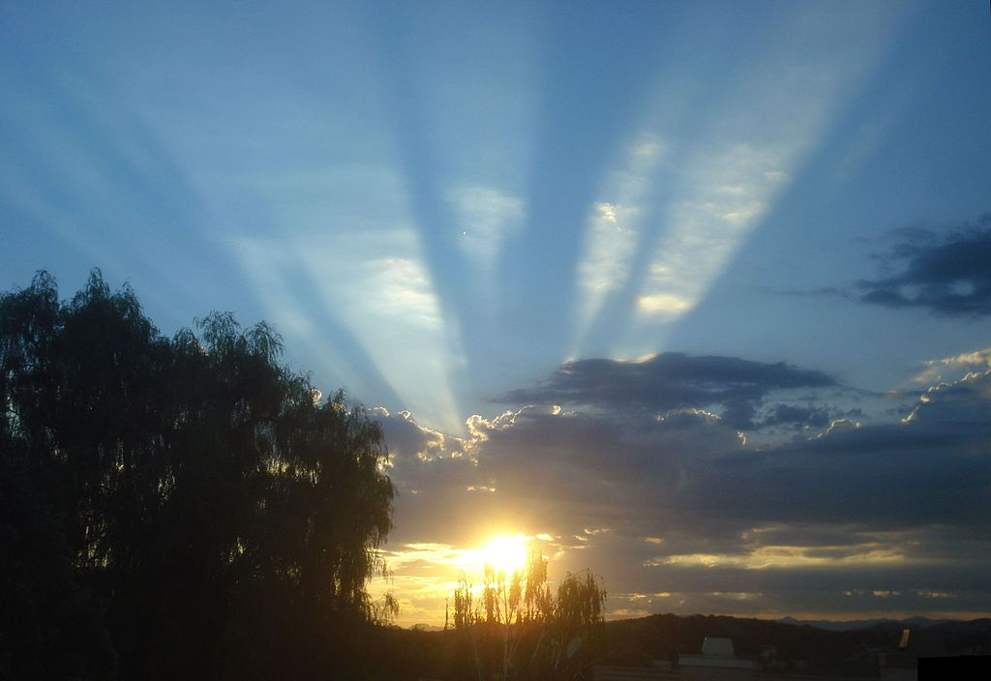
Crepuscular rays
Crepuscular rays
Notes:
Crepuscular rays in atmospheric optics are rays of sunlight that appear to radiate from the point in the sky where the sun is located. These rays, which stream through gaps in clouds or between other objects, are columns of sunlit air separated by darker cloud-shadowed regions. Despite seeming to converge at a point, the rays are in fact near-parallel shafts of sunlight, and their apparent convergence is a perspective effect .
The name comes from their frequent occurrences during twilight hours when the contrasts between light and dark are the most obvious. Crepuscular comes from the Latin word "crepusculum", meaning twilight.

Slide 26
Thank you for your attention! ☺

