Slide 1
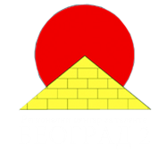
International Young Naturalists’ Tournament
12. Structure of a hair
Serbian team
Regional Center For Talented Youth

Slide 2
12. Structure of hair
Differences in hair structure?
How can we explain them?

Slide 3
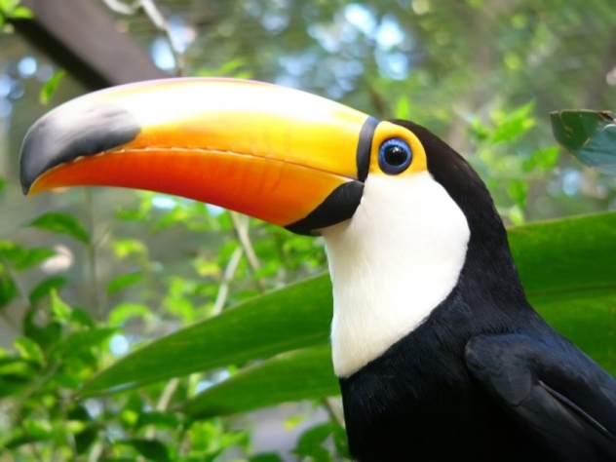
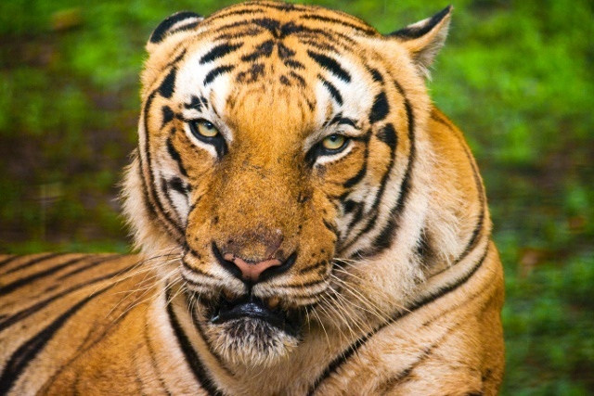
Which group of animals has hair?
Only mammals have hair
classis Mammalia - mammals
Animal
without hair
Mammal

Slide 4
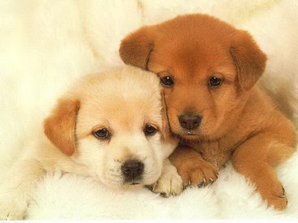
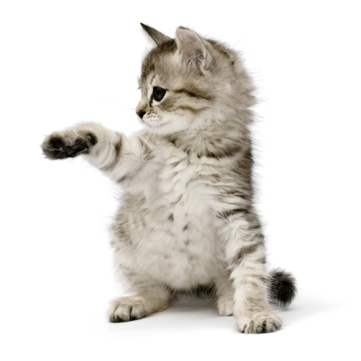
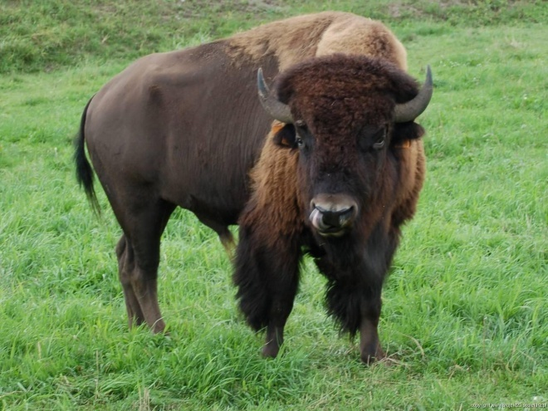
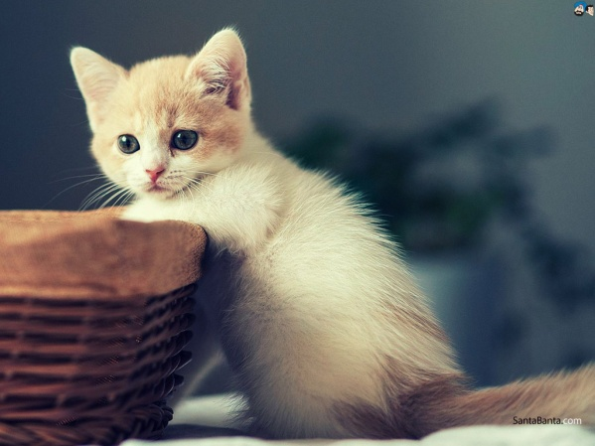
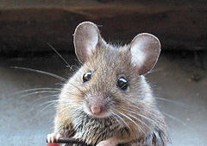
ANIMAL HAIR
Hair - one of the most important characteristics of mammals…
…but the structure of the hair varies from species to species

Slide 5
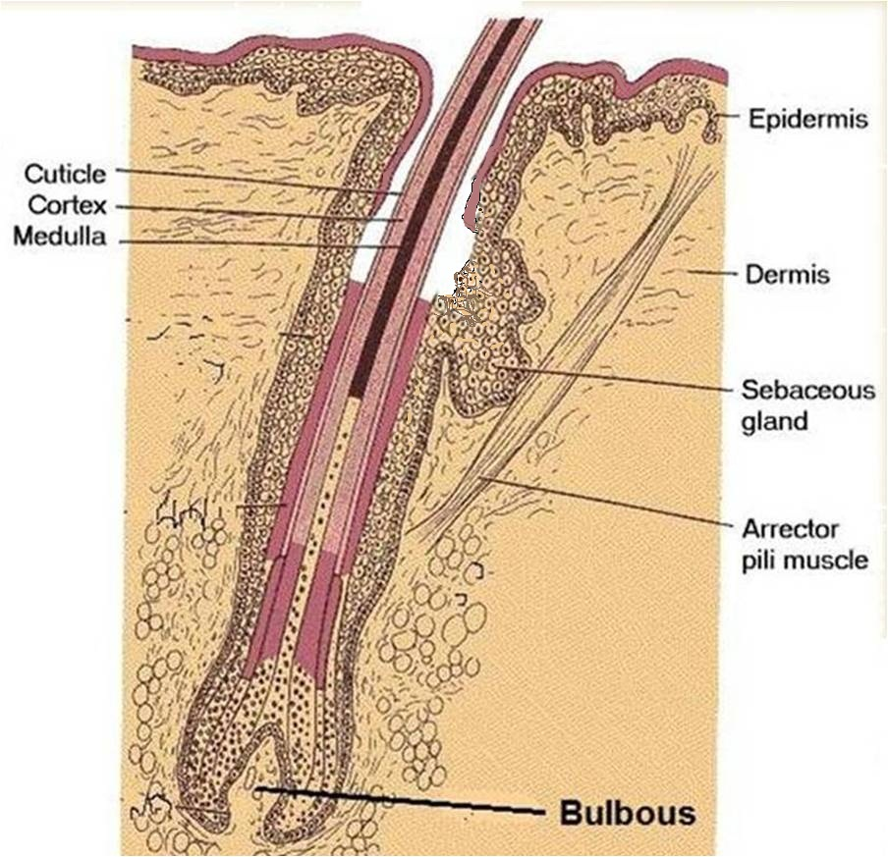
Structure of hair
Hair is made by two part-root and shaft
Shaft is consisted of 3 parts:
-cuticular scales
-cortex
-medulla

Slide 6
MEDULLA
DISCONTINIOUS CONTINUOUS FRAGMENTAL

Slide 7
CUTICULAR SCALES
IMBRICATE CORONAL

Slide 8
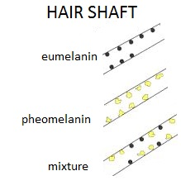
Hair pigment
Melanins: responsible for pigment
Eumelanin –
dark pigment
Pheomelanin -bright pigment
1% of total composition of hair

Slide 9
Animals have some types of hair…
Bristles
Underfur
Fur
Velli
Vibrissae (whiskers)

Slide 10
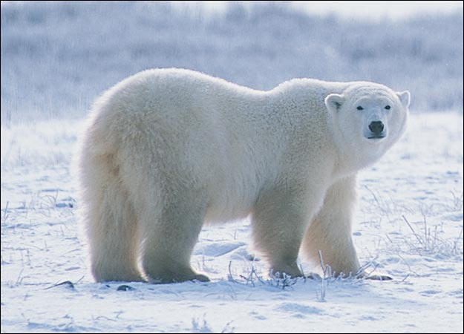
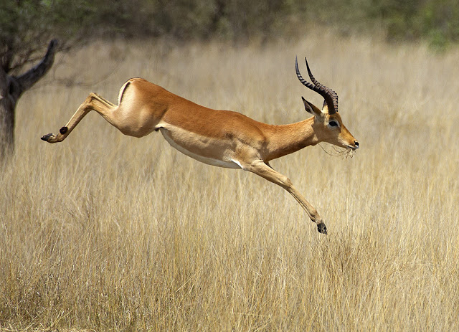
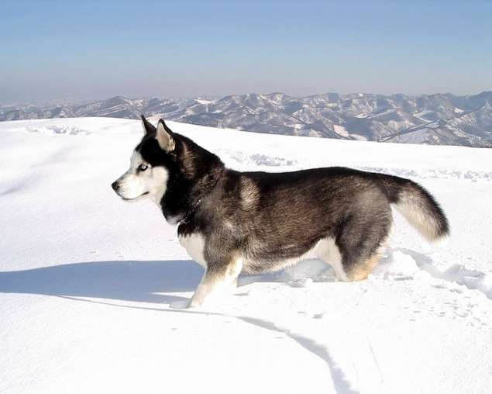
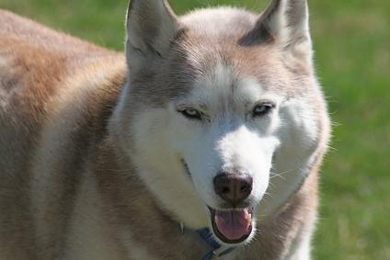
Differences between the animals
density of hair (thicker hair-better thermoregulation)
length of hair (depends on time of the year)
Polar bear
Impala

Slide 11
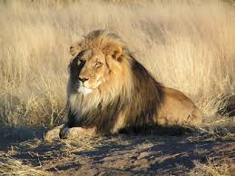
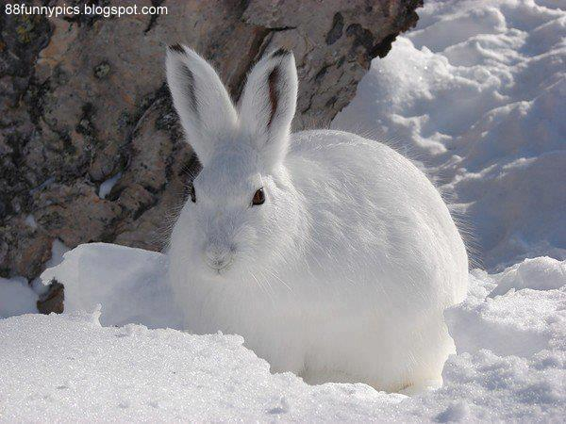
hair color ( Some animals have a certain color - ability of camouflage - natural adaptation to the environmental conditions )
Lion
Snow rabbit

Slide 12
Conclusion
Original characteristic of mammals
Differences in medulla and cuticular scales
Types: bristles, underfur, fur, velli, vibrissae
Visible differences: density, length and color of hair

Slide 13
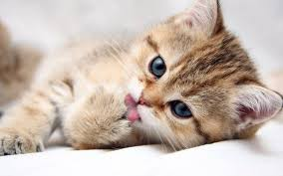
Thank YOU FOR YOUR ATTENTION !!!

Slide 14
Chemical composition of hair

Slide 15
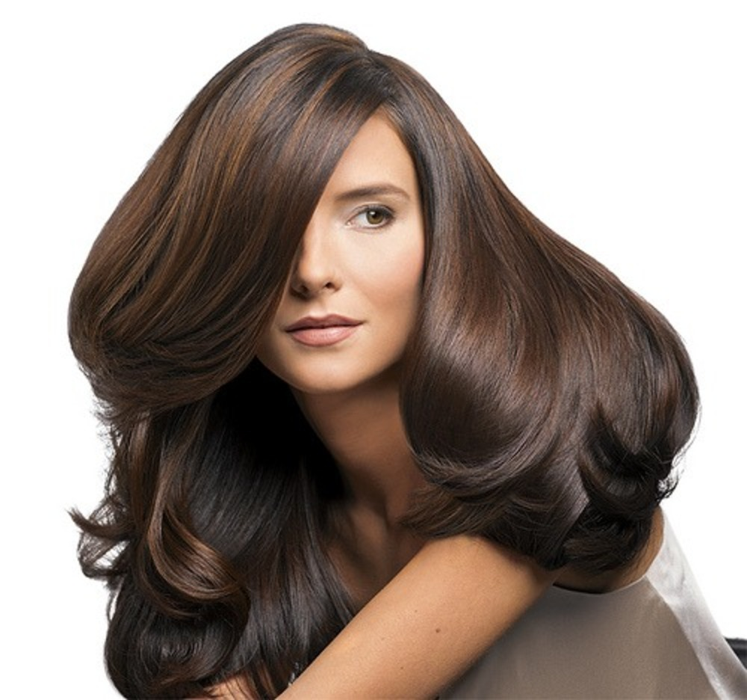
Keratin
Organised in the cortex
Essential component of hair
Protein formed by 18 amino acids
Produced by keratinocytes

Slide 16
http://www.jstor.org/stable/2456345?seq=3&hc_location=ufi#page_scan_tab_contents

Slide 17
CUTICULAR SCALES
I. Imbricate
Ovate
Acuminate
Elongate
Crenate
Flattened
II. Coronal
Simple
Serrate
Dentate

Slide 18
MEDULLAS
Discontinuous
A. Simple
1. Ovate
2. Elongate
3. Flattened
B. Compounnd
Ovate
Flattened
Cointenuous
Nodose
Homogeneous
Fragmnental

Slide 19
The medulla is a central core of cells that may be present in the hair. If it is filled with air, it appears as a black or opaque structure under transmitted light, or as a white structure under reflected light

