Slide 1
Cinder
Team: Georgia
Reporter: Tekle Dolidze
In The Middle Ages People Used To Wash Laundry In Cinder. Study The Effectiveness of Cinder in Washing Clothes.

Slide 2
Problem: Cinder
Plan:
Historical Review
Theoretical Model:
What is cinder, components of cinder
Two kinds of soils
Soap and its washing properties
Soaking process
Experiments:
Cinder and different kinds of grease
Cinder’s role in surface tension change
Washing different kinds of cloth
Conclusion

Slide 3
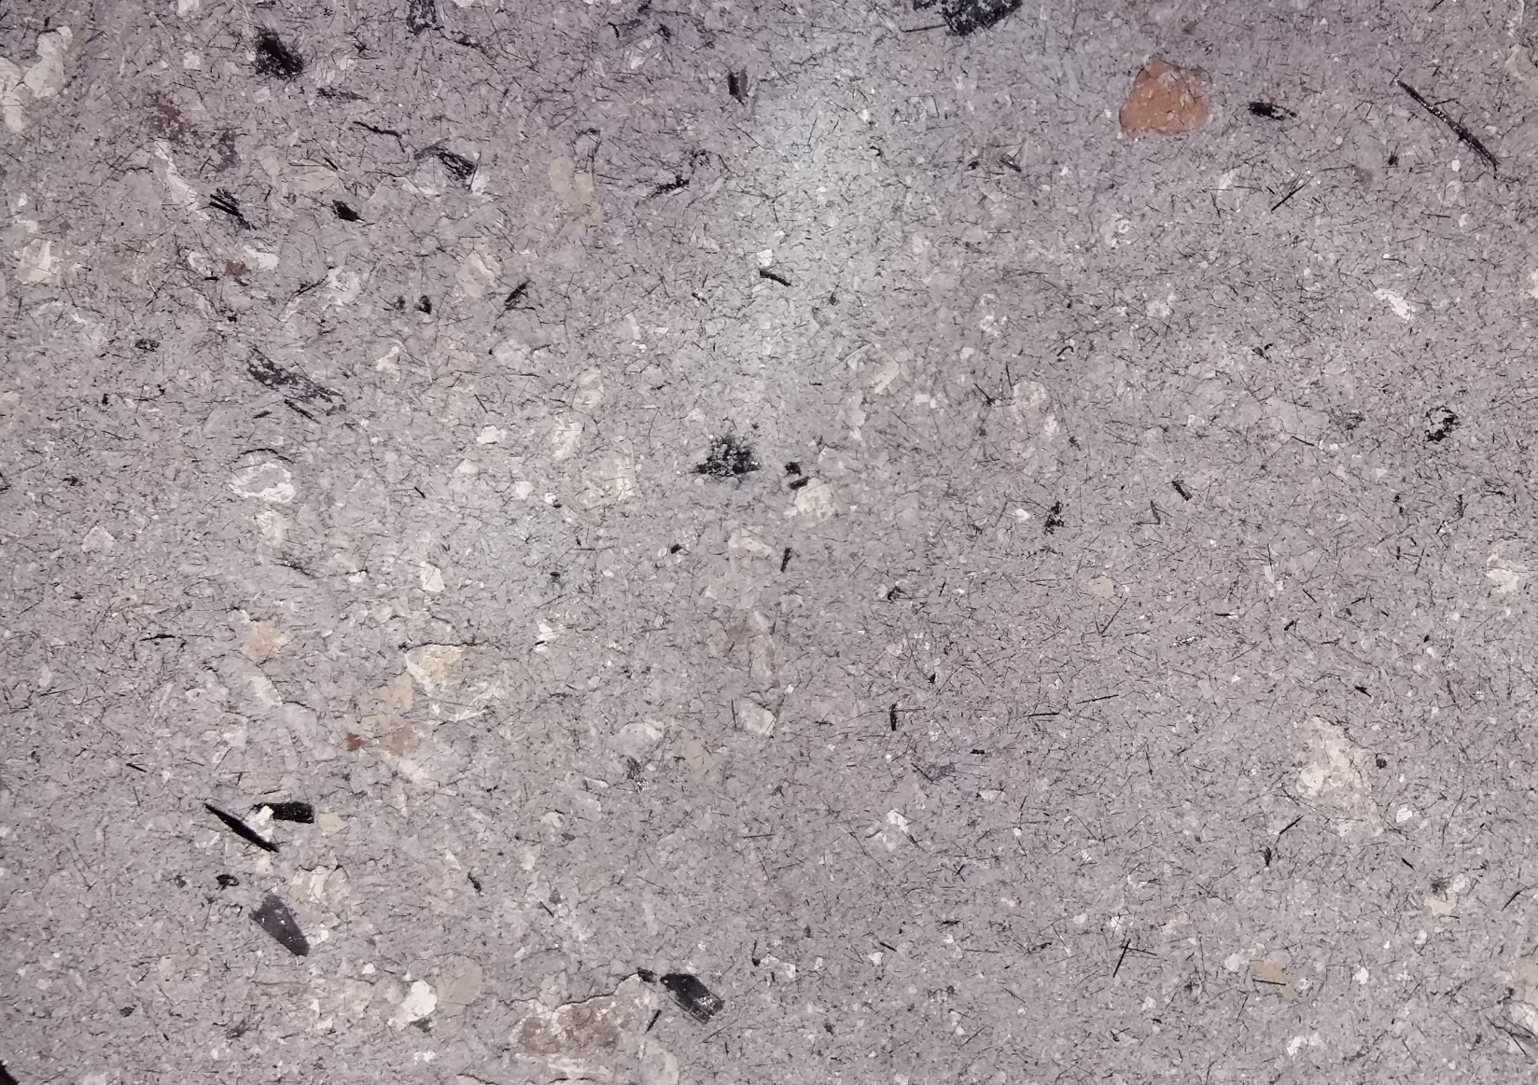
Washing in old ages was difficult
Washing with cinder
Soaps made from cinder and animal fat

Slide 4
Important Components of Cinder
Potassium salts
Sodium salts
Why?
K and Na are used to make soap (soluble components of wood ash)
Common in composition of different kinds of wood cinder:
Ca (about 40%)
K (about 10%)
Na (Very little)

Slide 5
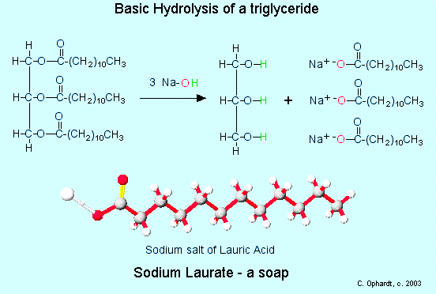
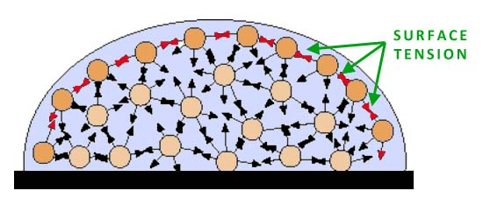
What is the reason they washed laundry in cinder?
Potassium and Sodium react with fats
Getting soap molecules
Soap molecules wash other soils from cloth
Cinder lowers Surface Tension

Slide 6
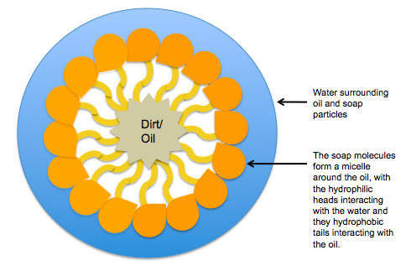
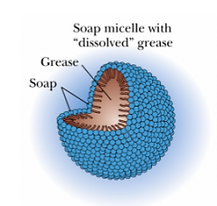
Washing with soap = Removing hydrophobic soils
Soap Molecule

Slide 7
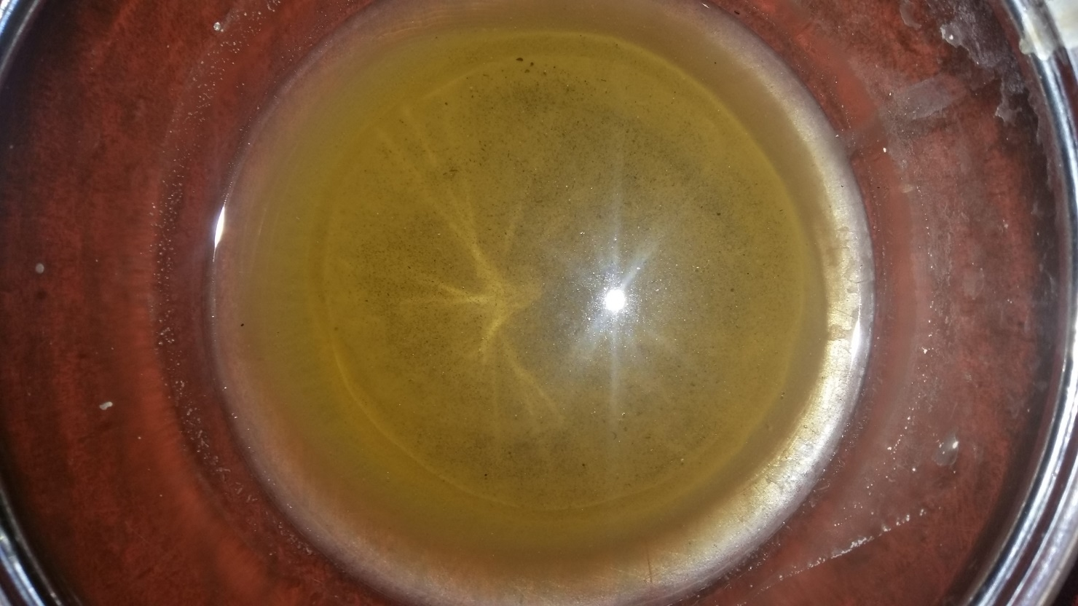
Explanation
K2CO3 reacts with water with forming K+ ions, and then reacts with fats on the cloth, converts it into glycerol and fatty acids. We get MOLECULES OF SOAP, which washes other fats.
On the picture: solution of cinder in water

Slide 8
Different kinds of grease and their fatty acids
Fatty acid | Total fatty acid in oil
Palmitic acid | 3.0-6.0
Stearic acid | 1.0-3.0
Oleic acid | 14.0-35.0
Linoleic acid | 44.0-75.0
Arachidic acid | 0.6-0.4
Behenic acid | 0.8
Fatty acid | Structure | Total fatty acid in butter %
Oleic acid | CH₃(CH₂)₇CH=CH(CH₂)₇COOH | 31.9
Myristic acid | CH₃(CH₂)₁₂COOH | 19.8
Palmitic acid | CH₃(CH₂)₁₄COOH | 15.2
Stearic acid | CH₃(CH₂)₁₆COOH | 14.9
Lauric acid | CH₃(CH₂)₁₀COOH | 5.8
Butyric acid | CH₃CH₂CH₂COOH | 2.9
Caproic acid | CH₃(CH₂)₄COOH | 1.9
Capric acid | CH₃(CH₂)₈COOH | 1.6
Caprylic acid | CH₃(CH₂)₆COOH | 0.8
Linoleic acid | CH₃(CH₂)₄CH=CHCH₂CH=CH(CH₂)₇COOH | 0.2
Linolenic acid | CH₃CH₂CH=CHCH₂CH=CHCH₂CH=CH(CH₂)₇COOH | 0.1
Fatty acid | Total fatty acid in animal fat %
Oleic acid | 44-47
Stearic acid | 12-14
Myristic acid | 1
Palmitic acid | 25-28
Palmitoleic acid | 3
Linoleic acid | 6-10

Slide 9
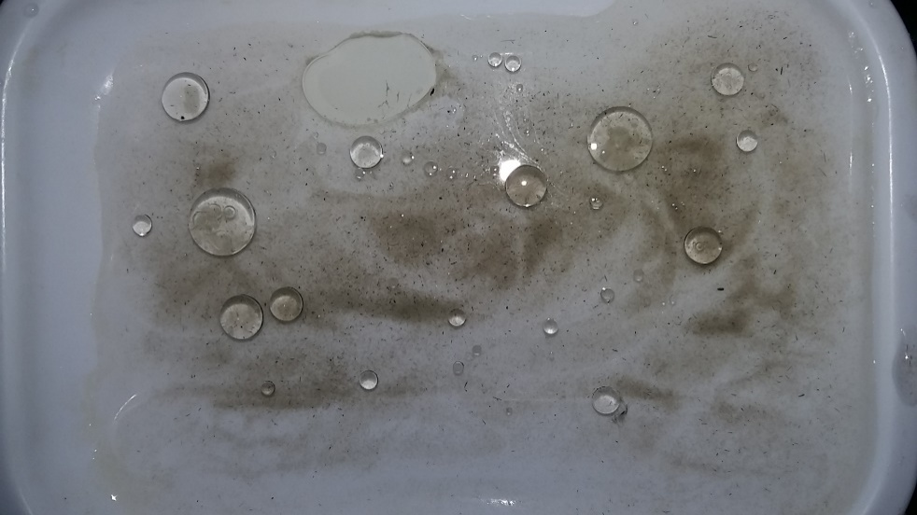
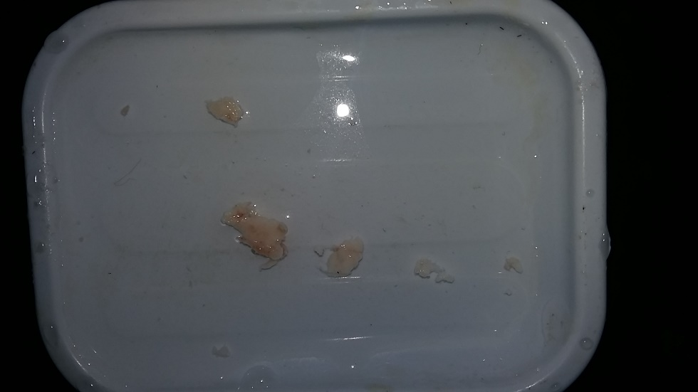
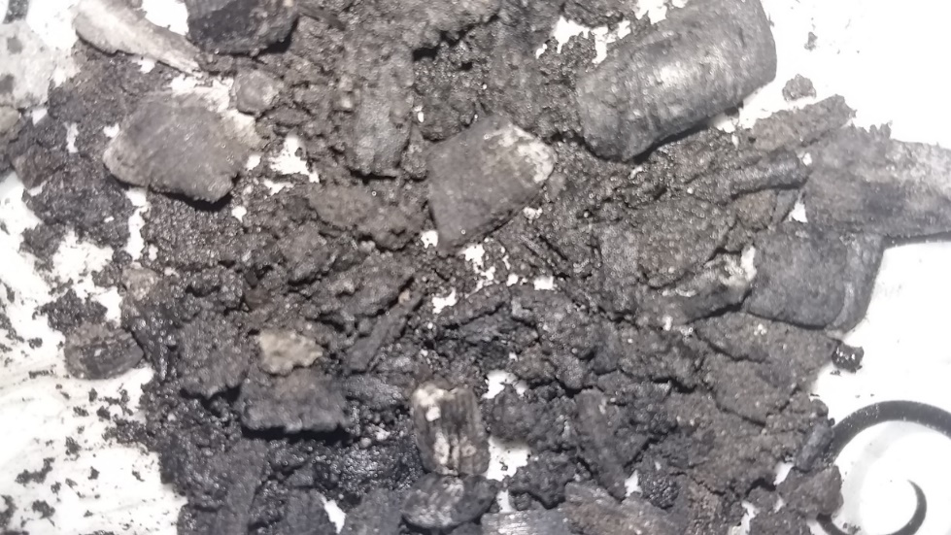
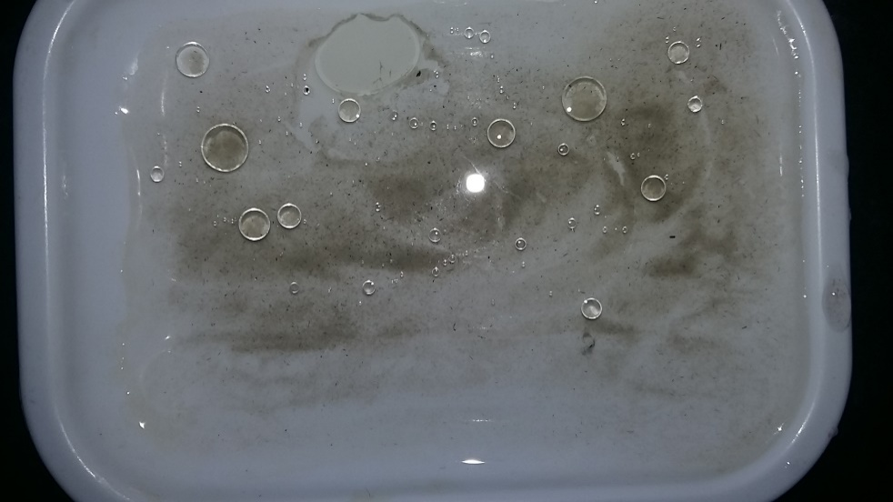
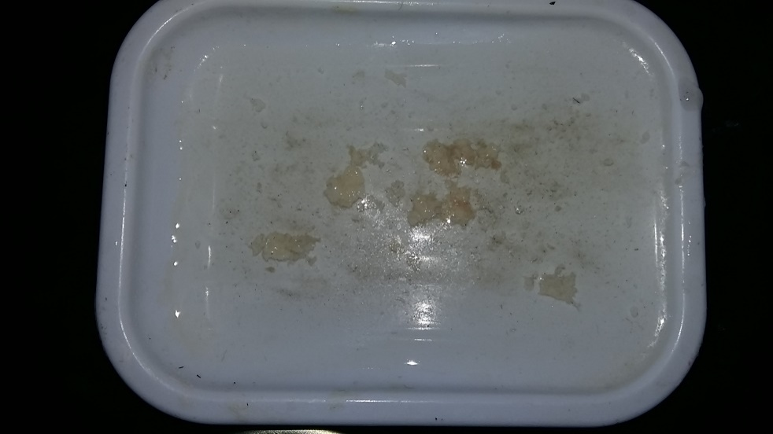
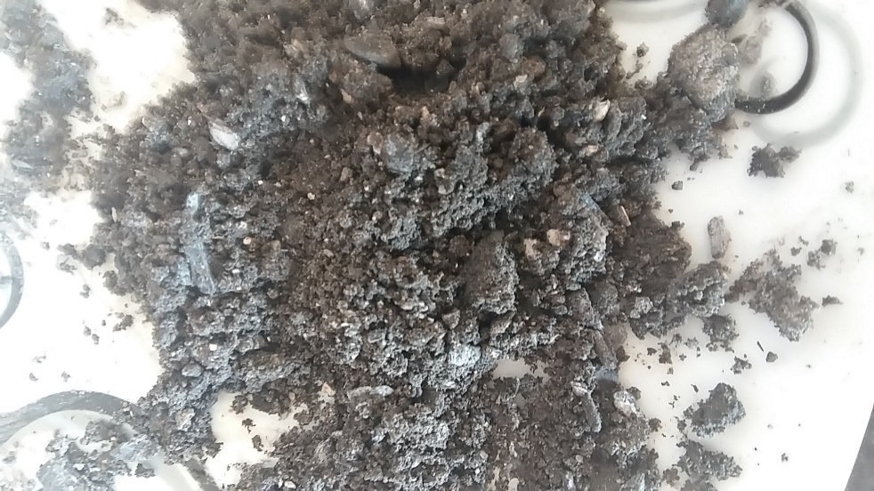
Sunflower seed oil
Animal fat
Hot sunflower seed oil
Hot animal Fat

Slide 10
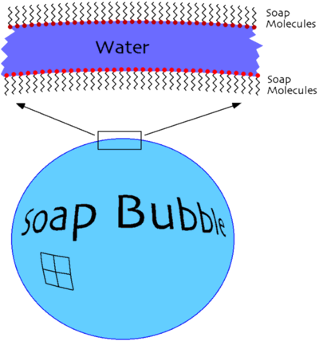
Surface Tension and cinder
Soap Decreases Surface tension, let’s see in case of cinder
Diameter of tube | Water | Very Diluted | Diluted
2mm | 39,289 | 32,052 | 32,092
1mm | 40,971 | 45 | 46,974
Dependence of angle between liquid and tube wall on amount of cinder in water

Slide 11
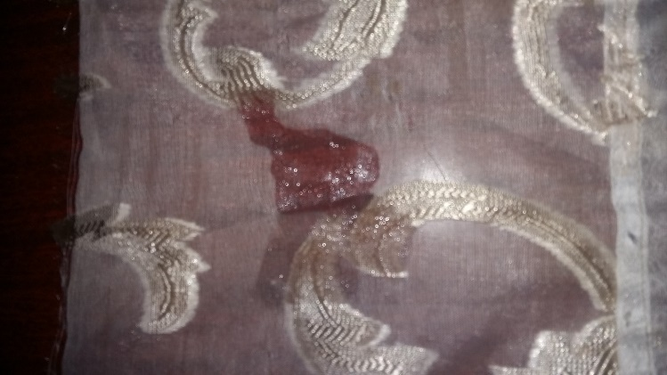
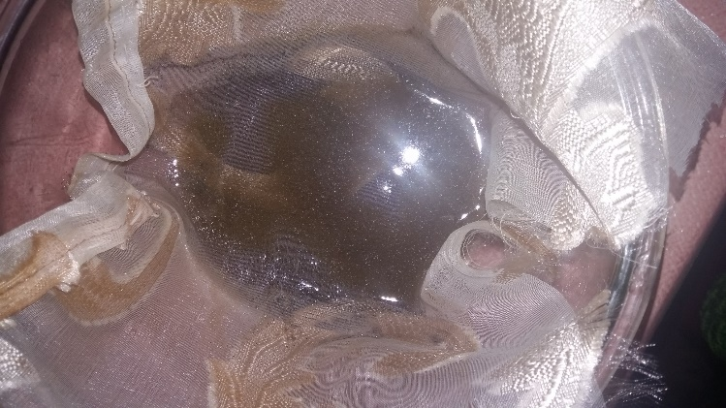
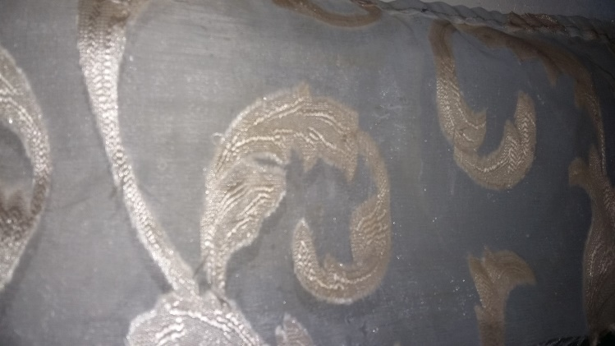
Dependence of kind of cloth on washing process
Volume
Area
Pores

Slide 12
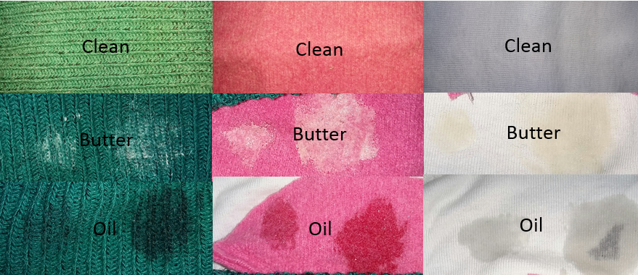
 | Thick cloth | Medium Cloth | Thin Cloth
Oil | 13hrs | 8hrs | 6hrs
Butter | 50hrs | 34hrs | 28hrs

Slide 13
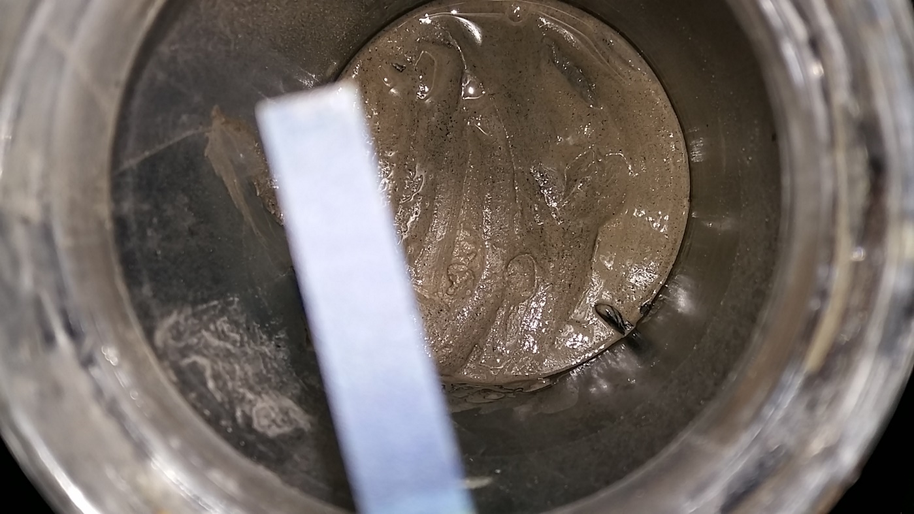
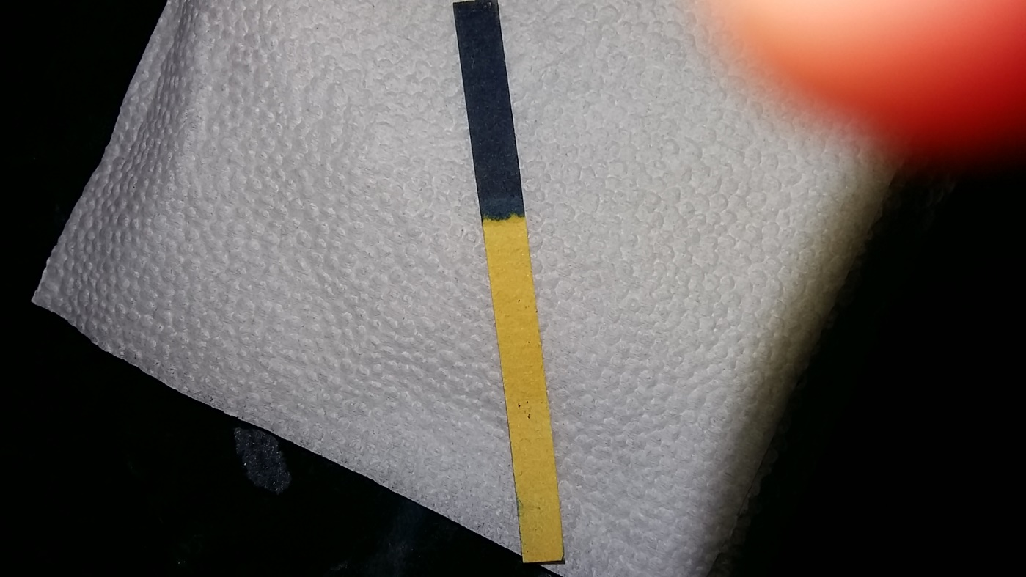
Cinder, Solution of Cinder and pH
Solution of 1 cup cinder + 1 cup water
pH indicator

Slide 14
References
http://www.drevesinas.ru/woodstructura/
https://ru.wikipedia.org/wiki/cinder
https://ru.wikipedia.org/wiki/lye
http://www.soap-making-resource.com/fatty-acids-soap-making.html

Slide 15
Conclusion
What are the components of cinder
What is washing, washing with cinder
Experiments showing effectiveness of washing with cinder
Opinions about washing with cinder
Thank you

