Slide 1
Reporter : Lasha Targamadze
Corrosion of Cola
Team : Georgia

Slide 2
Plan
Theoretical Model:
What is corrosion
Chemical components of cola
Reaction with metal
Experiment
Comparing Experiments and Theory
Conclusion

Slide 3
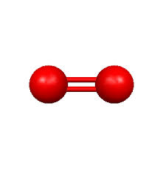
Theoretical Model Corrosion in general
o
o

Slide 4
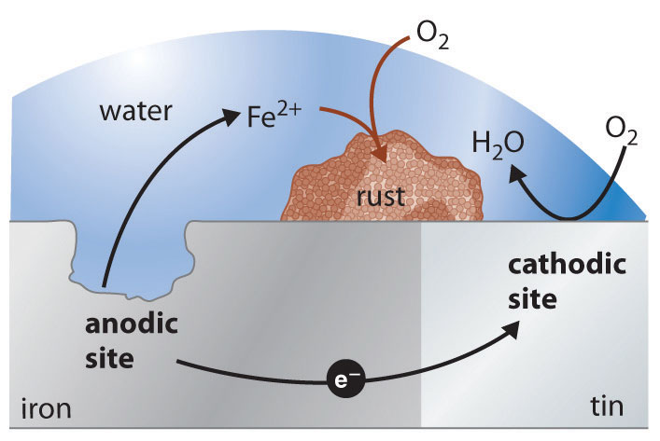
Corrosion on molecular level
Fe +2e =Fe
O2 +2H2O+ 4e = 4OH

Slide 5
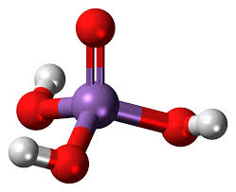
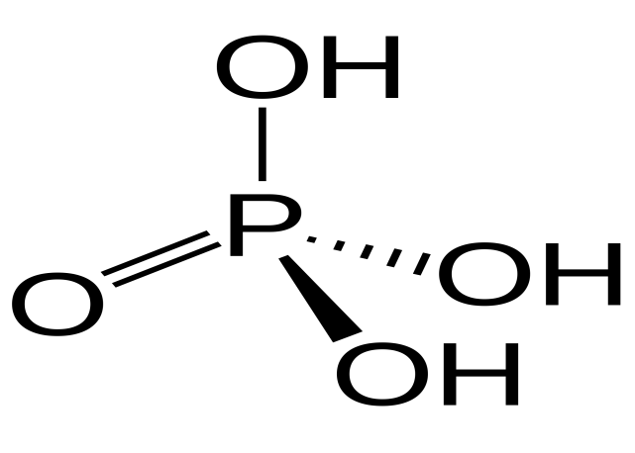
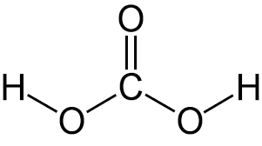
Chemical components of cola
Phosphoric acid H3PO4
Carbonic
acid
H2CO3

Slide 6
Chemical reaction with cola

Slide 7
Cola and phosphor
Every 250 ml of coca-cola contains 45 mg of phosphor according to coca-cola company.
Coca-cola (ml) | Phosphor (mg)
100 ml | 18 mg
200 ml | 36 mg
250 ml | 45 mg
500 ml | 90 mg
Phosphor (mg) | Moles
18 mg | 0.000563
36 mg | 0.001126
45 mg | 0.001451
90 mg | 0.002903

Slide 8
Fe
P
O4
Iron (g) | Iron Moles
0.03144355 | 0.000563
0.0628871 | 0.001126
0.08103835 | 0.001451
0.16213255 | 0.002903
Phosphor Moles | Phosphor (g)
0.000563 | 0.018
0.001126 | 0.036
0.001451 | 0.045
0.002903 | 0.090

Slide 9
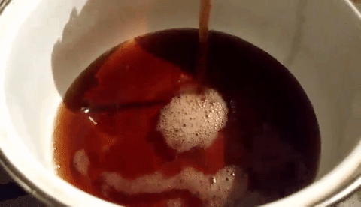
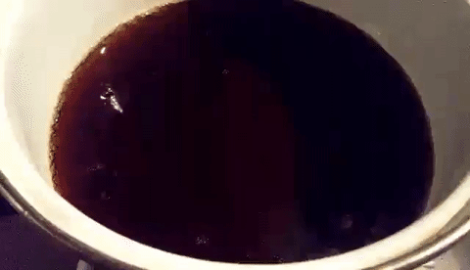
Experiments

Slide 10
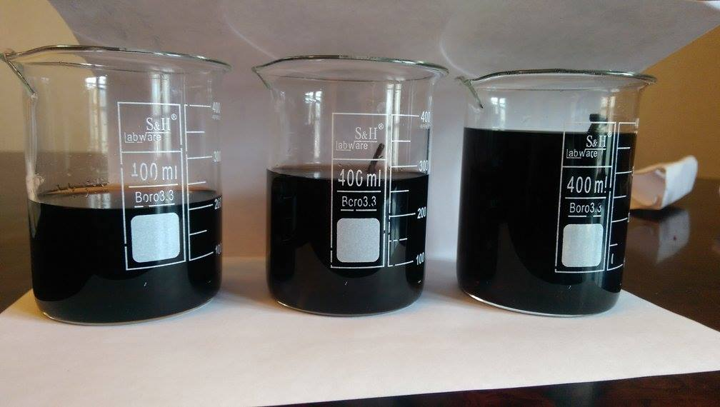
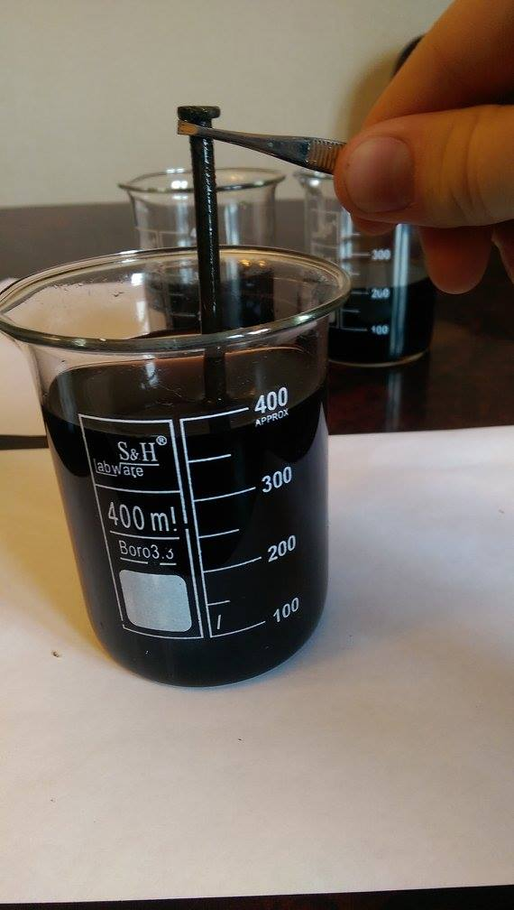
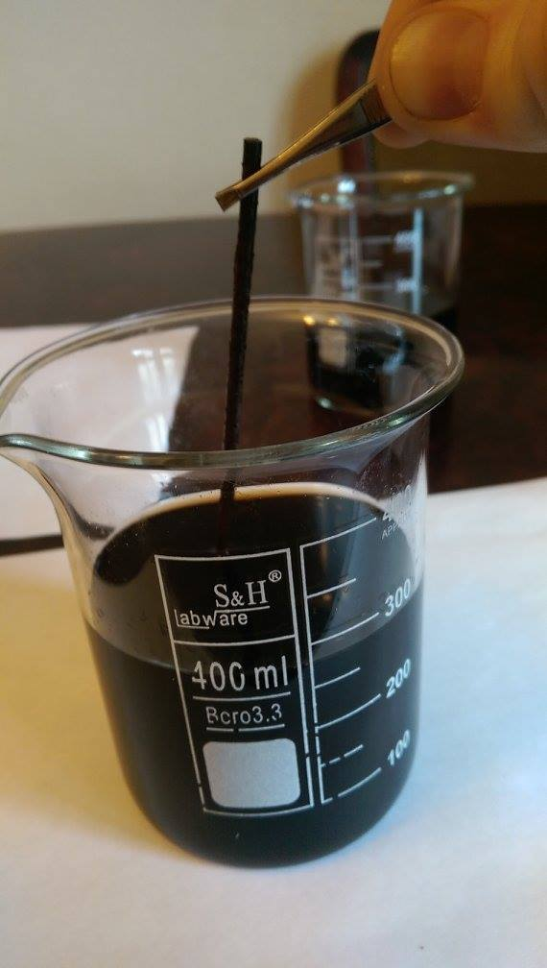

Slide 11
Experiment Results and Theory
Phosphor | Experiment Results (Removed Mass- E ) | Theory (Should have removed- T )
0.018 | 0.018 | 0.031
0.036 | 0.039 | 0.062
0.045 | 0.051 | 0.081
0.090 | 0.095 | 0.162

Slide 12
Conclusion
Theoretical model was written
Experiments were held
Comparison was made
Coca-cola can be used to remove rust

Slide 13
Thanks for your attention

