Slide 1
Dice
Reporter: Gvantsa Margvelashvili
Team: Georgia

Slide 2
Problem №6
In many games, dice are thrown to obtain random results. How does the results of a die roll depend on its height above a table, if the dies is released at zero initial speed?

Slide 3
Plan
Experiments
Critical Height
Different size dice
Theoretical model
Critical height
Comparison
Conclusion

Slide 4
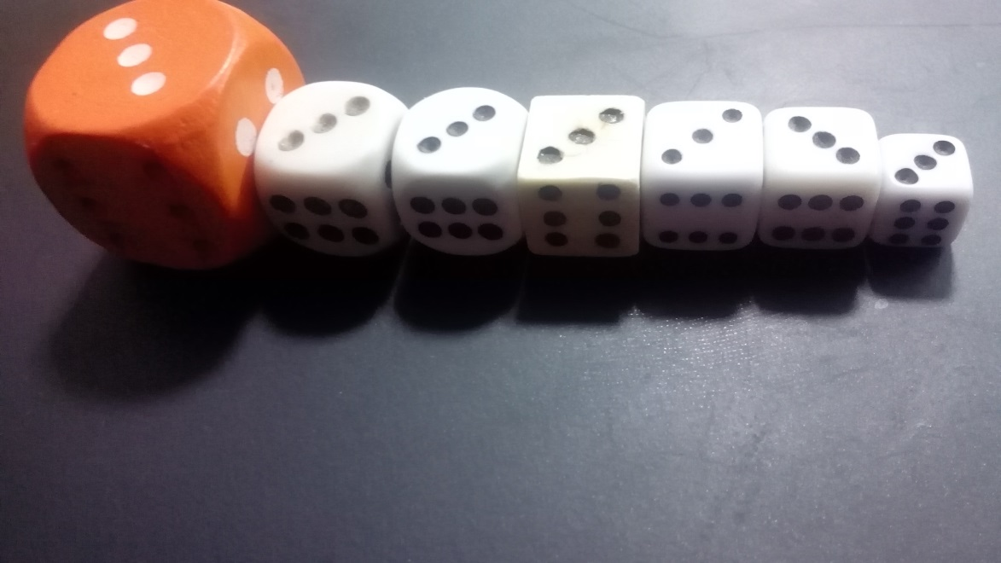
Dice

Slide 5
Electric magnet and dice with metal (experiment)

Slide 6
Upper face
Side faces
Lower face
$$h_{o}(p)$$

Slide 7
Upper face
Lower face

Slide 8
Side faces

Slide 9
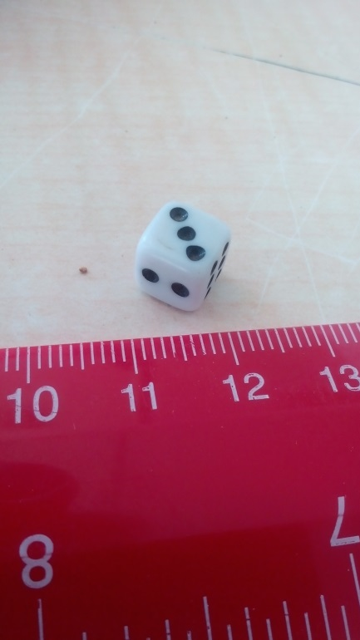
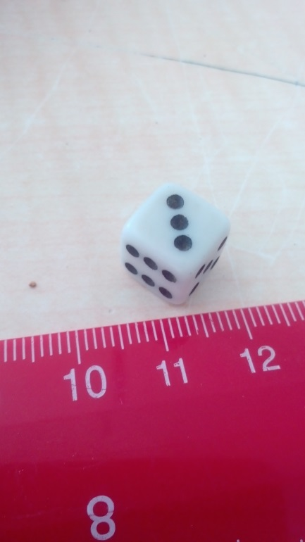
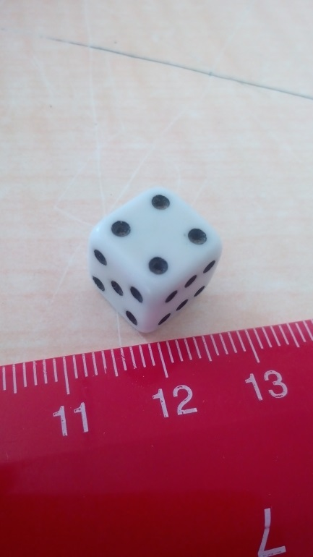
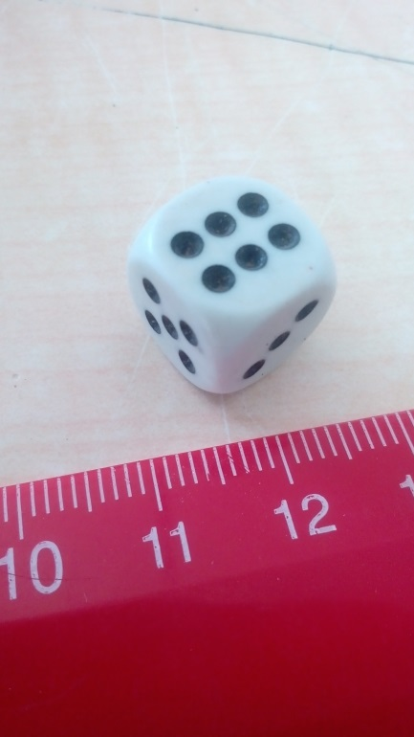
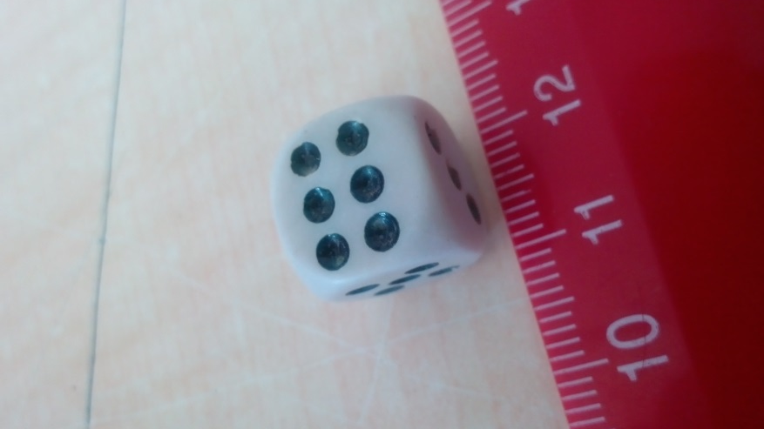
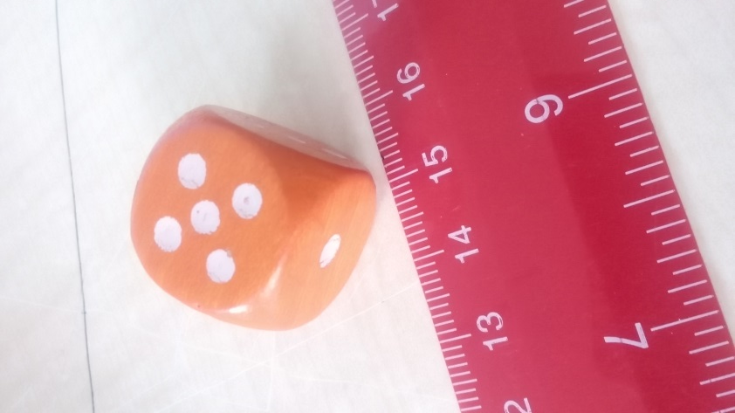
Different size dice

Slide 10
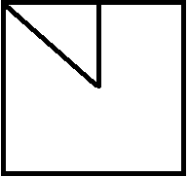
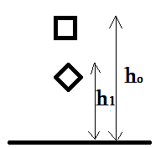
Theoretical model
2a
$$a(\sqrt{2}−1)$$
$$h_{1}≥a\left(\sqrt{2}−1\right)$$
$$h_{0}≥\frac{a\left(\sqrt{2}−1\right)}{c}$$
$$h_{0}∗c=h_{1}$$

Slide 11
Calculating c
Before overthrow dice has Potential Energy - $mgh_{0}$
Then it has - $mgh++\frac{I_{1}{w1}_{}^{2}}{2}+\frac{I_{2}{w2}_{}^{2}}{2}+\frac{mv^{2}}{2}$
C=$\frac{mgh+\frac{I_{1}{w1}_{}^{2}}{2}+\frac{I_{2}{w2}_{}^{2}}{2}+\frac{mv^{2}}{2}}{mgh_{0}}$
$w$- the angular velocity
$I$- the moment of inertia around the axis of rotation

Slide 12
Comparison
$$h_{1}=a\left(\sqrt{2}−1\right)$$

Slide 13
Conclusion
Critical Height was calculated
Experimental method
Theoretical model
Results depending on different size dice
Experiments and theoretical method were compared

Slide 14
References
https://en.wikipedia.org/wiki/Rotational_energy
https://en.wikipedia.org/wiki/Moment_of_inertia

Slide 15
Thanks for attention!

