Slide 1
Problem №14 Effervescent Tablet
Reporter : Zura Jashi
Team : Georgia

Slide 2
Introducing Problem
The rate of some chemical reactions may depend on surface area. Break effervescent tablets into smaller parts, or stir them into powder, to study how the dissolution rate depends on the surface area

Slide 3
Plan
1.Theoretical Model
A) Dissolution Theory
Tablet
Why We Use Tablet Shapes and Not Spheres ?
For Powder
2.Experiments
A) Data
B) Powder and Tablet
3.Comparing Experiments and Theoretical Model
A) Compare Obtained and Expected Graphics
B) Why We Use Tablet Shapes and Not Spheres ?
4. Conclusion

Slide 4
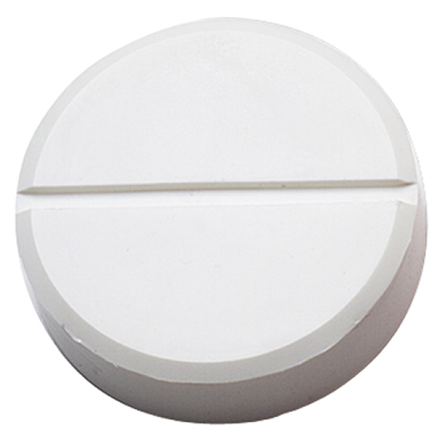
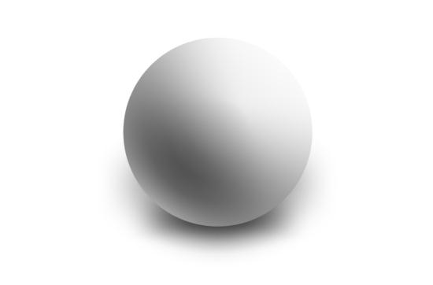
Sphere And Tablet
Tablet
Sphere

Slide 5
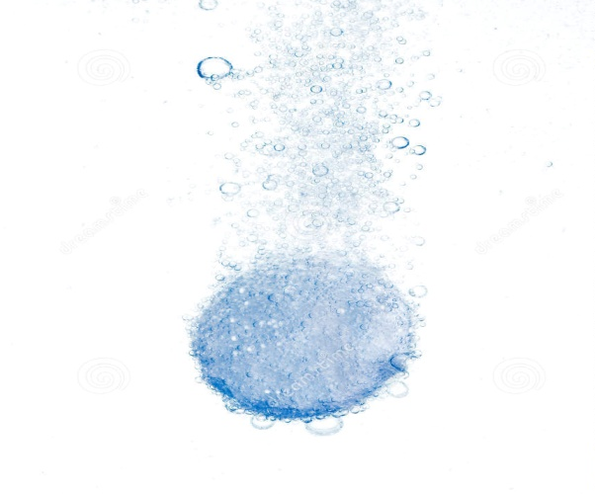
Dissolution Theory Tablet
dN/dt= Dissolution Rate
C0=Basic Concentracion
C=Concentracion In Solvent
S=Tablets Surface Area
K=Rate Constant

Slide 6
Dissolution Theory Tablet
µ0=Moles Of Substance
NA=Avogadro’s Constant
V0=Volume Of Substance
N0=Number Of Molecules
V=Volume Of Solvent

Slide 7
Dissolution Theory Tablet

Slide 8
Dissolution Theory Tablet
t(f)= Full Time

Slide 9
Dissolution Theory Tablet If V>>V(0)

Slide 10
Spheres And Tablets VT=VS mT=mS

Slide 11
Spheres And Tablets VT=VS mT=mS
h=3(mm)
RT=2,5(cm)

Slide 12
For Geometrical Shapes

Slide 13
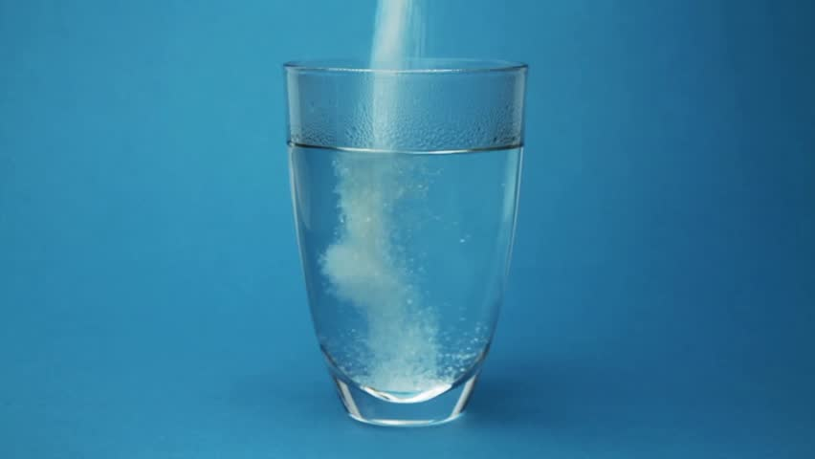
For Powder
m0= Basic Mass Of The Substance
m= Mass Of The Substance At Time t
α= Dissolution Rate Constant
tf=Full Dissolution Time

Slide 14
Experiments For Tablet

Slide 15
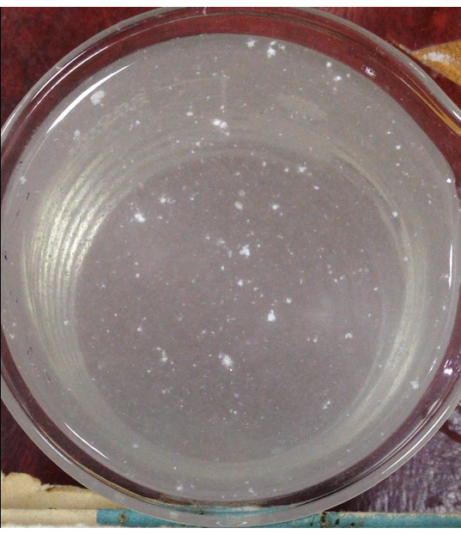
Experiments For Powder
 | ACC I | ACC II | Aspirin II | Aspirin II
$α×{10}^{−3}$[$\frac{kg}{s}$] | 0.031 | 0.031 | 0.017 | 0.017
m$×{10}^{−3}$[kg] | 0.43 | 1.1 | 2.6 | 2.16

Slide 16
Experiments V>>$V_{0}$
V=0.001(m^3)
 | Aspirin | ACC | Efer.
$K×{10}^{18}[\frac{1}{s×m×moles}$] | 13,2 | 15,25 | 31,8
$s×{10}^{−4}$ [$m^{2}$] | 4,9 | 2,55 | 4,15
$V_{0}×{10}^{−6}$[$m^{3}$] | 1,47 | 0,51 | 2,075

Slide 17
Experiments For Tablet Data
 | Aspirin I | Aspirin II | Efer. I | Efer. II | ACC I | ACC II
$K×{10}^{18}[\frac{1}{s×m×moles}$] | 13,2 | 13,2 | 31,8 | 31,8 | 15,25 | 15,25
$s×{10}^{−4}$ [$m^{2}$] | 4,9 | 4,9 | 4,15 | 4,15 | 2,55 | 2,55
$H×{10}^{−2}$ (m) | 0.3 | 0.6 | 0.5 | 1 | 0.2 | 0.6

Slide 18
Comparing Experiments and Theory For Powder

Slide 19
Comparing Experiments and Theory V>>$V_{0}$

Slide 20
Comparing Experiments And Theory For Tablet

Slide 21
Conclusion
Theoretical Model For The Tablet
Answered on The Question Why do we Use Tablets and Not Spheres
Theory was Written For Powder
Experiments were Conducted.
Proved Empirically That Theory For Powder Is Correct.
Experiments were Conducted For Various Tablets With Various Surface Area.
Obtained and Expected Dissolution Times were Compared.
Conclusion Was Made.

Slide 22
Bibliography
http://particle.dk/methods-analytical-laboratory/intrinsic-dissolution-rate/dissolution-rate/
http://www.slideshare.net/PRASHANTDEORE1/presentation-2-1-44770591
http://www.in-adme.com/dissolution_theory.html
http://www.authorstream.com/Presentation/pavanchowdary01-1502509-theory-dissolution-various-apparatus/
http://pharmatips.doyouknow.in/Articles/Pharmaceutics/Tablet/Drug-Dissolution-Theories.aspx

Slide 24
V>>$V_{0}$
 | Theory | Experiments
ACC | 80 | 75
Aspirin | 137(s) | 131
Efer. | 95 | 87

