Slide 1
Plants in Motion
Reporter: Mariam Lomtadze
Team: Georgia

Slide 2
Problem
Voracious plants can turn in response to the position of the sun or other light sources. Investigate this motion experimentally and theoretically.

Slide 3
Plan
Theoretical explanation
Experiments
Conclusion

Slide 4
Theoretical explanation
Photo Nasty
Phototropism

Slide 5
Photo Nasty

Slide 6
Phototropism
1. positive phototropism 2.negative phototropism

Slide 7
Auxin Distribution

Slide 8
Motor Cells
2H+
2K+

Slide 9
Bigroot Geranium mcenar

Slide 10
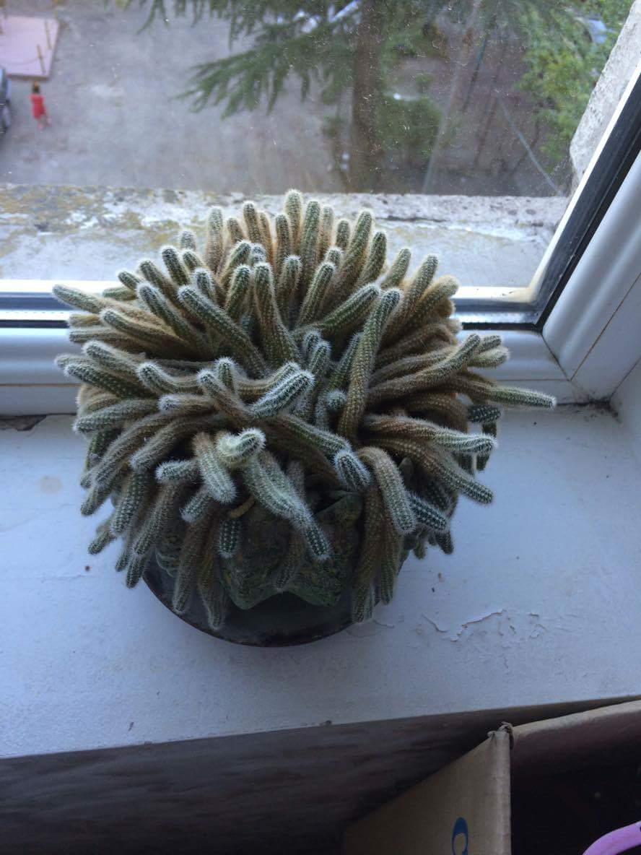
Cactus
morning
evening

Slide 11
The top is removed
Base is covered by not transparent glass
The top is covered by not transparent
glass
The top is covered by transparent glass

Slide 12
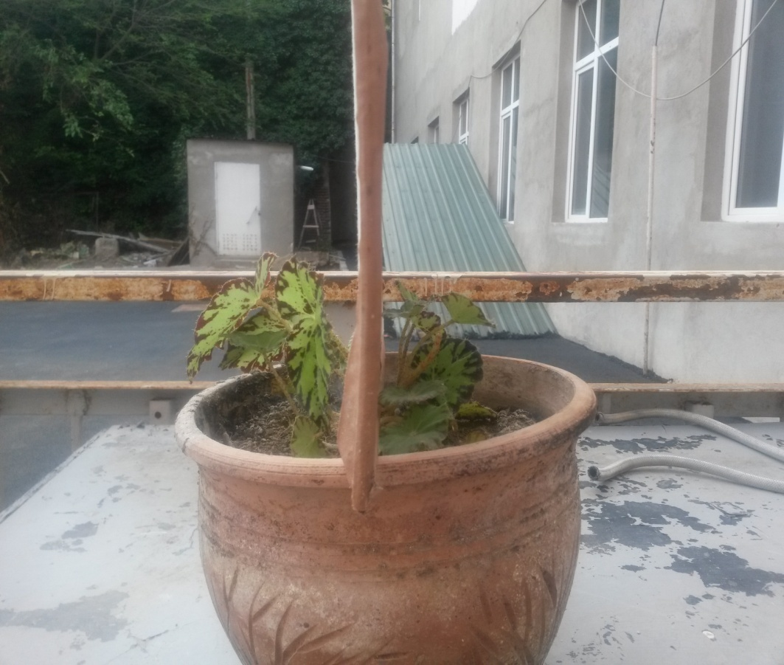
Experiment #1

Slide 13
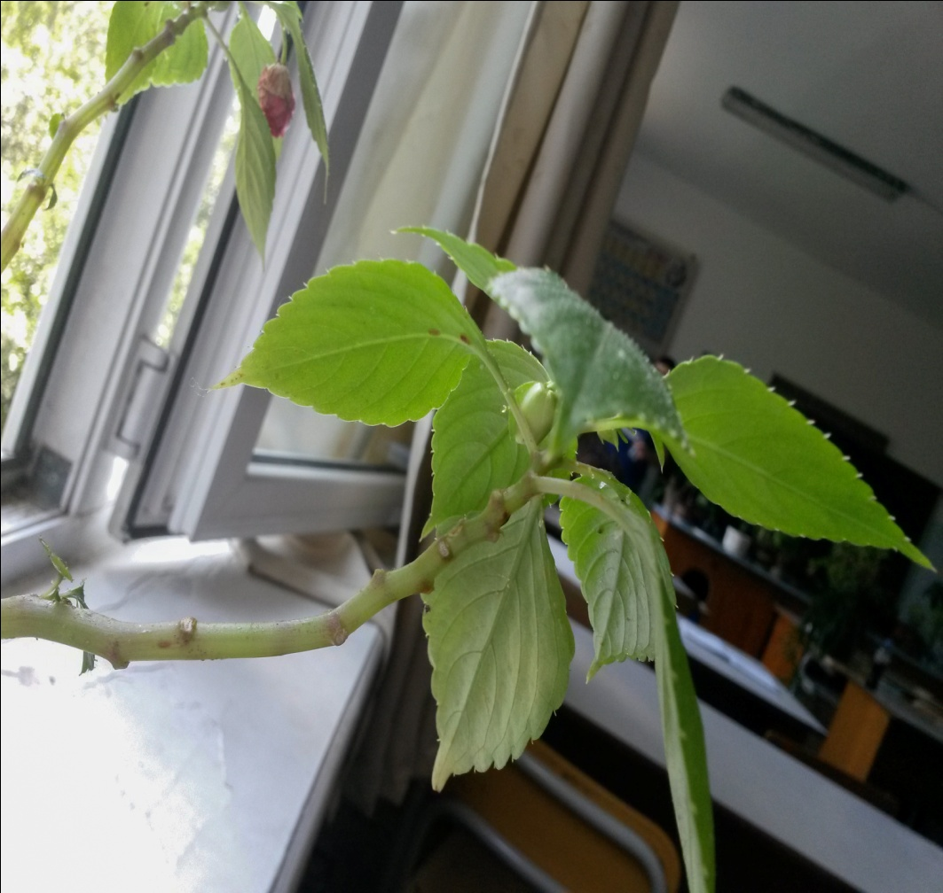
Experiment #2
After some days

Slide 14
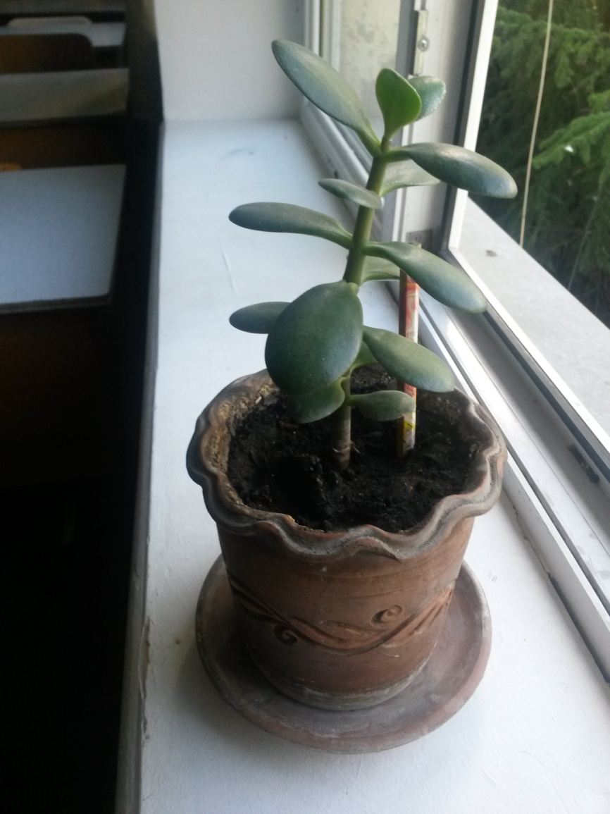
Experiment #3

Slide 15
References
https://en.wikipedia.org/wiki/Phototropism
Campbell Biology

Slide 16
Conclusion
The phototropism in plants was researched
Theoretical model was completed
Some experiments were conducted
Theory and experiment was compared
Result were shown

Slide 17
References
Wikipedi.org
Campbell’s biology

Slide 18
Thanks for your attention
^ ^

Slide 19
After sunrise
After sunrise

