Slide 1
Zipf’s law
Reporter: Mariam Lomtadze
Team:Georgia

Slide 2
Problem
Human language is described by unusual distributions. Take your favorite book and count how many times the most frequently appearing word (rank one) appears; The second most frequent word (rank two) appears, etc. Investigate and explain the dependence of the word count on its rank in the frequency table. Would it be same for another book in the same or different language?

Slide 3
Plan
Zipf’s law
Data analysis
Comparison different books
Conclusion

Slide 4
Zipf’s Law

Slide 5
My favorite books
A Song of Ice and Fire
Harry potter
The Dark Tower

Slide 6
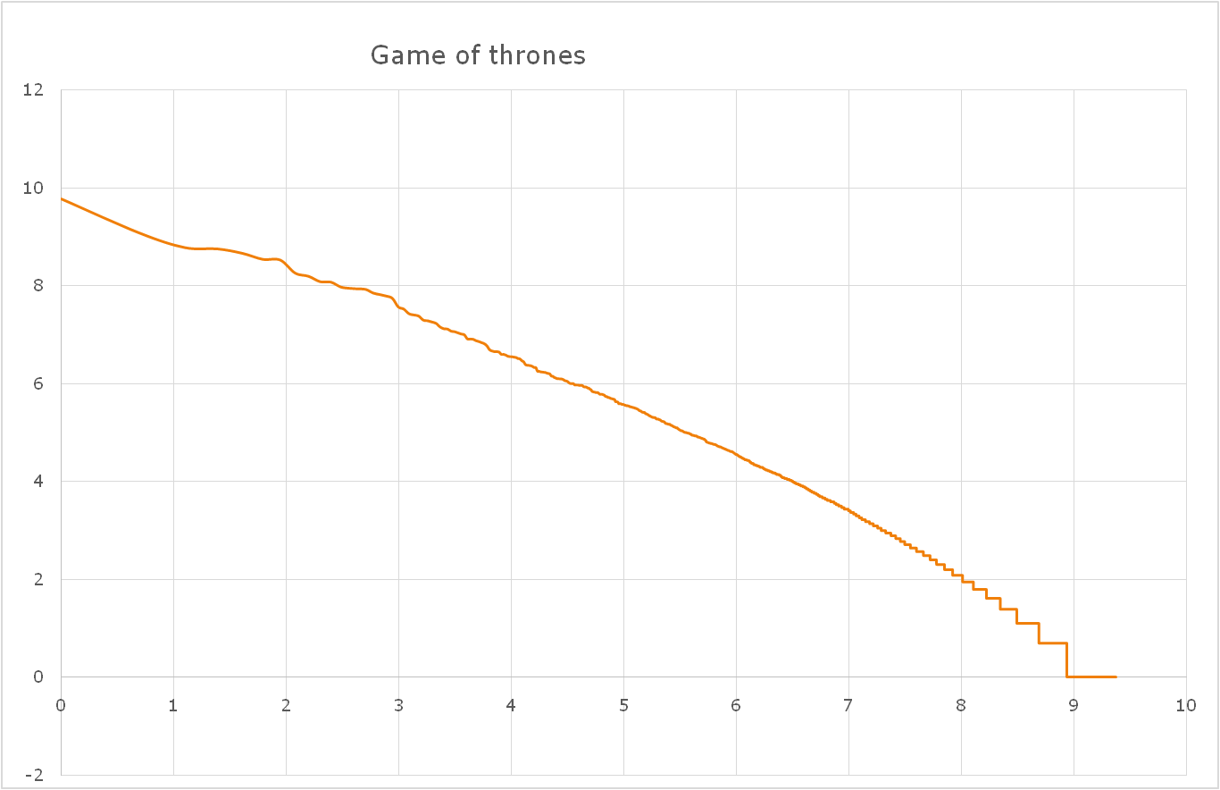
Log
Log R

Slide 7
Book series of different authors

Slide 8
Georgian author’s books

Slide 9
German books

Slide 10
Most frequently appearing words
in German books

Slide 11
Italian books

Slide 12
The most frequently appearing words
in Italian books
“e”=“is”
“di”=“of”

Slide 13
The most frequently appearing words
in English books

Slide 14
Distribution of slopes in English books

Slide 15
Conclusion
The slope is different for
Same author’s books
Books of different authors in same language
Books of different languages

Slide 16
References
Gutenberg.org
google.drive.com
Spyder

Slide 17
Thanks for attention ^_^

Slide 18
import numpy as np
from scipy import stats
f=open('C:/Users/мариами/Desktop/gertmanuli/20.txt','r',encoding='utf-8',errors='ignore')#input failis mdebareoba
dt=f.read()#.decode('utf-8')
den=['a','b','c','d','e','f','g','h','i','j','k','l','m'
,'n','o','p','q','r','s','t','u','v','w','x','y','z'
,'A','B','C','D','E','F','G','H','I','J','K','L','M'
,'N','O','P','Q','R','S','T','U','V','W','X','Y','Z','Ä','Ö','Ü',' ',] #inglisuri simboloebi
dge=['ა', 'ბ', 'გ', 'დ', 'ე', 'ვ', 'ზ', 'თ', 'ი', 'კ', 'ლ',
'მ', 'ნ', 'ო', 'პ', 'ჟ', 'რ', 'ს', 'ტ', 'უ', 'ფ', 'ქ',
'ღ', 'ყ', 'შ', 'ჩ', 'ც', 'ძ', 'წ', 'ჭ', 'ხ', 'ჯ', 'ჰ', ' '] #qartuli simboloebi
dot=[]# sxva enis simboloebi
nw='' #axali carieli stringi
for ob in dt: #bitebis wakitxva failSi
#x=chr(ob) #bitis simbolod gadaqceca
if ob in den: #tu es simbolo simboloebis siashi shedis daemateba axal strings
nw+=ob
dn=nw.lower().split() #asoebis dapataraveba da sityvebis gamoyofa speisebit
dic={} #dictionaris sheqmna
for ob in dn: #raodenobebis datvla
if ob in dic: #tu sityva dictionarishia daemateba erti
dic[ob]+=1
else: #tu araa mashin sheiqmneba da gaxdeba 1
dic[ob]=1
dta=sorted(dic.items(),key=lambda x: x[1],reverse=True) #zrdis mixedvi dalageba
a=sorted(dic.values(),reverse=True) #mxolod mnishnelobebis sia
x=np.arange(1,len(a)+1) # rankebis sia
y=np.array(a) #raodenobebis sia
x,y=np.log(x),np.log(y) #galogaritmeba
f1=open('C:/Users/мариами/Desktop/gertmanuli/wew3.txt','w') #output failis mdebareoba
for i in range(len(a)): #monacemebis text failshi chawera
st=str(x[i])+','+str(y[i])+'\n'
f1.write(st)
f1.close()
slop=stats.linregress(x,y)[0] #daxrilobis gamotvla
print(slop)

Slide 19
Fraction of word amount in different languages

