Slide 1
Natural pH Indicator
Reporter: Gvantsa Margvelashvili
Team: Georgia

Slide 2
№10 pH Indicator
The juice of many fruits or vegetable crops contains a natural pH indicator that changes colors according to the acidity or basicity of the solution. Investigate such pH indicator juices and their mixes. Propose the most precise and effective composition and compare its properties with those of common indicator paper.

Slide 3
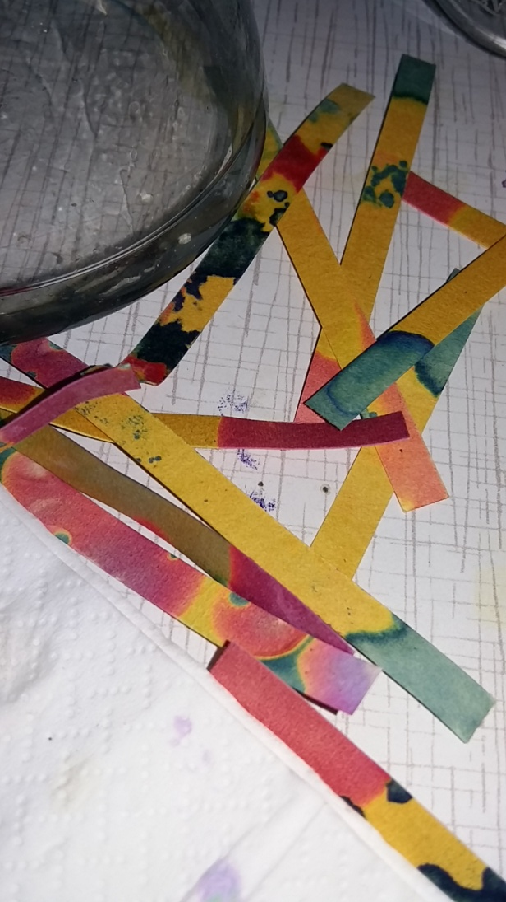
Plan
Theory
What is pH Indicator
What is Anthocyanin
Juice of different fruits and vegetables (experiments)
Red Cabbage
Beetroot
Blueberry
Mulberry
Mix
What did we mix
Why our mix is effective
Comparison
Common indicators
Difference between our mix and common indicators
Conclusion

Slide 4
pH indicator

Slide 5
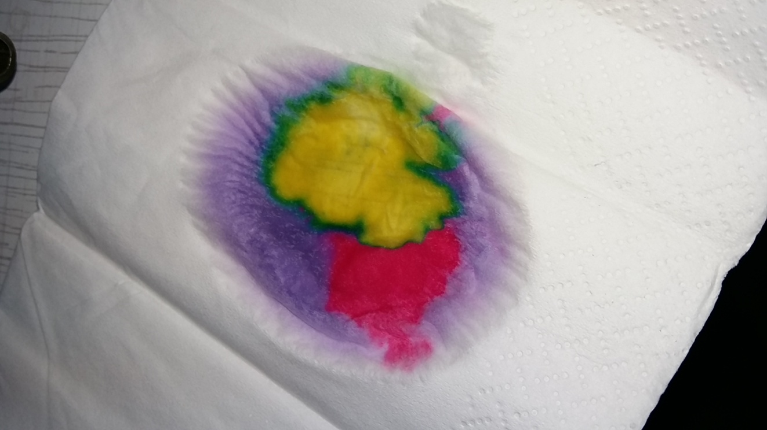
Anthocyanin
Acidic Solutions (pH < 7) pink
Neutral Solutions (pH ~ 7) purple
Basic Solutions (pH > 7) greenish-yellow
Very basic - colorless

Slide 6
Anthocyanin

Slide 7
Different kinds of Anthocyanin

Slide 8
Red Cabbage

Slide 9
Juice of Red Cabbage

Slide 10
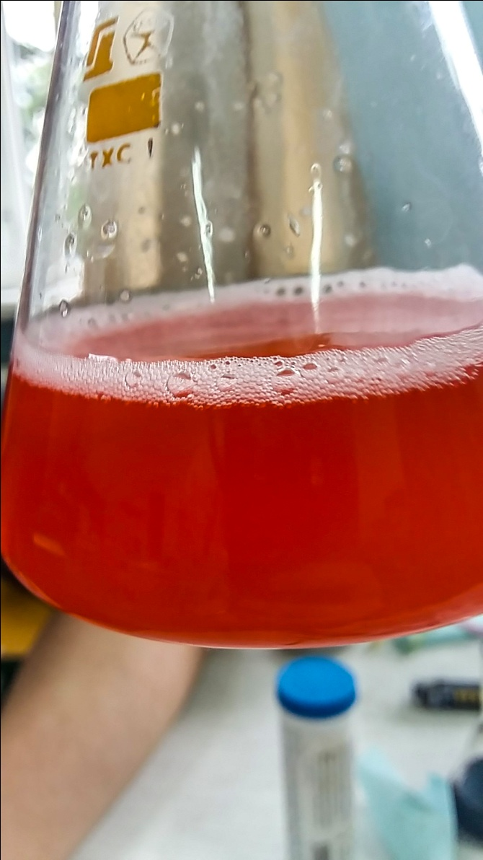
Red Cabbage (experiment)

Slide 11
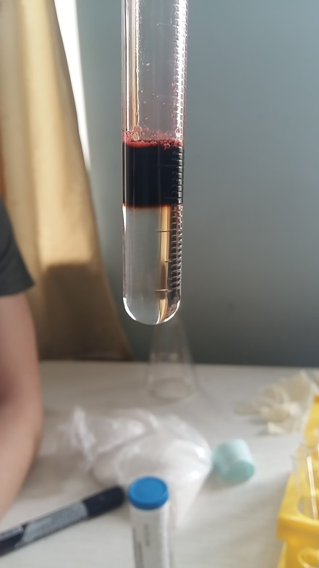
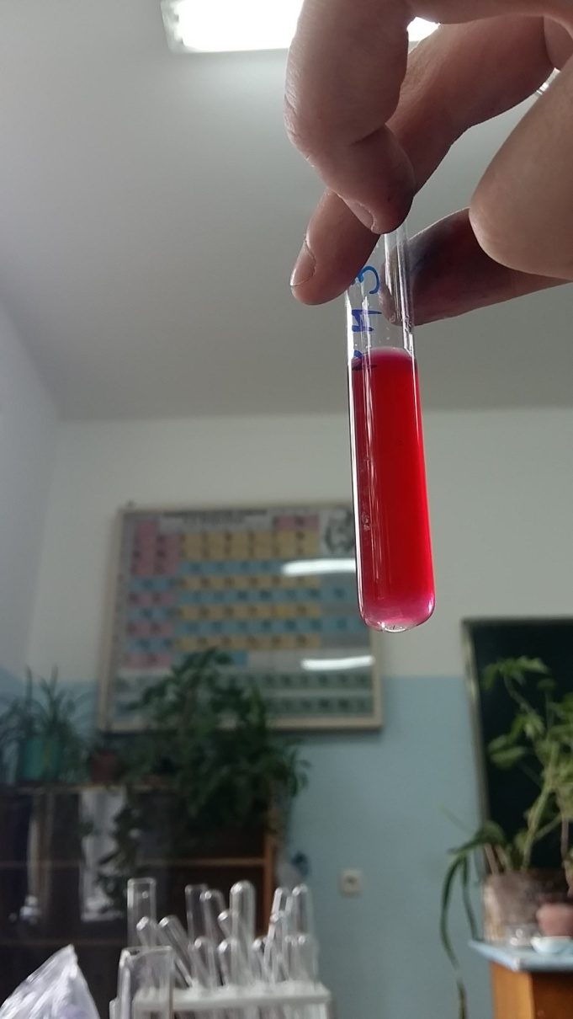
Red Cabbage (results)
pH=0
pH≈3-4

Slide 12
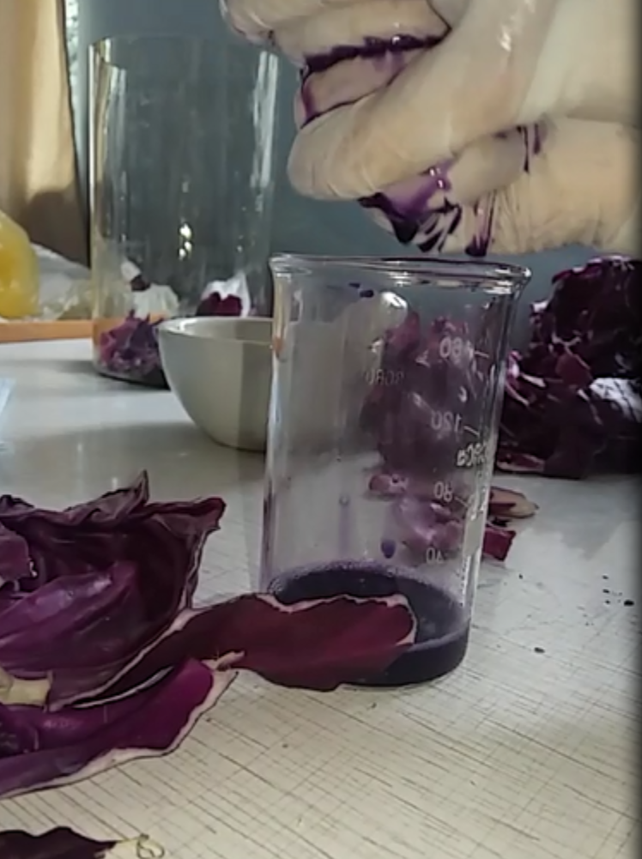
Red Cabbage (results)
pH ≈ 5-6
pH=7

Slide 13
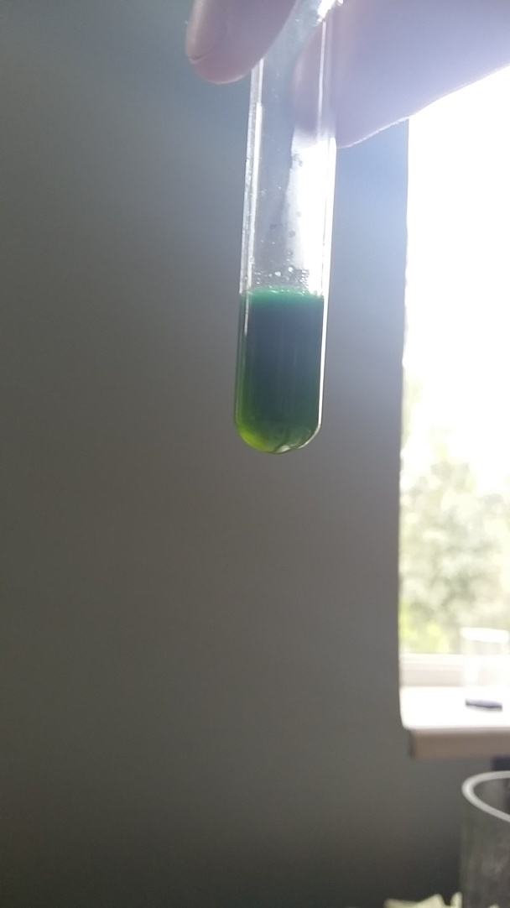
Red Cabbage (results)
pH ≈ 7.5-8.5
pH=11

Slide 14
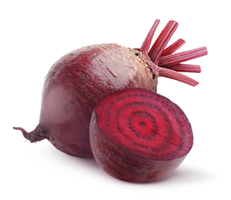
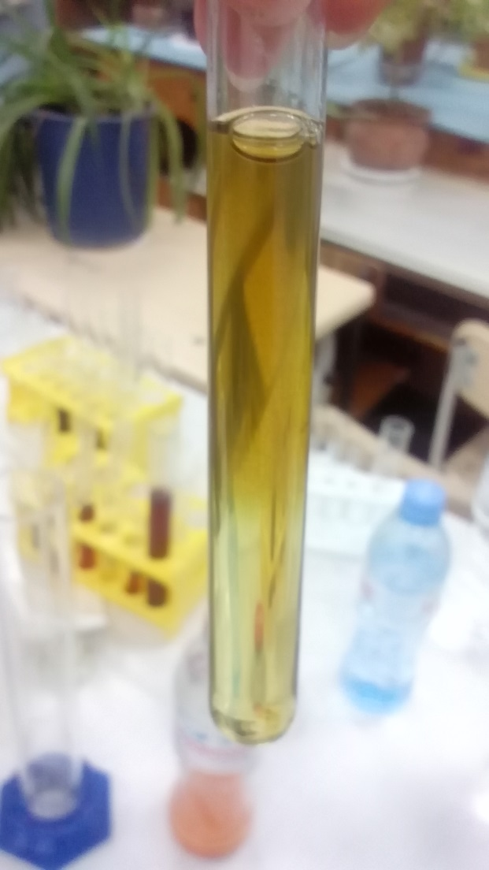
Beetroot (results)
Acid
Basic

Slide 15
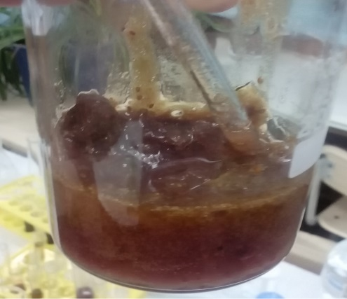
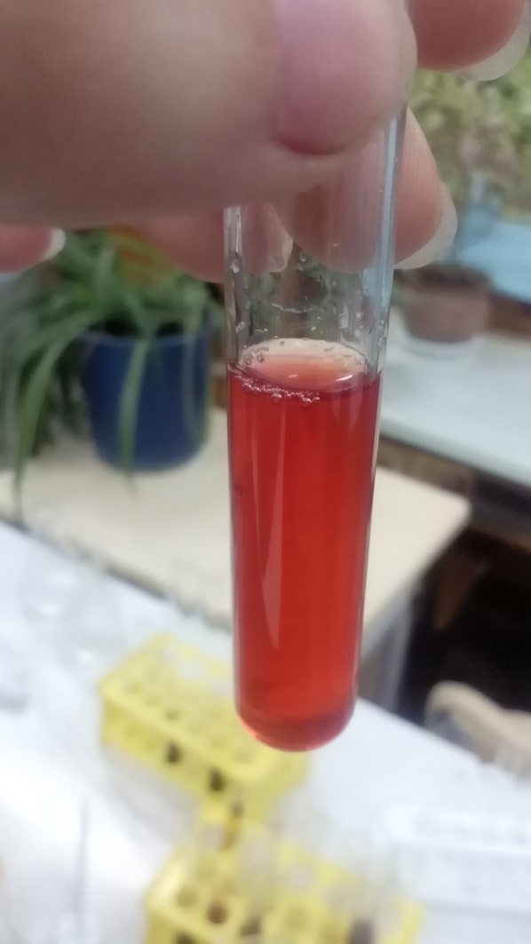
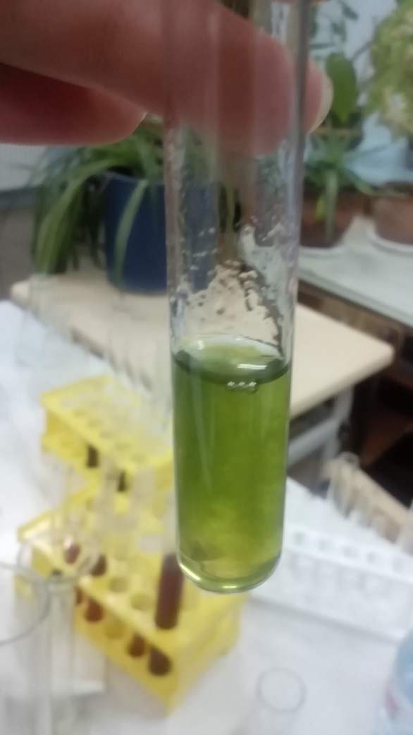
Blueberry (results)
Acid
Weak Basic
Strong Basic

Slide 16
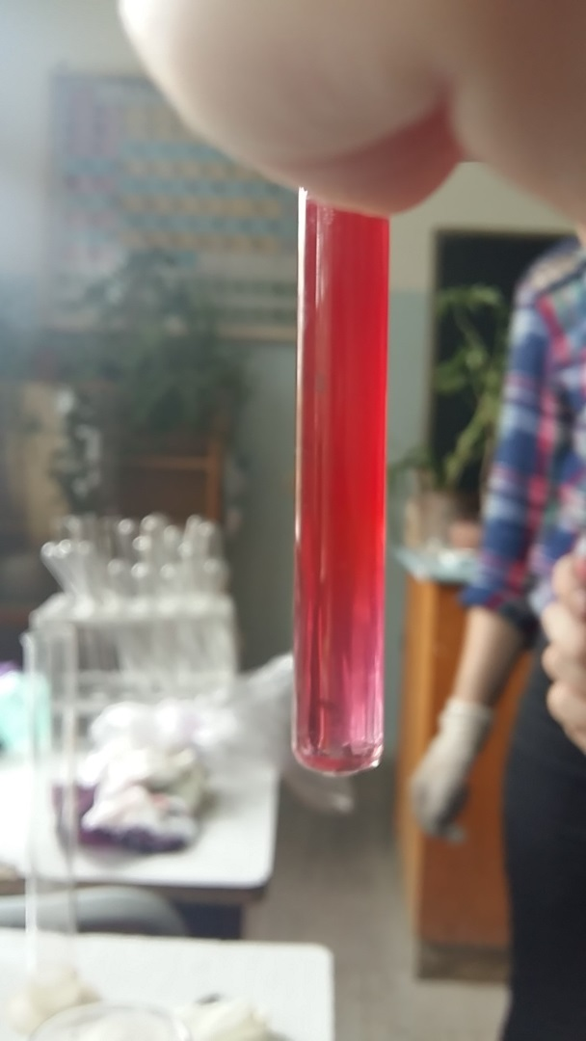
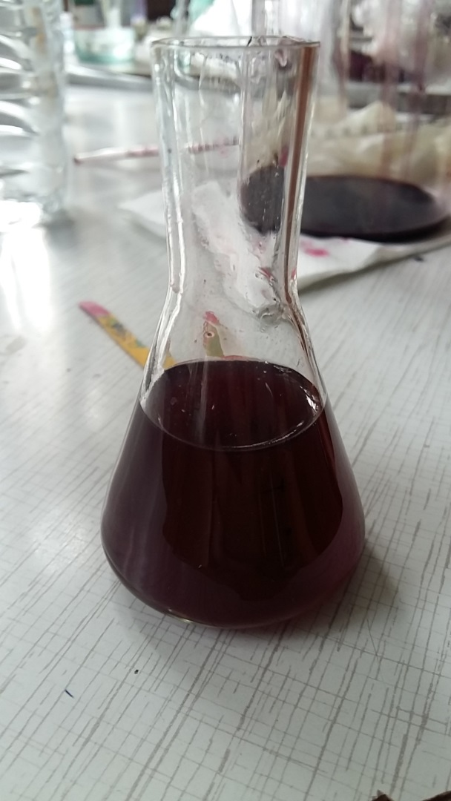
Mulberry (results)
Acid
Neutral
Basic

Slide 17
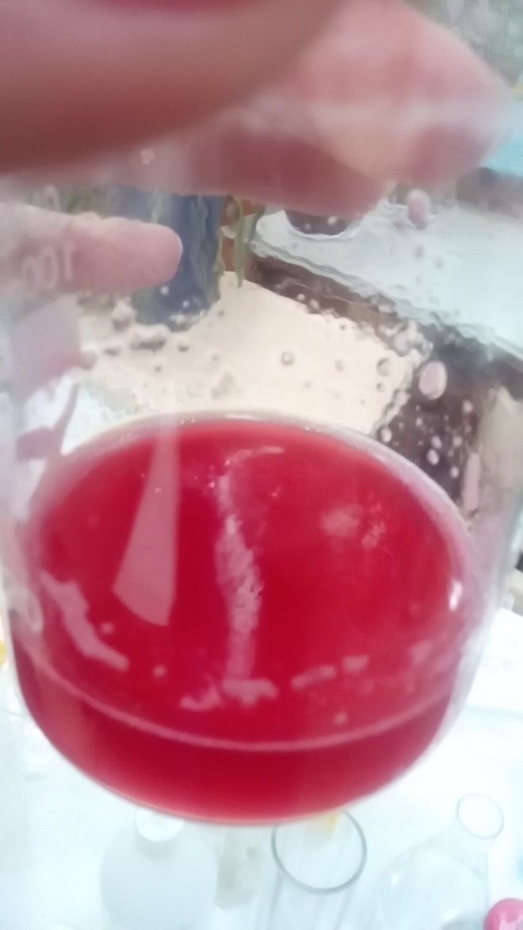
Red Cabbage
Mix
Currant

Slide 18
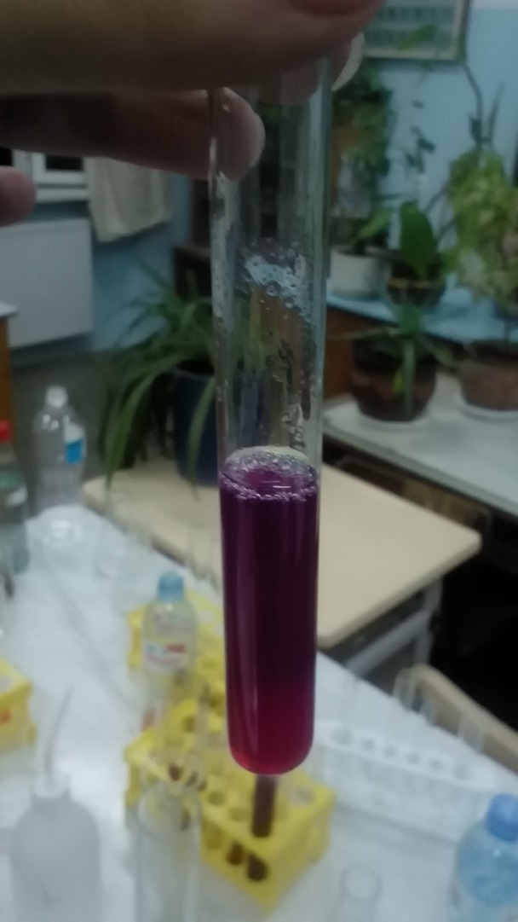
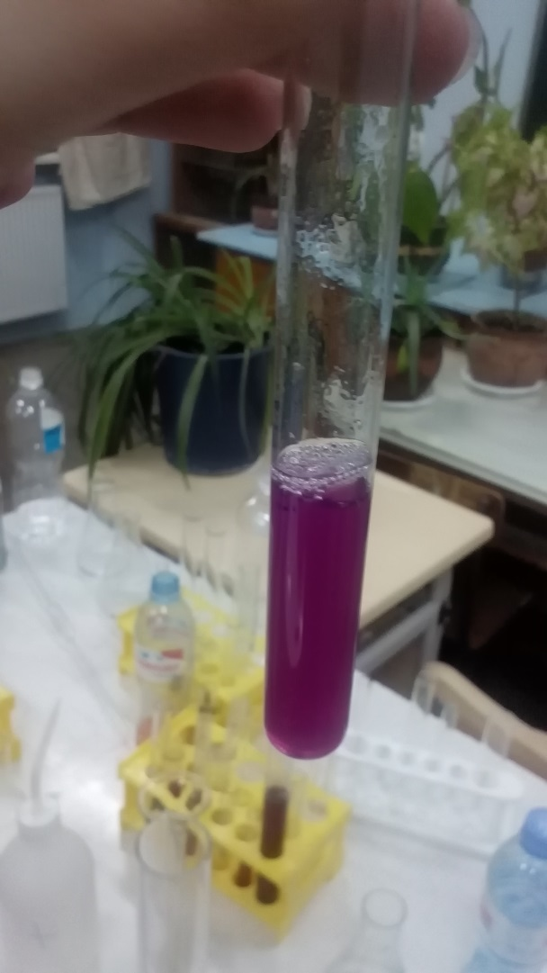
Mix (results)
pH=0
pH=2
pH=4.5

Slide 19
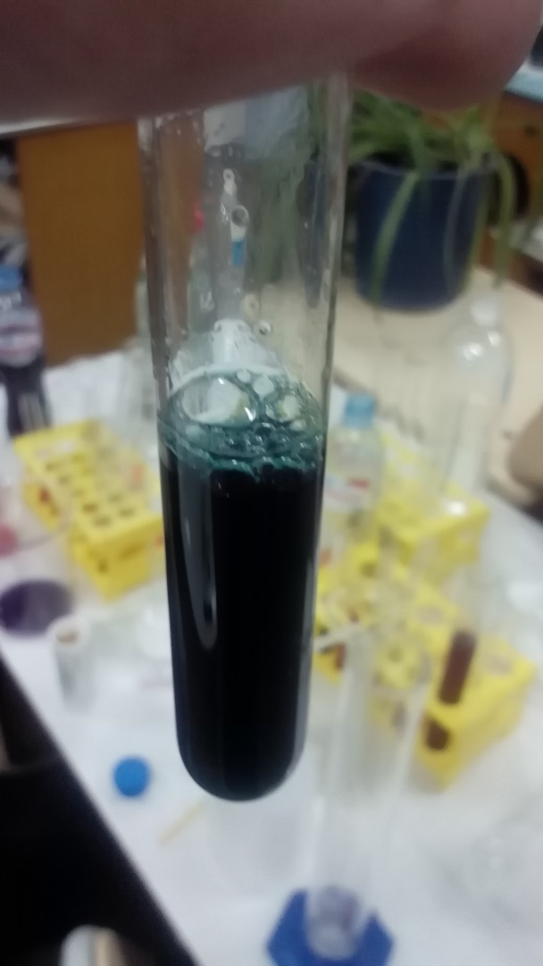
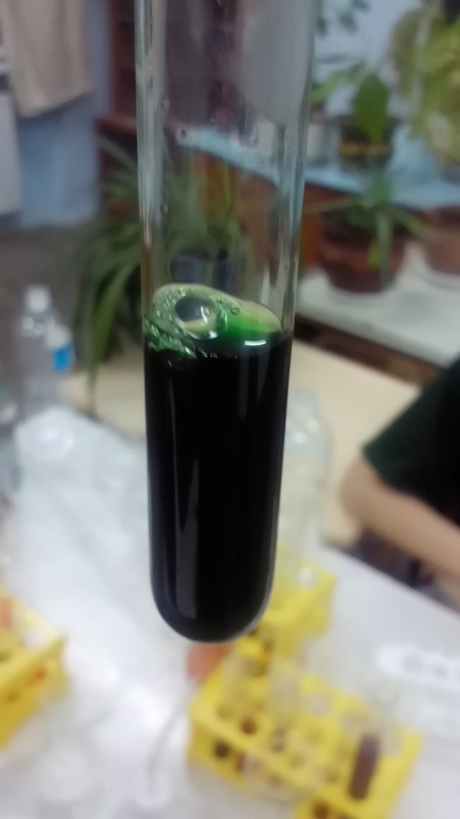
Mix (results)
pH=6
pH=7
pH=8

Slide 20
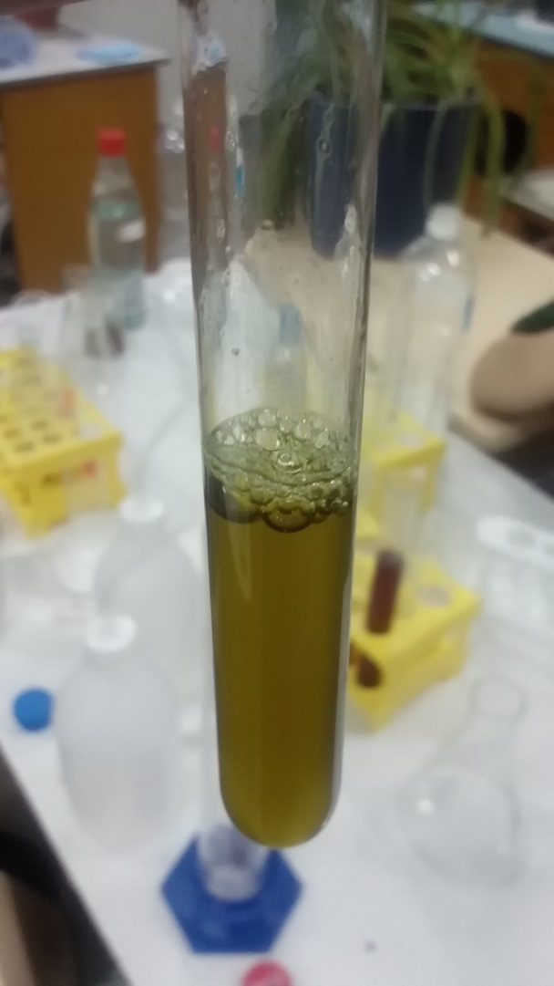
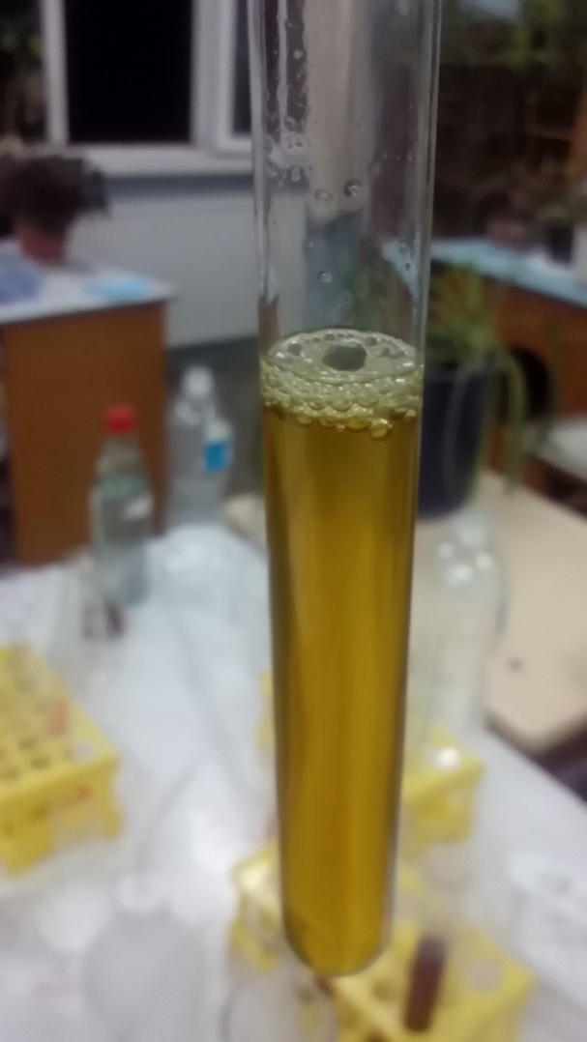
Mix (results)
pH=10
pH≈12-13-14
pH=11

Slide 21
Mix of very basic and acid solutions

Slide 22
Litmus
Acid: Red Base: Blue
Neutral: Purple

Slide 23
Phenolphthalein
Acid: Colorless Base: Pinkish violet color

Slide 24
Methyl Orange
Acid: Red Base: Yellow

Slide 25
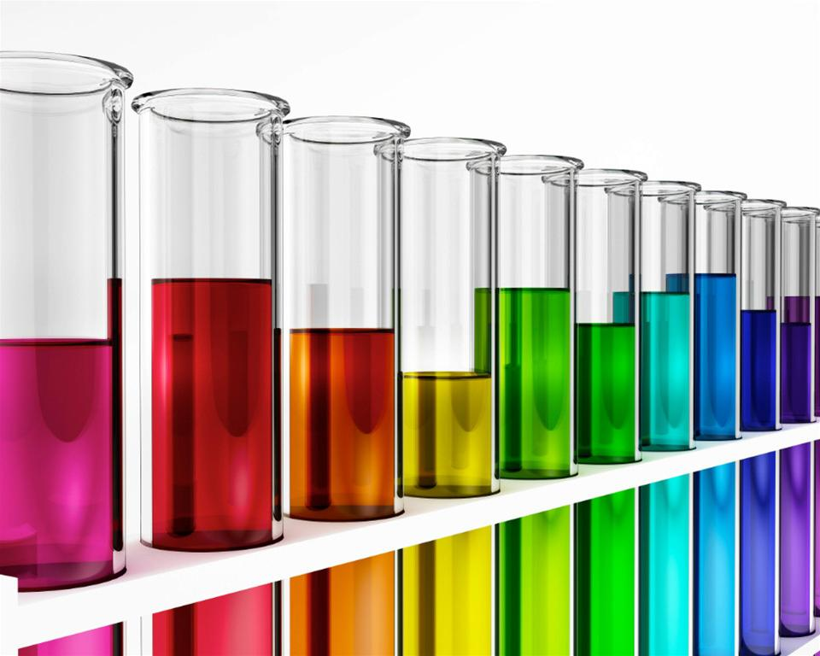
Conclusion
Theory was written
Why does juice changes color in acidic and basic solutions
Experiment
Talk about common indicators
Effective mix is made
Why is it effective

Slide 26
References
https://en.wikipedia.org/wiki/Anthocyanin
https://en.wikipedia.org/wiki/PH
http://chemwiki.ucdavis.edu/Exemplars_and_Case_Studies/Case_Studies/Acid_and_Base_Indicators/PH_Indicators

Slide 27
Thanks for attention

